Slide 1
Project 1
Modelo de predicción de demanda de gas natural por subsector industrial
Gabriela Olivera
January 19, 2019

Slide 2
Agenda
Project objective
Constraints
Solution design
Analysis
Models results

Slide 3
Project objetives
Natural gas has played an important role in the energy transition because it is a cleaner, more efficient and cheaper energy compared to other fossil fuels and it is one of the fuels that will maintain significant growth in the next fifteen years.
The objective of this project is to compare the linear and multiple regression analysis to perform the prediction of natural gas demand for the industrial sector.
El modelo exitoso será el que tenga el menor error de predicción.

Slide 4
Constraints
The data or the predictive model of natural gas demand for the industrial sector was taken from the INEGI and SENER pages
The range of historical information considered for the prediction is 10 years
The model will be tested using two approaches: simple linear regression and multiple linear regression
The variables that will be used for this model are:
Natural gas price (USD / MMBtu)
Fuel oil price (USD / MMBtu)
GDP/ gross domestic product (billions of pesos)

Slide 5
Solution design
The coded program loads the data of the model variables using an Excel file with the following structure:
Year | Sector | Branch | Natural gas demand | Industrial price of natural gas (PEMEX) | Fuel oil Price (PEMEX) | GDP | Efficiency factors
9999 | XXX | XXX | 999 | 999.99 | 999.99 | 999.99 | 999.99
9999 | XXX | XXX | 999 | 999.99 | 999.99 | 999.99 | 999.99
... | ... | ... | … | ... | ... | ... | ...

Slide 6
Solution design
The program is organized by three groups of functions, that are executed in the presented order:
Data processing:
read_data (filname)
lagged_dataframe (data, lags = 1)
Variables analysis
plot_demanda_gas_natural_subsector (data)
boxplot_standardized variables (data)
calc_timeseries (data)
histogram (data)
relacion_entre_variables (data)
correlacion_entre_variables (data)
Predictive Models
calc_regresion_lineal (data)
calc_regresion_lineal_multiple (datos_lagged)

Slide 7
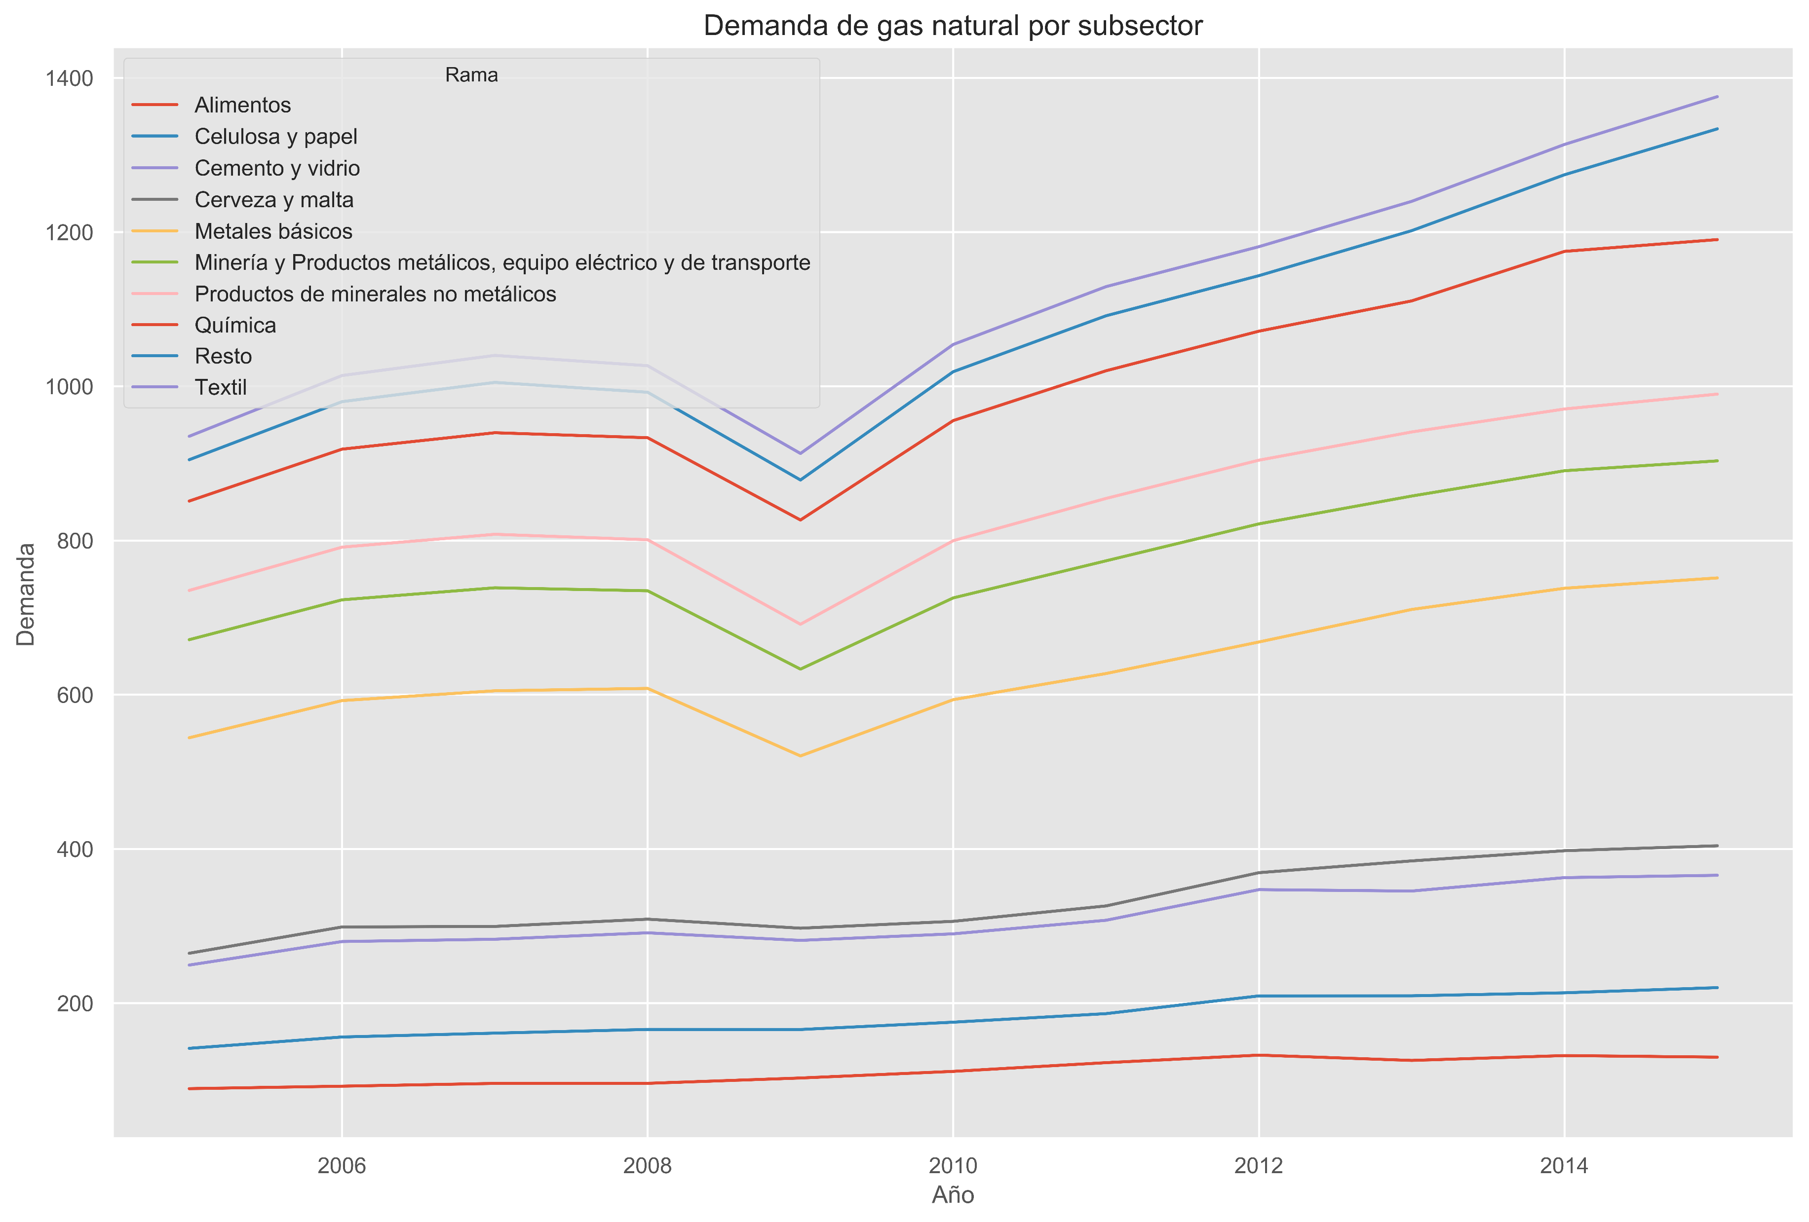
Analysis plot_demanda_gas_natural_subsector (data)
To present the demand for natural gas by sector, a line chart comparing all sectors was used.

Slide 8
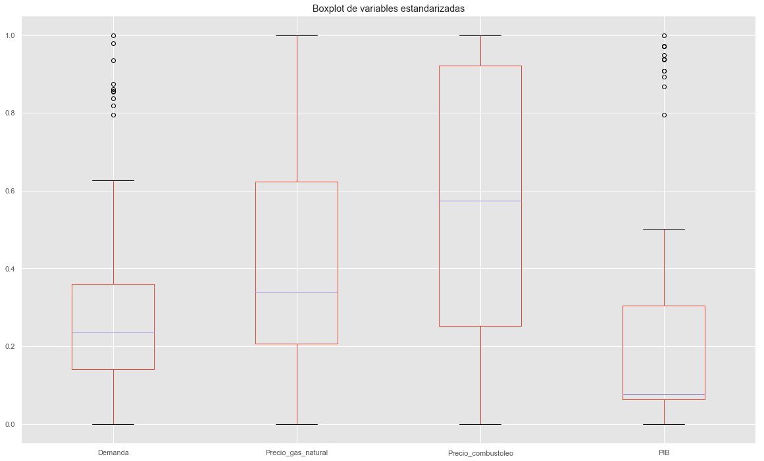
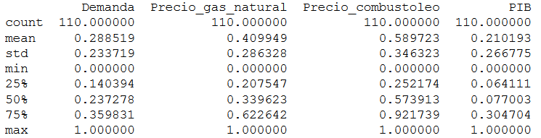
Analysis boxplot_standardized variables (data)
To analyze the dependent variables to the demand by sector, a box graph was used
The variables analyzed are: demand, GDP, fuel oil price, and natural gas price
In order to make the comparison between the variables, the data was standardized

Slide 9
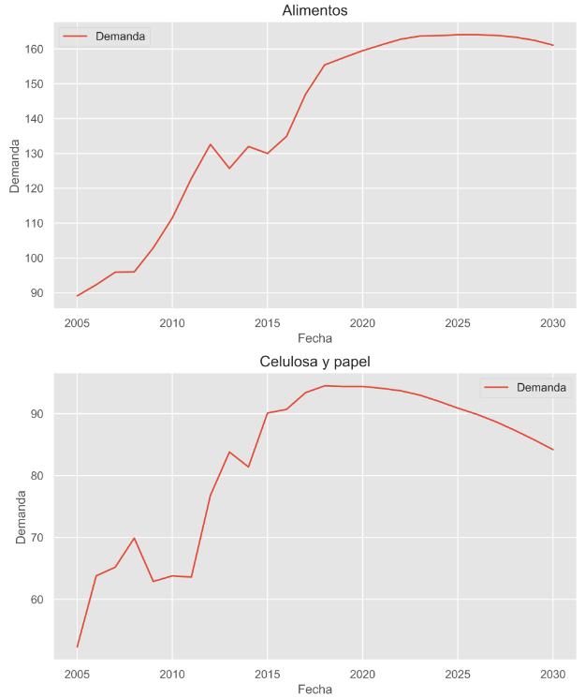
Analysis calc_timeseries (data)
It shows by sector the data recorded on a regular basis that show the demand for natural gas with standardized data.

Slide 10
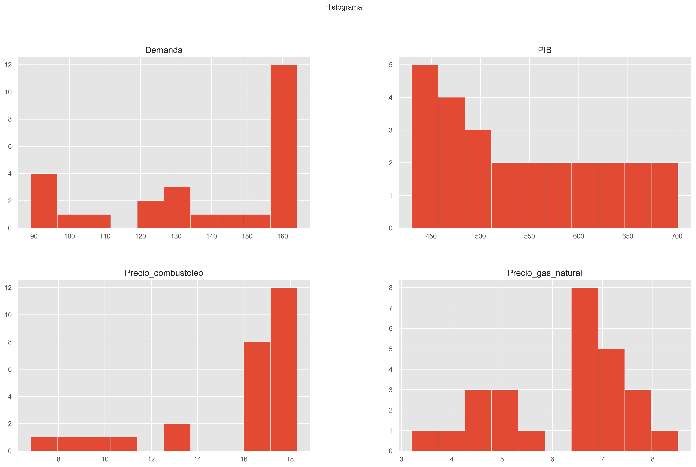
Analysis histogram (data)
Histograms were used to study the variables by sector, which represent the input data for the analysis.

Slide 11
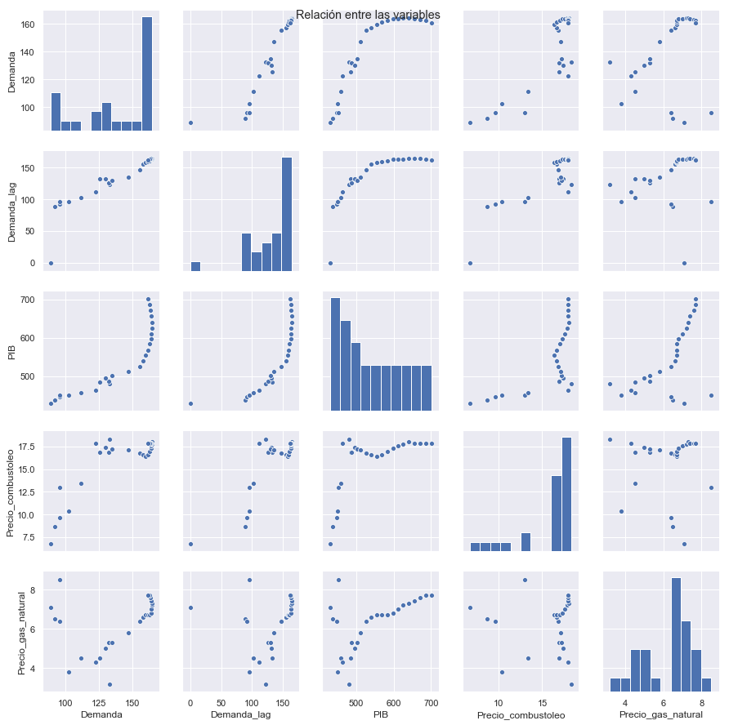
Analysis relacion_entre_variables (data)
This function presents, through the use of a scatter plot, the relationship between the pairs of the variable possibilities. That is, it is identified if the relationship between the variables is indeed direct.

Slide 12
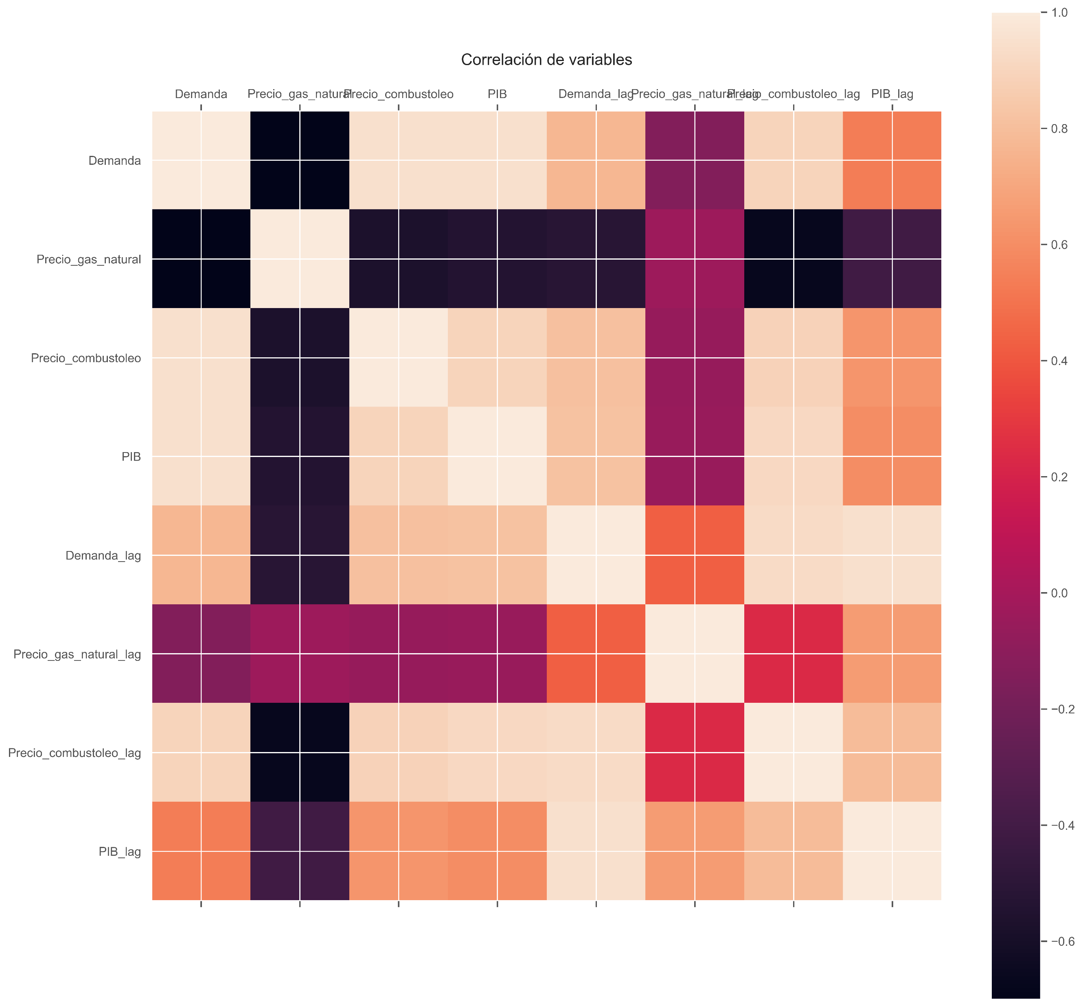
Analysis correlation_entre_variables (data)
The purpose of the correlation is to examine the direction and strength of the association between two quantitative variables. This way we will know the intensity of the relationship between them and if, when increasing the value of one variable, the value of the other variable increases or decreases.

Slide 13
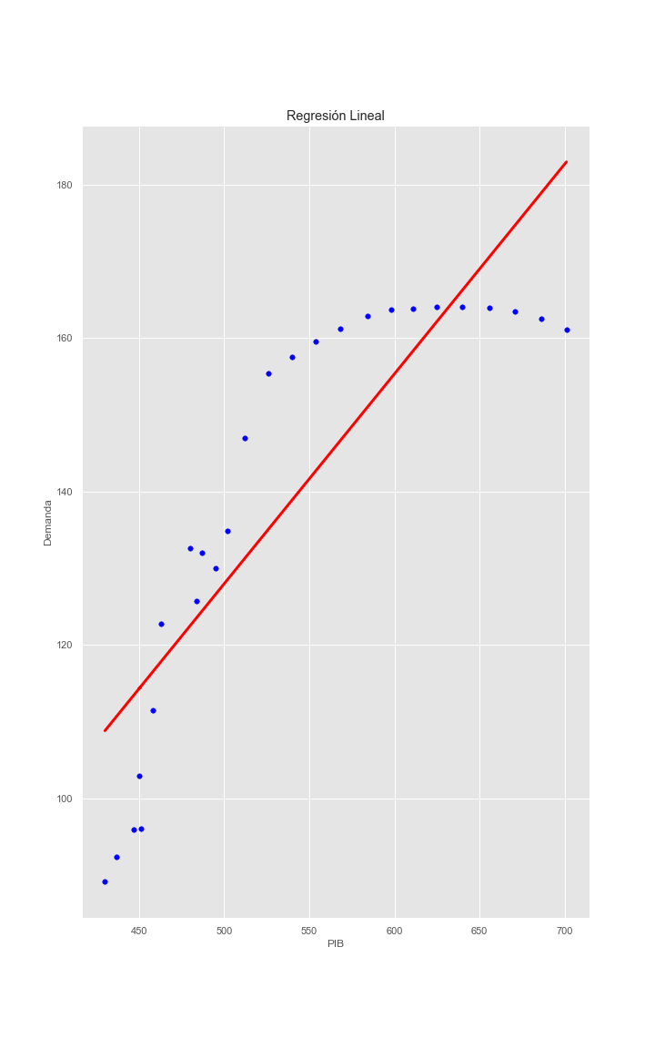
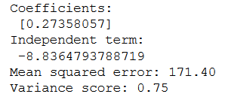

Predictive Model calc_regresion_lineal (data)
Regression methods are used to study the relationship between two numerical variables.
This relationship will allow in the future, to measure an unknown sample and know approximately its true value.

Slide 14
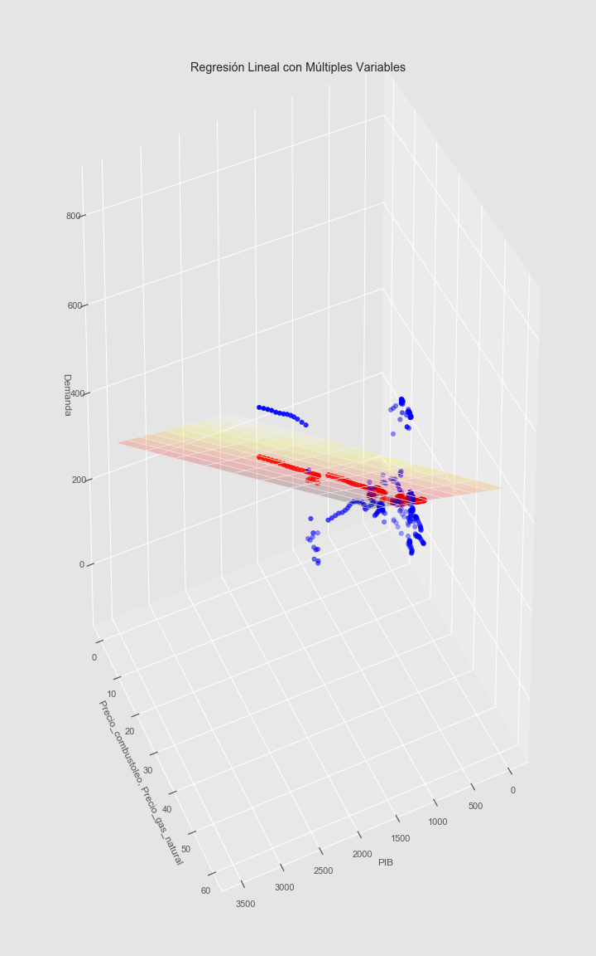

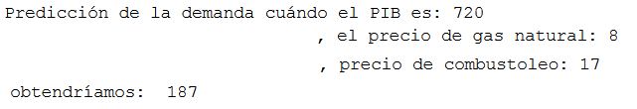
Predictive Model calc_regresion_lineal_multiple (datos_lagged)
In this case, 3 dependent variables were used: GDP, Fuel oil price and natural gas price

Slide 15
Models results
Simple linear regression
Multiple linear regression
Because the error value for the Simple liner regression is smaller, this model is the best option in this case.

