Slide 1


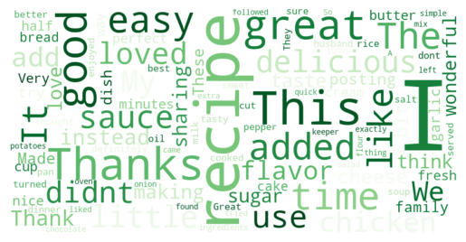
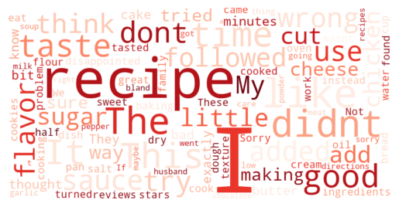
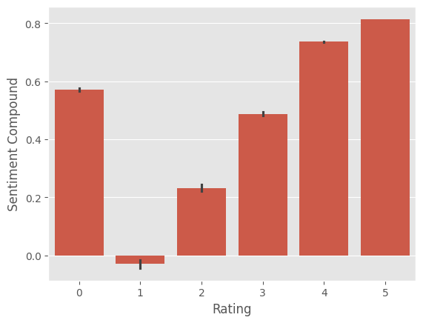
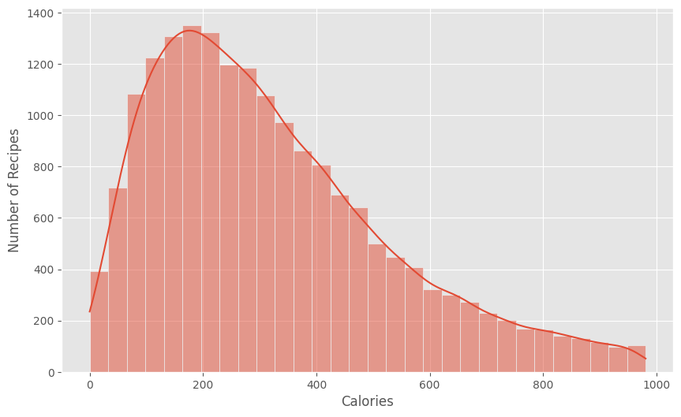
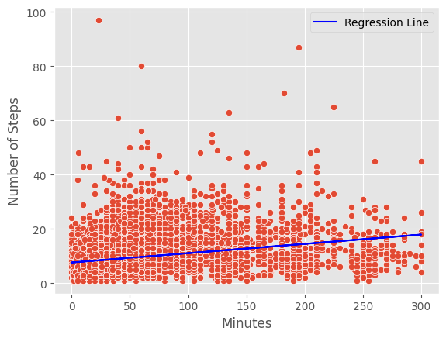
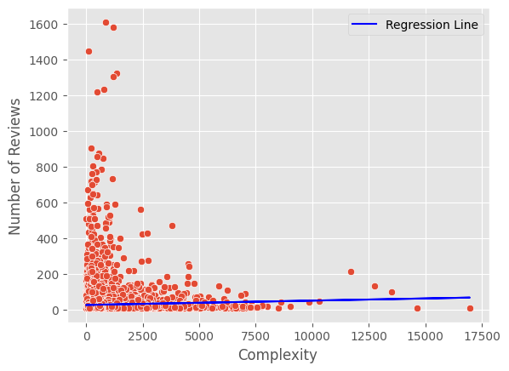
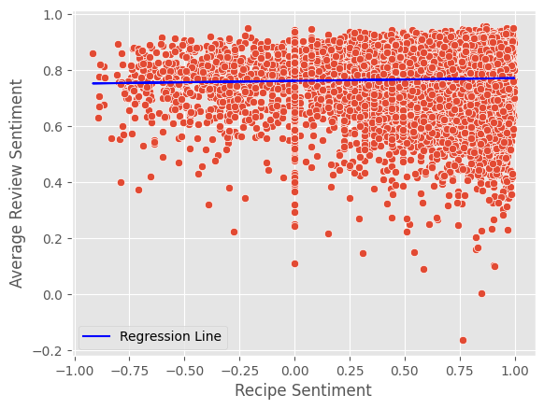
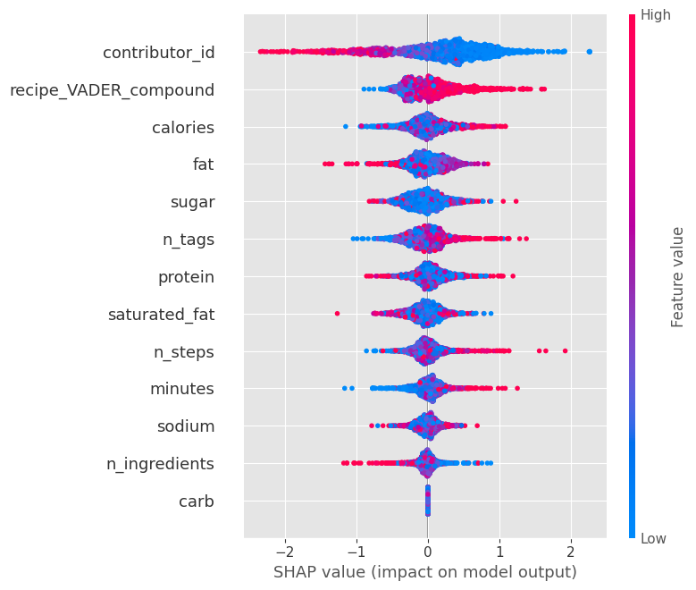
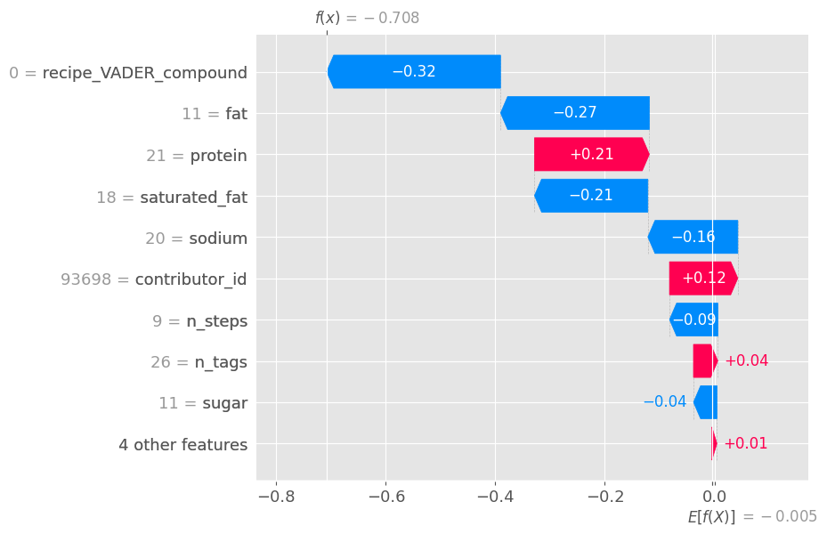
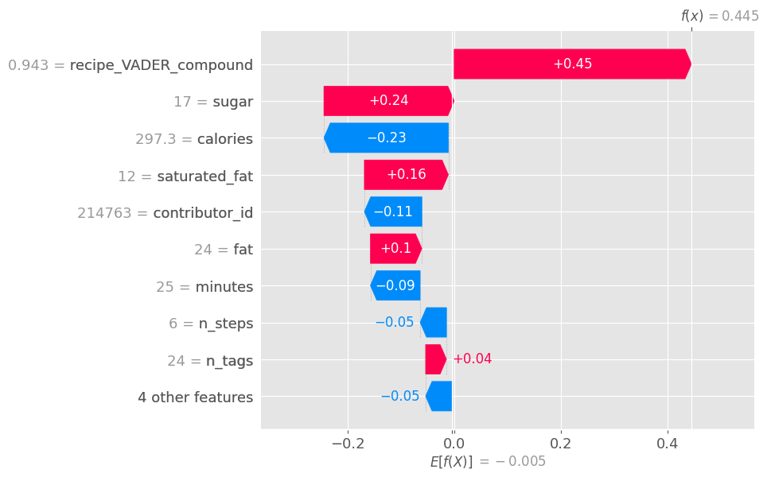
Understanding Recipe Engagement on Social Media
Do nutritional content and recipe information influence the engagement and sentiment of reviews for recipes online?
Sven Celin, Gabriela Ozegovic
INSTITUTE OF HUMAN-CENTRED COMPUTING, GRAZ UNIVERSITY OF TECHNOLOGY, AUSTRIA
Group 7
In recent years, social media has become a powerful tool for sharing food-related content, with recipe posts and reviews driving substantial engagement. As these platforms evolve, understanding the factors that influence user interaction and sentiment is crucial. While the nutritional content of recipes and the details provided in the recipe descriptions are commonly considered, the true impact of these elements on engagement and the emotional tone of reviews remains largely unexplored.
This research investigates whether the nutritional content of recipes, along with specific recipe information, such as description and recipe complexity, influence the engagement (number of reviews) and the sentiment expressed in the reviews. The findings could provide valuable insights for content creators, marketers, and even dietitians looking to optimize their social media strategies, enhance audience interaction, and foster more meaningful conversations around food.
Motivation
Test Setup
Data Exploration
FIGURE 1: MOST COMMON WORDS IN
POSITIVE REVIEWS
FIGURE 2: MOST COMMON WORDS IN
NEGATIVE REVIEWS
FIGURE 3: SCORES VS RATING FOR REVIEWS
FIGURE 4: DISTRIBUTION OF
CALORIES IN RECIPES
Words in reviews. We present most common words used in positive reviews (left) in green, or negative reviews (right) in red color. The size of the word reflects its frequency withing the respective group.
Users who post more positive reviews tend to give a higher score to the recipe. Users who opt to not giving a score to the recipe still give it a relatively positive review.
Majority of the recipe have around 200 calories per serving. This might imply that there are more recipes of snacks and small meals.
INFLUENCE ON THE RECIPE ENGAGEMENT AND REVIEW SENTIMENT
Recipe Complexity
Recipe Description
Description example:
A friend shared this with me last year. i have made a batch a month since then. it is an adaptation of a famous restaurants signature cheese. everyone likes it. it makes a great present. it will keep for extended periods when refrigerated but mine has never lasted more than a week. enjoy.
Influence of the Recipe Information
FIGURE 6: COMPLEXITY VS NUMBER OF REVIEWS
FIGURE 7: RECIVE VS AVERAGE REVIEWS SENTIMENT
FIGURE 5: MINUTES VS NUMBER OF STEPS
Method:
Check if time to complete a recipe and number of steps correlate
Create Complexity feature → minutes * steps
Objective: Analyze the impact of recipe complexity on review count
Key findings:
Very weak relationship (R-squared = 0.1%)
Still statistically significant (p < 0.001)
Coefficients: 0.0024 (minimal increase)
Conclusion: Recipe complexity has minimal impact on review count
Method: Calculate the sentiment of the recipe description, and the average sentiment of all reviews
Objective: Examine the relationship between recipe sentiment (VADER score) and average review sentiment
Key findings:
Very weak relationship (R-squared = 0.1%)
Still statistically significant (p < 0.001)
Coefficients: 0.0098 (minimal increase in review sentiment)
Conclusion: Recipe sentiment slightly influences average review sentiment
Calorie and Macronutrient Information
Influence of the Nutritional Content
FIGURE 8: SHAP visualizations for classifier predicting whether recipe will receive high engagement (large number of reviews) or not
FIGURE 9: benihana japanese fried rice
FIGURE 10: shrimp cole slaw
Explanation: High engagement posts are top 25% per number of received reviews.
Method: XGBoost model to predict whether a post will receive high levels of engagement
Result: AUC-ROC score = 0.56 → Quite bad ☹
Recipe description:
'source: www.topsecretrecipes.com'
Recipe description: a few years ago my husband and i were in kemah, and with our meal, we were served regular coleslaw with bits of shrimp in it. the slaw was good but we felt that it needed something to spice it up, so i came up with my own recipe. during the hot summer months we enjoy it as a light meal with toasted garlic bread, on these occasion i use 2 pounds of shrimp.
Human behavior is complex: predicting and modeling behavior is inherently challenging due to the unpredictable nature of individual and their personal bias
Prediction limitations: while regression models and algorithms like XGBoost can provide some insights (explainable models with SHAP), they struggle with capturing the full range of human nuances and miss unmeasured factors
Importance of feature selection: choice of features significantly impacts model’s results and accuracy
Correlation or causation?!: establishing causality in human behavior is difficult, as correlations generally do not translate directly into casual relationships
The best review (Sentiment 0.9994)
The worst review (Sentiment -0.9844)
Deeelicious! I love fried potatoes and I haven't had them in ages. I am so glad you posted this Uncle Bill! I had to sub a baking potato for the russet or yukon, margarine for the butter, and frozen chopped onion instead of sliced. The onions carmelized beautifully, the garlic powder, salt, and pepper are the perfect combo. I actually didn't measure the spices :) but that didn't cause a problem at all. I only used 1 medium-large size potato since I was the only one eating this.
Uncle bills fried potatoes and onions
I HATE to do this but feel I need to as a possible warning to others. I printed and made this recipe (Shrimp only - not the dipping sauce) just a couple of days after the transition between Recipezaar and Food.com. There are many, many complaints of ingredients in recipes not being accurate since the change. I'm not sure if that's the case with this recipe or not but this recipe was a DISASTER for me and I followed it EXACTLY.
Outback steakhouse gold coast coconut shrimp
Major Takeaways
January 28, 2025 I Graz, Austria

