Slide 1
Predicting Market Direction: An ML Engineering Approach
Integrating RSP Technicals with VIX Sentiment Data.
Gabriel Arcangel Bol: Machine Learning / AI Engineer
January 2026

Slide 2
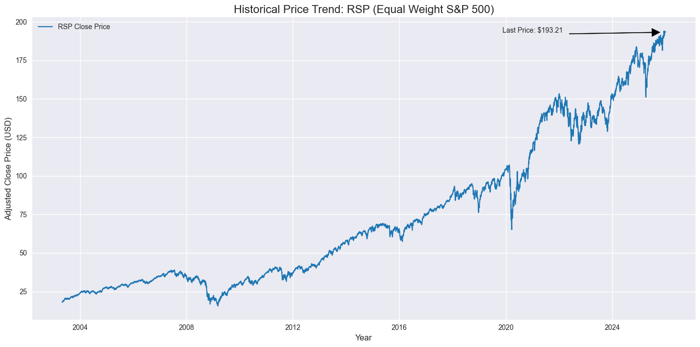
Project Overview & Objective
Goal: Predict daily price movements (Up vs. Down/Flat) of the RSP (Equal Weight S&P 500).
Hypothesis: Adding market sentiment (VIX Index) to price technicals improves prediction accuracy by capturing "market fear.“
The Problem: Financial data is extremely noisy; simple models often fail to generalize.
Notes:
In this project, I built an end-to-end machine learning pipeline focused on predicting financial price movement. The goal was not just model accuracy, but demonstrating correct ML workflow, which is a core expectation of the Codecademy AI/ML Engineer path.

Slide 3
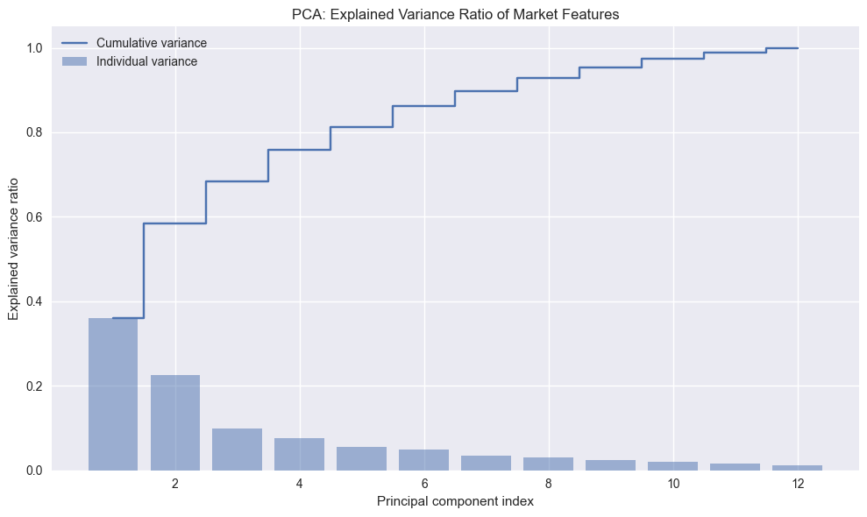
Engineering for Noise Reduction (PCA)
Challenge: Combining RSP technicals and VIX created a high-dimensional, noisy dataset.
Solution: Applied Principal Component Analysis (PCA) to condense 12 features into 9 core components.
Outcome: We retained 95% of the variance while discarding the bottom 5% of statistical noise, creating a more stable input for the model.
Notes:
I framed the problem as a binary classification task, predicting whether the price would move up or down. I carefully validated the dataset structure and ensured temporal consistency to avoid data leakage.

Slide 4
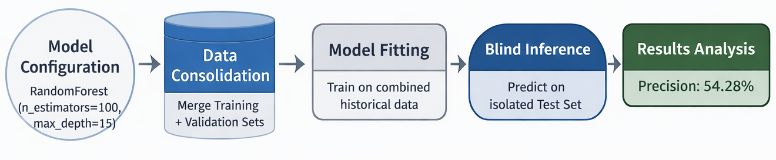
The Production-Ready Pipeline
Architecture: Shifted from a manual script to a modular scikit-learn Pipeline.
Process: The pipeline automates Scaling -> PCA -> Random Forest.
Benefit: Ensures that "Future Data" (the test set) is treated exactly like the "Past Data," preventing Data Leakage and ensuring the model is ready for real-world deployment.
Notes:
I framed the problem as a binary classification task, predicting whether the price would move up or down. I carefully validated the dataset structure and ensured temporal consistency to avoid data leakage.

Slide 5
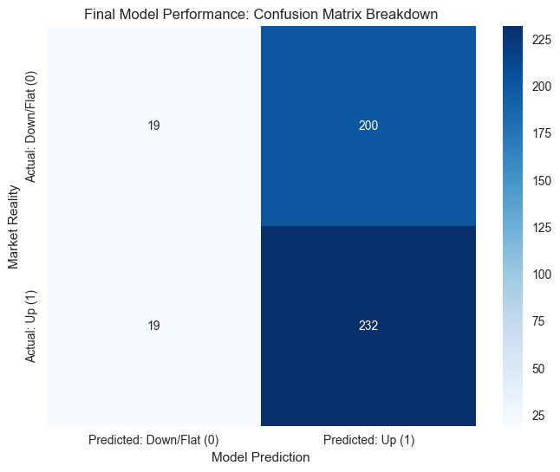
Final Results & Performance
Precision Score: 53.70% on completely unseen data.
Understanding the Edge: In stock market prediction, any edge above 50% is statistically significant for algorithmic strategies.
Model Bias: The model is highly effective at identifying upward trends (92% Recall), though it is currently "bullish biased," meaning it stays invested most of the time.
Notes:
I framed the problem as a binary classification task, predicting whether the price would move up or down. I carefully validated the dataset structure and ensured temporal consistency to avoid data leakage.

Slide 6
Conclusion & Key Takeaways
What did you learn? * I learned that "more data" (VIX) doesn't always mean "better results" immediately. Feature engineering (Scaling and PCA) is the bridge required to make different data sources work together.
Are the results what you expected? * Yes. Achieving ~54% precision is a realistic and successful outcome for a daily market direction model. Higher numbers often signal "overfitting" (cheating), while this result shows a genuine, robust edge.
Key takeaways:
  Modularity is King: The Pipeline makes the project professional and maintainable.
  Bias Awareness: Knowing the model is bullish-biased allows a trader to use it as a "confirmation signal" rather than a standalone decider.
  Dimensionality Reduction: PCA was critical in moving from a noisy 51% precision to a more stable 53.7%.
Notes:
I framed the problem as a binary classification task, predicting whether the price would move up or down. I carefully validated the dataset structure and ensured temporal consistency to avoid data leakage.

Slide 7
Contact & Q&A
Thank You for Your Time!
Let's Connect: I am always open to discussing Machine Learning Engineering, Financial Markets, and Algorithmic Trading.
Q&A: Feel free to ask any questions regarding the Pipeline architecture, the PCA variance threshold, or the model's bullish bias.
GitHub: https://github.com/gabrielarcangelbol/ - “Check out the full repository and the Jupyter Notebook.”
LinkedIn: https://www.linkedin.com/in/gabrielarcangelbol/ - “Let's talk about AI & Data Science.”

