Slide 1
ENGR CL 057: stems CORE Lab Blurring and Noise Removal in Photographs ~or~ How nearsighted people see the world
Gabriel Bessler and Richard Zhang
https://github.com/gabrielbessler/CoreLabProject

Slide 2
Blurring – Some Whack Math things
Basic Blur: Box Blur (Box Linear Filter)
Next Level Blur: Gaussian Blur (Gaussian smoothing)
Noise-zifying: Randomly Adding Pixels
Un-noise: Unsharp Masking (UM)
Fancy Un-noise: Median Filter
Unblurring – Some more Whack Math things

Slide 3
Linear vs Non-linear filter
Linear Filters: Output is a linear transformation of the input
Non-linear Filters: Output is not a linear transformation of the input
Notes:
Linear filters have their output as a linear function of the input; output pixels' value is a linear combination of the values of the pixels in the input pixel's region. On the other hand, nonlinear filters's outputs cannot be reconciled as linear combinations of the input values. This usually involves some sort of non-linear weighting.

Slide 4
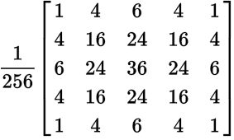

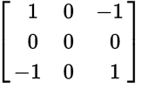

CONVOLUTION
[kon-vuh-loo-shuh n] Def: n. to make more convoluted
Example Kernels:
Notes:
where things get really complicated. In terms of image processing, convolution adds each element (pixel) of an image to its local neighbors, weighted by a kernel, a chosen weighting matrix.
You place the NxN kernel centered over an NxN pixel region of an image
Multiply each kernel element with the pixel value it overlaps
Sum up, new value
Identity kernel (does nothing), edge detection kernel (makes the image negative/black and white, accentuates edges), box blur kernel (linear) (takes the average of a 3x3 window), and gaussian blur kernel (non-linear) (takes the gaussian distribution-weighted average of a 5x5 window)

Slide 5
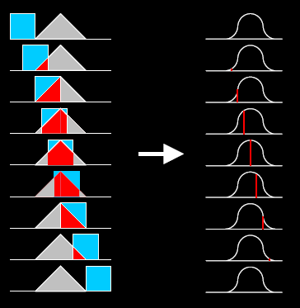
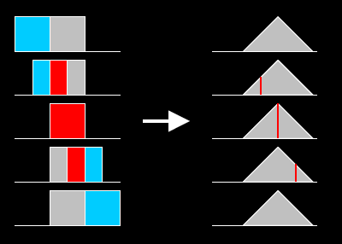
CONVOLUTION
Notes:
Here is a visual representation of how convolution acts upon functions. The boxes are squarewaves, representing box filtering. Basically, you have two functions, f and g. You hold one stationary, and move the other across it with constant time. As time passes you take the integral of their product: in affect, the area of the intersection of the two functions
This visual representation shows that if you keep convoluting with box filters, you eventually arrive at a gaussian-like wave. This visually represents how box filtering over and over again approximates the gaussian distribution.

Slide 6
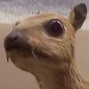

The algorithms – Box Filter
Linear Filter
Output pixel value: calculated from unweighted neighbor pixel average
STEMs 057: Low-pass filter
Simplest way to blur photo
When repeated, can approximate Gaussian blur (Central Limit Theorem)
Notes:
-this is a linear filter. Every output pixel has a value calculated from the average value of it's neighboring pixels. This is a low-pass, blurring filter. This is the most simple kind of blur, and is used to approximate a Gaussian Blur (using the box blur a lot, by the central limit theorem, gets the result of a gaussian blur)!

Slide 7

The algorithms – gaussian blur
Nonlinear filter
Employs the gaussian distribution
STEMs 057: Low-pass filter
Uses the gaussian distribution to create a weighted average of pixel values
More complicated: not just a simple average
Notes:
-this is a nonlinear filter. It employs the gaussian (relating to normal distribution) to calculate the transformation to apply to each pixel in an image. The gaussian function creates a surface that creates a weighted average of each pixel's neighborhood. In effect, each pixel's value is set to be the average of pixel values present in a radius around the original pixel as determined by a gaussian distribution

Slide 8
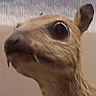
ROTATE THE BOARD – unsharp masking!
Depending on the technique, can be linear or nonlinear
Step 1: blur image
Step 2: subtract blurred image from image
Step 3: profit!
STEMs 057: High pass filter, amplifies edges
Value = Original + (Original − Blurred) * Amount
Notes:
-image sharpening technique. Named for how it uses a blurred negative image of the original image to create a mask of the original image; that unsharped mask is combined with the original image to create an image that is less blurry. Though the resulting image is clearer, it can be a less accurate representation. Unsharp masking can be linear or nonlinear, and in the context of signal processing (E79!!!) it is a filter that amplifies high-frequency components of a signal and cancels low-frequency information (high pass filter). The result is that image sharpness increases
-In digital processing, software creates a blurred copy of the original image with gaussian blur. Then, it compares this blurred mask of the image to the original, and with a user-defined threshold setting, the images are subtracted from one another; this removes the blurred (analogous to low-frequency) portions of the photo. If applied to the whole image, this can increase image noise or cause conspicuous edge effects, so unsharp masking is usually applied only to desired regions.

Slide 9
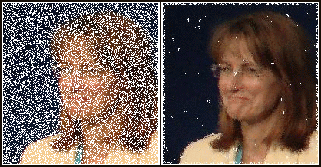
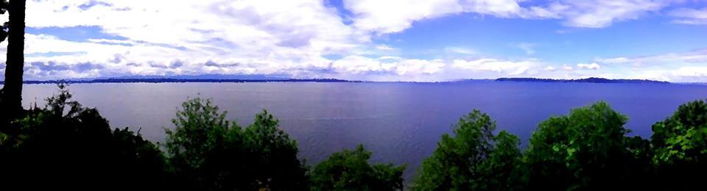
Median filter: UN-Noise! Turn it up down
Noise-zify: Randomly adds pixels of noise
Median filter: Nonlinear
Usually pre-processing
Takes in a window of pixels
Finds the median, applies that to the center pixel
Makes things look artsy!
Notes:
-Median Filtering: Nonlinear filtering technique, usually used to remove noise from an image (or a signal). It is usually used as a pre-processing step to improve results for other processing steps, such as edge detection. It has potential to preserve edges while removing noise. Median filters run through the image pixel by pixel, and replaces pixel values with the median of neighboring pixels. For 2D images each pixel has a "window" of neighbors, which can be several different patterns: box, cross, or others.

Slide 10

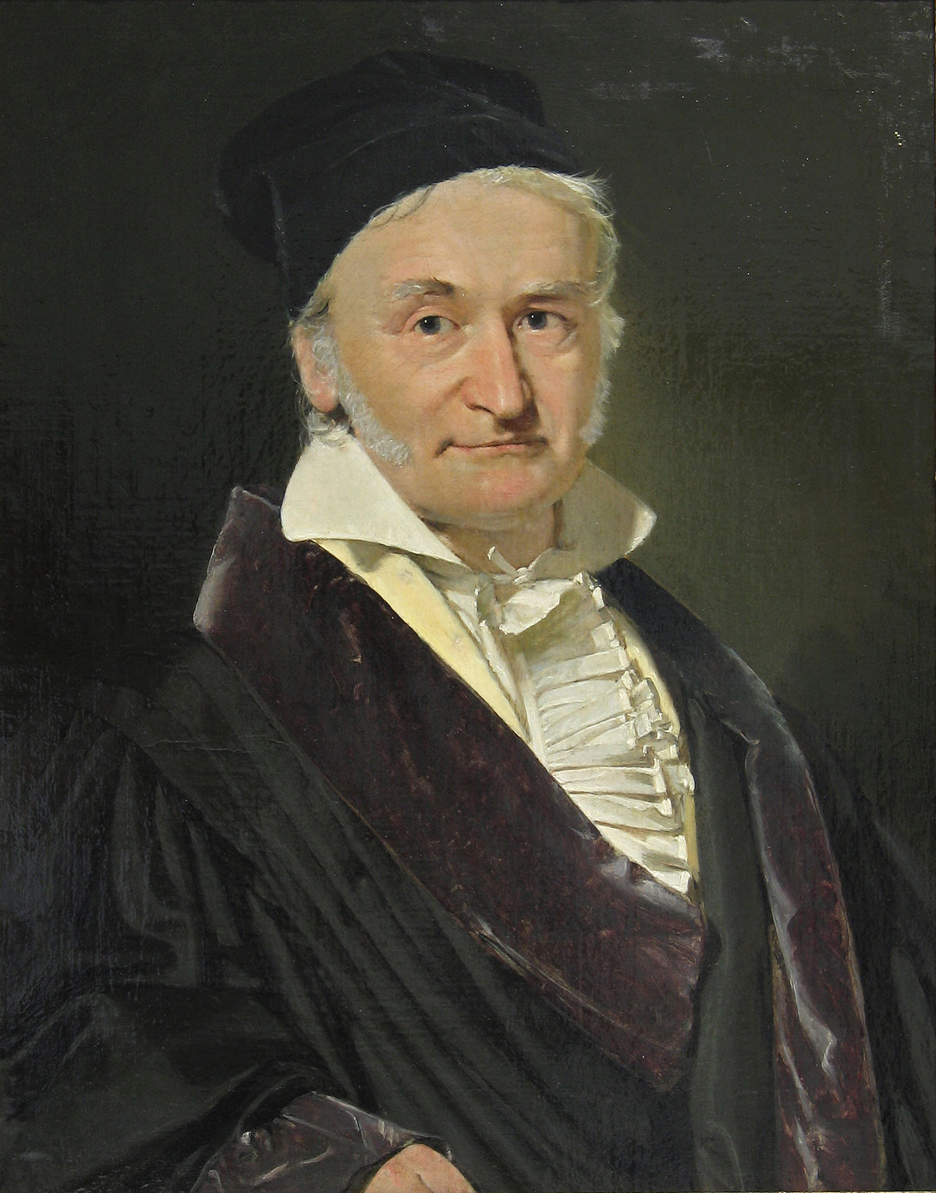
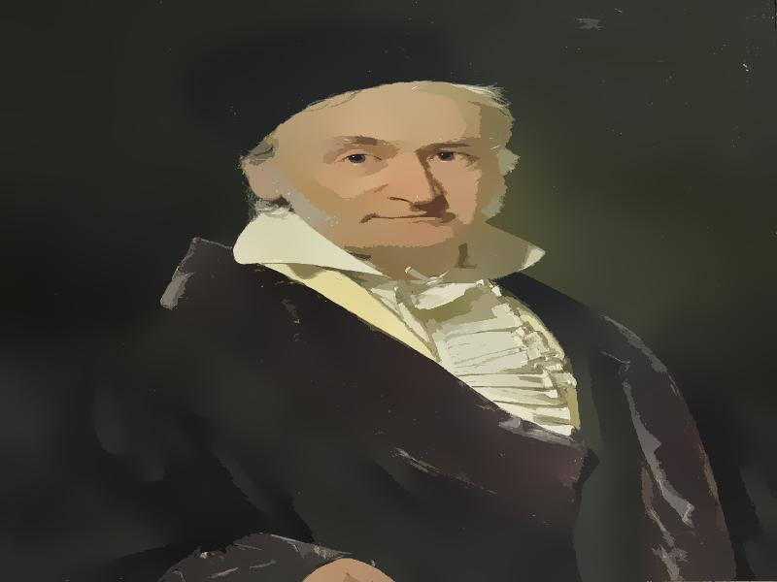
Bilateral Filter
Like a box filter, but NON-linear
Weighted average around each pixel
Weight = F(Euclidean distance, Color distance, and more)
Great at preserving (sharp) edges while removing noise (e.g. textures).
Notes:
Color intensity, depth, luminosity, etc
Explain why it’s good at preserving edges
If we increase spatial parameter (sigma d) it blends colors at a further distance
If we increase the range parameter (sigma r), it approaches the gaussian distribution

Slide 11
<Programming>
Python* Libraries:
Tkinter-based GUI
PIL (Python Image Library) for Image Processing
ImageCV for Algorithms
Running the Script:
python main.py [-v] [-w=WIDTH] [-h=HEIGHT] [-s]
v turns on detailed mode
s shows output pictures in default OS picture display
*working in Version 3.6.1
Notes:
Tkinter is a library that allows you to use Tcl (Tool Command Language)/Tk (graphical interface toolkit) in Python to make GUIs. Basically, anything that is displayed on the screen is done with Tkinter, althought it doesn’t do any of the actually processing. PIL is the standard Python Image Library, and is used for opening the images, obtaining the pixel data, editing the pixel data, and saving images. It contains an ImageTk object which is is a convenient way to interface with Tkinter.
ImageCV was used for the various blurring algorithms. Although it wouldn’t be a lot of work to write these functions yourself, the ImageCV functions in python are usually more efficient and easy to use. They also let you modify all of the paremeters in the equations (which is useful if you more or less know what you’re doing).
(Mention that I “threw it together” in X hours?)

Slide 12
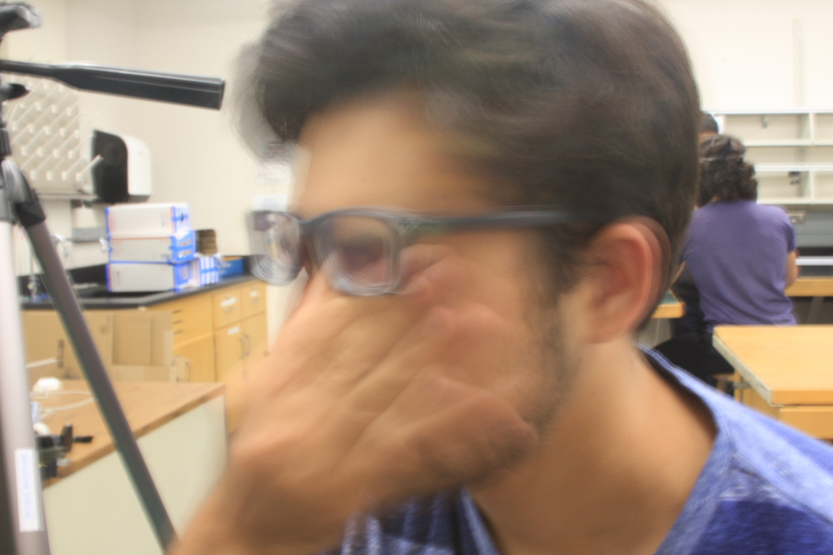
Results (see through the eyes of gabe - and other nearsighted people))

Slide 13
Sources
SentDex – Tkinter tutorials https://www.youtube.com/watch?v=JBME1ZyHiP8
Stackoverflow:
https://stackoverflow.com/questions/18537918/set-window-icon
https://stackoverflow.com/questions/14134892/convert-image-from-pil-to-opencv-format
OpenCV: https://docs.opencv.org/2.4/doc/tutorials/imgproc/gausian_median_blur_bilateral_filter/gausian_median_blur_bilateral_filter.html
Professor Wojciech Jarosz: https://www.scribd.com/document/186896423/Wjarosz-Convolution-2001
Laplacian Kernel Explanation: http://www.idlcoyote.com/ip_tips/sharpen.html
Wikipedia. Lots of Wikipedia
https://en.wikipedia.org/wiki/Unsharp_masking
https://en.wikipedia.org/wiki/Nonlinear_filter
https://en.wikipedia.org/wiki/Mask_(computing)
https://en.wikipedia.org/wiki/Deconvolution
https://en.wikipedia.org/wiki/Convolution
https://en.wikipedia.org/wiki/Box_blur
https://en.wikipedia.org/wiki/Gaussian_blur
https://en.wikipedia.org/wiki/Median_filter
https://en.wikipedia.org/wiki/Noise_(signal_processing)
https://en.wikipedia.org/wiki/Salt-and-pepper_noise
https://en.wikipedia.org/wiki/Kernel_(image_processing)

