Slide 1
Waveguide
Down The Portfolio Project Rabbit Hole

Slide 2
Intro
Undergrad in Physics and Math at Carleton University
Advanced Diploma in Computer Science at Algonquin College
Closing the gap between Algonquin’s curriculum and where web development technology has gotten today.
Continuing work on my portfolio project, Waveguide

Slide 3
A Global Context
I participate in a global artistic community that has emerged across social networks and streaming platforms over the past eight-or-so years.
While the community has gathered loosely around a genre we call wave, the deeper point is the common support and distributed growth that is occurring around the world.
Have seen rapid growth from URL ➡ IRL with the sprouting of record labels, art collectives, promotion agencies, sound design companies, regular club nights, and cross-continental tours.
Currently, the way you access, experience, and participate in this community is fractured across Facebook groups, sub-reddits, chat servers, etc…
The intention of Waveguide is to build a community directory that can be a hub for the network.

Slide 4
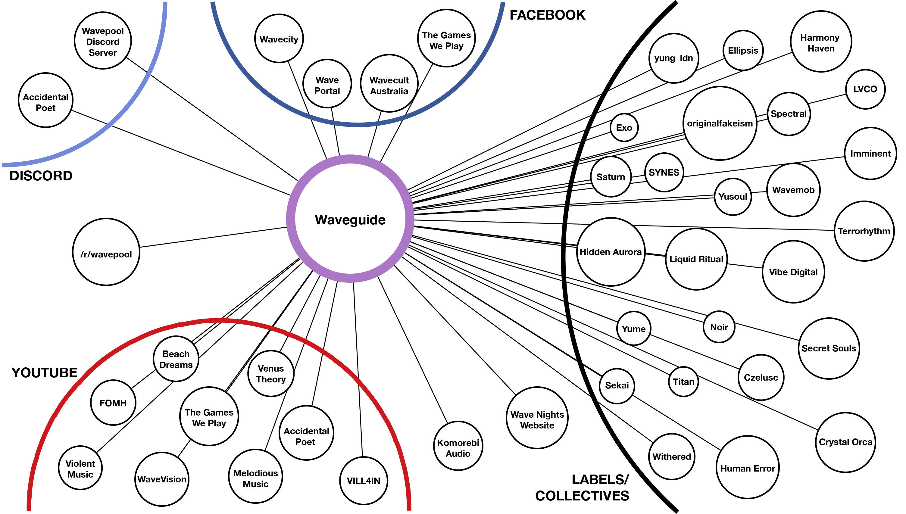

Slide 5
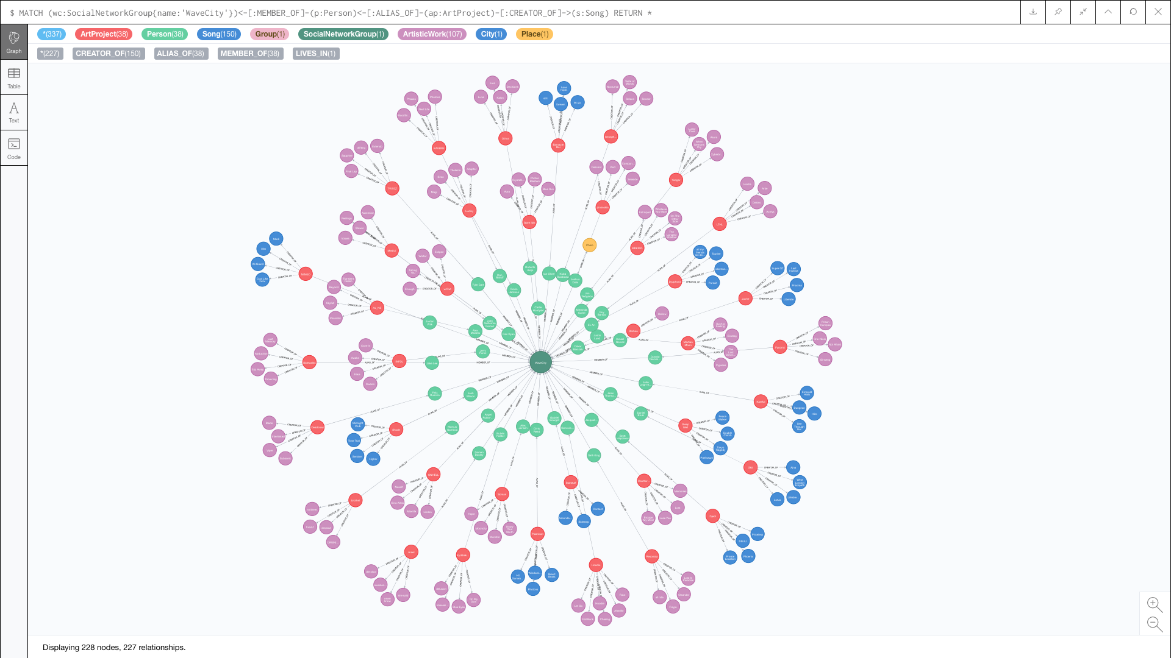

Slide 6
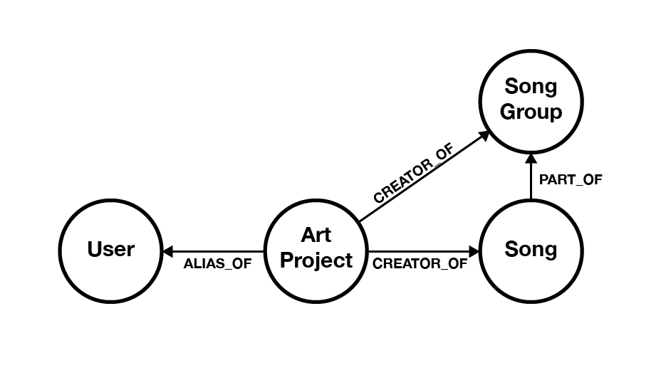
Portfolio project DATA MODEL

Slide 7
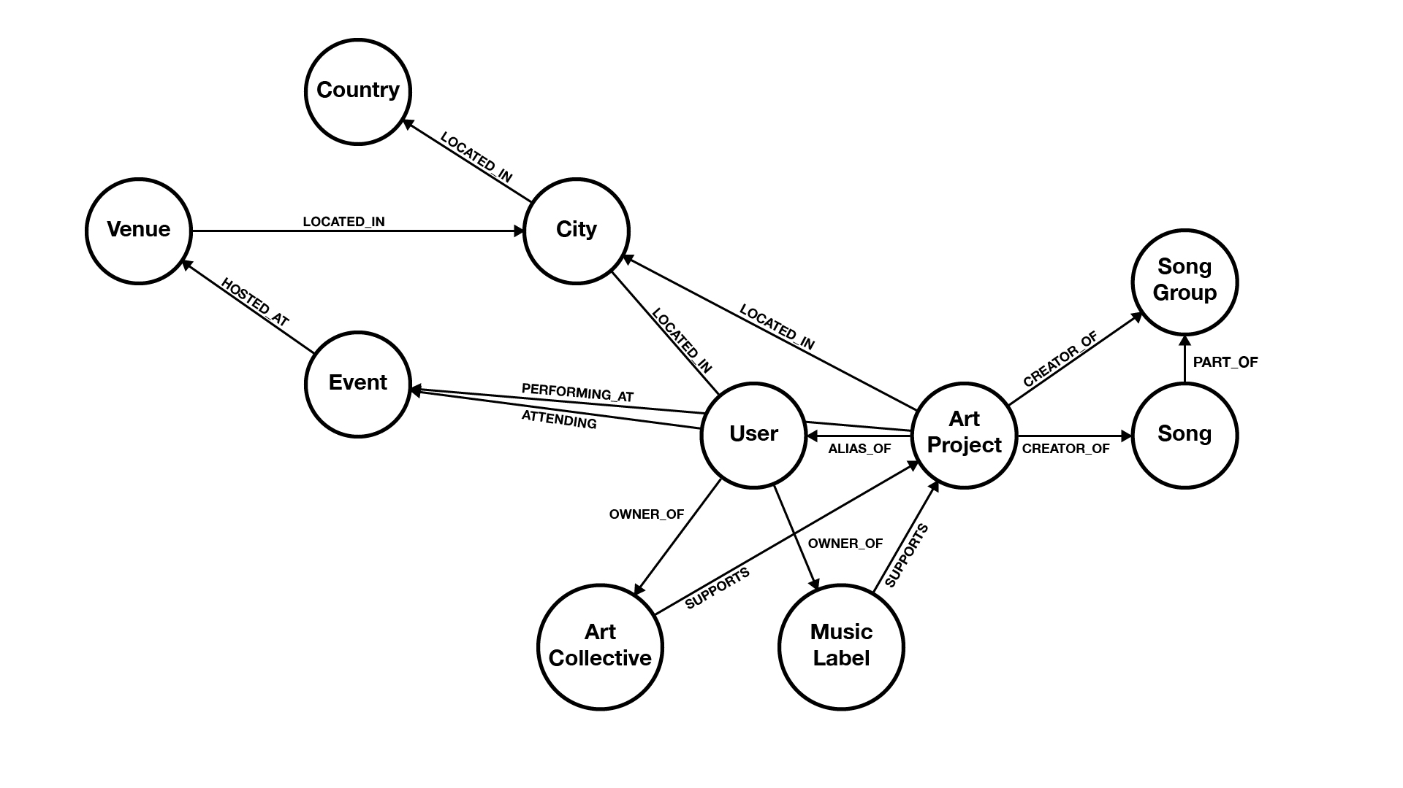
OVERALL DATA MODEL

Slide 8
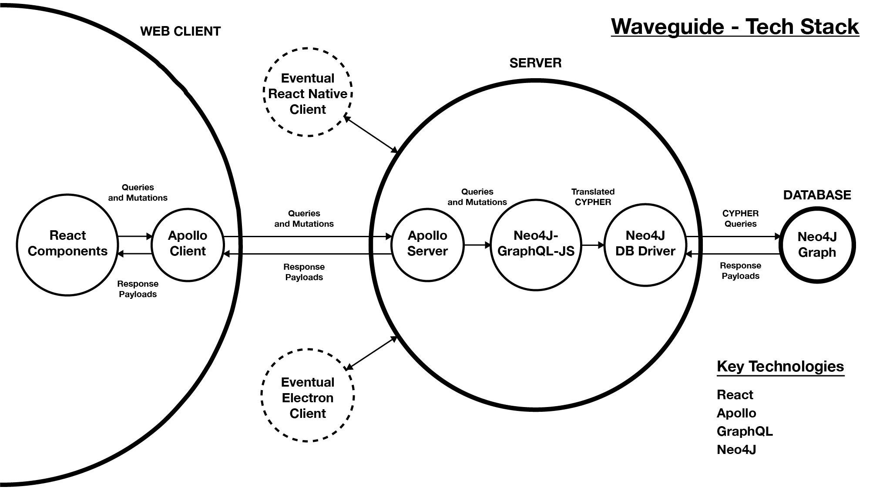

Slide 9
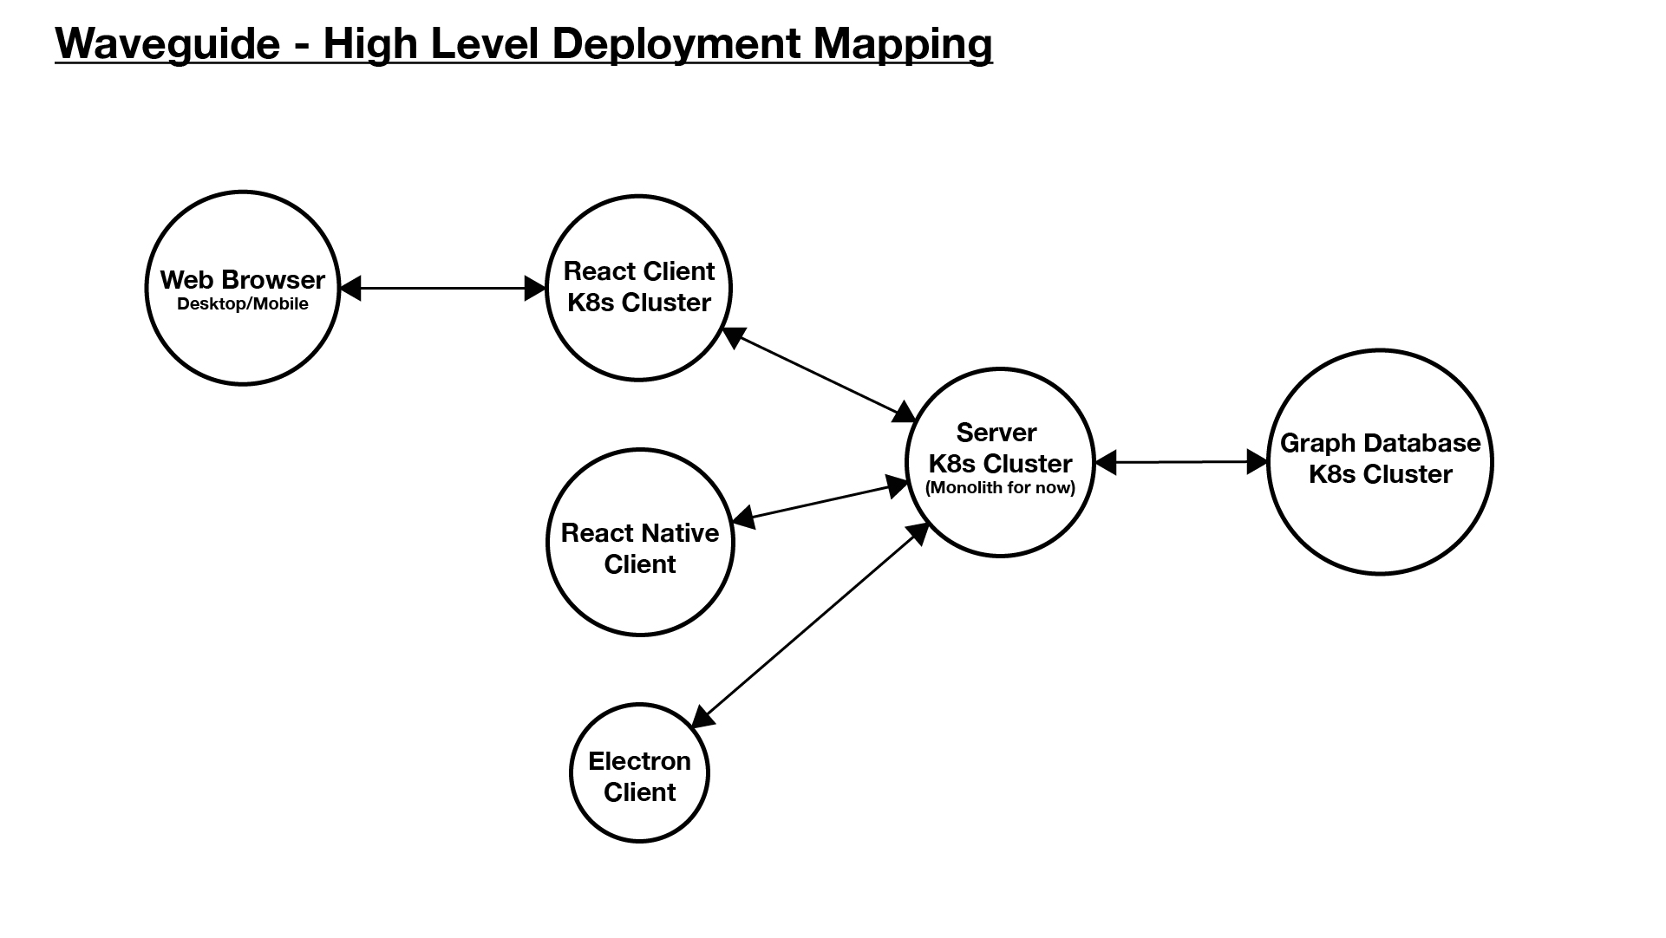

Slide 10
Active learning areas
Testing (Unit, Integration, E2E)
Containerization (working with Docker)
Orchestration (working with Kubernetes)
Continuous Integration/Continuous Deployment
Server-Side Caching (working with Redis)
Internationalization
Static Asset Hosting (have worked with Cloudinary)

Slide 11
Beyond portfolio scope
Mixing tool for DJs in the community (data analysis on key signature and tempo)
Collaborative Filtering (start with event recommendation)
Map Component (events, artist locations, venues, etc…)
Public facing GraphQL and REST APIs for community use.
Artists
Events
Songs
Labels/Collectives
Etc…

