Slide 1
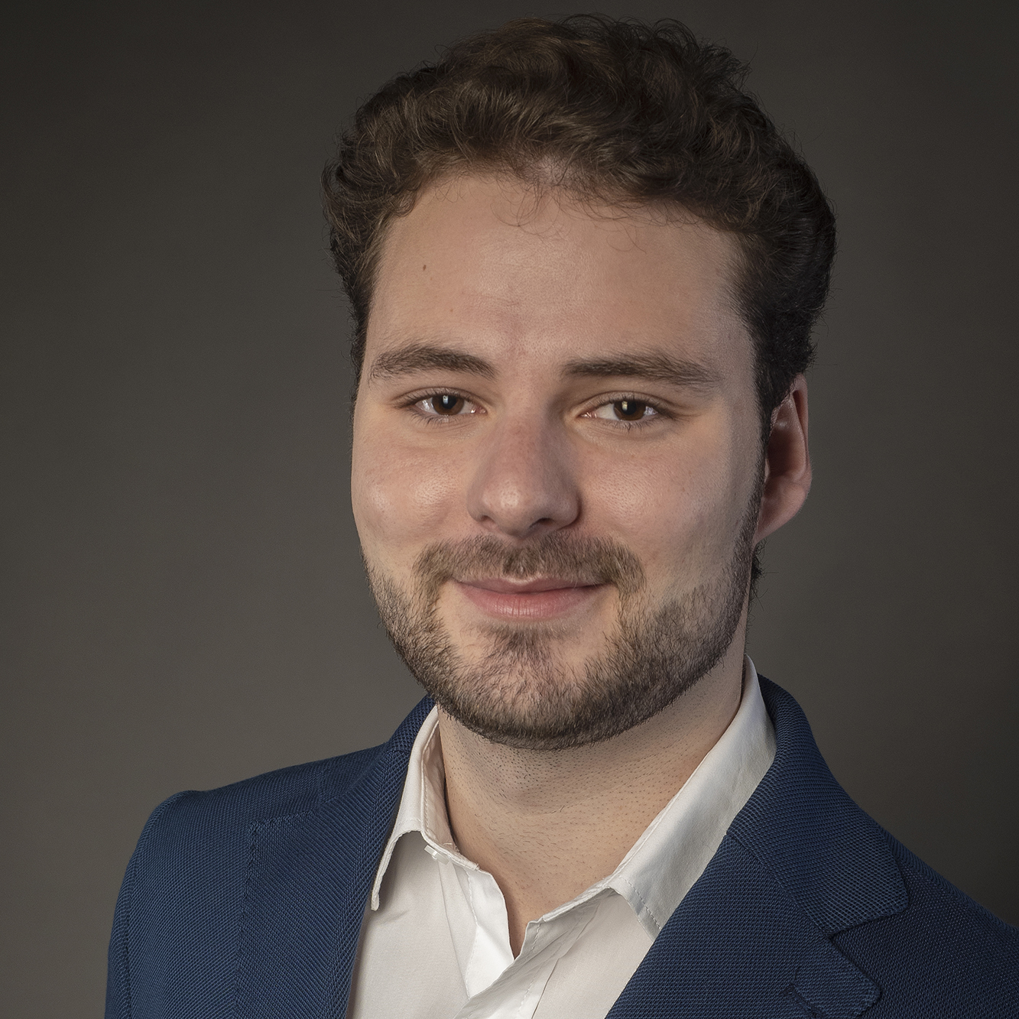
Renato Tempini – Graduate Analyst (AIA Modern Data Engineering)
Data-driven HSG Business Innovation alumni with a flair for technology, data and visualization. My passion is gaining insight from data in order to create impact.
During my studies and work experience, I have gained experience with tools like Python, R, Power BI and SQL. My Projects varied from visual analytics, AI/ML to NLP, as well as innovating and coming up with new business models.
Currently doing trainings on Azure to get the Azure Data Scientist Associate certification
Professional background
Cognizant (since Jan -2022)
Core Competencies
Visual Analytics (Power BI, Tableau)
Data Handling (SQL, R, Python)
Industry Experience
Information Technologies, Measurement, and Visualization
Academics
Bachelor of Arts (Business Administration)
Master of Arts (Business Innovation with focus on Data Science)
Languages
German (native)
English (fluent)
Professional & Learning experience
Extensive knowledge of significant and innovative visualizations. Analyzing and visualizing complex data sets in dashboards and stories using Power BI and Tableau.
Experience in data preparation and processing of complex data sets using Python, R-Studio, SQL and Excel.
Basic knowledge in Artificial Intelligence, Machine Learning & Deep Learning. ML project in Python: movie review scorer on multiple sentiments. R-Studio Project: predicting used car prices based on a variety of features.
Created SQL queries on MSSQL for Absence tool in IT department of a bank.
Specialization and expertise
Visualization: Power BI (Microsoft Certified: Power BI Data Analyst Associate) , Tableau
Microsoft Azure (Microsoft Certified: Azure AI Fundamentals)
Programming Languages: Python, R-Studio
Databases: MS SQL Server
ETL: Informatica PowerCenter

