Slide 1
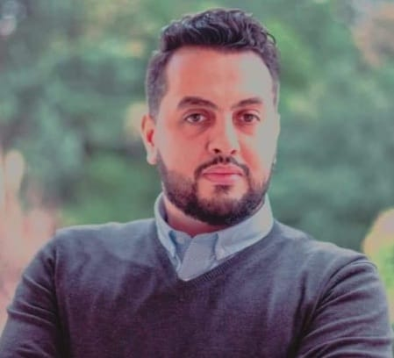
Mohamed Cherif Dani – Data Science Specialist & Solution Architect
Skills / Competencies
Consulting/Advisory
Data Science, ML, DL
Data Engineering
Machine & Deep Learning
Predictive Maintenance & analytics
Cloud data solutions (Azure)
Databricks & Apache Spark
SQL (PL/SQL, My-SQL),
SAS, R, Python (Pandas, Keras, sklearn, tensorflow, MLLib)
AutoML & XAI, H2O.AI, AzureML, AutoKeras, , XAI (Lime, Shap, etc.)
Specialization Areas
Energy , Oil & Gas
Aerospace & Avionics
Profile Snapshot
Data Science manager & Solution Architect across Cognizant’s industry verticals in Switzerland
10+ years of data analytics experience in consulting and delivery from different countries & industries (Airbus, Engie, Shell, Intel, Thales, etc.).
Representative Experience
Leverage robust hands-on data mining, modeling, and regression analysis to oversee architecture of products and services tailored to client needs. Lead alignment of core analytics adoption products and execute strategies encompassing data-led thinking for go-to-market and investor readiness.
Rebuilt Gas trading solutions (Python, Flask API, Oracle, etc.), and participated to the global digital transformation.
Led multiple AI projects for different departments for an energy group in Amsterdam, as: AutoML project, XAI project, 3D localization using point cloud, sentiment analysis, price & competitors price analysis, Data versioning & pipeline using databricks and pachyderm.io, etc.
Led predictive maintenance project using IoT and supply chain data: Built multiple proof-of-concepts to predict RUL of machines equipment’s, Built data infrastructure based on azure for IoT data, Text mining on supply chain data, time series analysis, derived data roadmap & strategy, etc.
Led multiple AI and Machine learning projects, Built proof-of-concepts for different clients and sectors as avionics, aerospace, energy, cybersecurity, in Toulouse, France
Held responsibility for the portfolio of analytical projects (client & team management, requirements gathering, scoping for changes, planning, negotiating) for top avionics companies in France.
Led a health monitoring solution development for HPC, logs analysis (classification, anomaly detection & failure prediction) of more than 14gb of daily' logs, for CEA (Atomic Energy Centre group) in Paris, France & Carry, USA.
Performed analysis on aircraft condition monitoring system (ACMS) and related data to enable prognostic health monitoring systems (PHM) with anomaly, fault, failure detection, clustering, classification, and remaining useful life estimation.
Ranked 4th in AI for medical challenges HACKATHON organized by PIERRE FABRE, Castre, France
Education / Professional Certification
PhD in Data Science
Msc in Machine Learning
Msc in Economics & Management
MBA – General management

