Slide 1
LHCb and SciFi Tracker
Gabriel Cammany

Slide 2
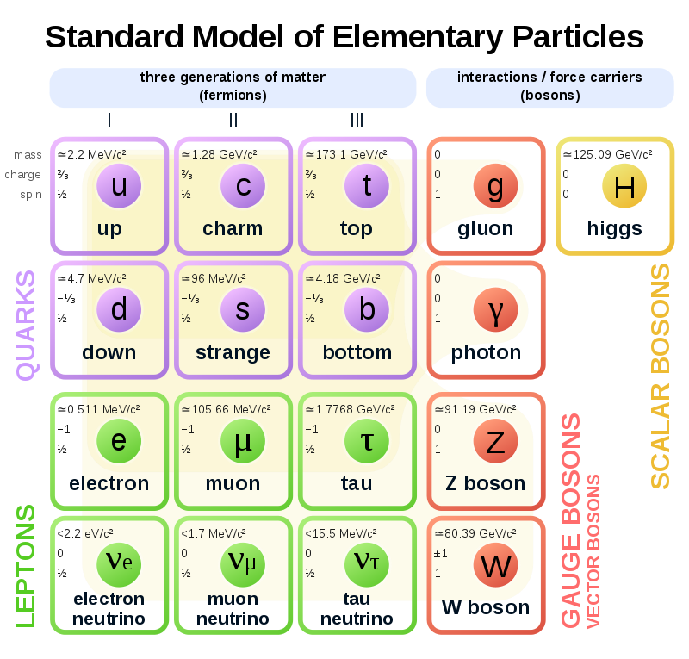
Concepts
Elementary particles Subatomic particles without sub structure, thus not composed of other particles. Currently:
Quarks and Leptons (with their corresponding antimatter)
Bosons (Gauge and Higgs)
Composite particles, particles formed with two or more elementary particles.
Hadrons (combinations of quarks)
Baryons, three quarks (E.g. Protons, Neutrons).
Mesons, two quarks (E.g. Pion, Kaon).

Slide 3
Particle accelerators (1)
Propels charged particles, such as protons or electrons, at high speeds, close to the speed of light.
They are then smashed either onto a target or against other particles circulating in the opposite direction.
The energy of the collision is transformed into matter in the form of new particles.
This phenomenon is described by Einstein’s famous equation E=mc², according to which matter is a concentrated form of energy, and the two are interchangeable.

Slide 4
Particle accelerators (2)
Accelerators use electromagnetic fields to accelerate and steer particles. Radiofrequency cavities boost the particle beams, while magnets focus the beams and bend their trajectory.
Linear and Circular, accelerators.
In a circular accelerator, the particles repeat the same circuit for as long as necessary, getting an energy boost at each turn. In theory, the energy could be increased repeatedly. However, the more energy the particles have, the more powerful the magnetic fields must be to keep them in their circular orbit.
The type of particles, the energy of the collisions and the luminosity are among the important characteristics of an accelerator.

Slide 5
Particle accelerators (3)
An accelerator can circulate a lot of different particles, if they have an electric charge so that they can be accelerated with an electromagnetic field.
The energy of a particle is measured in electronvolts. One electronvolt is the energy gained by an electron that accelerates through a one-volt electrical field.
Luminosity is a key indicator of an accelerator’s performance: it indicates the number of potential collisions per surface unit over a given period expressed in cm⁻²s⁻¹

Slide 6
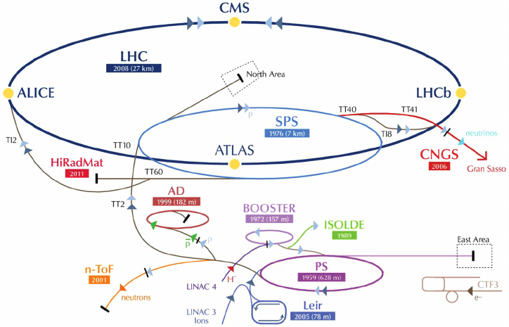
CERN
Large Hadron Collider, boosts particles in a loop of 27 kilometers at an energy of 6.5 TeV, generating collisions at 13 TeV, thanks to the addition of the two particles energies when colliding.
Generally accelerates protons but can also nuclei of ionized atoms (ions), such as the nuclei of lead, argon or xenon atoms.
The Large Hadron Collider is supplied with protons (or others) by a chain of four accelerators that boost the particles and divide them into bunches.
Four crossing points with a particle detector on each one.
Bunch crossing every 25 nanoseconds (40 MHz).

Slide 7
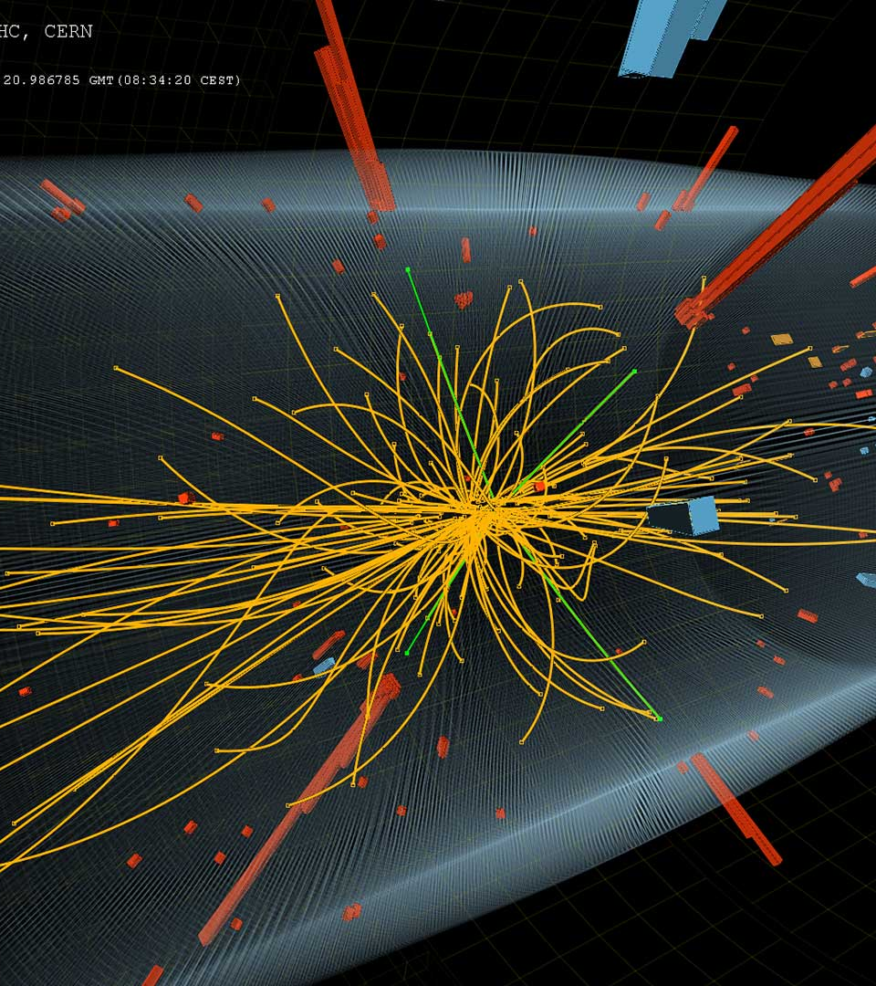
Collision
Collision point is called Primary Vertex.
Ideal number of collisions are 1 in each bunch crossing, but this number fluctuates statistically.
When more than one occurs, it is defined as a pile-up, accumulation of primary vertices.
Secondary vertex, is considered the disintegration point of a given particle. It is displaced and distinguishable from its primary vertex.

Slide 8
LHC-beauty
Specializes in investigating the slight differences between matter and antimatter by studying a type of particle called the "beauty quark", or "b quark".
Instead of surrounding the entire collision point with an enclosed detector as do ATLAS and CMS, the LHCb experiment uses a series of subdetectors to detect mainly forward particles - those thrown forwards by the collision in one direction over a length of 20 meters.

Slide 9
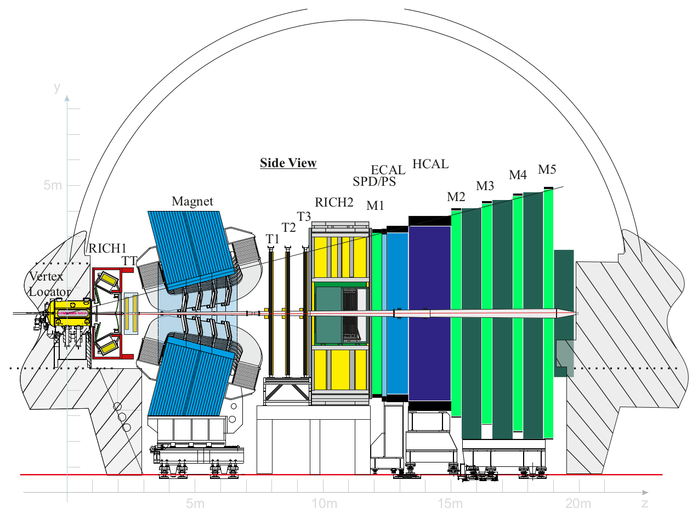
LHCb Systems
Tracking
VELO (Vertex Locator) + TT (Tracker Turicensis ) + Magnet + T1,2,3 (Tracking Stations)
Particle Identification
RICH1, 2 (Cherenkov detectors) aimed to distinguish different types of hadrons.
ECAL (Electromagnetic Calorimeter) and HCAL (Hadronic Calorimeter) for photon, electron and hadron candidate's identification.
M1,2,3,4,5 (Muon Stations) for muons identification.
Trigger
L0 (Level 0) trigger, implemented in Hardware (To be removed on Run 3)
HTL (High level trigger), implemented in software running on a computing farm of thousands of cores.

Slide 10
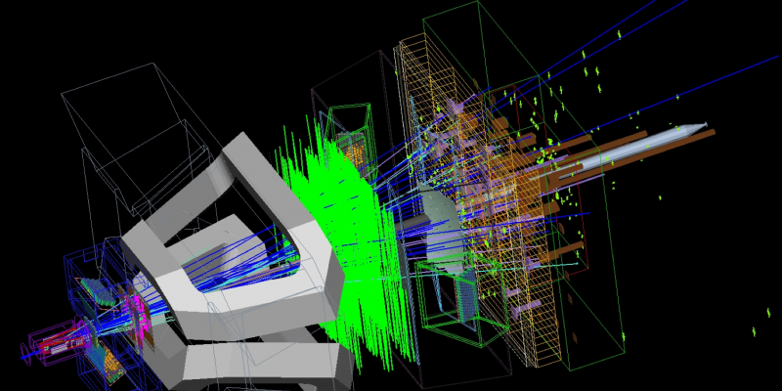
Tracking System
The principle task of the tracking system is to provide efficient reconstruction of charged-particle tracks.
Multiple types of tracks based on the trajectory and momentum of a given particle (more on next slide).
The Tracking in the LHCb reconstruction sequence consists of two parts.
The first is the pattern recognition, which combines individual measurements in the various tracking systems to form track candidates.
The second part is to optimally determine the track parameters using a Kalman filter based fitting approach.
The reconstruction efficiency ε is measured using simulation by comparing the number of correctly reconstructed tracks with the number of tracks defined to be reconstructible. This is made possible by using truth information available in simulated samples.
When reconstructing tracks, the algorithm may produce a Ghost Track, which is basically a wrong constructed track. The ghost rate (being the fraction of ghost tracks relative to all reconstructed tracks) is computed to determine, along with many other factors, the efficiency of a given algorithm.

Slide 11
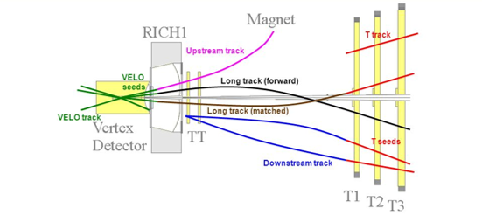
Track types
Long tracks are the most value ones for physics, which are reconstructed in VELO and T-stations.
T tracks are not used in physics analyses but are used in the reconstruction of the downstream tracks.
Downstream tracks are important for the reconstruction of the daughters of long-lived particles.
Upstream tracks used to reconstruct low momentum particles which are bent before reaching T stations.
VELO tracks:
Forward, only used as inputs for the tracking algorithms which upgrade them to upstream or long tracks.
Backwards are important for the reconstruction of the position of the primary vertices.
Nevertheless, except VELO tracks, all tracks are used as inputs for the reconstruction algorithms of the RICH detectors.

Slide 12
LHCb upgrade 2018-2019
Necessity to maximize sensitivity, as precision studies may become the only way to unravel new effects at the LHC.
In order to achieve it, these must be performed at the highest possible LHC energy and luminosity, but the main limitation of today's system is the ability of the read-out and trigger scheme to inject data into the trigger farm.
To solve this, two major upgrades will be applied:
The full read-out of the front-end electronics (currently limited by the L0 trigger at 1Mhz) will be replaced by a 40Mhz trigger system. Making it possible to feed complete events every 25ns to the LHCb data acquisition farm and apply a full software trigger to every single bunch crossing.
Because the luminosity is increased by a factor of five compared to current detector, resulting in an average number of visible interactions per bunch crossing of 7,6 , there is a requirement to replace the front-end electronics and the sensitive elements of the detectors (most notable the silicon tracking devices, T1,2,3). In the latter case by a single homogeneous detector based on scintillating fibers called SciFi.

Slide 13

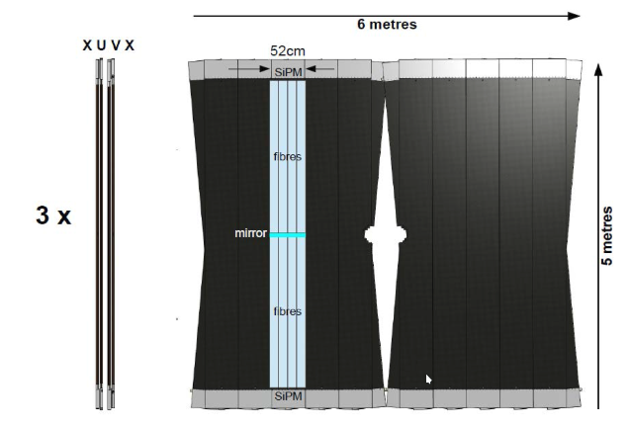
Scintillating Fibre Tracker
The SciFi tracker consists of three stations each with four detection planes, as shown in the figure.
The detector is built from individual modules (0,5 m×4,8 m), each comprising 8 fiber mats with a length of 2,4 m as active detector material.
The detector is designed to provide low material budget (1 % per layer), hit efficiency of 99 % and a resolution better than 100μm (~70μm).
The full detector, comprising 590.000 channels, is read-out at 40 MHz.

Slide 14
Patter recognition Algorithms
In the first stage of the reconstruction of the tracks so-called the pattern recognition algorithms are run to find a collection of hits associated to the flight path of charged particle through the detector.
The two most important pattern recognition algorithms using information from the Scintillating Fiber in the LHCb track reconstruction are the Forward Tracking and the Seeding.
While the Forward Tracking uses as an input tracks found in the VELO, the Seeding relies exclusively on information from the Scintillating Fiber detector.
Moreover, the tracking system of the upgraded LHCb detector is structured similarly to the that of the current detector, therefore the pattern recognition sequence is unchanged compared to that used for the current detector.
However the individual algorithms are adapted to the new detector geometries, as the performance number of the algorithms used in the current LHCb experiments are computed with an interaction rate of v = 2, new ones of v = 3,8 and v = 7,6 (being v the mean value of primary vertices per bunch crossing).

Slide 15
Seeding Algorithm PrSeedingXLayers
The prototype algorithm PrSeedingXLayers relies on a similar logic to what was developed for current LHCb detector, namely PatSeeding.
Which was based on the idea to have a track model that accurately describes the shape of a track in the T stations. Following the logic that because tracks generally stay within a certain region of the T stations (e.g. in the upper half of the Outer Tracker, or the left boxes of the Inner Tracker), one can first search for tracks per region and only then attempt to find the tracks that migrate between regions to reduce combinatorics.
The individual steps of the prototype algorithm are: Track model and track fit, collection of hits in the x-layers, addition of stereo hits and finally conversion of hits collections to LHCb tracks (explanation of each step in the following slides).

Slide 16
Track model and track fit (1)
It is important to define how to represent each track and more importantly, the heuristic to follow when reconstructing tracks from the enormous amount of hits in all the detector layers. Thus the algorithm concedes the following:
LHCb magnetic field is considered when recreating tracks, but only when considering the x-z trajectory, since magnet field has impact primarily in the latter, while its influence is almost negligible in the y direction.
Due to the above, it uses a straight-line description of the trajectory in y - z direction and a parabolic in the x − z projection.
Each layer of the detector is divided in an upper and lower zone and numbered from 0 - 23, being the even numbers the lower zones and odds the upper zones, as most tracks do not cross y = 0 plane. Thanks to this separation, only half of the hits are processed each time.
Track search is first done in the x-layers and then u/v-layer.

Slide 17
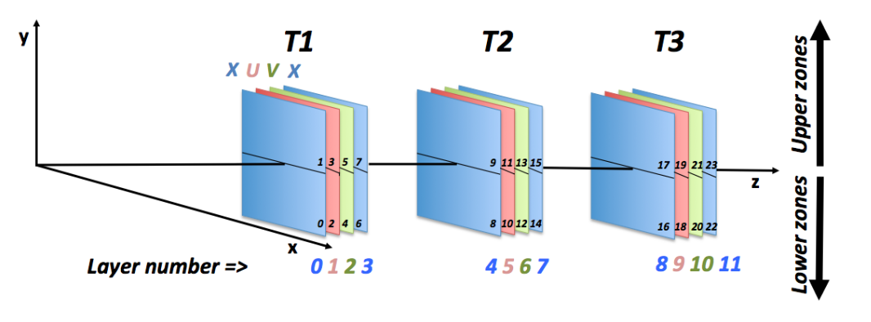
Track model and track fit (2)

Slide 18
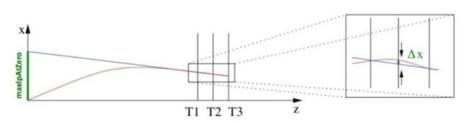
Collecting hits in x-layers (1)
Defined the track model and fit, collection of hits in the x-layers is the first step and more important of the algorithm, which follows the next steps:
As no input tracks from VELO are used, an assumption of the track origin is made. In order to accomplish it, there is a parameter (maxIPAtZero) used to define the maximum and minimum straight lines connecting the hit to the z = 0 plane.
By the equation defining these straight lines, it is possible to extract the maximum and minimum hits in the latter layer. This range is latter used to collect all hits inside a defined tolerance between the first and last as they are considered potential hits of the entire track.
Given the collection of hits, a third hit is searched to define a parabola between the first, last and middle layers, which is latter used to define the search window to locate the remaining hits in all the remaining layers.
For each layer, only one hit is added inside the defined search window, in case of finding more than one hit, the one with the least distance to the parabola is taken.

Slide 19
Collecting hits in x-layers (2)
The procedure mentioned is repeated 3 times. As there are cases where there are no hits in layer 0 or 11 (the clones generated by this procedure are removed).
First assuming, layer 0 is the first one and 11 the last one.
Secondly layer 3 as first and 11 last.
Finally layer 0 as first and 8 last.
Once the sets of hits are obtained, a fit is performed to each set of hits (using a polynomial of second order). In case the fit is not successful, the worst hit is removed, and a new fit is repeated until it becomes successful.
The search of hits in the x-layers is the most time-consuming step and takes about 88% of the Seeding time processing.

Slide 20
Adding Stereo hits
The above procedure only considers hits in the x-layers, as such, the stereo layers (u/v-layers) must be added to construct a whole track.
Based on a defined interval it calculates the predicted x coordinate of the track candidate at the z layer. Which later performs, based on a tolerance and angle values, the selection of hits that complies with the requirements.
Once the hits have been selected, the fit is performed again, this time using also the stereo hits, and the same criteria as before (worst stereo hit removal for failed fits, clone's removal), are applied to select the best track candidate.

Slide 21
Converting the hit collections tracks
Each track produced by a charged particle going through the LHCb detector is described in 5 parameters:
Position (x,y)
Track slopes (tx = dx/dz, ty = dy/dz)
Momentum
So in order to complete all the parameters for each track candidate, these are passed to the PrGeometryTool, which the main purpose of this algorithm is to evaluate the momentum of these tracks, which is the last thing to complete.
This evaluation is done using an empirical model which models the behavior of the tracks in the LHCb magnetic field.
After the evaluation, these tracks are latter converted into the standard object (LHCbTrack) used in the LHCb track reconstruction.

Slide 22
References
May 22, 2006, Frontier Detectors for Frontier Physics, Elba, 2006. Jeroen van Huenen 5LHCb Tracking - http://lhcb-doc.web.cern.ch/lhcb-doc/presentations/conferencetalks/postscript/2006presentations/VanHunen_Elba.pdf
Tracking system, https://lhcb-public.web.cern.ch/lhcb-public/en/detector/Trackers2-en.html
Trigger System: Present and Future, http://iopscience.iop.org/article/10.1088/1742-6596/623/1/012003/pdf
SciFi: A large Scintillating Fibre Tracker for LHCb, https://arxiv.org/abs/1710.08325
PatSeeding, https://twiki.cern.ch/twiki/bin/view/LHCb/PatSeeding
The Seeding tracking algorithm for a scintillating fibre detector at LHCb, https://cds.cern.ch/record/1641928/files/LHCb-PUB-2014-002.pdf

