Slide 1

Computer Graphics
Project 1
3D Scene
Artur De Vlieger Lima - 13671574
Gabriel da Costa Merlin - 12544420

Slide 2
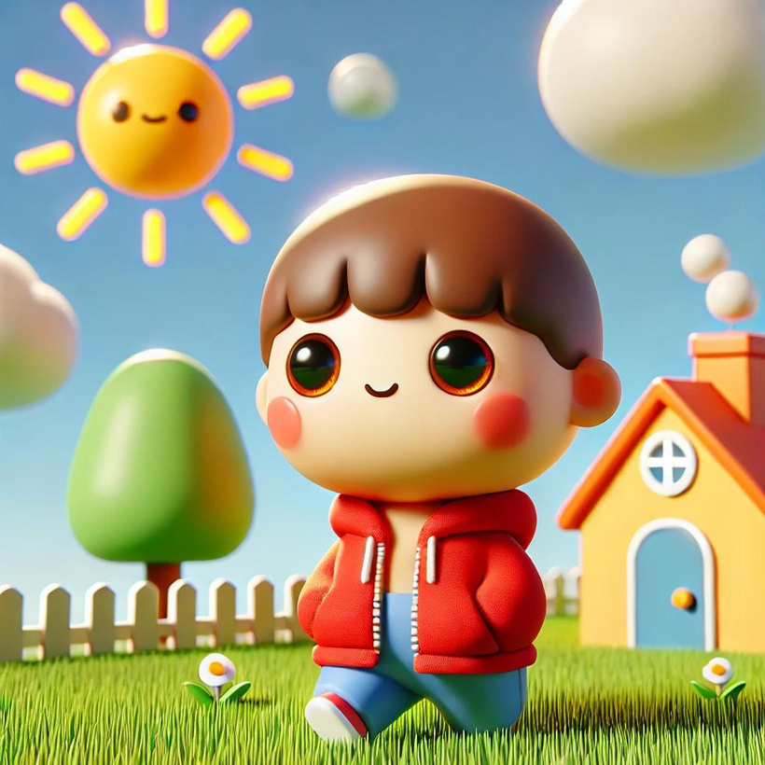
Idea
Chat-GPT version of our drawing

Slide 3
How to run
More detailed in GitHub
Miniconda (Python 3.9)
Numpy 2.0.1
GLFW 2.7.0
OpenGL 3.1.7
Problems with Wayland

Slide 4
Modules
What each file does
main
config_screen
keyboard
geometric_transf
shapes
vertexes
drawings

Slide 5
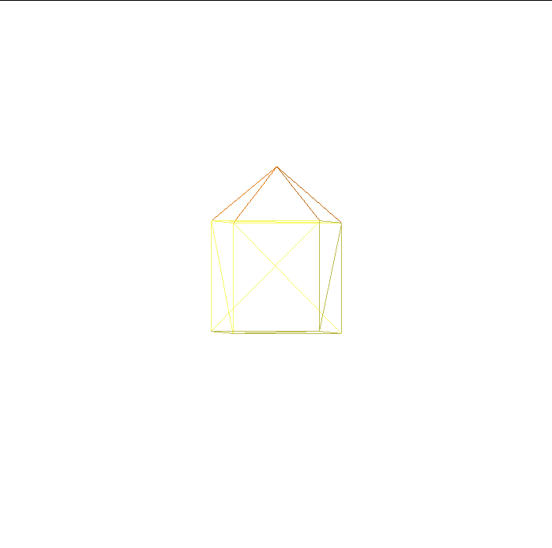
Objects
House

Slide 6
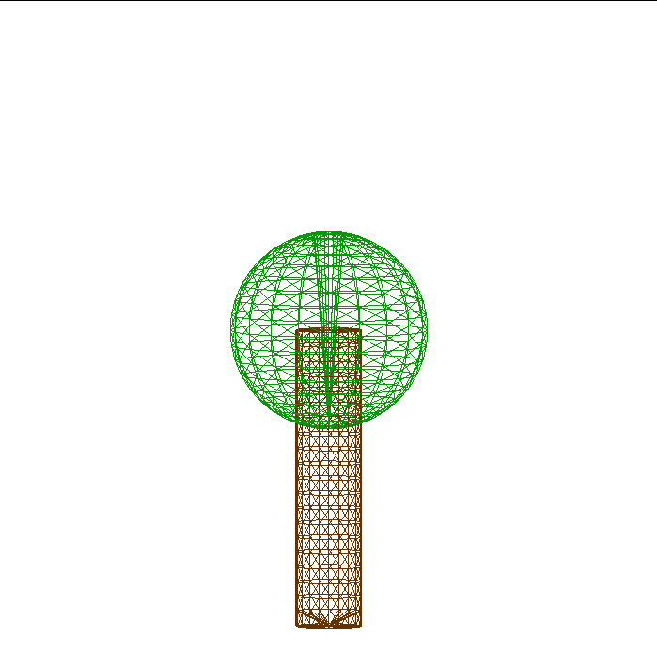
Objects
Tree

Slide 7
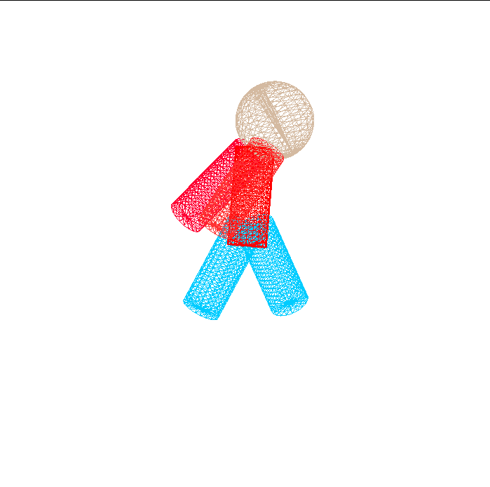
Objects
Person

Slide 8
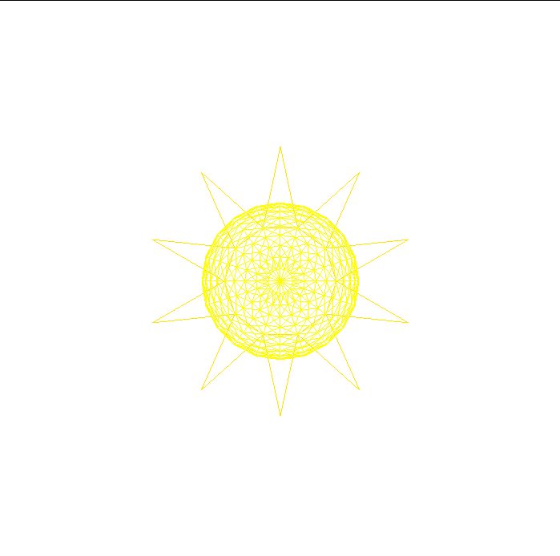
Objects
Sun

Slide 9
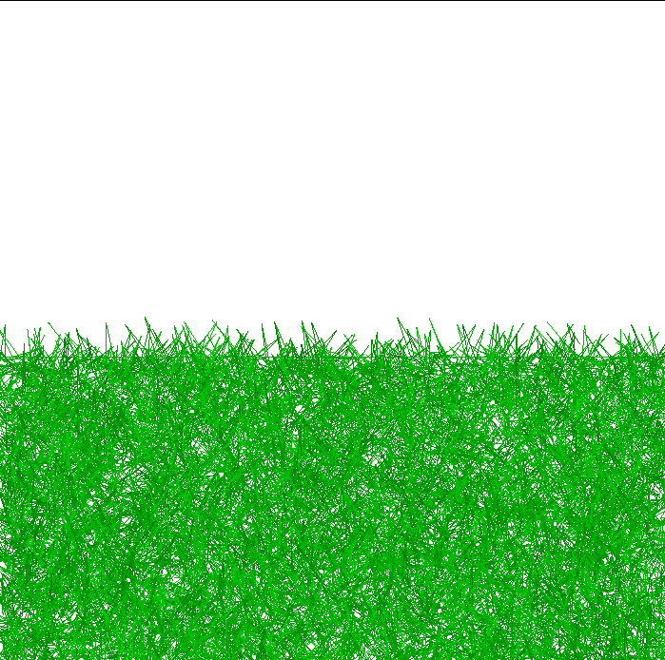
Objects
Ground

Slide 10
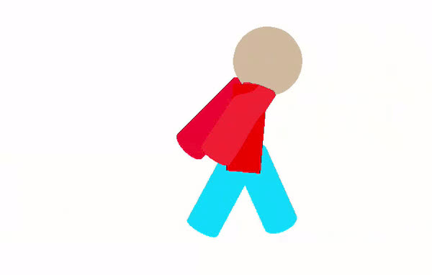
Geometric Transformations
Translation

Slide 11
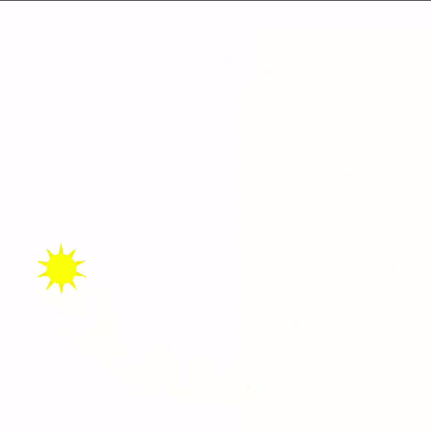
Geometric Transformations
Rotation

Slide 12
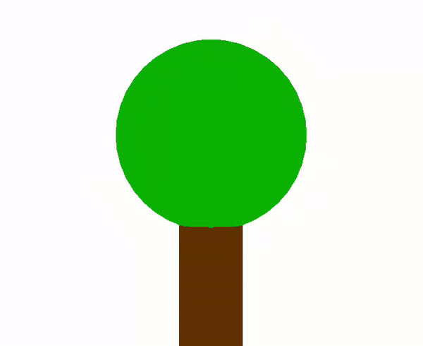
Geometric Transformations
Scale

Slide 13
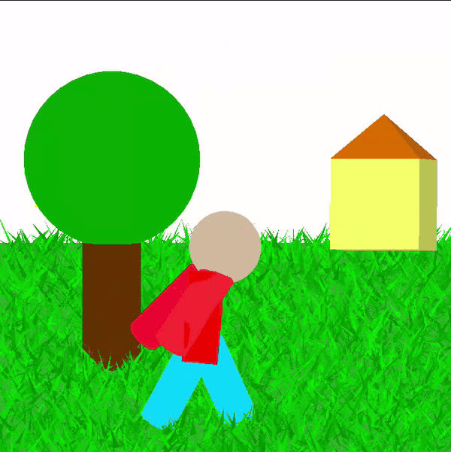
Thanks!

