Slide 1
LiRo Machine-Learning Romanian NLP Hackathon
Presentation by AYAYA:
- Constantin Gabriel-Adrian
- Sociu Daniel

Slide 2
Task description
There were multiple tasks to choose from at this hackathon:
Named Entity Recognition
Emotion Detection from Tweets
Semantic Text Similarity
Sentence Segmentation
Diacritic Restoration
We chose task 1 - NER as our task and began the exploration of the dataset

Slide 3
Dataset exploration
The dataset that we had to use for this task was RONECv2. It contains sentences tat are splitted into tokens (usually words on punctuation symbols). Each of these tokens can be part of a certain class represented in BIO2 format (B-class, I-class, O class). The classes that we hat to work it were:
Thus, taking into consideration the BIO2 format, the model must predict 31 classes.
PERSON | GPE | LOC
ORG | LANGUAGE | NAT_REL_POL
DATETIME | PERIOD | QUANTITY
MONEY | NUMERIC | ORDINAL
FACILITY | WORK_OF_ART | EVENT

Slide 4
Main approach
Considering the fact that we have to solve a token classification task into categories we had a few main steps to follow:
We obtain the embeddings for each token to later on use a classifier to properly classify them.
Train a transformer model for the classification of our embedded tokens
Predict on the test data
Therefore in the following slides we will present some implementation details and the obtained results.

Slide 5
BERT
To train the classifier, we must process the tokens such that the data will be represented in numerical form. Thus, we used BERT transformer to transform the tokens because:
Takes into account the context of the sentence
It's pretrained on a dataset of considerable size (15GB – the Romanian variant)

Slide 6
Step by step implementation of solution
Input token size of 128 ( + padding if necessary)
Replaced special characters via regex (such as “\n” with “n”)
Implemented main model class with functions for train/test/split
Implemented dataset classes in orter to instantiate dataloaders
Mitigated unbalanced dataset problem
Loaded the pretrain model with AutoModelForTokenClassification(bert-base-romanian-cased-v1)
Training & prediction using feature extraction

Slide 7
Tokenization & padding
Considering we have sentences of different lengths (number of tokens), and that we are using a transformer, we have to make each sentence a specific length.
We decided to have each sentence with 128 tokens, therefore we either split it (if it is longer) or we pad it.
To be mentioned that the tokenizer used splits some tokens with multiple sub-tokens, which should not be learned by the transformer, therefore we assigned them a special label (-100).

Slide 8
Mitigation of the unbalanced dataset problem
The number of token occurences for each class varries vastly. There are big differences between them that will introduce a bias in the model. Below we can see the distribution of classes:
In order to counter balance this, we used compute_class_weight from sklearn to assign weight to each class when computing the loss function
Class | Occurences
PERSON | 19167
GPE | 8193
LOC | 1824
ORG | 5688
LANGUAGE | 342
NAT_REL_POL | 3673
DATETIME | 6960
PERIOD | 862
Class | Occurences
QUANTITY | 1161
MONEY | 1041
NUMERIC | 5734
ORDINAL | 1377
FACILITY | 840
WORK_OF_ART | 1157
EVENT | 826

Slide 9
Training and validation
The training and evaluation of the model was done in 10/15 epochs.
Using the dataloader the data was split in batches of size 64.
For the evaluation we used a validation set given by them.
As transformer model we used BERT pretrained on the romanian language, upon which we made some modifications

Slide 10
Training via Feature extraction
Given the fact that the aforementioned model was trained on an entirely different task & dataset, we had to faind a way to adapt it to out challenge.
Thus, in the literature there are 2 main approaches:
Continue model training using the pretrained weights as the starting point
Feature Extraction – freeze embedding layers in order to preserve model’s capacity to represent feature’s data in latent space
We explored the option of retraining some layers (mainly classifier layers) of the model in order to fine-tune our soultion.

Slide 11
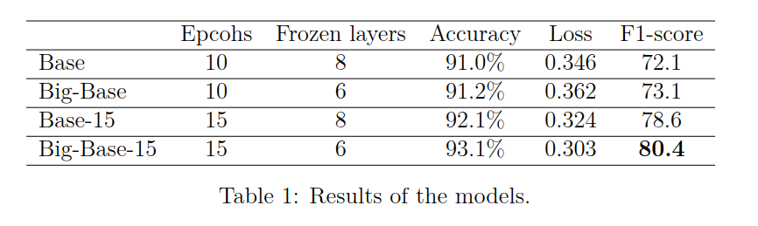
Final results

Slide 12
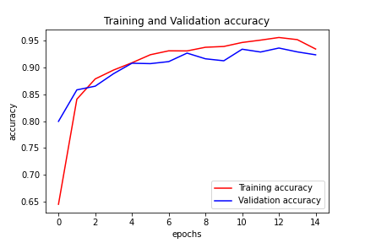
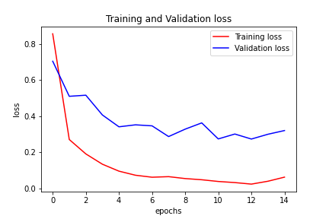
Accuracy and loss

Slide 13
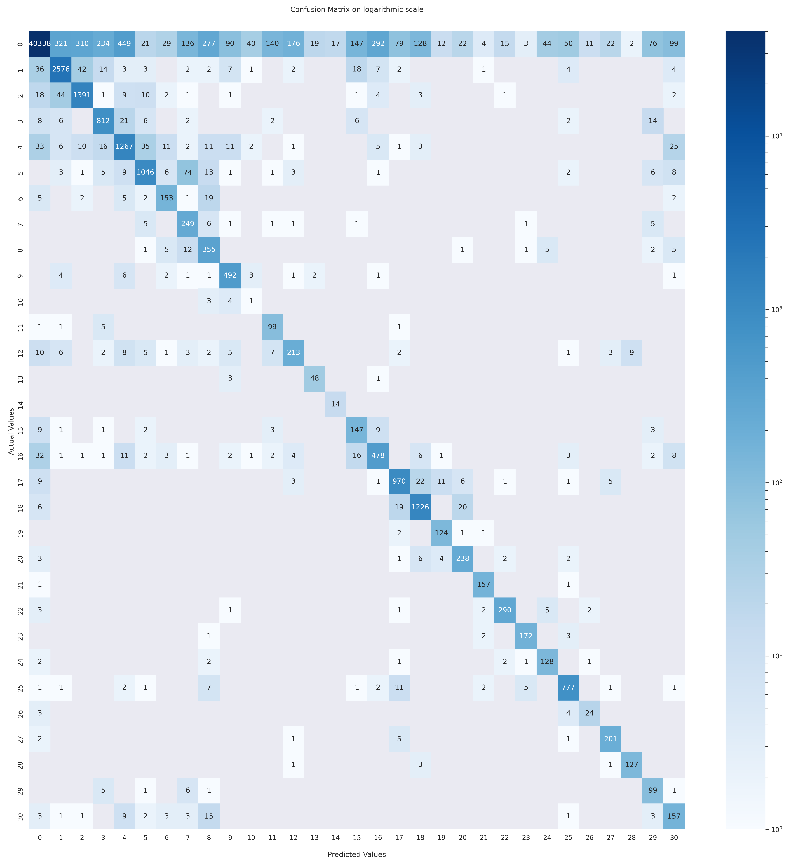
Confusion matrix

Slide 14
Thank you !

