Slide 1
Quiz1Book
File created on: 11/18/2023 10:09:56 PM

Slide 2
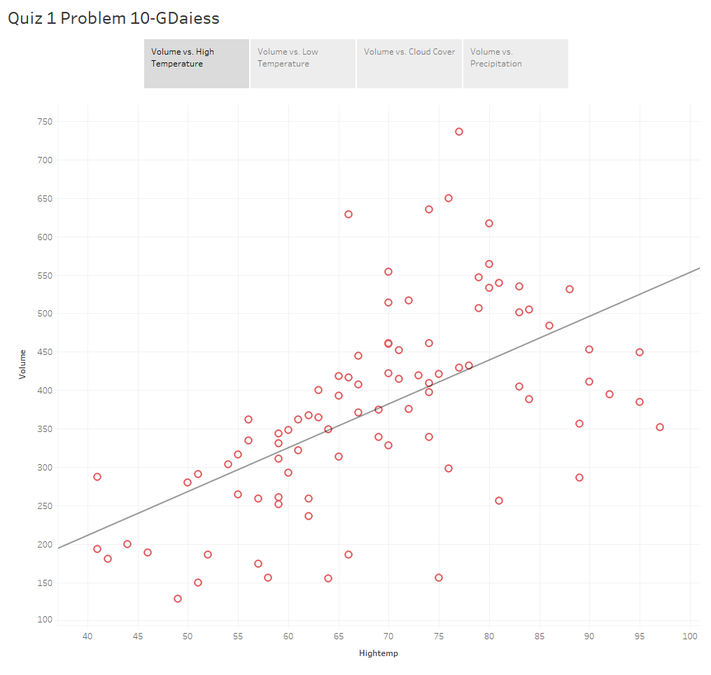

Slide 3
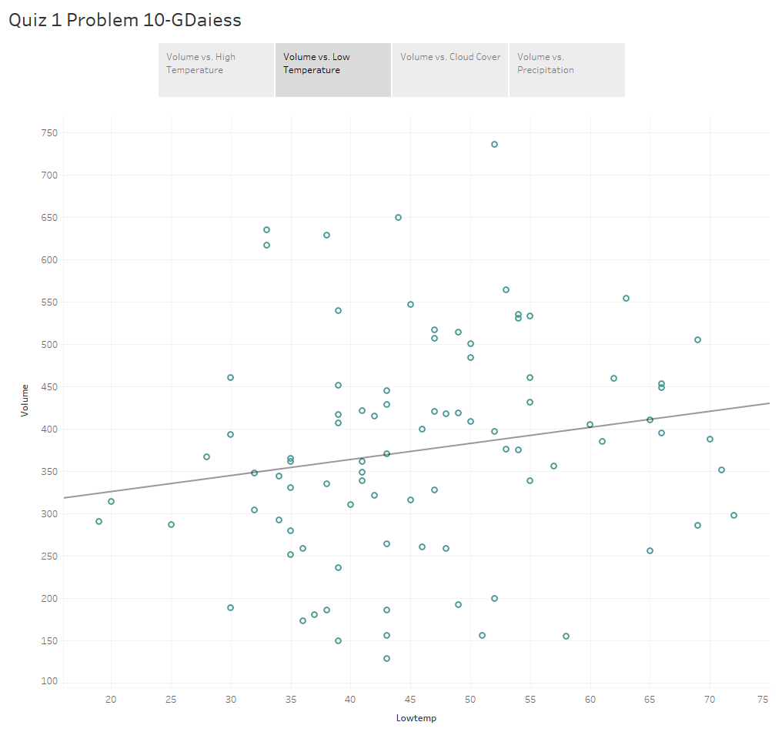

Slide 4
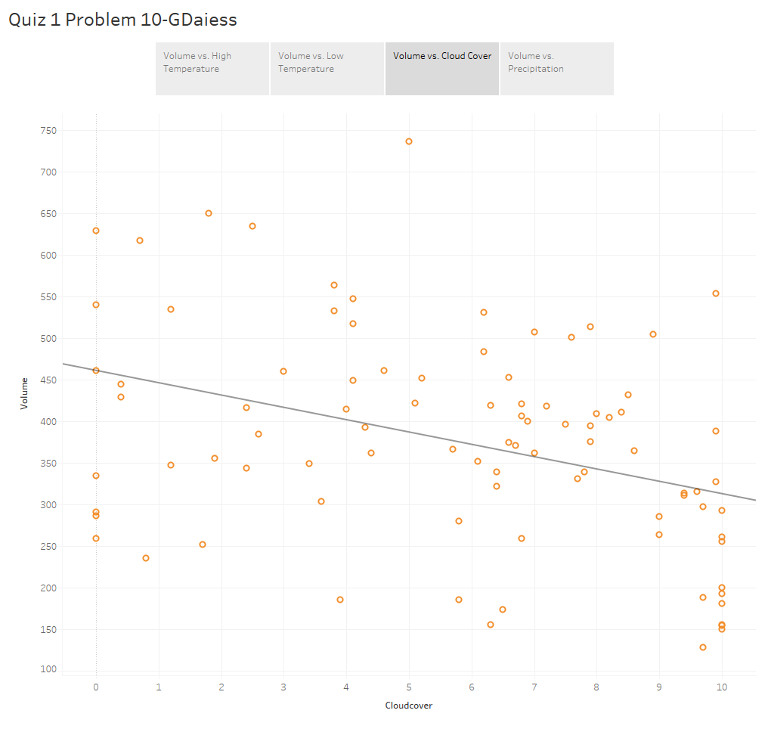

Slide 5
