Slide 1

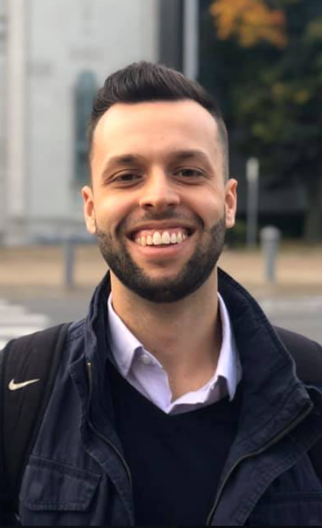
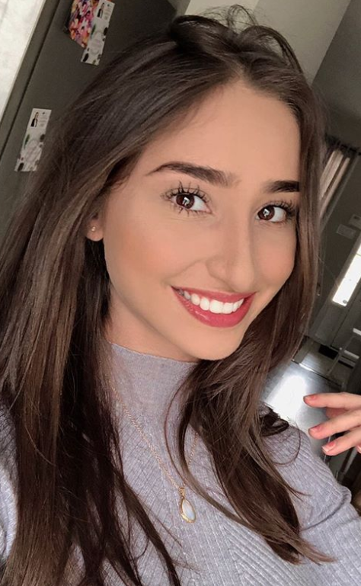
OOP 3200
Object-oriented Programming II
C++ Lab 5 – Standard Template Library
Gabriel Dietrich
100764733
Fleur Blanckaert
100747083

