Slide 1

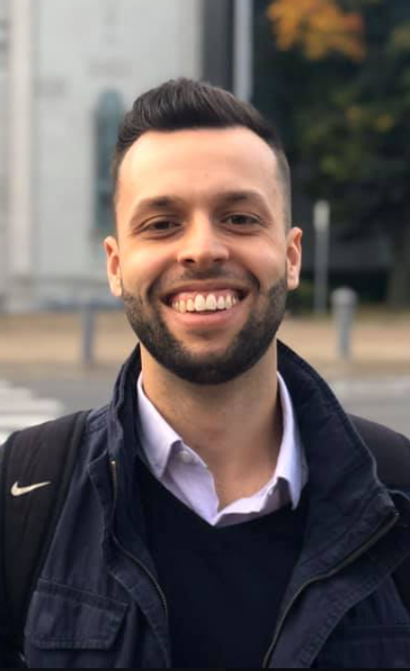
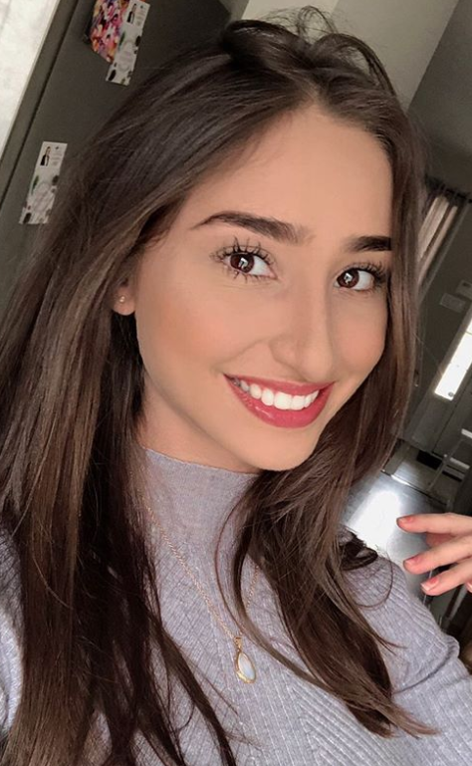
OOP 3200
Object-oriented Programming II
Java Lab 2 – Classes
Gabriel Dietrich
100764733
Fleur Blanckaert
100747083

