Slide 1




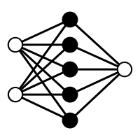


Inputs
\
Markov Chain Monte Carlo
Outputs
Sequences
Inference
Estimates
Phylodynamic priors
Phylodynamic parameters
Weights prior
BELLA
Weights
Interpretation
Predictors
generalizes
GLM
Time
Skyline

