Slide 1
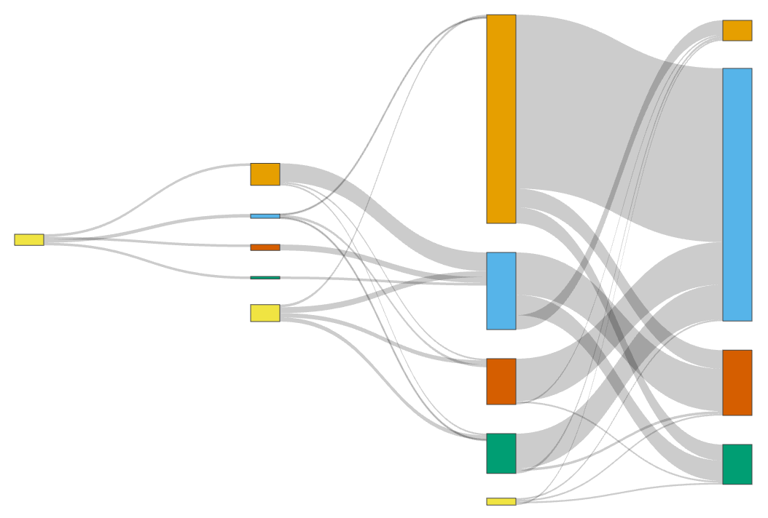
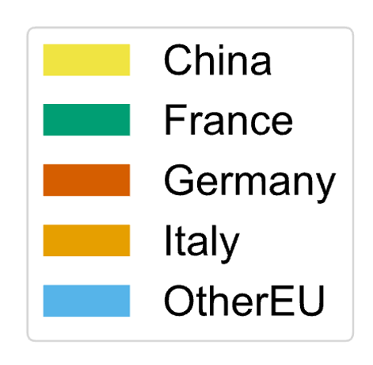
= 50 migration events
05-01-2020
26-01-2020
16-02-2020
08-03-2020

