Slide 1





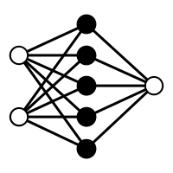



4
\
Inputs
Markov Chain Monte Carlo
Outputs
Data
Inference
Estimates
Phylodynamic priors
Phylodynamic parameters
Time
BELLA
Interpretation
Predictors
GLM
Weights prior
Weights

