Slide 1
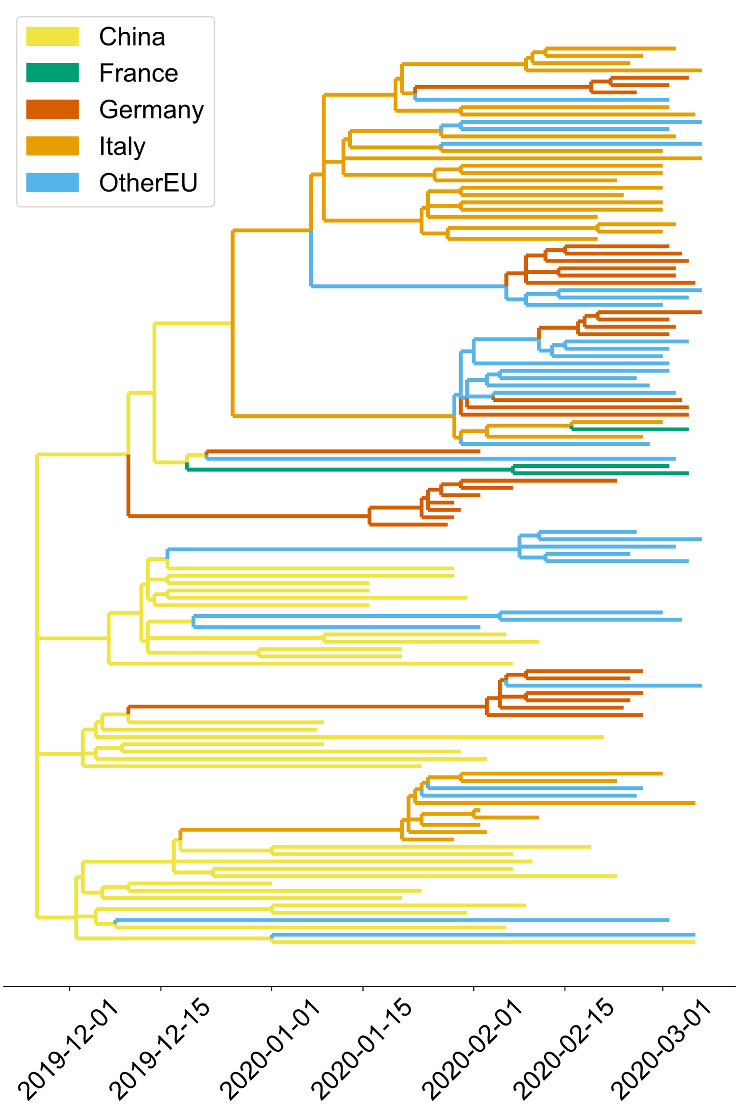
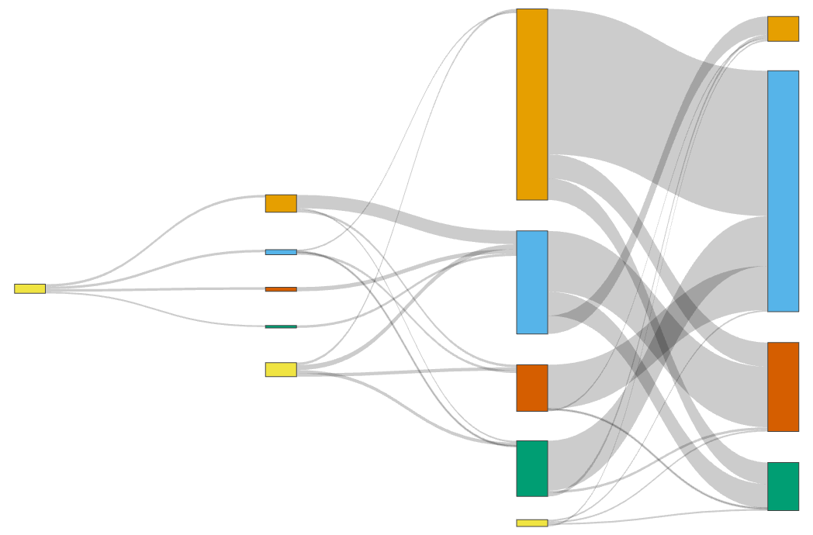
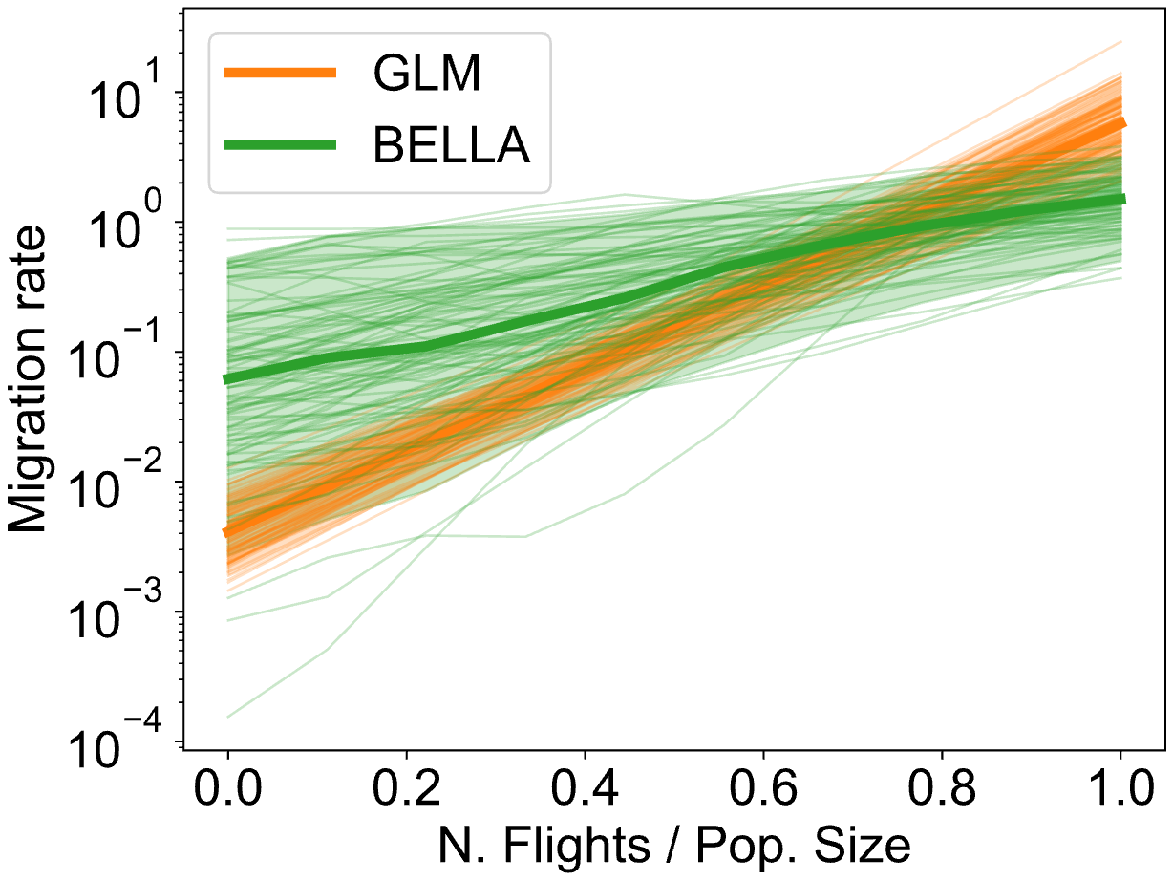
Transmission tree
Migration fluxes
= 50 migration events
05-01-2020
26-01-2020
16-02-2020
08-03-2020
PDPs

