Slide 1
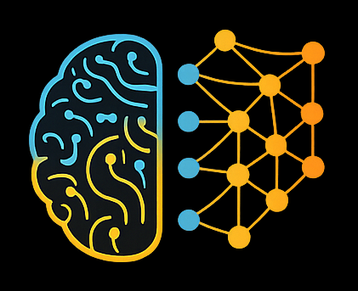

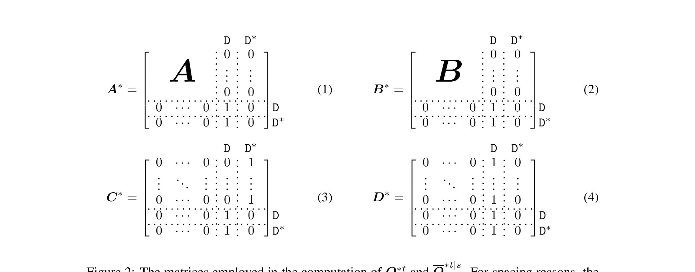
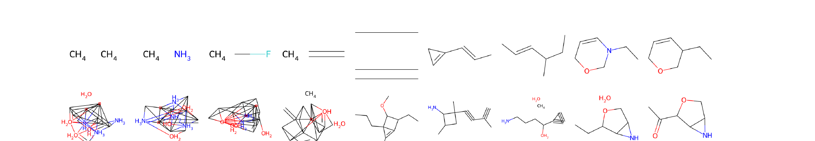
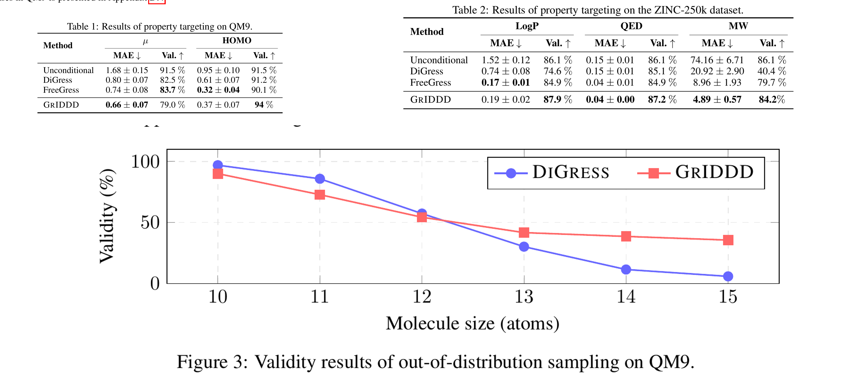
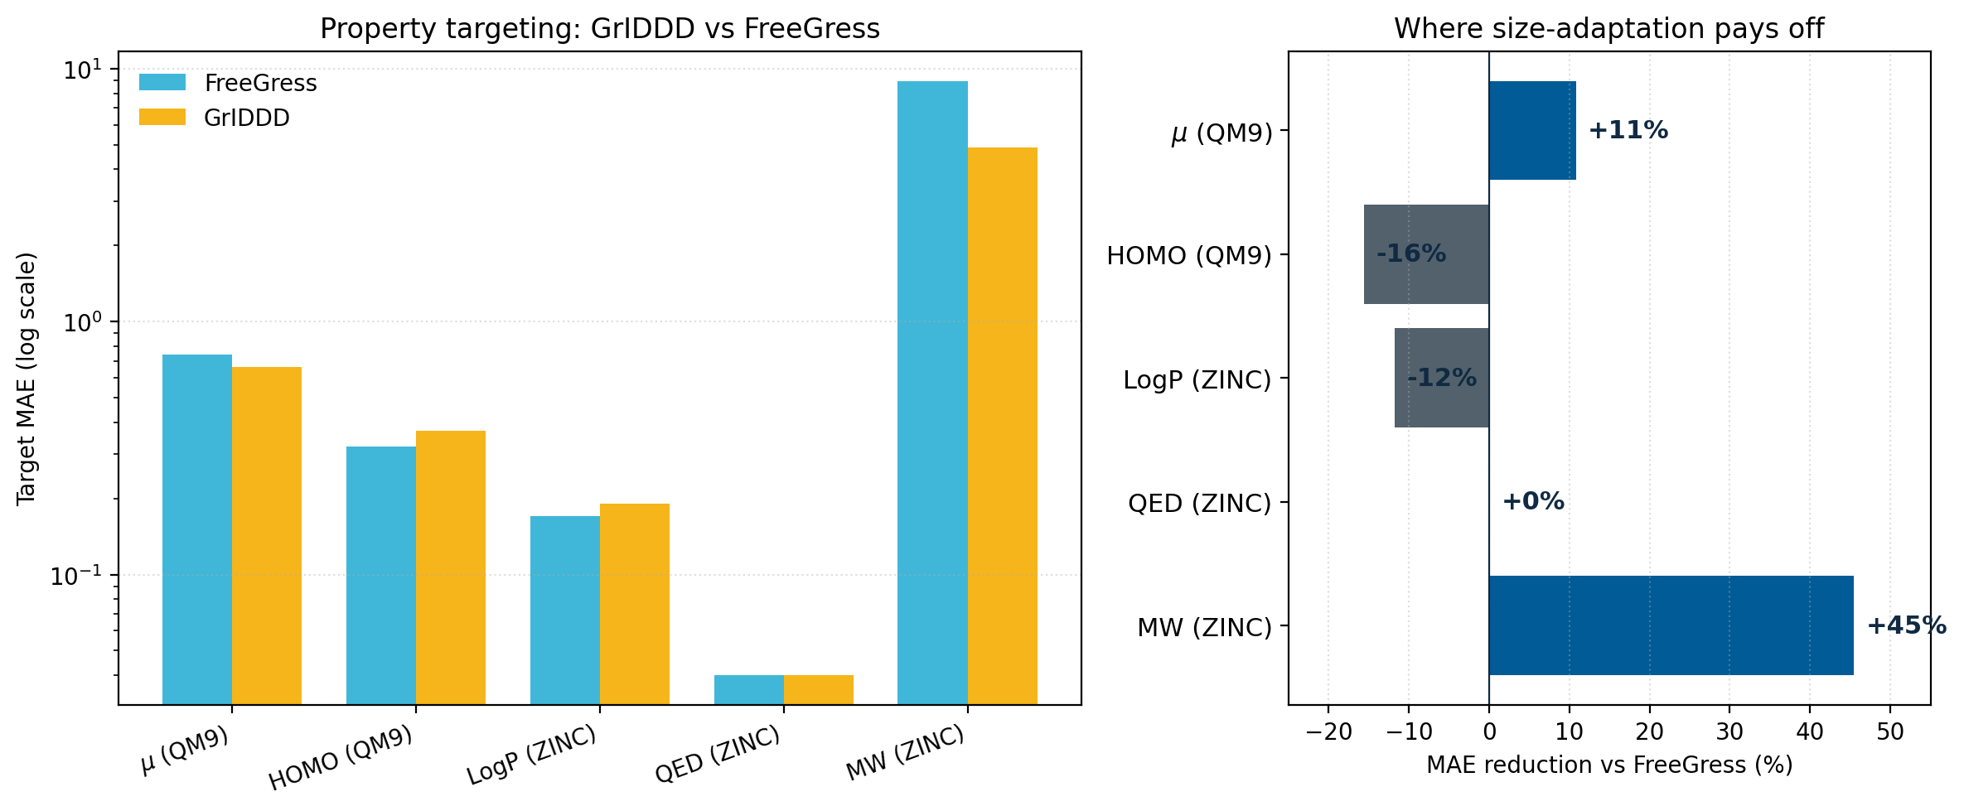
GrIDDD: Graph Diffusion
that can Insert and Delete
Author Name 1 · Author Name 2 · Author Name 3 · Author Name 4
Generative and Deep Learning Course 2025/2026 - University of Pisa
1. Introduction
2. Approach
Why fixed-size graph diffusion is a bug for property-driven molecular design.
Discrete diffusion on graphs, generalized to monotonic node insertions and deletions.
Task.
Generative graph DDPMs for de-novo molecular design — two settings: property targeting (generate molecules with prescribed properties) and property optimization (edit a molecule to improve a target property).
The fixed-size limitation.
All existing graph DDPMs (DiGress, FreeGress, MiDi) keep the atom count fixed throughout diffusion. This breaks down when the target property correlates with molecular size (MW, QED). Pre-sampling the size from a classifier does not help in optimization, where the size is part of what must change.
Contribution.
GrIDDD is the first discrete graph DDPM that monotonically inserts and deletes nodes during both forward and reverse processes — size-adaptive molecular generation. Matches or beats SOTA on targeting; substantially outperforms specialized optimizers.
Setup.
Molecule = graph G = (X, E): one-hot atoms X, one-hot bonds E (no-bond as a category). Discrete DDPM under classifier-free guidance on a property y.
Three forward regimes (Δ^T = n^T − n^0).
• Δ^T = 0 → standard DiGress / FreeGress.
• Δ^T < 0 → absorbing DEL + transient DEL* (DEL* can revert to a real type in reverse → enables reinsertion).
• Δ^T > 0 → nodes appear at sampled timesteps with type drawn from the empirical marginal m_X.
Insert/delete times follow a logistic ζ'(t) with center D, steepness w.
Reverse — two networks + loss.
Main net predicts (X^0, E^0) + activation time ŝ per node. Aux g_φ predicts how many DEL* to inject at step t.
L = λ_X·CE_X + λ_E·CE_E + λ_S·CE_S + λ_DEL·CE_DEL (eq. 10). Conditional dropout with prob. ρ.
Fig. 1 — qualitative behavior of GrIDDD on QM9.
Top: 2-atom latent → +6 atoms inserted. Bottom: 18-atom latent → −9 deleted. Graph size adapts dynamically during denoising.
Fig. 2 — augmented transition matrices A*, B*, C*, D*.
Three forward regimes (Δ^T = 0, < 0, > 0). Auxiliary DEL* state allows reinsertion during reverse; g_φ predicts how many DEL* to inject at each step.
3. Experiments
4. Personal considerations
Property targeting, property optimization, and out-of-distribution sampling.
What we take from this work and how it relates to the course.
Setup.
QM9 + ZINC-250k. T = 500 steps. Guidance λ = 3 (QM9) / 2 (ZINC).
Property targeting (MAE ↓).
• QM9 μ: 0.66 — best (FreeGress 0.74, DiGress 0.80).
• ZINC MW: 4.89 vs 8.96 — nearly halved (size matters).
Property optimization (Jin et al.).
• QED success: 45.1% vs 9.4% GCPN (≈ 5×).
• LogP improvement: 2.70 vs 2.49 GCPN.
OOD + ablation.
At size 15 (training cap 14): GrIDDD 35% valid, DiGress ≈ 0%. Disabling insert/delete drops QED 45.1 → 33.8 — confirms size adaptation is the source of the gain.
Strengths.
Minimal extension (DEL + transient DEL*) unlocks variable graph size. Gains are largest where size matters (MW, QED); marginal elsewhere.
Weaknesses.
Two networks can conflict on the same step. More disconnected molecules than FreeGress / DiGress. ~30% training overhead.
Course connection.
Discrete DDPMs (GDL27) × graph message passing (GDL19–22). Denoiser is a graph transformer. Pushes diffusion past its fixed-dimension assumption.
Open questions.
• Can g_φ be folded into the main net?
• Generalize beyond molecules (e.g. floor plans)?
Tables 1–3 + Fig. 3 — consolidated results.
Property targeting (QM9 + ZINC) · property optimization on ZINC · OOD validity at 15 atoms.
Where size-adaptation pays off (MAE reduction vs FreeGress).
MW: −45% MAE · μ: −11% · QED ≈ flat · HOMO/LogP slightly worse. Gains track size-dependence of the property — confirming the design hypothesis.
Ninniri M., Podda M., Bacciu D. — Graph Diffusion that can Insert and Delete — NeurIPS 2025 — arXiv:2506.15725 — code: https://github.com/mninniri/GrIDDD
Generative and Deep Learning Course · University of Pisa

