Slide 1
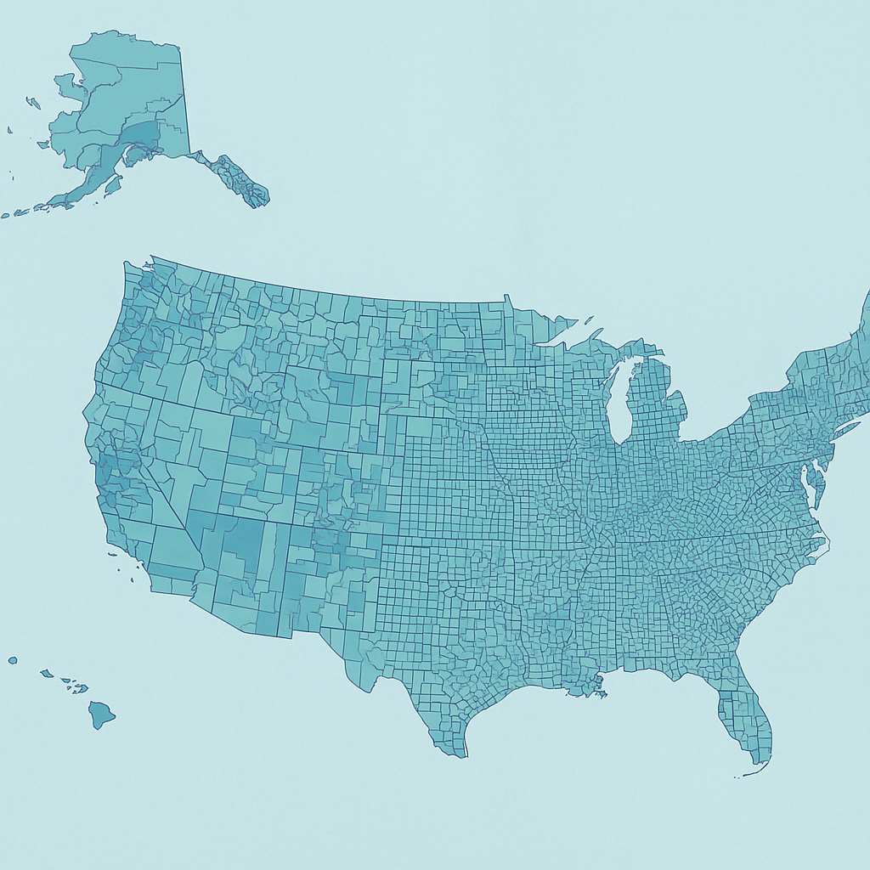

Understanding Income Drivers in the US Population
Uncovering actionable insights
07-04-2025
Gabriele Coli

Slide 2


The Task
Every ten years, the census is conducted to collect and organize information regarding the US population with the intention of effectively allocating billions of dollars of funding to various endeavours.
Additionally, the collection of census information helps to examine the demographic characteristics of subpopulations across the country.
Help policymakers identify groups that are more or less likely to earn >$50K, to guide economic support strategies.

Slide 3

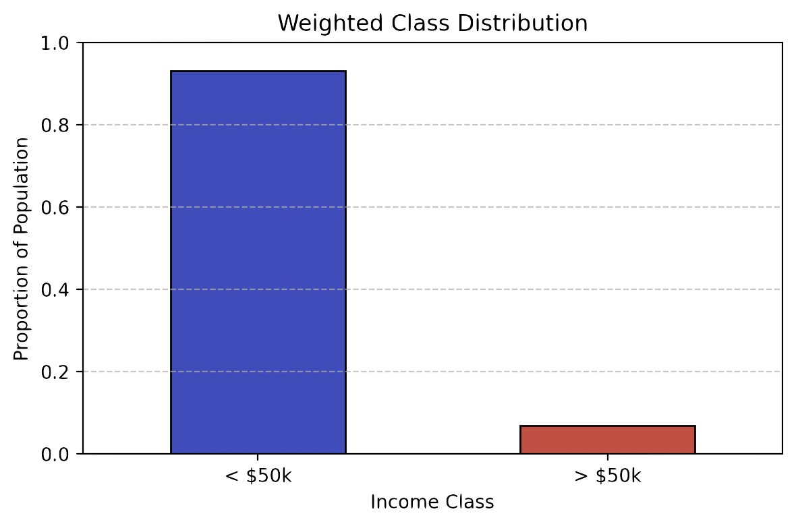


The Dataset
~300k anonymised individuals from US census, already split between training and test sets.
Features around age, education, occupation, citizenship, migration condition, sex, ethnicity, and more.
Collected with stratified sampling: each record has an associated weight.

Slide 4

Methodology Overview
Data Validation
(duplicates, data leakage, target mapping)
EDA
(bivariate and multivariate analysis, outliers, skewed distributions, dominant and rare classes)
Feature Engineering
(features encoding, new features, correlation-based selection)
Modelling
(multiple competing models, oversampling, hyperparameters tuning, validation metrics)
Explanations
(global feature importance, local feature importance)
Actionable Insights

Slide 5
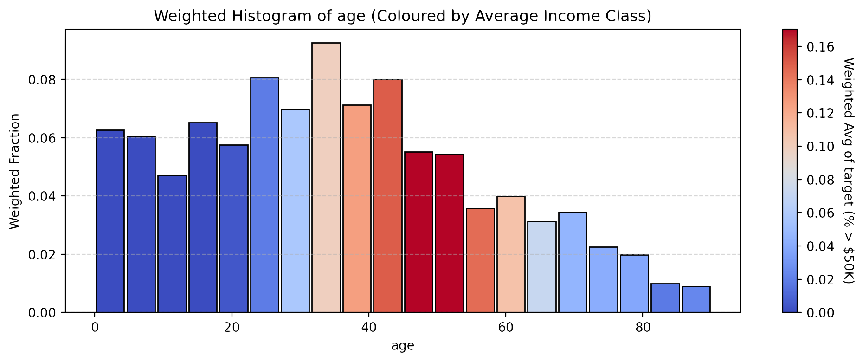
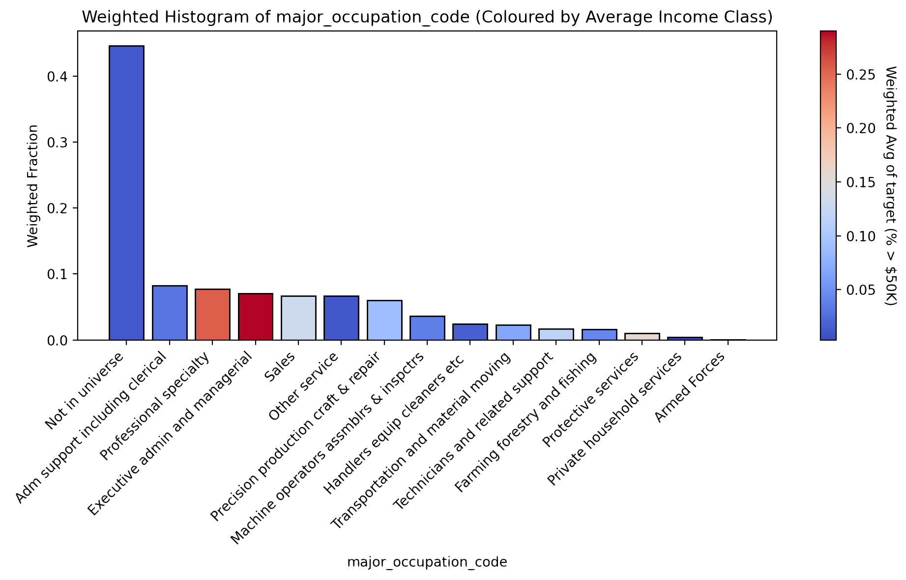
Key EDA Insights
Average target greatly varies with age;
Occupation strongly correlates with income levels;
Investment activities does too, but shows a very skewed distribution;
Whether the individual is a male or a female also correlates with income levels.

Slide 6
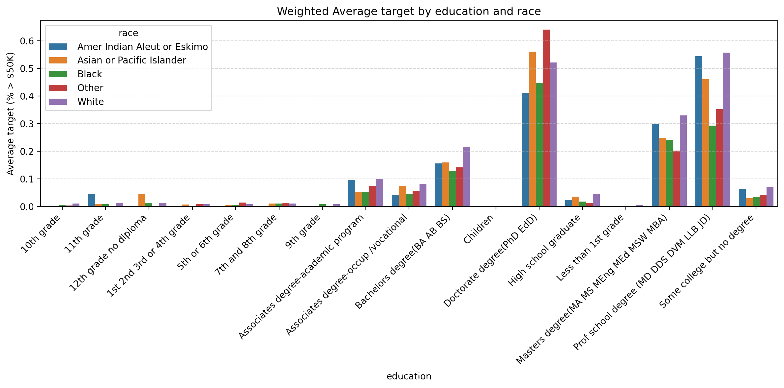
Key EDA Insights
Possibly the strongest predictor seems to be the education level of the individual. The multivariate analysis below simultaneously shows an income level disparity based on individual’s ethnicity.

Slide 7


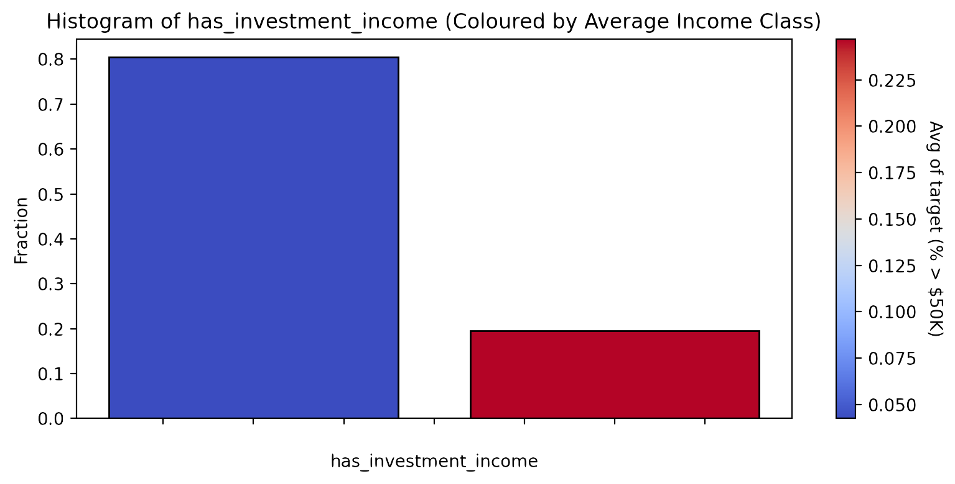
Data Preparation (numerical)
Feature | Distribution | Predictive Power | Action
Age | Balanced | High | Keep + Group
Capital Gains | Skewed | High | Bool + Group
Veterans Benefit | Unbalanced | Low | Drop
False
True

Slide 8
Data Preparation (nominal)
Feature | Dominance | Cardinality | Predictive Power | Comments | Actions
Education | 26% | 17 | Strong | There is an existing order of values | Ordinal Encoding
Occupation Code | 44% | 15 | Strong | Frequency correlates with target | Frequency Encoding
Hispanic Origins | 88% | 10 | Medium | Natural way of grouping some of the values | To boolean
Tax Filer Status | 35% | 6 | Medium |  | One-hot encoding
Previous Residence in Sunbelt | 49% | 4 | Weak | Many NaNs | Drop
Enrolled in education programme | 93% | 3 | Medium | Redundant | Drop

Slide 9
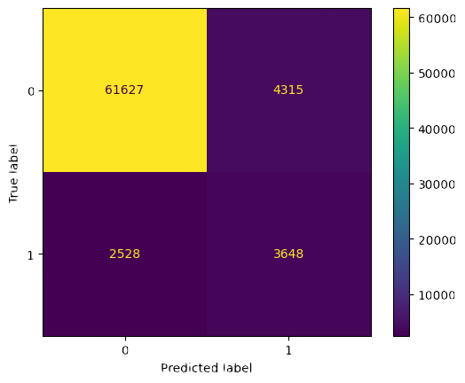
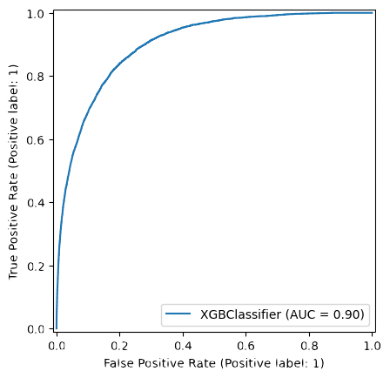
Modelling Approach & Results
Given the resulting feature matrix, we tried several models and parameters, and ultimately we made the following modelling choices:
Oversampling of the minority class: given the strong class imbalance, we need to force the model to weight more the high income records in order to learn meaningful patterns.
XGBoost Classifier: notoriously high-performance model, particularly suited for a mix of numerical and categorical features.

Slide 10

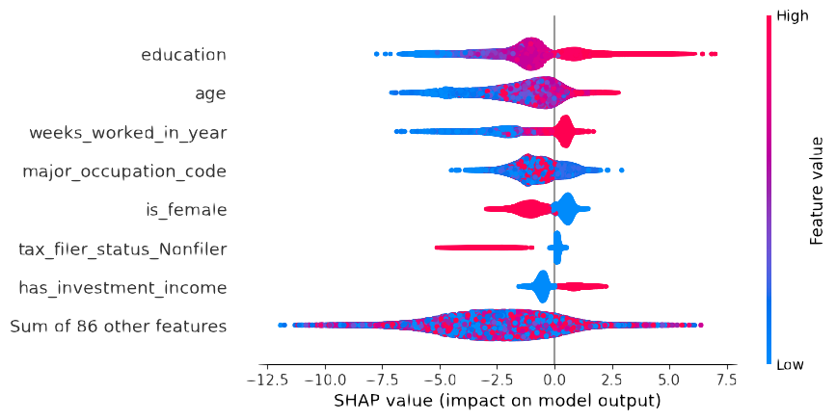


Feature Importance: Key Drivers
The key driver for income level is education above all. The specific occupation of an individual, together with her investment activities and her sex also strongly contribute.
When it comes to characterising the profile of an individual with high income, age and tax filer status are also crucial predictors, but it’s important to be mindful of the causality relationships here.
Other less crucial drivers are the ethnicity of the individual, her potential Hispanic origins, and the birth country of her parents.

Slide 11
Feature Importance: From Modelling to Policy
The key driver for income level is education above all. The specific occupation of an individual, together with her investment activities and her sex also strongly contribute.
Education accessibility could radically improve economic outcomes for certain subpopulations.
Increase funding or access to adult education and degree-completion programs, especially in underprivileged areas.
Invest in mid-career upskilling programs to maintain productivity and income levels as the population ages.
Design financial literacy and investment education programs, especially for underserved communities.
Align workforce development initiatives with high-paying industries.
Promote inclusive hiring and pay transparency initiatives.
Promote initiatives to reduce the gender income gap, such as improving access to affordable childcare.
When it comes to characterising the profile of an individual with high income, age and tax filer status are also crucial predictors, but it’s important to be mindful of the causality relationships here.
Other less crucial drivers are the ethnicity of the individual, her potential Hispanic origins, and the birth country of her parents.

Slide 12
Limitations & Future Work
Limitations:
No residency geographical data: it would unlock tailored interventions in specific areas/states.
No information on family social class: it would enable a deeper understanding of social lift and its effectiveness.
Limited temporal data: not possible to assess temporal trends and policy outcomes.
Future Work:
Deep-dive in specific population segments and their correlation with income level.
Rigorous feature selection mechanism to enhance model predictions and explainability.
Automated HTML report generation from pipeline.
Pipeline robustness enhancement.
Causality study.

Slide 13
Questions?

