Slide 1
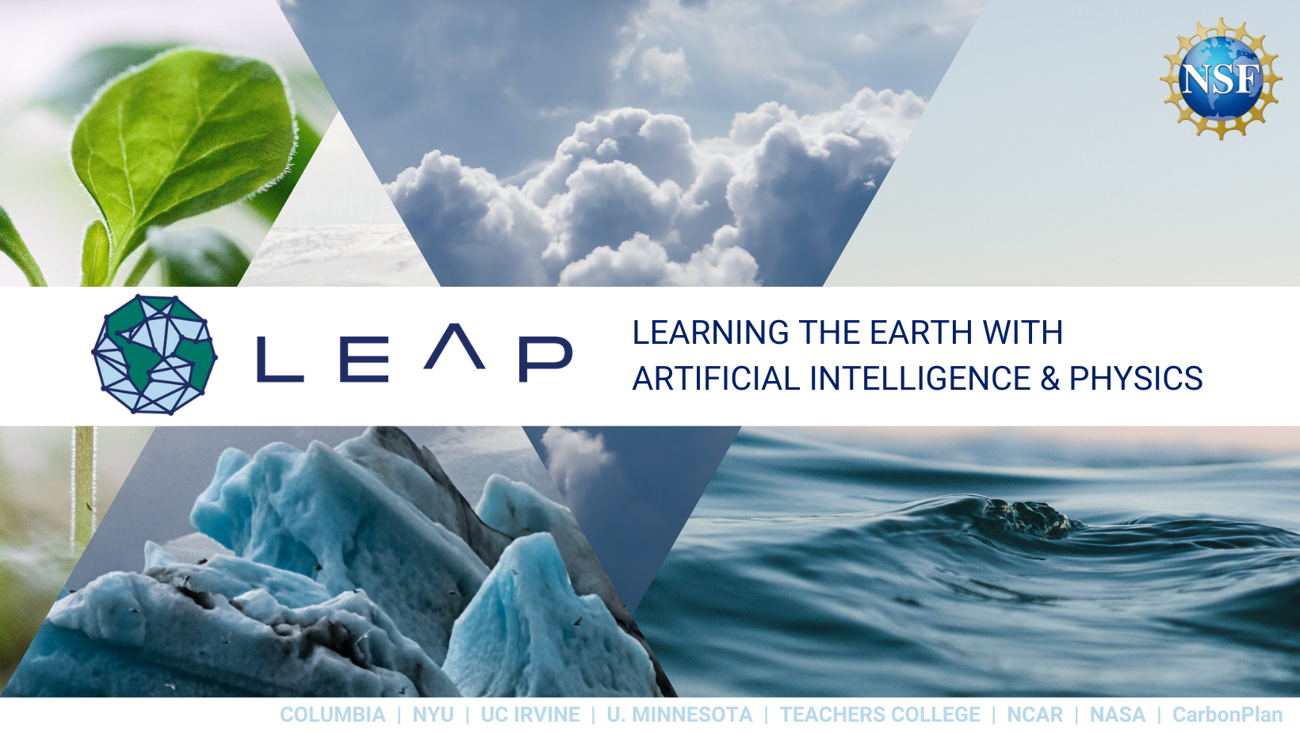
INTRODUCTION TO MACHINE
LEARNING AND NEURAL NETWORKS
LEAP Summer Bootcamp | Day 1

Slide 2




Schedule for the 2nd week of the Bootcamp
Gabriele Accarino
Columbia/LEAP
Day 1 & Day 2
Introduction to ML + ANNs
Matthiew Blanke
NYU/LEAP
Day 3
GenAI
Viviana Acquaviva
CUNY/Columbia/LEAP
Day 4
LLMs 4 Science

Slide 3
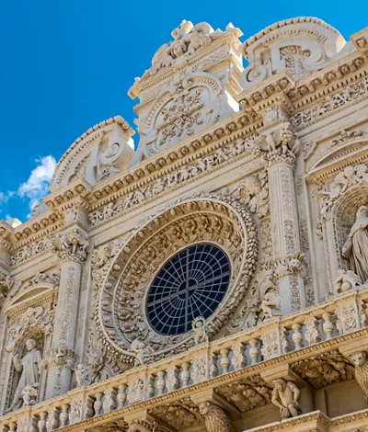

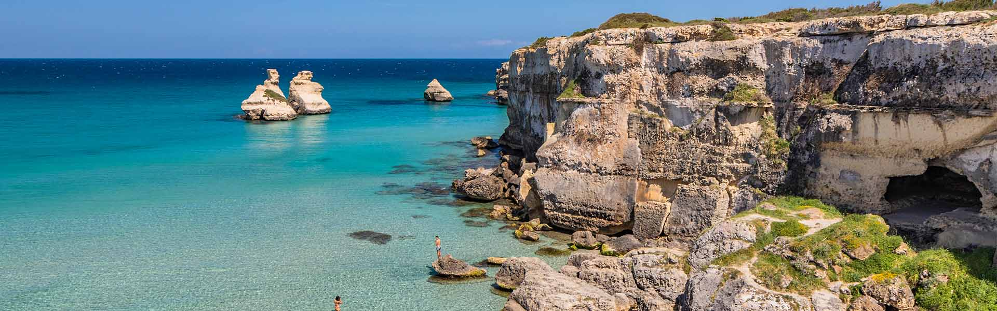
…Just a little bit more about me
Gabriele Accarino
Postdoctoral Research Scientist
Department of Earth and Environmental Engineering
Columbia University & LEAP NSF STC, New York, US
ga2673@columbia.edu
Background: Computer Engineering + Env. Science
Research Interests
ML emulators of physical systems
ML for extreme weather events detection
GenAI
From Lecce (Italy)
Also called “The Florence of the South”

Slide 4
Today's Agenda
What is Machine Learning? Definitions, types, and examples
Applications in Climate & Earth Science
Linear and Polynomial Regression
Cost function, Gradient Descent, Bias-Variance tradeoff
Perceptron and Artificial Neural Networks
PyTorch Framework

Slide 5
Machine Learning
Fundamentals
Definitions, types, examples, and pitfalls

Slide 6
Traditional Programming vs. ML
Traditional Programming
Machine Learning
Data + Program
↓
Computer
↓
Output
Data + Output
↓
Computer
↓
Program (Model)
Ref: Mitchell, T. (1997). Machine Learning. McGraw Hill.

Slide 7
What is Machine Learning?
The goal of machine learning is to extract useful information from data
and learn patterns that generalize to new, unseen examples.
Key idea
Given data samples (inputs x, outputs y), learn a model that maps x to y
The model is an input-output relationship learned from data
Even simple methods like linear regression are part of ML methods
x and y can be scalars, vectors, images, time series, or any combination

Slide 8
Supervised Learning
Learn from labeled data: each input $x$ comes with a known output (label) $y$.
Regression
Classification
Output is continuous (real-valued)
Predict precipitation amounts
Estimate sea surface temperature
Forecast wind speed
Output is discrete (categories)
Cloud type: convective vs. stratiform?
Is there a hurricane in this image?
Anomaly: severe weather event?
Both require labeled datasets: input features paired with known correct outputs.

Slide 9
Other Types of Machine Learning
Unsupervised Learning
Reinforcement Learning
Self-Supervised Learning
No labels. Learn structure, clusters, or compressed representations from data alone.
Examples:
• K-means clustering
• PCA for dimensionality reduction
• Anomaly detection
Learn through trial and error. Agent takes actions, receives rewards.
Examples:
• Optimizing renewable energy dispatch
• Adaptive weather forecast strategies
• Game playing (AlphaGo)
Create labels from the data itself. Bridge between unsupervised and supervised.
Examples:
• Predicting masked regions of satellite images
• Contrastive learning on climate fields
• Foundation models

Slide 10
ML Applications in Climate & Earth Science
Prediction tasks
Predict physical fields, e.g., temperature, precipitation
Classification tasks
Distinguish cloud types (stratiform vs. convective), detect Tropical Cyclones in climate maps
Object detection
Locate Tropical Cyclone center
Anomaly detection
Severe weather, heat waves
Subgrid-scale parameterization
Replace computationally heavy or uncertain parameterizations in numerical models with ML

Slide 11
Regression
Linear regression, cost function, gradient descent, and the bias-variance trade-off

Slide 12

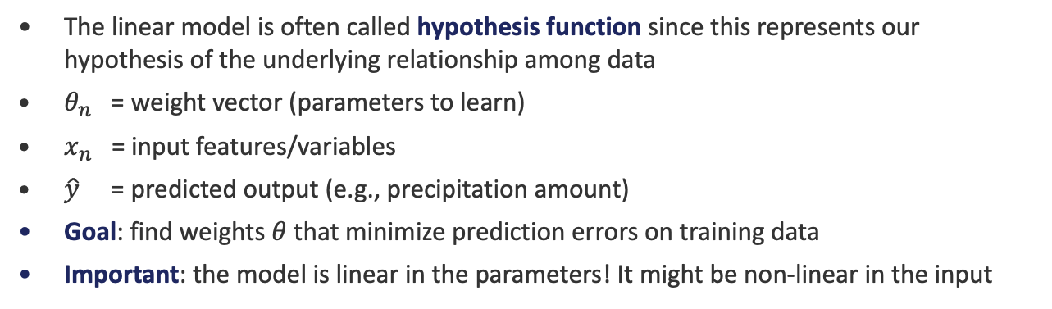
Linear Regression
The simplest ML model: fit a straight line to data.
Model
$$\hat{y}=h_{θ}\left(x\right)=θ_{0}+θ_{1}x_{1}+ ⋯ +θ_{n−1}x_{n−1}$$
The linear model is often called hypothesis function since this represents our hypothesis of the underlying relationship among data
$θ_{n}$ = weight vector (parameters to learn)
$x_{n}$ = input features/variables
$\hat{y}$ = predicted output (e.g., precipitation amount)
Goal: find weights $θ$ that minimize prediction errors on training data
Important: the model is linear in the parameters! It might be non-linear in the input

Slide 13
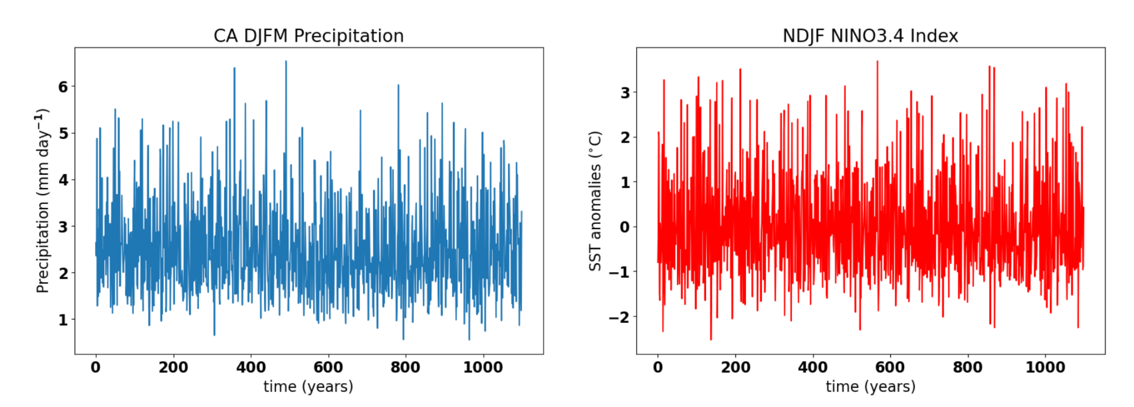
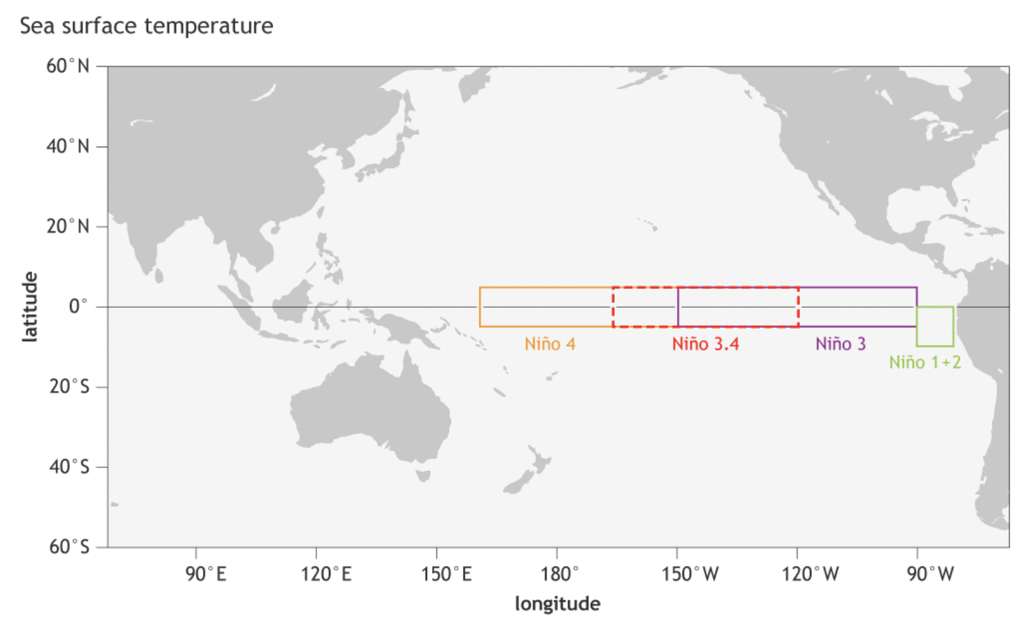
Example: NINO3.4 index in GCM simulations
Goal: Predict precipitation in California from SST anomalies over the NINO3.4 region
ENSO (El Niño Southern Oscillation) is a recurring global climate pattern involving changes in the temperature of waters in the tropical Pacific Ocean. It is made of different phases:
El Niño represents the warming phase, i.e., California typically gets more winter rainfall and vice versa when there is a La Niña event (cooling phase). We have also a neutral phase.
kls2177.github.io/Climate-and-Geophysical-Data-Analysis

Slide 14
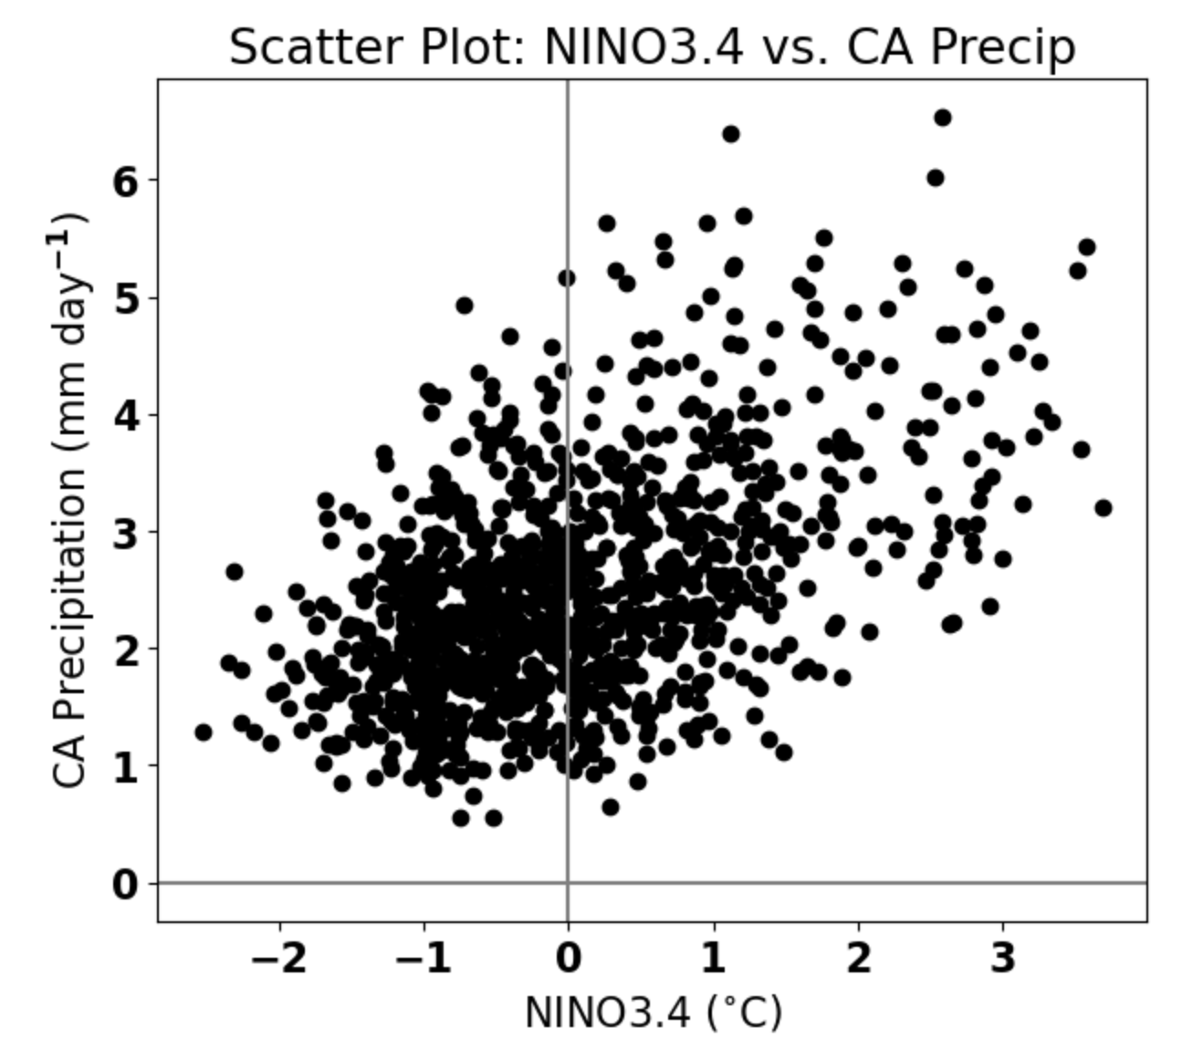
Example: NINO3.4 index
To what type of ML category linear regression belongs to?
Supervised Learning
Our dataset is supervised as we are using the precipitation variable as the ground truth
What type of learning task are we addressing?
Regression, as the target is represented by numerical values (not categories)
kls2177.github.io/Climate-and-Geophysical-Data-Analysis

Slide 15
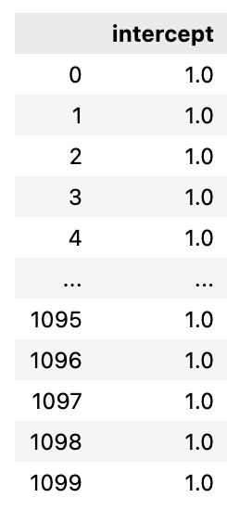
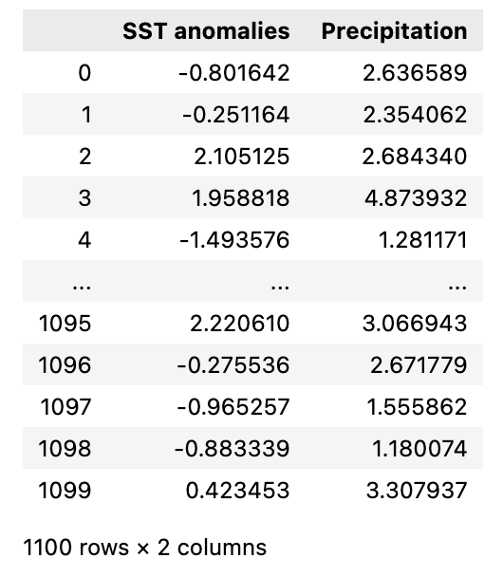

Linear Regression: Model representation
𝜃₀* 1
𝜃₁* x
y
m = number of training example
n = number of features
x’s = “input” variable / features
y’s = “output” variable / “target” variable
m = 1100
n = 2

Slide 16

Training/Learning Task Overview
Training Set
Learning Algorithm
SST Anomalies
(x)
h_{𝜃}(x)
Precipitation (y)
: Parameters
How to choose ?
hypothesis

Slide 17
Regression
Linear regression, cost function, gradient descent, and the bias-variance trade-off

Slide 18
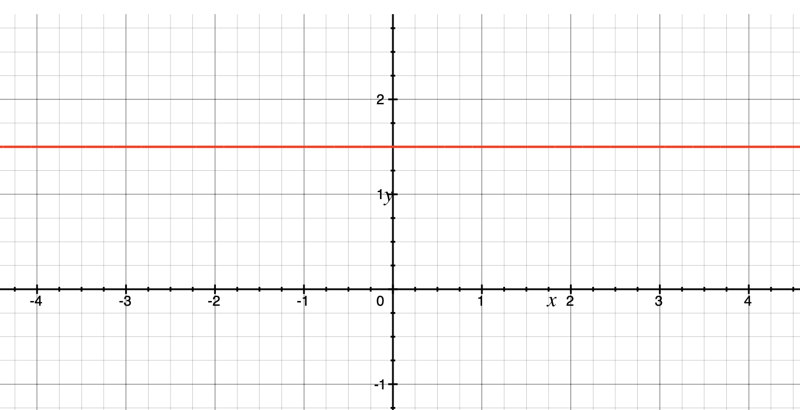
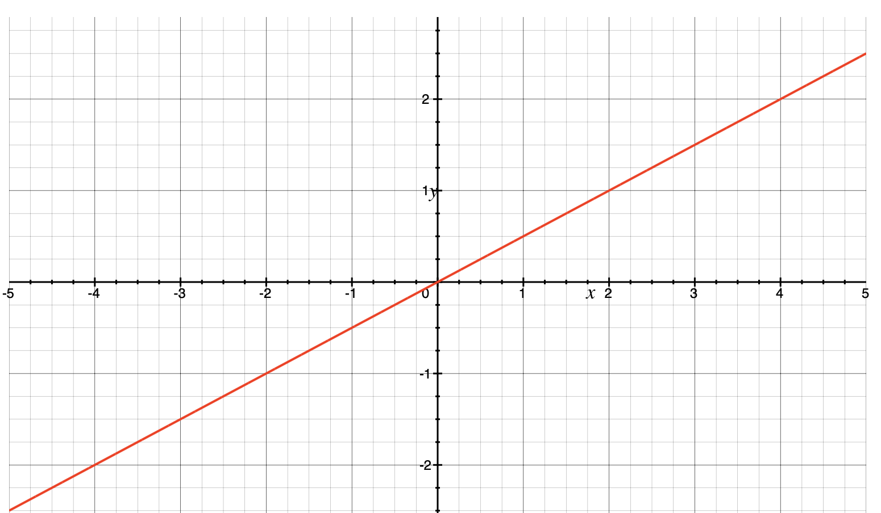
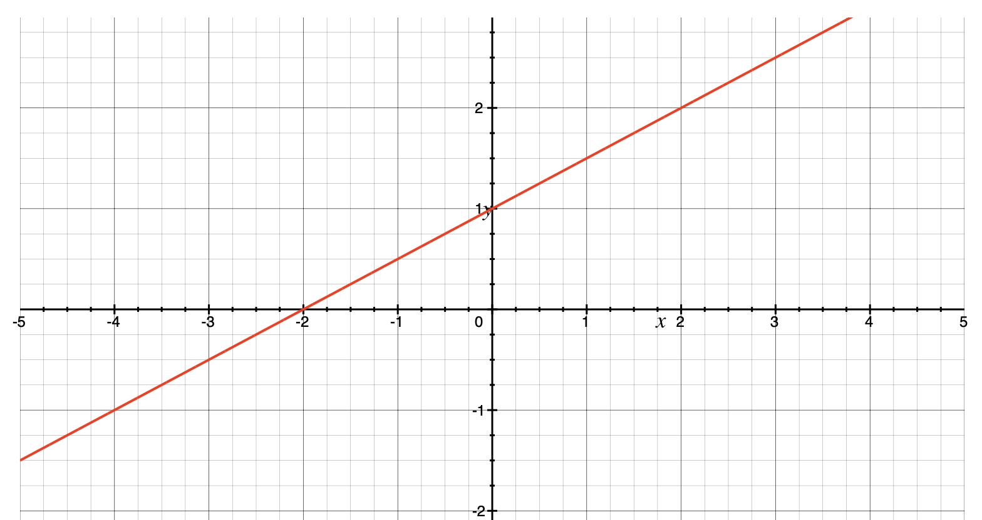



Different parameters identify different models
There are infinite ways to select those parameters. One can randomly pick them, or just impose them, but how do we ensure that they are good parameters?
From an infinite set of solutions, we are interested in the best one. But what does it mean best?

Slide 19
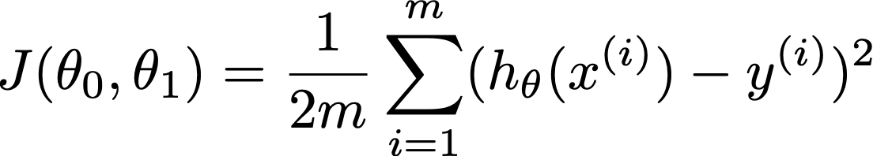

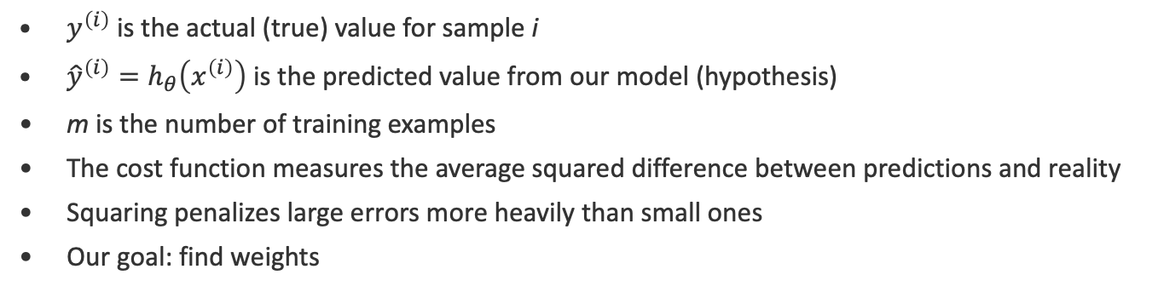
Cost Function: Mean Squared Error
How do we measure how well our model fits the data?
$y^{\left(i\right)}$ is the actual (true) value for sample i
${\hat{y}}^{\left(i\right)}=h_{θ}\left(x^{\left(i\right)}\right)$ is the predicted value from our model (hypothesis)
m is the number of training examples
The cost function measures the average squared difference between predictions and reality
Squaring penalizes large errors more heavily than small ones
Our goal: find weights

Slide 20
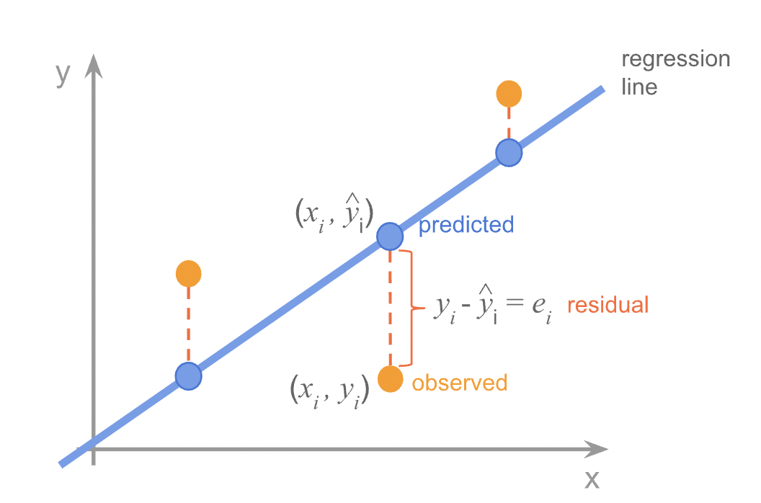

Cost Function: Intuition
Credits: https://allmodelsarewrong.github.io/ols.html
Notes:
J(\theta_{0}, \theta_{1}) = \frac{1}{2m}\sum_{i=1}^{m} (h_{\theta}(x^{(i)}) - y^{(i)})^2

Slide 21
Cost Function: Intuition (cont’d)
Credits: https://allmodelsarewrong.github.io/ols.html
Notes:
J(\theta_{0}, \theta_{1}) = \frac{1}{2m}\sum_{i=1}^{m} (h_{\theta}(x^{(i)}) - y^{(i)})^2

Slide 22

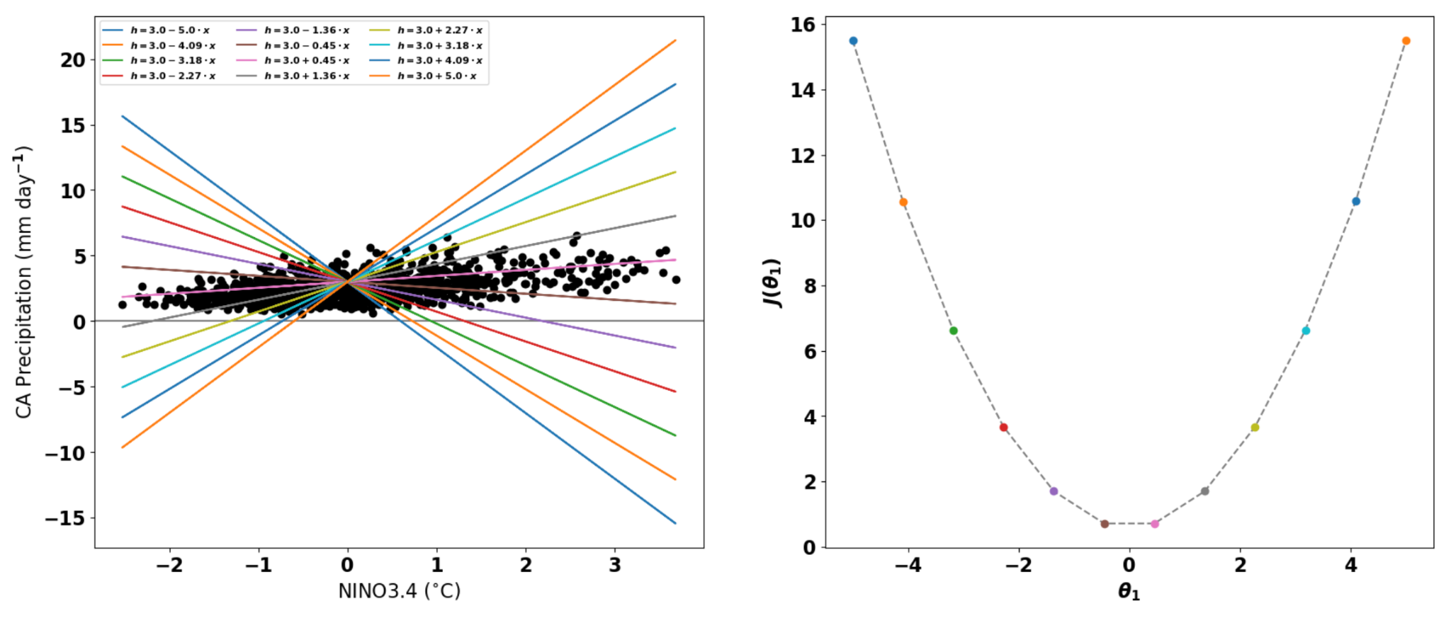
Cost Function Representation: 1D case
Feature Space
Parameter Space
Notes:
J(\theta_{0}, \theta_{1}) = \frac{1}{2m}\sum_{i=1}^{m} (h_{\theta}(x^{(i)}) - y^{(i)})^2

Slide 23
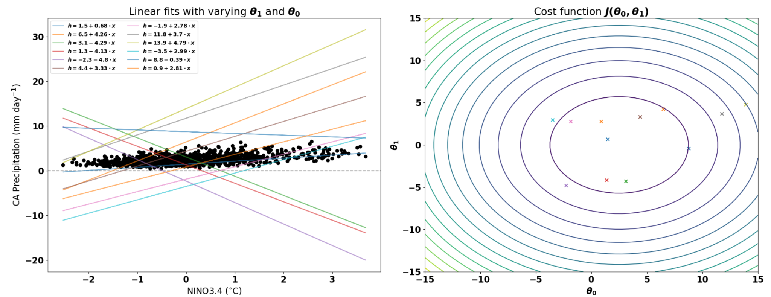
Cost Function Representation: 2D case
Feature Space
Parameter Space
Notes:
J(\theta_{0}, \theta_{1}) = \frac{1}{2m}\sum_{i=1}^{m} (h_{\theta}(x^{(i)}) - y^{(i)})^2

Slide 24
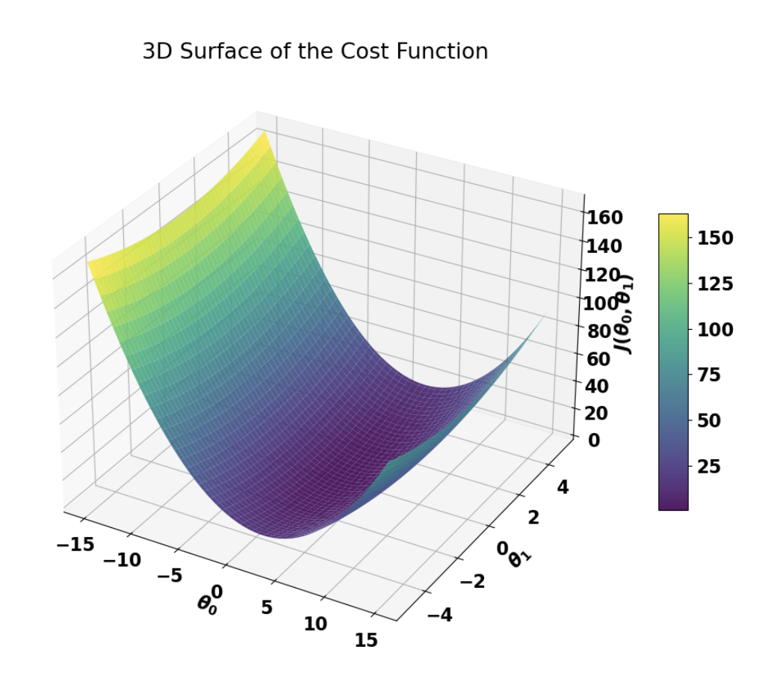
Cost Function Representation: 3D case
Notes:
J(\theta_{0}, \theta_{1}) = \frac{1}{2m}\sum_{i=1}^{m} (h_{\theta}(x^{(i)}) - y^{(i)})^2

Slide 25
Regression
Linear regression, cost function, gradient descent, and the bias-variance trade-off

Slide 26
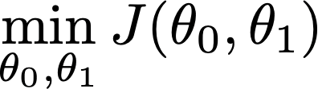

Minimizing the Cost Function
Have some cost function
Want to
Steps:
Start with some
Keep updating to reduce
Hopefully, after some iterations we end up at a minimum of the cost → optimal params
… but in which way should we keep updating the parameters?
Notes:
J(\theta_{0}, \theta_{1}) = \frac{1}{2m}\sum_{i=1}^{m} (h_{\theta}(x^{(i)}) - y^{(i)})^2

Slide 27
Gradient Descent: Intuition
Imagine standing on a hilly landscape in fog. You want to reach the lowest valley.
Step 1: Feel the slope under your feet (compute gradient)
The gradient tells you which direction is uphill
Step 2: Take a step downhill (update weights)
Move in the opposite direction of the gradient
Step 3: Repeat until you reach a valley (convergence)
When the gradient is near zero, you've found a minimum
Challenges
Local minima: for non-convex functions, you might get stuck
Saddle points: flat regions where gradient is near zero but not a minimum

Slide 28
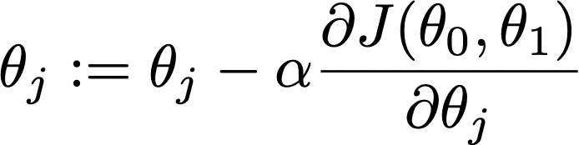

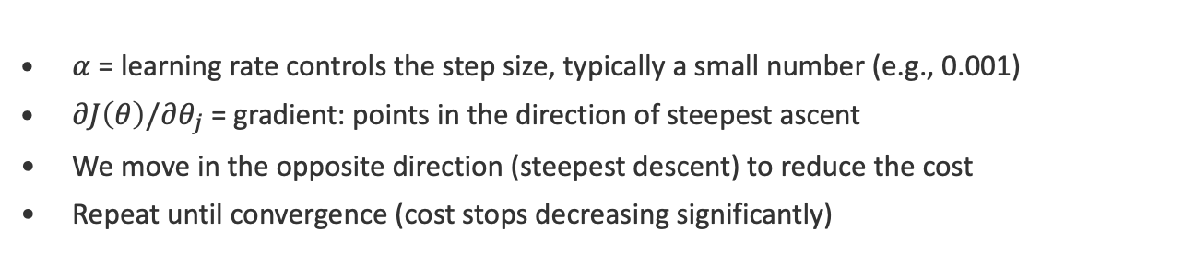
Gradient Descent
An iterative optimization algorithm to find the minimum of the cost function.
Learning Rate
Update rule
Update the previous value with the new
Partial derivative of the Cost with respect to parameter $θ_{j}$
$α$ = learning rate controls the step size, typically a small number (e.g., 0.001)
$∂J\left(θ\right)/∂θ_{j}$ = gradient: points in the direction of steepest ascent
We move in the opposite direction (steepest descent) to reduce the cost
Repeat until convergence (cost stops decreasing significantly)

Slide 29
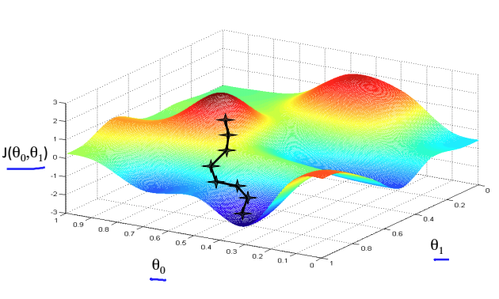
Cost Function Representation: 3D case

Slide 30
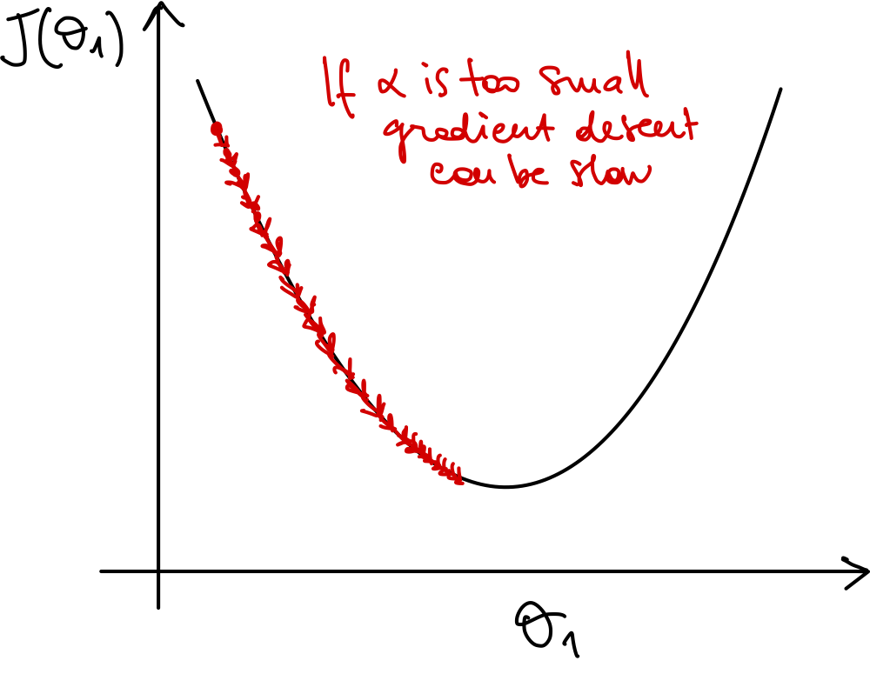
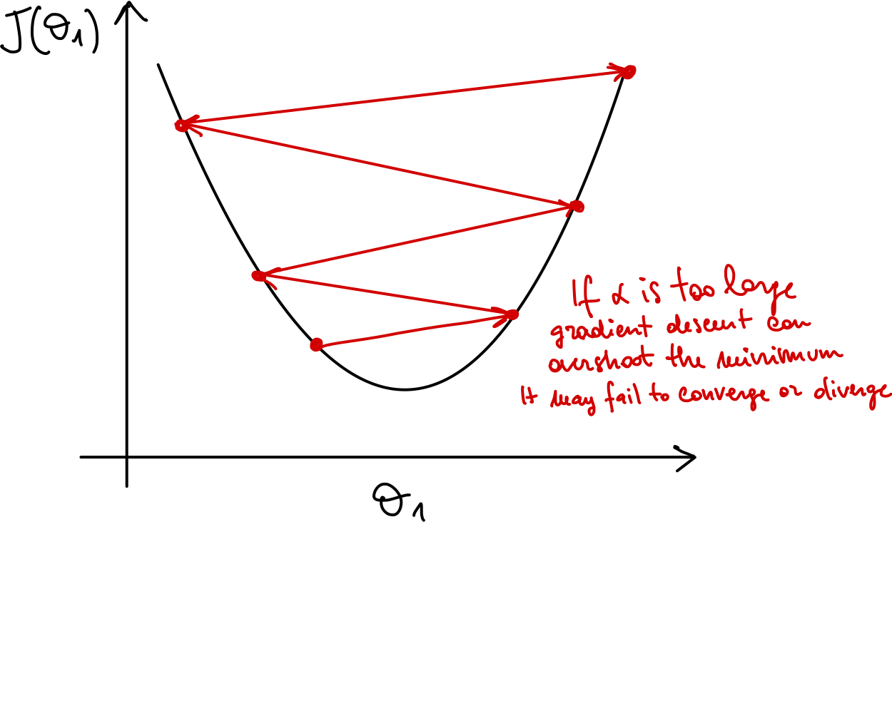
How to choose the learning rate
The learning rate can be fixed to a small (positive) number. Even fixed, Gradient Descent will automatically take small steps as we approach a local minimum. So, no need to decrease the learning rate over time (that’s not always true).
Notes:
\theta_j := \theta_j - \alpha \frac{\partial J(\theta_0, \theta_1)}{\partial \theta_j}

Slide 31
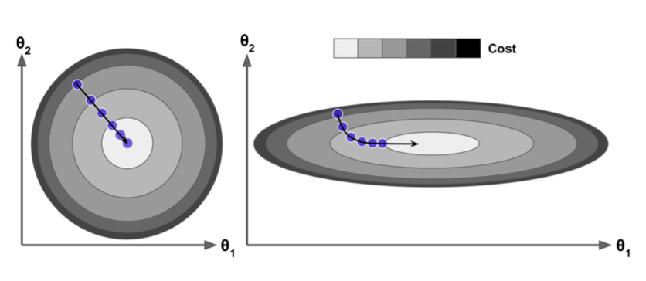
Gradient Descent: Pitfalls
Selecting the appropriate learning rate is often a trial-and-error process.
When features vary widely in magnitude, gradient descent may struggle to converge efficiently.
To address this, it's helpful to scale features to a similar range, typically between 0 and 1.
Min-Max Normalization: Rescales features to a fixed range, usually [0, 1].
Standardization (Z-score Normalization): Transforms features to have zero mean and unit variance.
Notes:
J(\theta_{0}, \theta_{1}) = \frac{1}{2m}\sum_{i=1}^{m} (h_{\theta}(x^{(i)}) - y^{(i)})^2

Slide 32
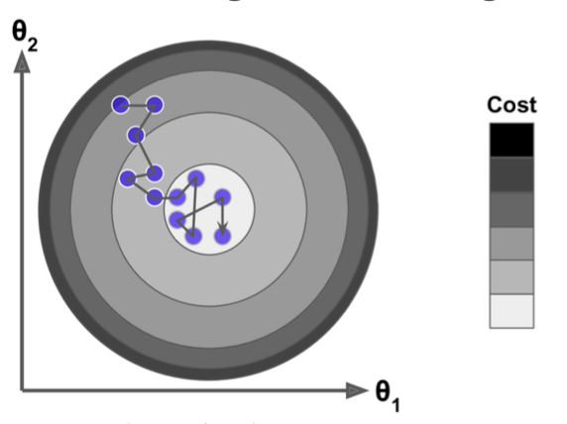
Stochastic Gradient Descent
Batch Gradient Descent: Computes the gradient using the entire training set at each step. Requires a lot of memory!!!
Stochastic Gradient Descent: Uses one random instance per step, requiring less memory.
The randomness makes the cost function fluctuate, though it decreases on average.
Final parameters are typically close to optimal, but not exact due to the noise.
This "bouncing" can help escape local minima in non-convex cost functions.
Mitigation: gradually decrease the learning rate using a learning schedule.
Notes:
J(\theta_{0}, \theta_{1}) = \frac{1}{2m}\sum_{i=1}^{m} (h_{\theta}(x^{(i)}) - y^{(i)})^2

Slide 33
Mini-batch Gradient Descent
A compromise between Batch (entire dataset) and Stochastic (single instance) gradient descent.
Computes gradients using small random subsets of the training data, called mini-batches (e.g., 32, 64, 128 instances).
Offers a good balance between computation efficiency and convergence stability.
Smoother convergence, but the reduced noise can make it harder to escape local minima or flat regions
Often used in practice due to its efficiency on large datasets and compatibility with GPU acceleration.
Notes:
J(\theta_{0}, \theta_{1}) = \frac{1}{2m}\sum_{i=1}^{m} (h_{\theta}(x^{(i)}) - y^{(i)})^2

Slide 34
Polynomial Regression
Extend linear regression by adding polynomial features.
Still a linear model in terms of weights (linear in parameters)
Can capture non-linear relationships in data
Higher degree = more flexible model, but higher risk of overfitting
Key question: how do we choose the right polynomial degree?
This leads us to the bias-variance trade-off...

Slide 35
Regression
Linear regression, cost function, gradient descent, and the bias-variance trade-off

Slide 36
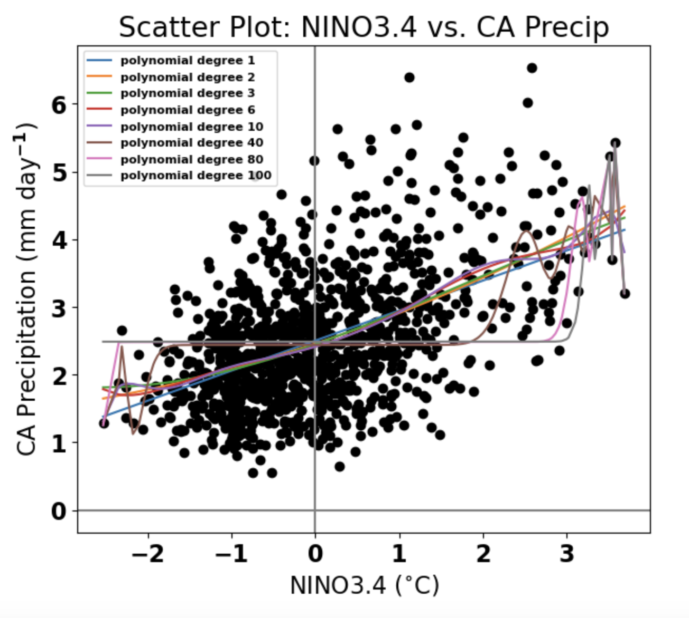
Overfitting: How to Choose the Right Polynomial Degree?
Polynomial models of degree higher than 10 are probably too complex and may overfit training data
The polynomial degree 1 model (standard Linear Regression) is probably too simple

Slide 37
Bias-Variance Trade-off
Underfitting
Just Right
Overfitting
High bias, low variance
Model is too simple.
Cannot capture the true pattern.
Bad on both training and test data.
Example: fitting a line to clearly curved data
Solution: Add more parameters in the model (e.g., consider additional polynomial features)
Balanced
Model captures the underlying pattern without memorizing noise.
Good on both training and test data.
This is the sweet spot we aim for.
Low bias, high variance
Model is too complex.
Memorizes training data including noise.
Great on training, poor on unseen data.
Example: degree-20 polynomial for 10 data points
Solution: Reduce the model complexity, e.g., reduce the parameters of the model, add more data, use regularization techniques (see next)
What should you do in practice, and how can you understand which case you are in?
Take some validation examples apart (not seen during training), and plot learning curves

Slide 38
Diagnose Bias vs. Variance
Underfitting (High Bias)
J_{val}
Cost
Just right
High Bias (Underfitting)
J_{train} will be high
J_{val} ~ J_{train}
High Variance (Overfitting)
J_{train} will be low
J_{val} >> J_{train}
Overfitting (High Variance)
J_{train}
Model complexity

Slide 39
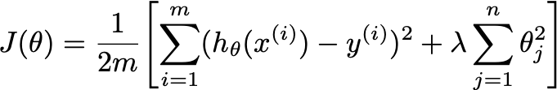
Regularization: intuition
Y
By making those parameters small we simplify the hypothesis
Simple hypothesis are less prone to overfitting
X

Slide 40
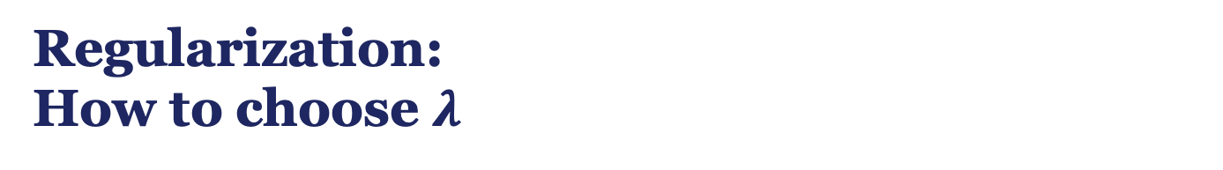



Regularization:
How to choose $λ$
$$λ=0$$
$$λ>>0$$
$λ$ just right
Y
X
X
X

Slide 41
Artificial Neural Networks
Architecture, activation functions, cost functions, and backpropagation

Slide 42
Biological Inspiration
Brain function occurs through the firing of neurons
Neurons connect through synapses that propagate electrical impulses
~100 billion neurons and ~100 trillion synapses in the human brain
Artificial Neural Networks (ANNs)
Algorithms inspired by (but much simpler than) the brain
First wave in the 1980s-90s, then a resurgence with deep learning (2012+)
Now state-of-the-art for many tasks in computer vision, NLP, and science

Slide 43
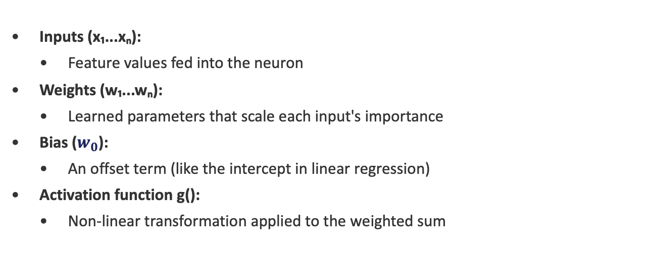
The Perceptron: Simplest Neural Unit
A single neuron that takes weighted inputs, sums them, and applies an activation function.
output = g$(w₁x₁ + w₂x₂ + … + wₙxₙ + w_{0})$
Inputs (x₁...xₙ):
Feature values fed into the neuron
Weights (w₁...wₙ):
Learned parameters that scale each input's importance
Bias ($w_{0}$):
An offset term (like the intercept in linear regression)
Activation function g():
Non-linear transformation applied to the weighted sum
Ref: Rosenblatt, F. (1958). The perceptron: a probabilistic model for information storage and organization in the brain.

Slide 44
Credits: ML for Env Eng and Sci, P. Gentine, 2025

Slide 45
Credits: ML for Env Eng and Sci, P. Gentine, 2025

Slide 46
Credits: ML for Env Eng and Sci, P. Gentine, 2025

Slide 47
Credits: ML for Env Eng and Sci, P. Gentine, 2025

Slide 48
Credits: ML for Env Eng and Sci, P. Gentine, 2025

Slide 49
Credits: ML for Env Eng and Sci, P. Gentine, 2025

Slide 50
Credits: ML for Env Eng and Sci, P. Gentine, 2025

Slide 51
Credits: ML for Env Eng and Sci, P. Gentine, 2025

Slide 52
The Role of Non-Linearity
Without activation functions:
Multiple linear layers collapse into a single linear transformation: f(g(x)) = Ax + b
No matter how many layers, the network can only learn linear decision boundaries
With activation functions:
Each layer can learn increasingly complex non-linear features
Universal Approximation Theorem: a single hidden layer with enough neurons can approximate any continuous function
Deeper networks learn hierarchical representations more efficiently
Credits: ML for Env Eng and Sci, P. Gentine, 2025

Slide 53
Cost Functions for Neural Networks
Regression
Classification
Most common for continuous outputs.
Penalizes large errors quadratically.
Cross-entropy for probability outputs.
Binary CE for 2 classes, Categorical CE for multi-class.
Paired with sigmoid (binary) or softmax (multi-class).
Credits: ML for Env Eng and Sci, P. Gentine, 2025

Slide 54
How ANNs Learn: Forward Pass
Data flows forward through the network to produce a prediction.
Step 1: Input features are fed to the input layer
Step 2: For each hidden layer:
Compute z = Wx + b (weighted sum)
Apply activation: g(z)
Step 3: Output layer produces final prediction ŷ
Step 4: Compute loss: L = J(y, ŷ)
Compare prediction to true label and quantify the error
Now, how do we use this error to update the weights?

Slide 55
How NNs Learn: Compute gradients
Credits: ML for Env Eng and Sci, P. Gentine, 2025

Slide 56
How NNs Learn: Compute gradients
Credits: ML for Env Eng and Sci, P. Gentine, 2025

Slide 57
How NNs Learn: Backpropagation algorithm
Credits: ML for Env Eng and Sci, P. Gentine, 2025

Slide 58
How NNs Learn: Backpropagation algorithm
Credits: ML for Env Eng and Sci, P. Gentine, 2025

Slide 59
How NNs Learn: Backpropagation algorithm
Credits: ML for Env Eng and Sci, P. Gentine, 2025

Slide 60
How NNs Learn: Backpropagation algorithm
Credits: ML for Env Eng and Sci, P. Gentine, 2025

Slide 61



Gradient Descent for ANNs
1. Initialize weights randomly
2. Forward pass: compute predictions and loss
3. Backward pass: propagate error gradients from output to input
Apply the chain rule
Each layer passes its gradient to the previous layer, store gradients
3. Update weights
4. Repeat for many iterations (epochs) over the dataset
5. Monitor how training and validation loss look across epochs
Credits: ML for Env Eng and Sci, P. Gentine, 2025

Slide 62
Overfitting and Regularization
Ref: Srivastava et al. (2014). Dropout: A Simple Way to Prevent Neural Networks from Overfitting. JMLR.
Credits: ML for Env Eng and Sci, P. Gentine, 2025

Slide 63
Credits: ML for Env Eng and Sci, P. Gentine, 2025

Slide 64
PyTorch Framework
Building and training neural networks in practice

Slide 65
PyTorch: Overview
An open-source deep learning framework developed by Meta (Facebook) AI Research.
Dynamic computation graphs:
Build the graph on-the-fly (eager execution). Easy to debug with standard Python tools
Automatic differentiation (autograd):
Automatically computes gradients for backpropagation. No manual calculus needed!
GPU acceleration:
Seamlessly move tensors and models between CPU and GPU with .to(device)
Rich ecosystem:
torchvision, torchaudio, torchtext, PyTorch Lightning, Hugging Face integration
Pythonic:
Feels like NumPy with GPU support and automatic gradients
Ref: https://pytorch.org

Slide 66
Tensors and Autograd
Tensors
Multi-dimensional arrays (like NumPy ndarrays but with GPU support)
Operations: torch.tensor(), torch.zeros(), torch.randn(), reshaping, slicing
Move to GPU: tensor.to('cuda') or tensor.cuda()
Autograd: automatic differentiation
Set requires_grad=True on tensors you want gradients for
PyTorch records all operations in a computational graph
Call loss.backward() to compute all gradients automatically
Access gradients via tensor.grad
Handles arbitrarily complex computation graphs

Slide 67
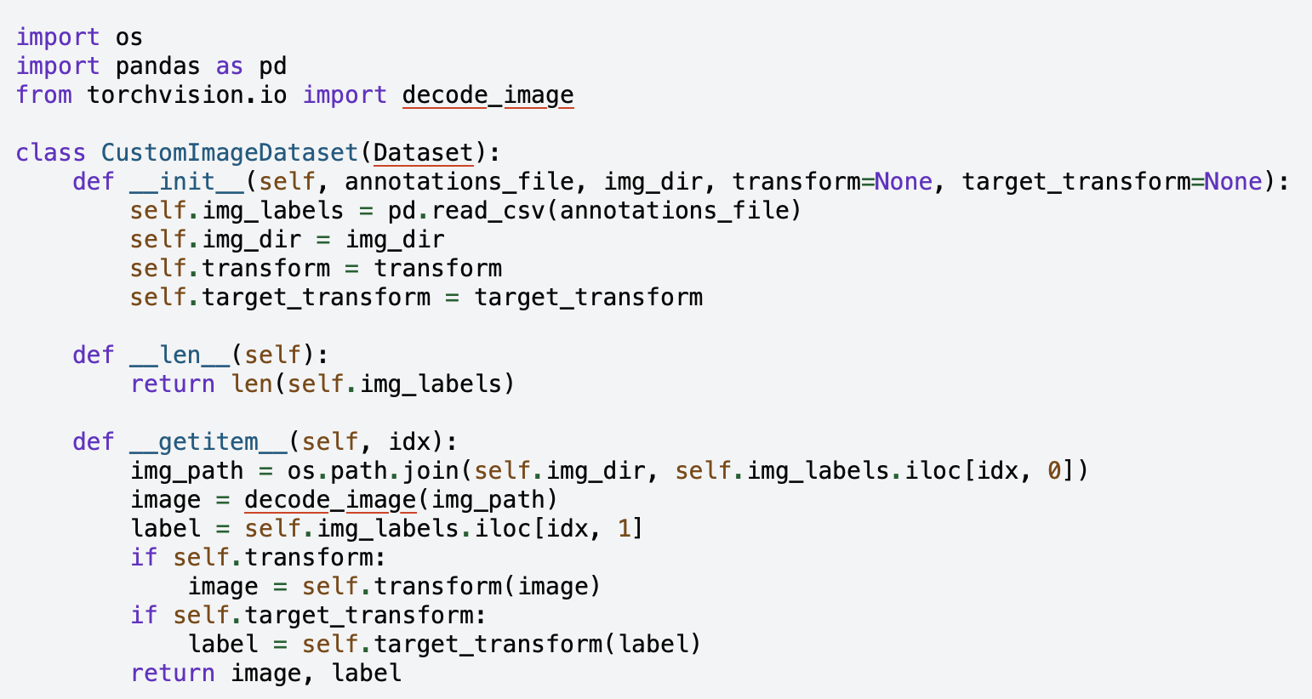
Dataset Class
torch.utils.data.Dataset
Custom class that implements __len__() and __getitem__(idx)
__len__: returns the total number of samples
__getitem__: returns one sample (input, target) given an index
Handles loading, preprocessing, and augmentation per sample

Slide 68
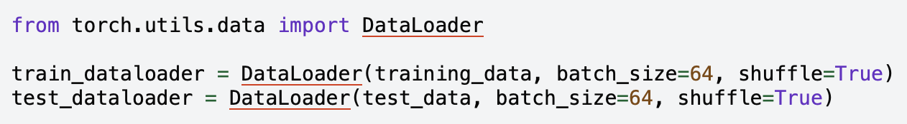
DataLoaders
torch.utils.data.DataLoader
Wraps a Dataset and provides batching, shuffling, and parallel loading
Key arguments: batch_size, shuffle, num_workers, pin_memory
Handles memory-efficient loading of large datasets
Automatically creates mini-batches for training
In this example both training_data and test_data are instances/objects of a Dataset class

Slide 69
Building a Neural Network in PyTorch
Define a model by subclassing torch.nn.Module.
class MyANN(nn.Module):
def __init__(self):
super().__init__()
self.layer1 = nn.Linear(10, 64)
self.layer2 = nn.Linear(64, 32)
self.output = nn.Linear(32, 1)
self.relu = nn.ReLU()
def forward(self, x):
x = self.relu(self.layer1(x))
x = self.relu(self.layer2(x))
return self.output(x)

Slide 70
PyTorch Training Loop
model = MyANN().to(device)
optimizer = torch.optim.Adam(model.parameters(), lr=1e-3)
criterion = nn.MSELoss()
for epoch in range(num_epochs):
for batch_x, batch_y in train_loader:
batch_x = batch_x.to(device)
batch_y = batch_y.to(device)
pred = model(batch_x) # Forward pass
loss = criterion(pred, batch_y) # Compute loss
optimizer.zero_grad() # Clear old gradients
loss.backward() # Perform Backpropagation
optimizer.step() # Update weights
5 key steps per iteration: forward pass → loss → zero_grad → backward → step

Slide 71

Optimizers, Callbacks, and Device Handling
Common optimizers:
torch.optim.SGD, Adam, AdamW, RMSprop, LBFGS
Learning rate schedulers (callbacks):
StepLR: decay lr every N epochs
ReduceLROnPlateau: reduce lr when validation loss plateaus
CosineAnnealingLR: smooth cyclic lr schedule
Device handling:
device = torch.device('cuda' if torch.cuda.is_available() else 'cpu')
model.to(device) and data.to(device) move computation to GPU
Multi-GPU: torch.nn.DataParallel or DistributedDataParallel

Slide 72
Day 1: Key Takeaways
ML learns patterns from data to generalize to unseen examples
Supervised learning (regression + classification) requires labeled data (ground truth)
Linear/polynomial regression minimize MSE using gradient descent
Bias-variance tradeoff: balance model complexity vs. generalization
Regularization prevents overfitting by reducing model complexity
Neural networks stack layers of non-linear transformations
Backpropagation efficiently computes gradients via the chain rule
PyTorch provides tensors + autograd for flexible model building

