Slide 1
Milestone 2 Group 1 SEC 101
Gabriele Chiossi, Ben Marschall, Si'raaj Woods

Slide 2
Technology stack and tool chain
We have been using VS Code to edit all of our files, and a browser to see the changes that we put in our code
Github for this last milestone was not very used because we do not have something ready to be push. People are learning and coding at the same time. When we feel like we have a decent code to be implemented we will push it to our master branch

Slide 3
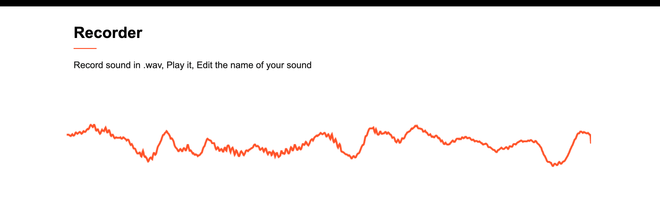
Individual responsibilities of all members
Gabriele Chiossi: has been working on te stream for the wave form when recoding. The biggest issue now that I am trying to solve is that the stream of the microphone is always on, what I want it to do is to be on and draw the wave only when the record button is on. Here below our wave form when recording.
Ben Marschall and Si'raaj Woods: have been working on the music player

Slide 4
Technology/device access of all members
We use a lot of different technologies to see if te system works on multiple platforms
MAC OS
WINDOWS OS
LINUX OS
TEAMS (to comunicate via videocall)
Imessage (to chat daily and update the team)
Browsers: Chrome and Firefox mainly

Slide 5
Definition of the next two milestone
Milestone 3: have a better knowdlege on JavaScript and good piee of code on music player to implement to our project
Milestone 4: put the code together and debug the main issues

Slide 6
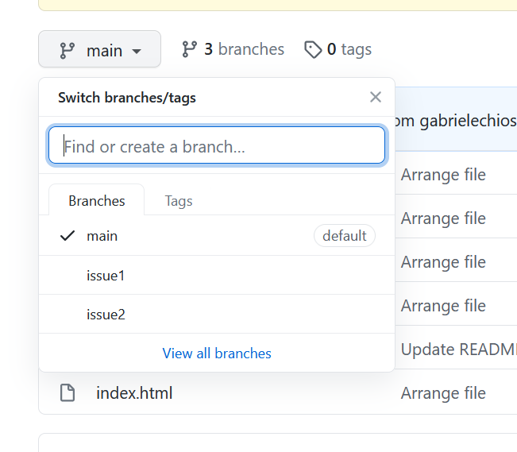
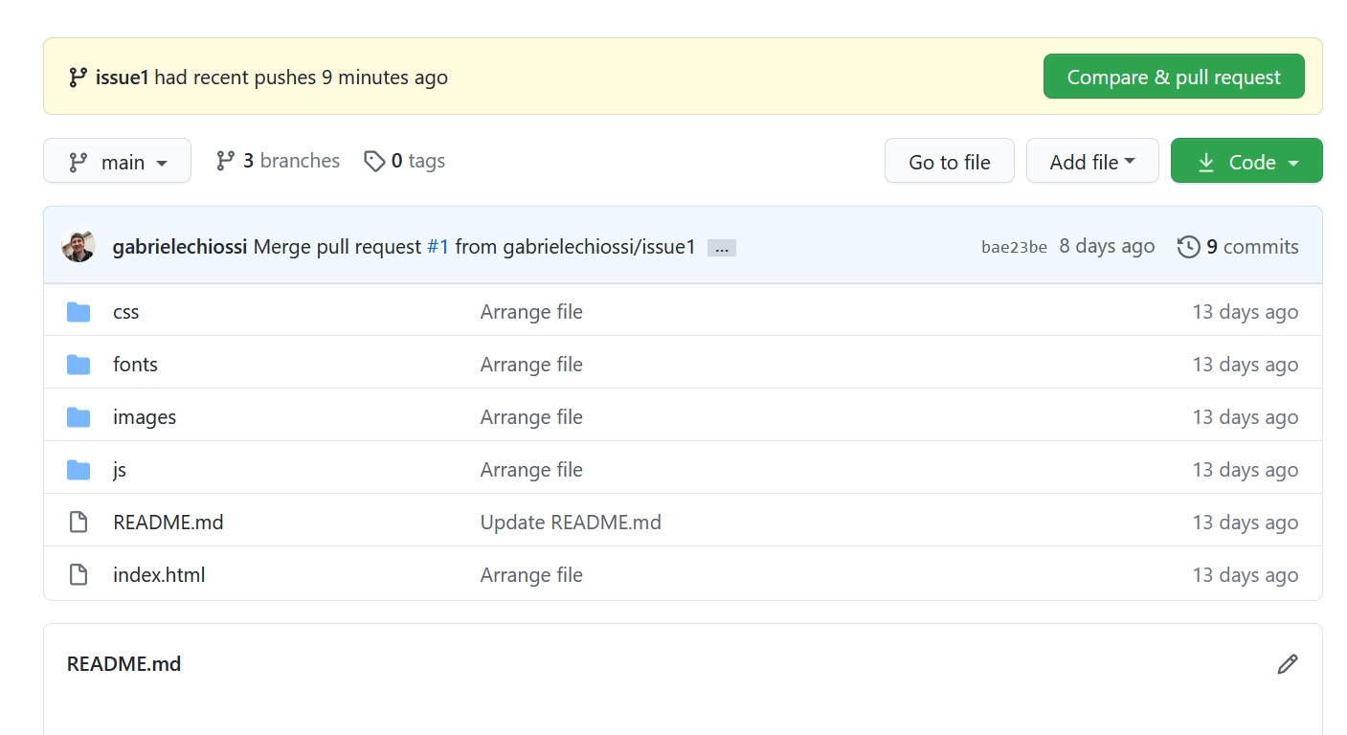
A walk-through of the git repo

Slide 7
Team communication plan and workflow, including the two time slots for potential team meetings
We communicate very often a text messages for easy comunication, but usually we FaceTime or video calls on Teams for some main issues or information that the team need to know.
We meet at least twice a week, Tuesday and Thursday night usually after class time if synchronous or during class time if asynchronous and either saturdays or sundays during weekends
Everything we make that works and the team agree on it get pushed to gitHub

