Slide 1
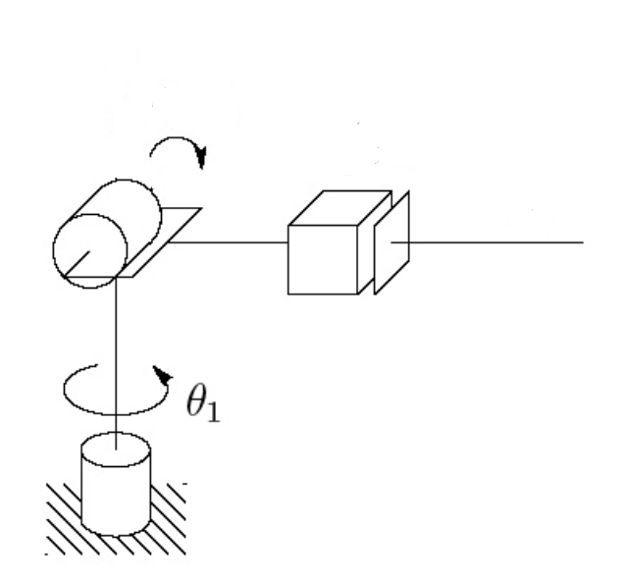
Tabela Denavit-Hartenberg
D1
z1
i | θ | d | a | α
1 | θ1* | D1 | 0 | -90°
x1

Slide 2
Tabela Denavit-Hartenberg
D2
θ2
z2
x2
D1
z1
i | θ | d | a | α
1 | θ1* | D1 | 0 | -90°
2 | Θ2* | 0 | D2 | -90°
x1

Slide 3
Tabela Denavit-Hartenberg
D2
D3
θ2
z2
X3
x2
z3
D1
z1
i | θ | d | a | α
1 | θ1* | D1 | 0 | -90°
2 | Θ2* | 0 | D2 | -90°
3 | 0 | D3* | 0 | 0
x1

Slide 4
Matriz Homogênea
¹A0 = Rot(z,θ1)Trans(z,D1)Trans(x,0)Rot(x, -90°)
Cθ1 | -Sθ1 | 0 | 0
Sθ1 | Cθ1 | 0 | 0
0 | 0 | 1 | 0
0 | 0 | 0 | 1
1 | 0 | 0 | 0
0 | 1 | 0 | 0
0 | 0 | 1 | D1
0 | 0 | 0 | 1
1 | 0 | 0 | 0
0 | 1 | 0 | 0
0 | 0 | 1 | 0
0 | 0 | 0 | 1
1 | 0 | 0 | 0
0 | 0 | -1 | 0
0 | 1 | 0 | 0
0 | 0 | 0 | 1
¹A0 =
=
Cθ1 | 0 | -Sθ1 | 0
Sθ1 | 0 | Cθ1 | 0
0 | 1 | 0 | D1
0 | 0 | 0 | 1
¹A0 =

Slide 5
Matriz Homogênea
²A1 = Rot(z,θ2)Trans(z,0)Trans(x, D2)Rot(x, -90°)
Cθ2 | -Sθ2 | 0 | 0
Sθ2 | Cθ2 | 0 | 0
0 | 0 | 1 | 0
0 | 0 | 0 | 1
1 | 0 | 0 | 0
0 | 1 | 0 | 0
0 | 0 | 1 | 0
0 | 0 | 0 | 1
1 | 0 | 0 | D2
0 | 1 | 0 | 0
0 | 0 | 1 | 0
0 | 0 | 0 | 1
1 | 0 | 0 | 0
0 | 0 | -1 | 0
0 | 1 | 0 | 0
0 | 0 | 0 | 1
²A1 =
=
Cθ2 | 0 | -Sθ1 | D2Cθ2
Sθ2 | 0 | Cθ1 | D2Sθ2
0 | 1 | 0 | 0
0 | 0 | 0 | 1
²A1 =

Slide 6
Matriz Homogênea
³A2 = Rot(z,0)Trans(z, D3)Trans(x, 0)Rot(x, 0)
1 | 0 | 0 | 0
0 | 1 | 0 | 0
0 | 0 | 1 | 0
0 | 0 | 0 | 1
1 | 0 | 0 | 0
0 | 1 | 0 | 0
0 | 0 | 1 | D3
0 | 0 | 0 | 1
1 | 0 | 0 | 0
0 | 1 | 0 | 0
0 | 0 | 1 | 0
0 | 0 | 0 | 1
1 | 0 | 0 | 0
0 | 1 | 0 | 0
0 | 0 | 1 | 0
0 | 0 | 0 | 1
³A2 =
=
1 | 0 | 0 | 0
0 | 1 | 0 | 0
0 | 0 | 1 | D3
0 | 0 | 0 | 1
³A2 =

