Slide 1
Many obs, Many features + Space: an animated solution
Animated visualization for multiple features with spatial dimension
Gabriele Pinto - Madas

Slide 2
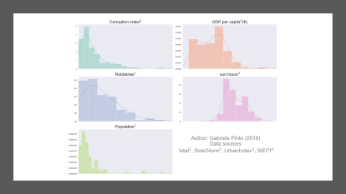

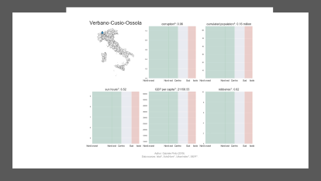
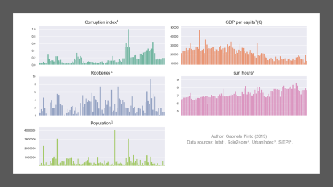
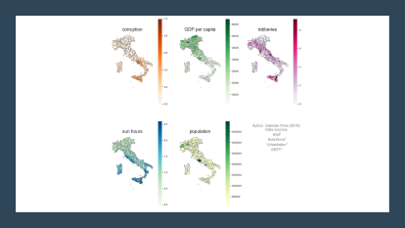
OUTLINE

Slide 3
Data Overview

Slide 4
The dataset
Observations | Features | Spatial
110 Italian Provinces | corruption GDP per capita robberies Sun hours Total Population | The shape of the province

Slide 5
Description of the variables
Features | Sources | Type of variable
Corruption | SIEPI | Index between 0 and 1. (0=high corruption,1=low corruption)
GDP per capita | ISTAT | Euros per year
robberies | ISTAT | Number of per capita robberies in bank and postal office.
Sun hours | Sole 24 Ore qualità del Clima | Average sun hours per day
Total population | ISTAT | Total number of citizens

Slide 6
The visualization problem
We have multiple features
We have many observations
Our observations have a spatial attribute that is relevant

Slide 7
Visualize the dataset
5 Features
We have a 5*110 Matrix.
How can we visualize it in a compact way ?
110 Observations

Slide 8
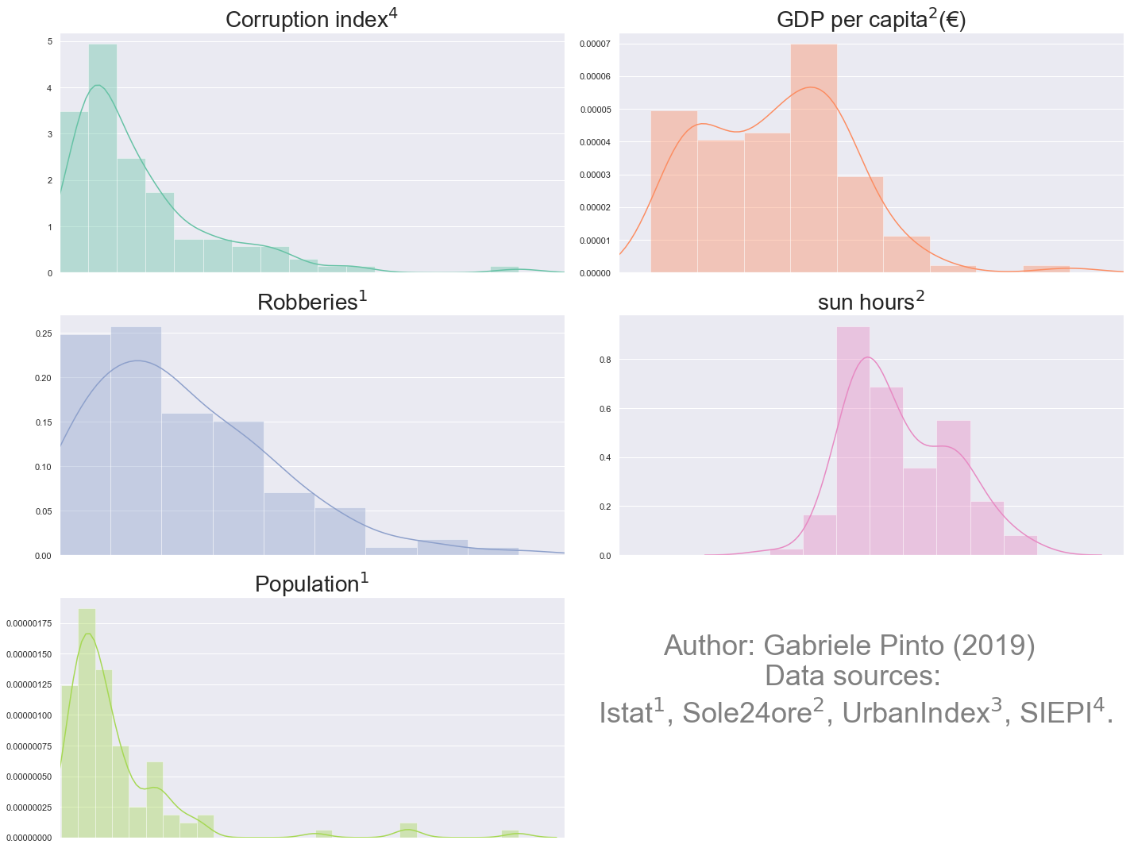

Slide 9


Distribution plot
We can see general trend of distribution
No spatial relationship
Not able to identify observations

Slide 10
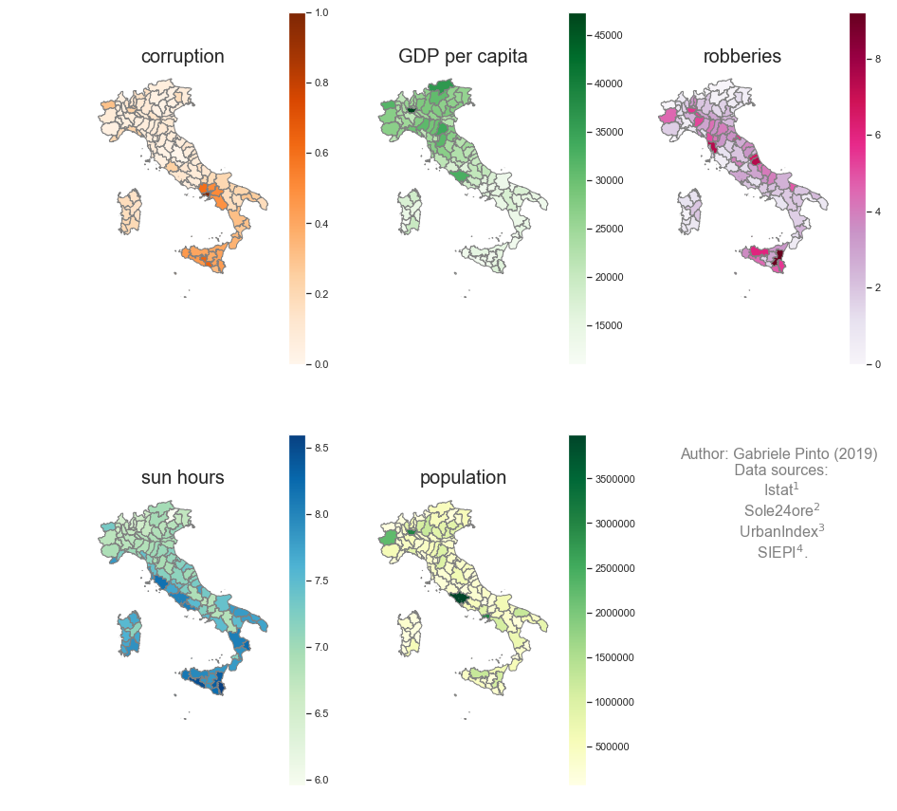

Slide 11
Chorophlet visualization
We are able to compare “statically” provinces
Difficult to identify “spatial trends”
Bounded to classification methods of the choroplets

Slide 12
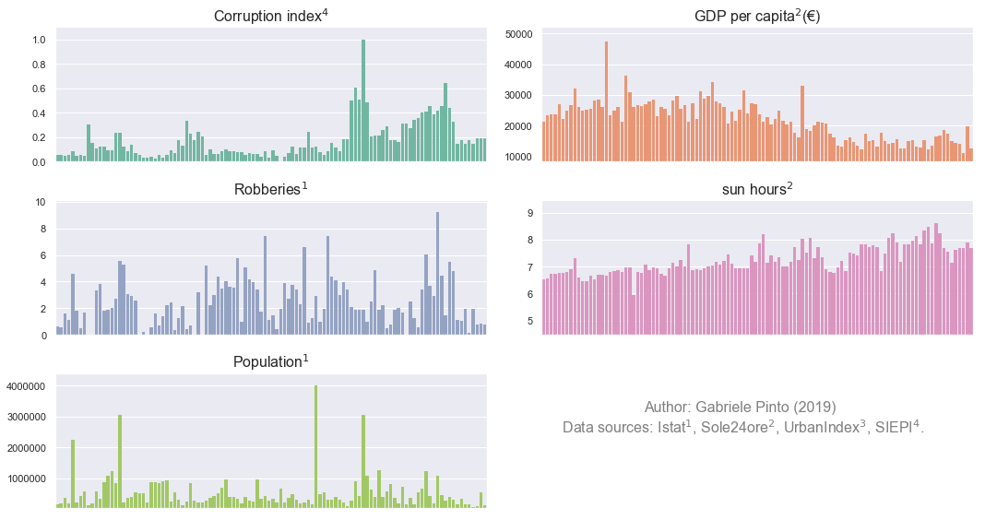

Slide 13
Bar-plot visualization
Markers (bars) do not depend from classification methods as in the choropleth
Difficult to identify provinces (there are too many observations)

Slide 14
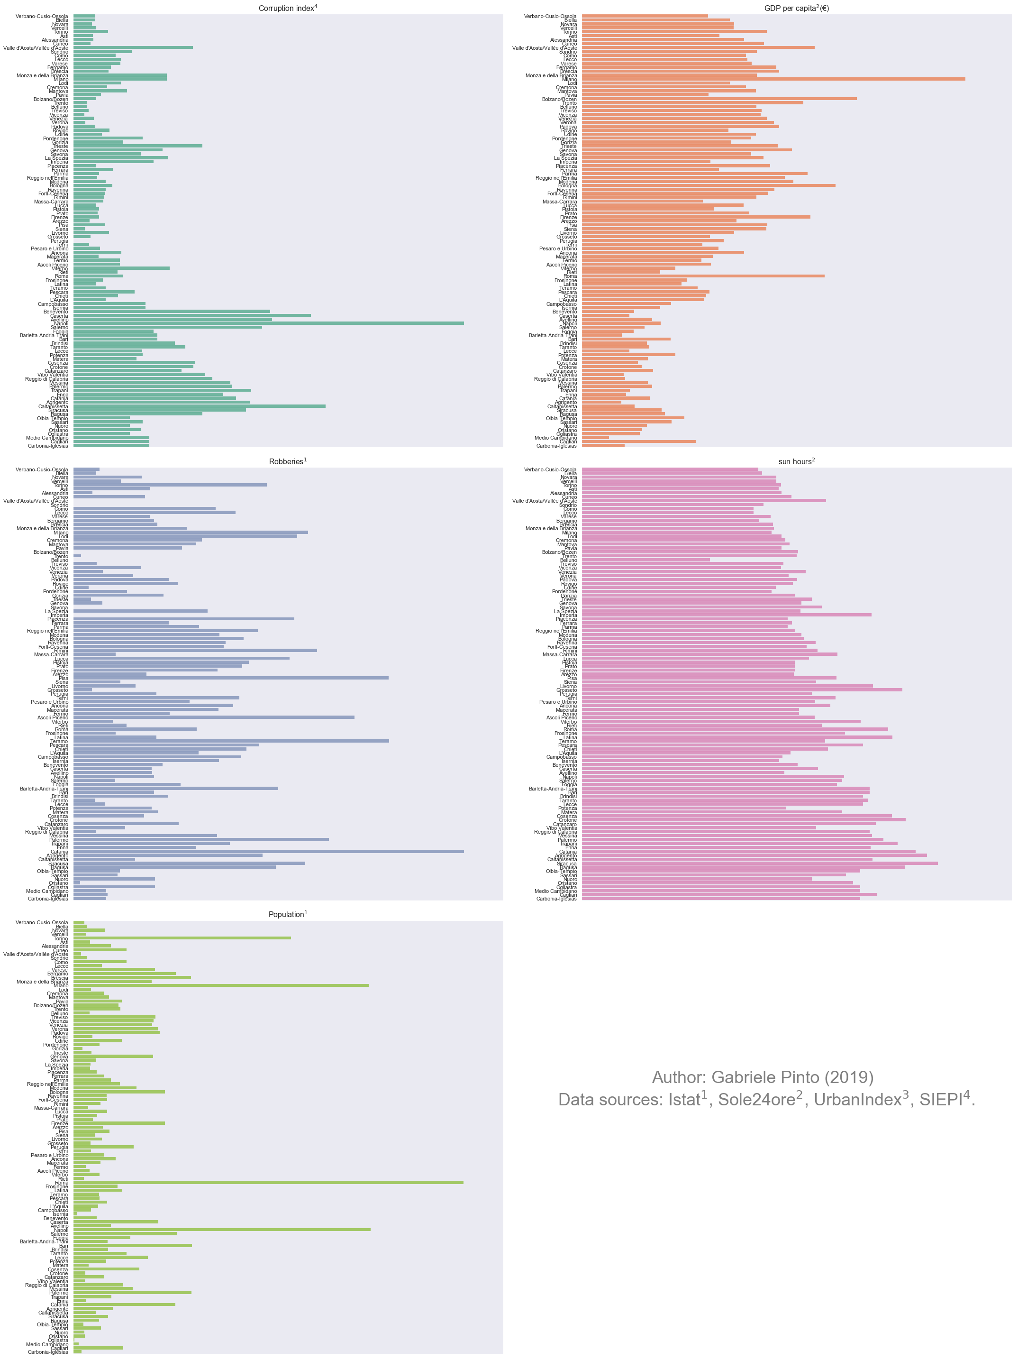
Bar-plot visualization
Difficult to find a way to make 110 indexes readable.
(especially in one single fig)

Slide 15
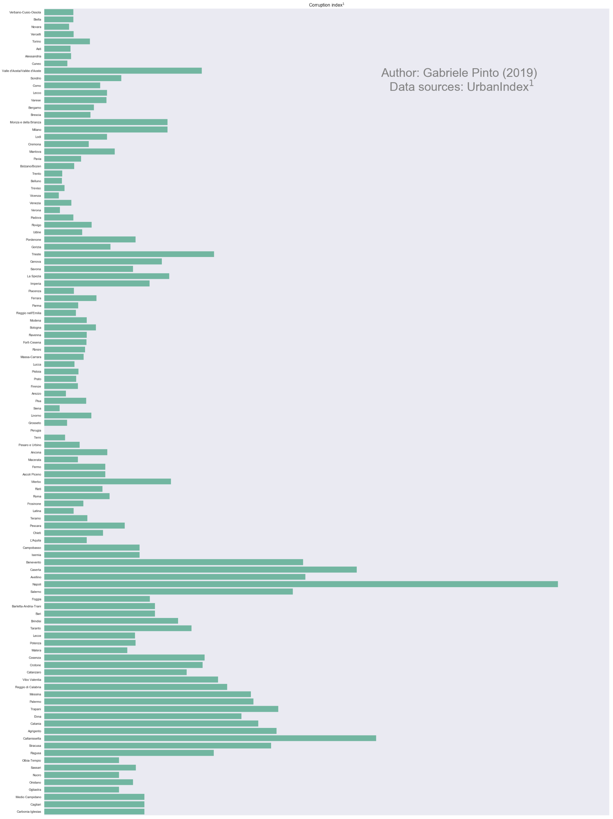

Bar-plot visualization
NOT READABLE!

Slide 16
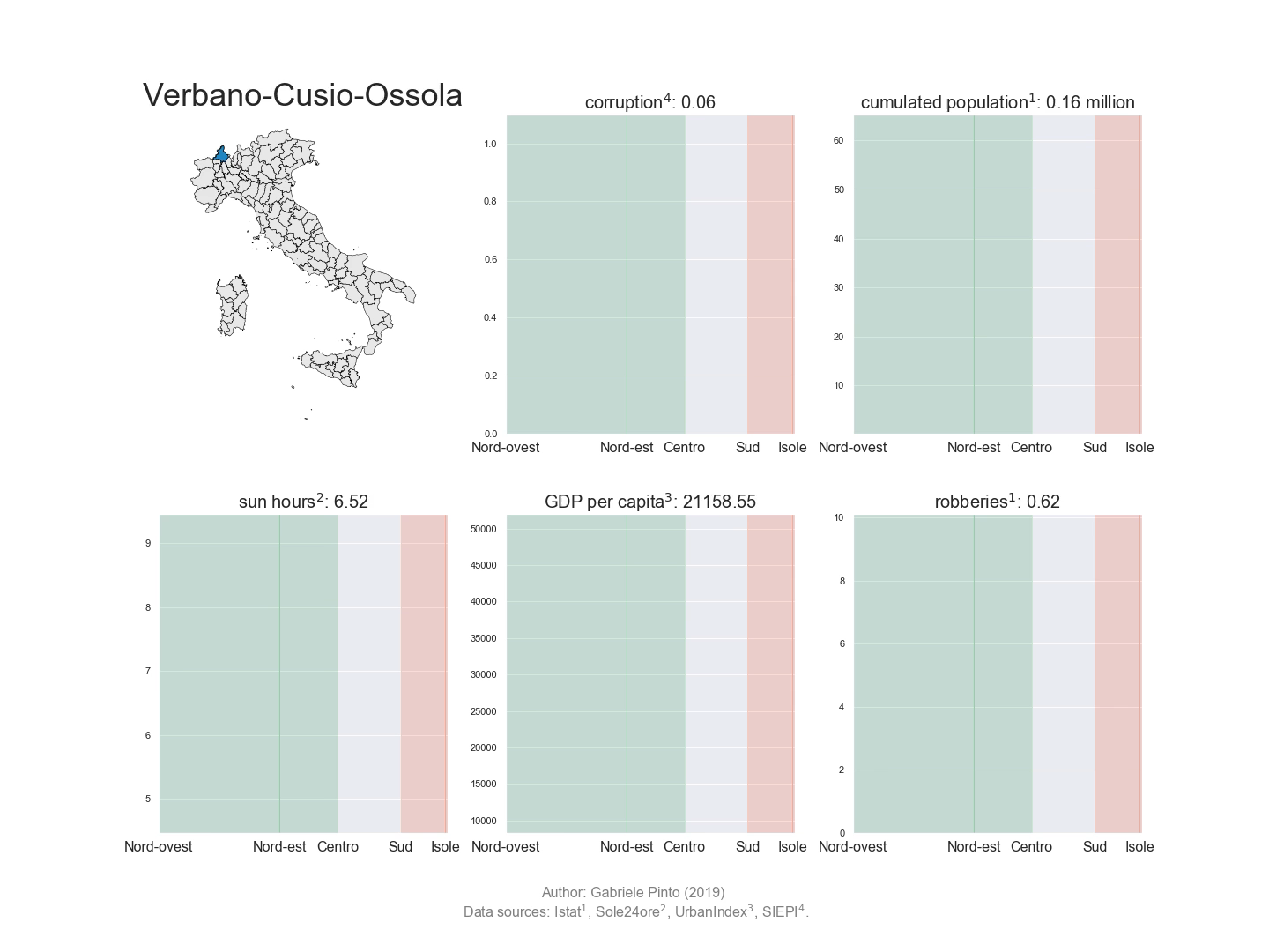

Slide 17
Animated visualization
Compact representation
We can identify “spatial” trends (north->south)
We cannot identify “statically” provinces
We need a “dynamic” document (e.g. not available on paper)
Line marker might be misleading.

Slide 18


Conclusions
Animation can be useful to represent spatial data with several features and observations.
Python packages for animations is very heavy… (over 20 minutes to write the video)

Slide 19
Packages
Everything was run using Python
Matplotlib (both the pyplot API and the low-end modules)
Shapely and Geopandas for the spatial features

Slide 20
Thanks for your attention !

