Slide 1
KGB investigating crime in Phoenix
Krys Doyle
Gabriel Franco
Bo Perez

Slide 2
Motivation
Understand crime distribution in Phoenix and how it has evolved over the past 4 years.
Investigate what are the most dangerous parts of Phoenix by ZIP codes and the impact that crime occurrences have on the oscillations in housing prices.

Slide 3
Materials and methods
Crime database from the city of Phoenix from January 2016 through August 2019.
Housing price changes in 2017-2018 for the city of Phoenix.
Pandas and matplotlib libraries in Python as well as Google Maps.

Slide 4
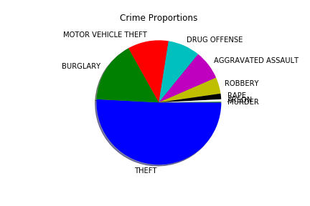
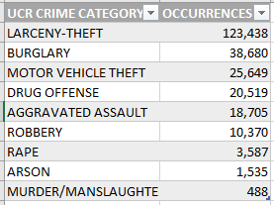
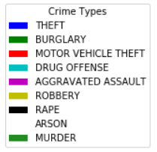
What is the most common crime in Phoenix?
Larceny/theft is the most common crime overall

Slide 5
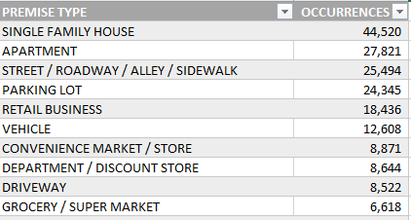
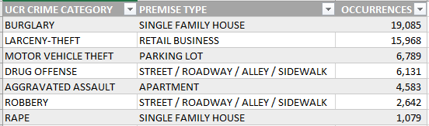
What is the most common premise for each crime type? How does it relate to the most common crime?

Slide 6
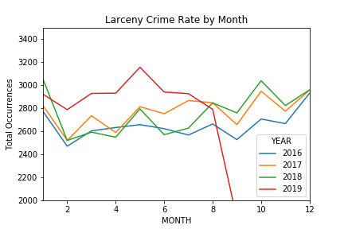
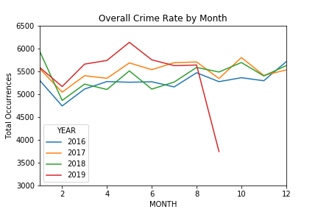
What time of year does Crime most often occur?
Increases in January, May, October and December.
Increase in crime in 2019.

Slide 7
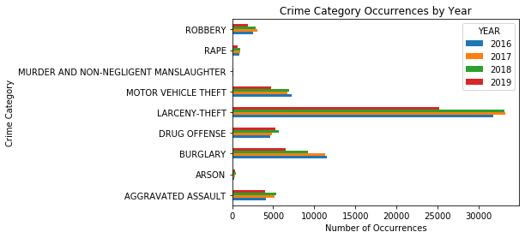
3 - When was there the highest crime incidence?
The apparent lower crime occurrences for 2019 as opposed to 2018 has to consider that 3 ½ months are still missing from the database

Slide 8
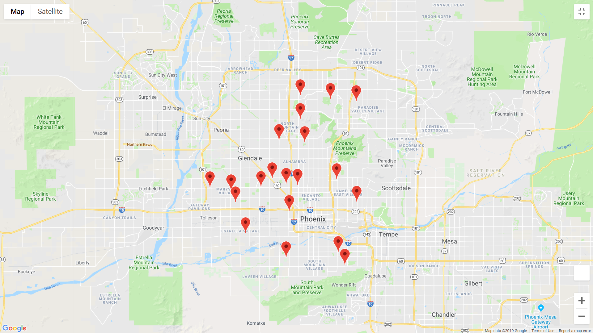
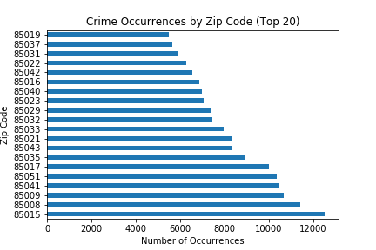
What are the most dangerous ZIP codes?

Slide 9
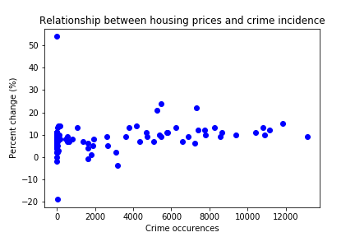
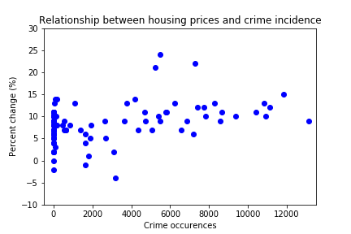
What is the relationship between oscillations in housing prices and crime incidence?

Slide 10
Conclusions
The most recurrent crime type (larceny/theft) partially explains the the highest premise type, since burglary is the crime type that drives up the occurrences in single family houses, whereas the most common premise for theft is retail business, with single family house as a close second.
Crime is increasing in Phoenix and it spikes in some months, although the reason for these specific months could not be ascertained.
Housing price oscillations seem to be unaffected by crime occurrence.

