Slide 1
ADAS-TO × TabPFN
Forecasting post-takeover behaviour from pre-takeover signals
Driver-disjoint evaluation · TabPFN + tree baselines · feature ablations

Slide 2
What we did
• Task — from the pre-takeover window [−5, 0] s, predict the post-takeover maneuver (post_maneuver_type) and its intensity (steer torque, jerk).
• Data — ADAS-TO sample: 1,591 clips, 1,043 re-identified/labelled, 208 drivers, 21 brands.
• Split — driver-disjoint train/val/test (the paper's protocol); brand-OOD reported separately.
• Models — TabPFN (in-context) vs LightGBM / XGBoost / CatBoost.
• Three feature families tested: CAN signals, YOLOv8n vision geometry, optical-flow residual.
• Deliverable — this deck + an explorer app that scores held-out test clips live.

Slide 3
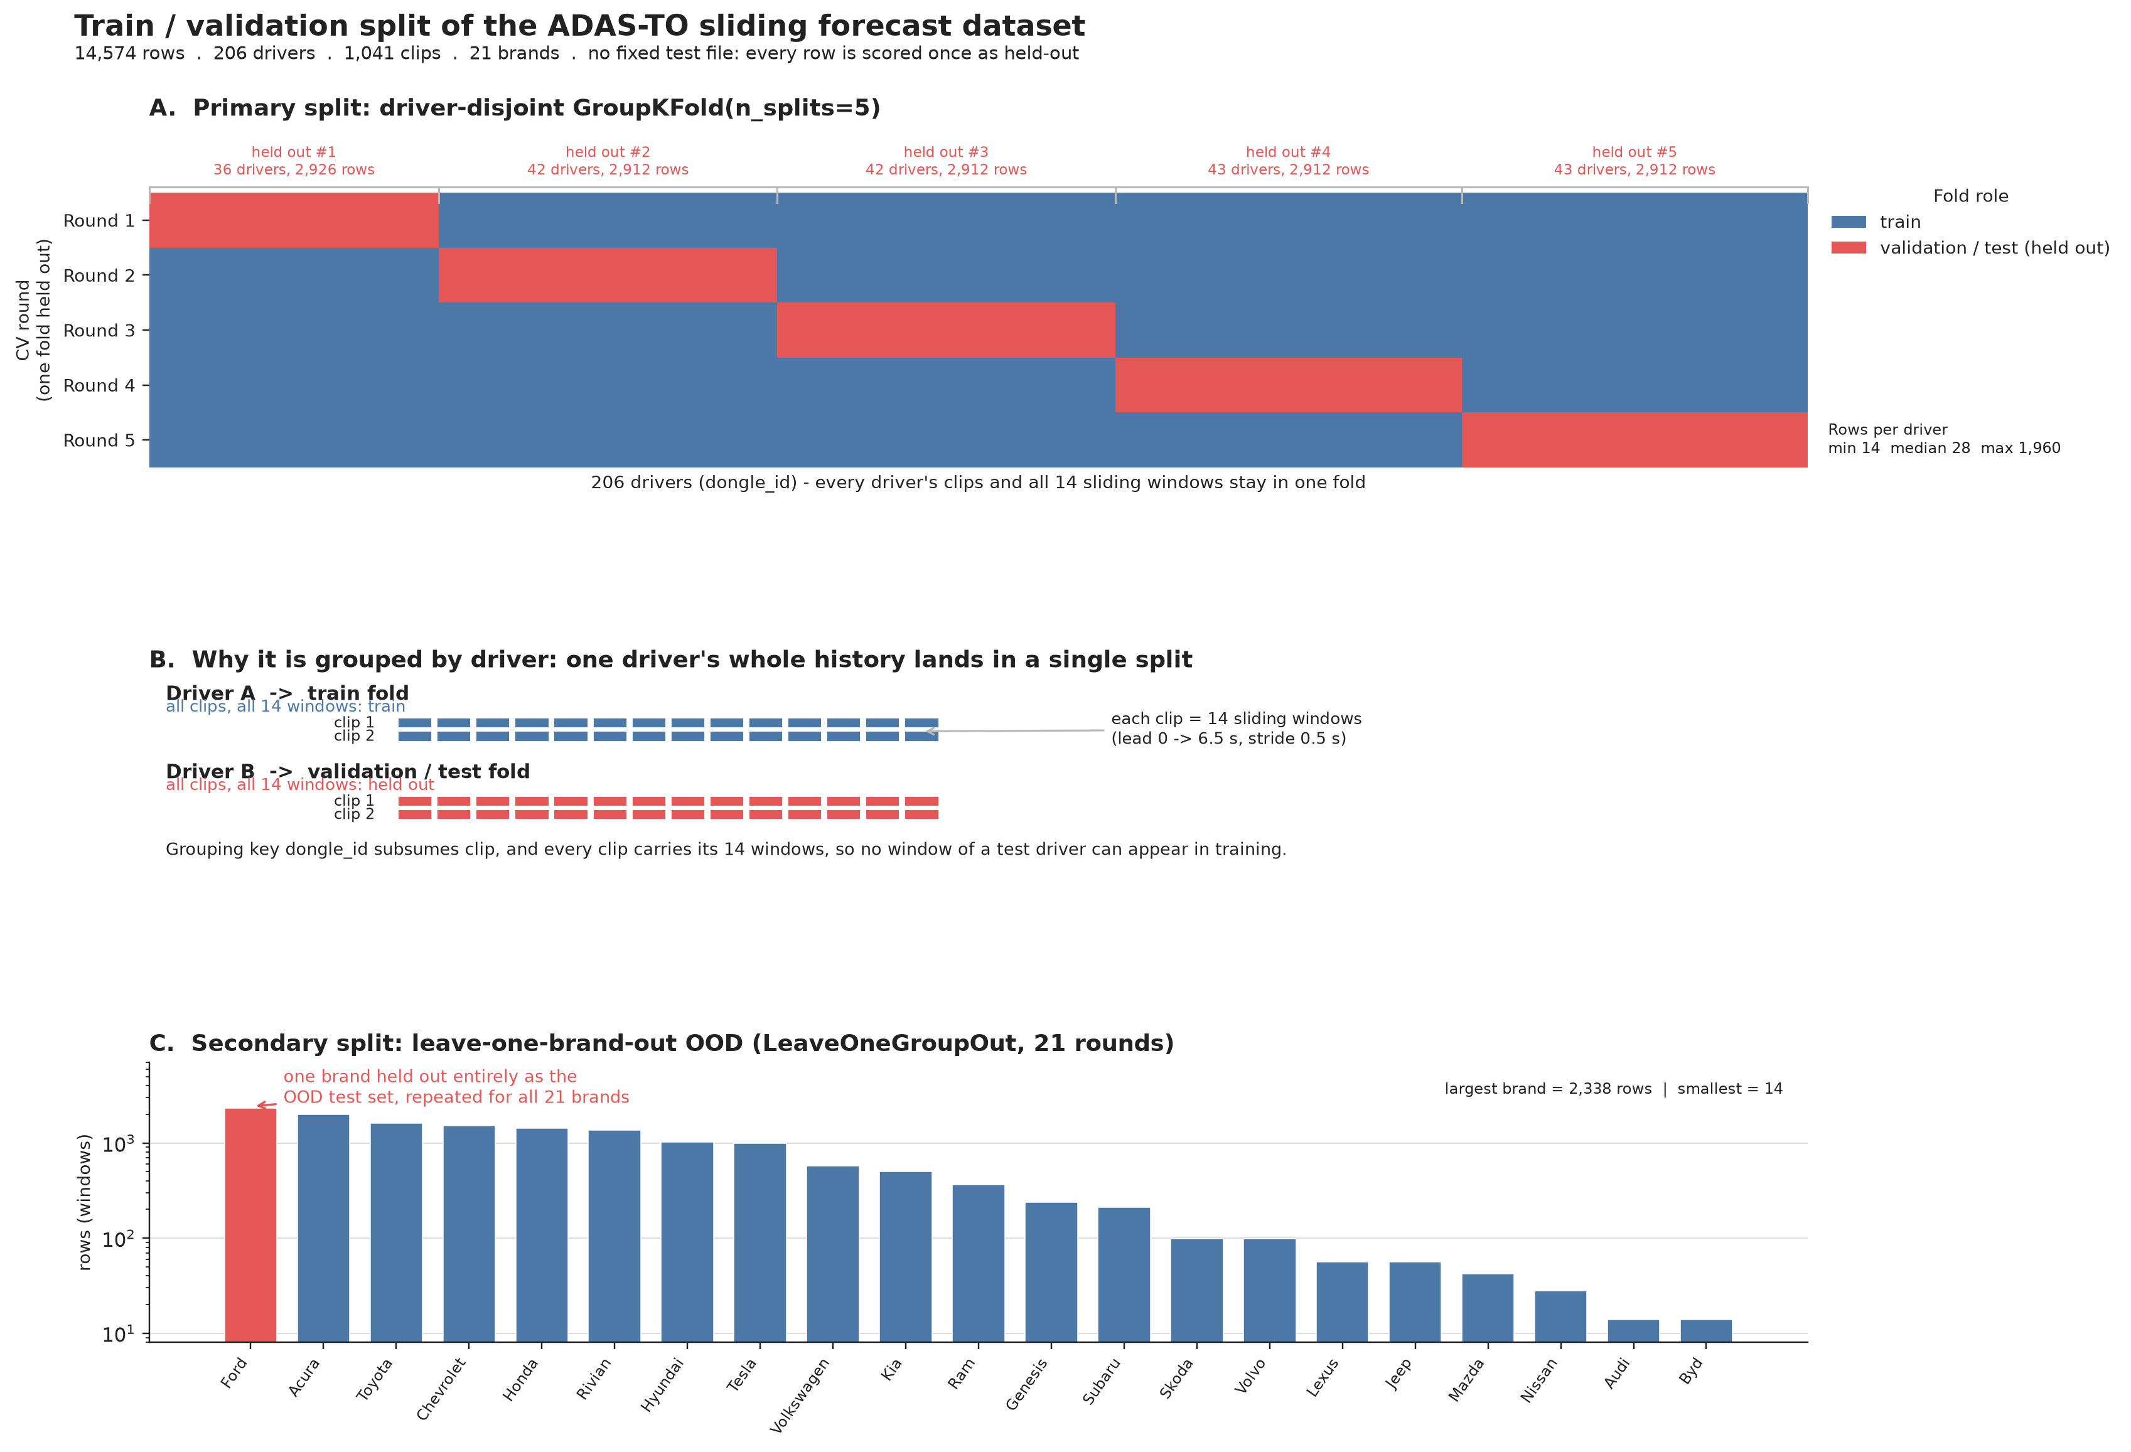
The split: driver-disjoint, balanced by clip count
• Group key = driver (dongle_id). All of a driver's clips stay in one split.
• Why: 208 drivers, median 2 clips, top driver = 13.4% of rows — clip balancing
• stops one driver skewing a split.
• Fixed split: train 625 / val 209 / test 209 rows.
• Honest scoring: test clips are never seen by the model that scores them.

Slide 4
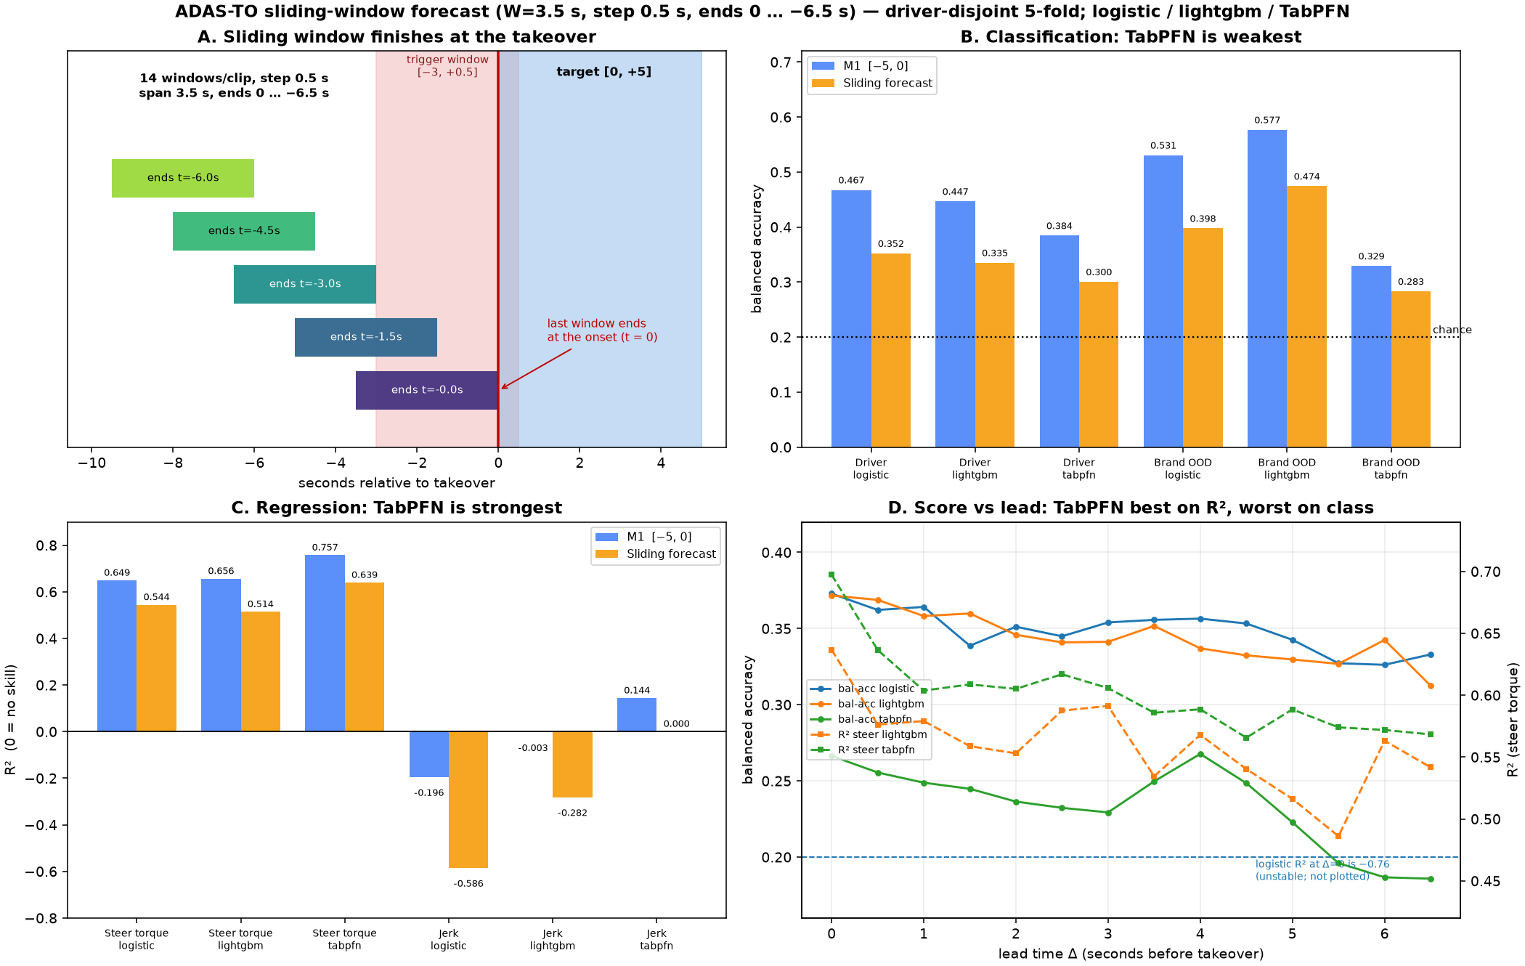
Experiment 1 — CAN-only baseline (frozen for ablations)
metric | lightgbm | tabpfn
maneuver bal-acc | 0.335 | 0.300
macro-F1 | 0.306 | 0.244
steer-torque R² | 0.514 | 0.639
jerk R² | −0.282 | 0.000
• Driver-disjoint CV on the sliding forecast table (14,574 windows).
• Steer-torque R² ≈ 0.51–0.64 is the real signal: pre-window kinematics predict post-takeover steering intensity.
• Maneuver class is weak (bal-acc 0.30–0.34 vs 0.25 chance); jerk is not predictable (R² ≈ 0).
• This is the CAN baseline both feature ablations are diffed against.

Slide 5
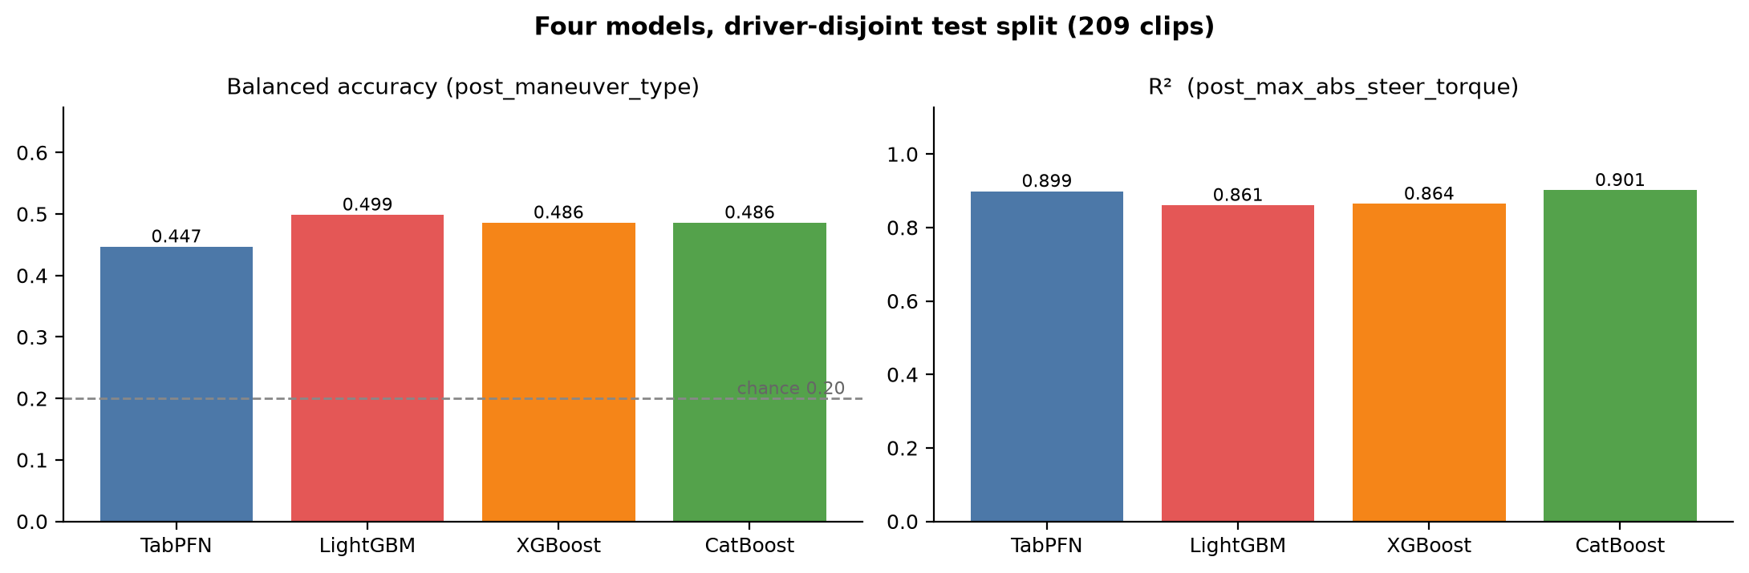
Experiment 2 — four models on the test split
model | bal-acc | macro-F1 | accuracy | steer R²
tabpfn | 0.447 | 0.378 | 0.388 | 0.899
lightgbm | 0.499 | 0.498 | 0.694 | 0.861
xgboost | 0.486 | 0.484 | 0.684 | 0.864
catboost | 0.486 | 0.485 | 0.684 | 0.901

Slide 6
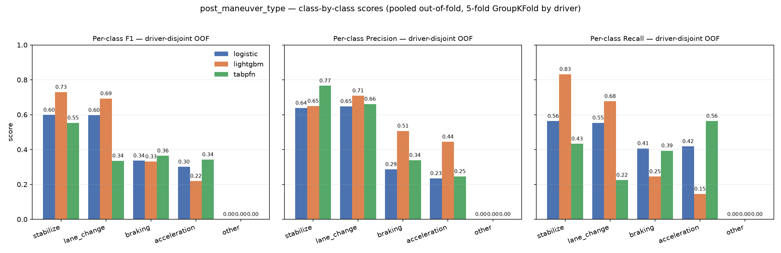
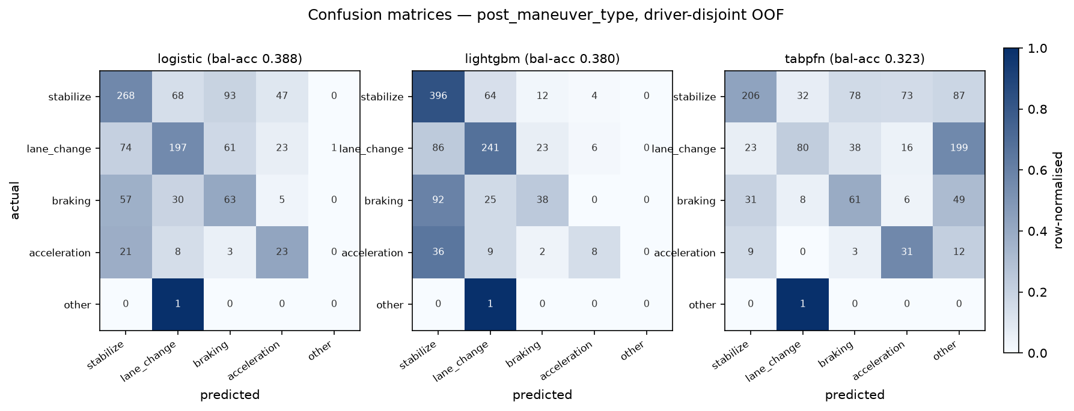
Per-class behaviour

Slide 7
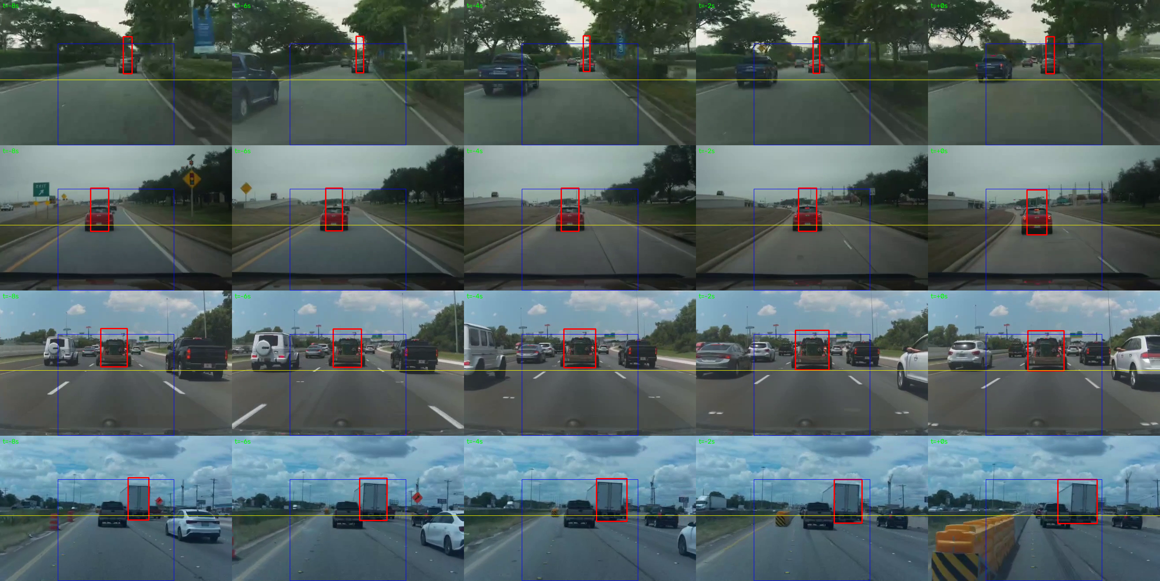
Experiment 3 — YOLOv8n vision features (null result)
metric | CAN | CAN+vision | CAN+light
maneuver bal-acc (tabpfn) | 0.300 | 0.305 | 0.306
steer R² (lightgbm) | 0.514 | 0.533 | 0.546
bal-acc brand-OOD (lgbm) | 0.474 | 0.433 | 0.467
• alignment QA: median Spearman 0.75, 83% positive — PASS
• The detector is not the excuse: it matches radar's lead in 94% of lead windows.
• Net gain is noise, and it reverses out-of-distribution (brand-OOD).
• Read as a clean null, not a failure of the model.

Slide 8
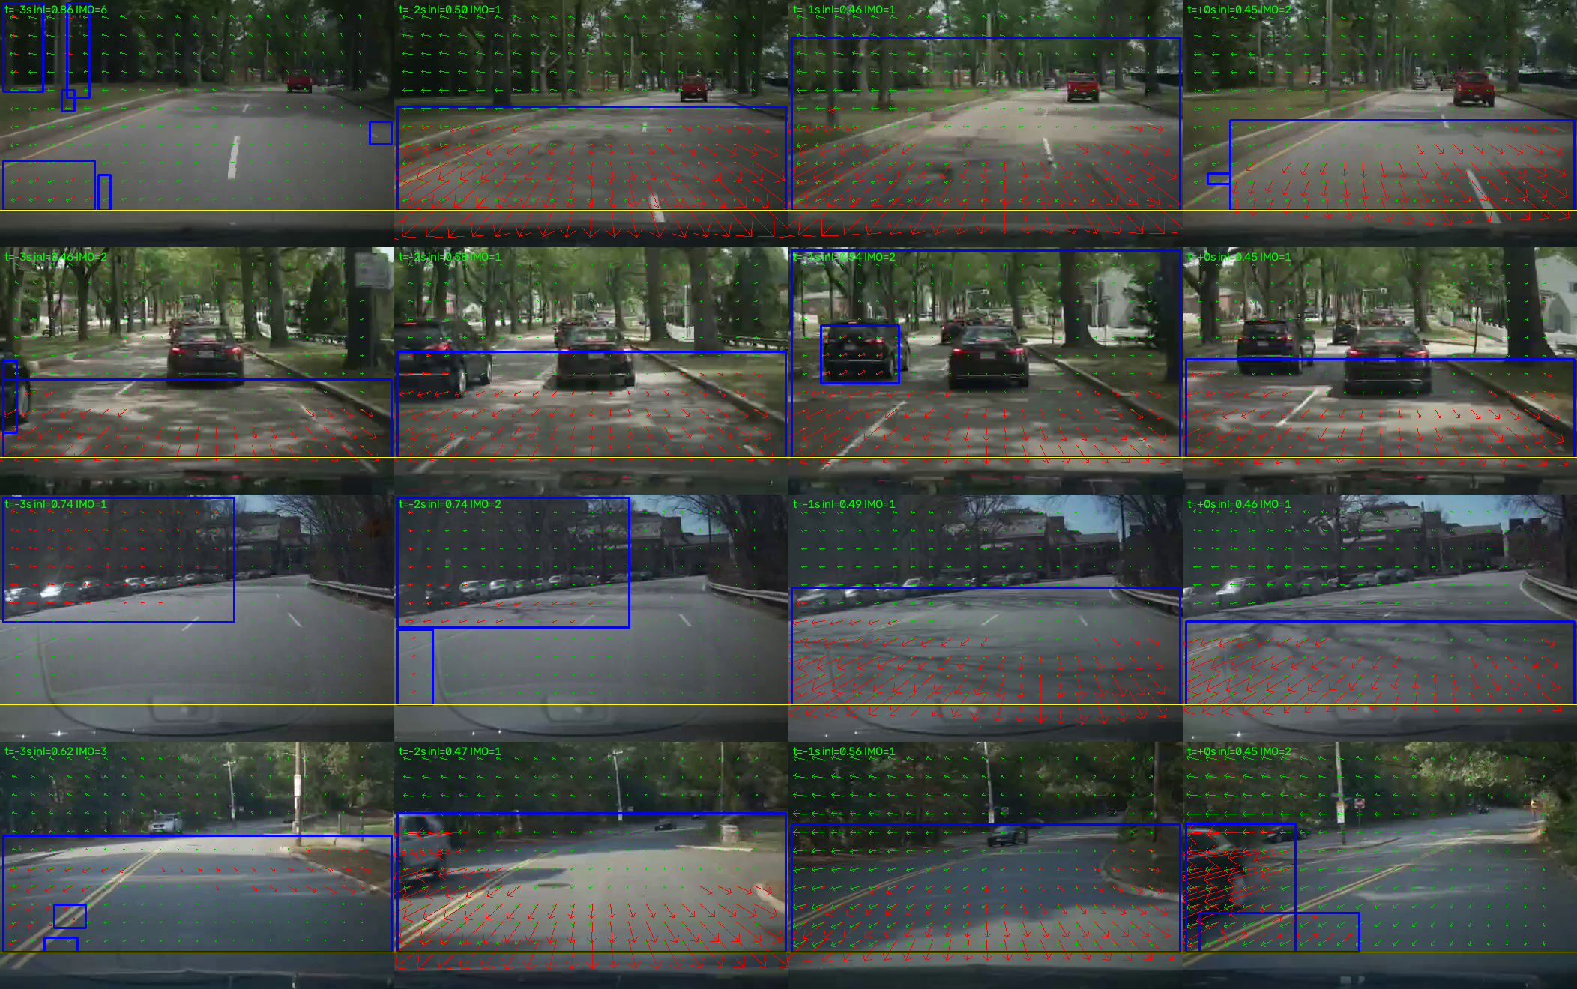
Experiment 4 — optical-flow features (null result)
metric | CAN | flow only | CAN+flow
maneuver bal-acc (lgbm) | 0.335 | 0.290 | 0.334
steer R² (lgbm) | 0.514 | −0.409 | 0.547
bal-acc brand-OOD (lgbm) | 0.474 | 0.350 | 0.460
• alignment QA: median Spearman -0.026, 55% negative — FAIL (radar cross-check)
• Pooled bump does not survive the non-radar / brand-OOD test.
• Residual is dominated by ego motion (largest blob ≈ 12% of frame).
• Verdict: third feature family, third null result.

Slide 9
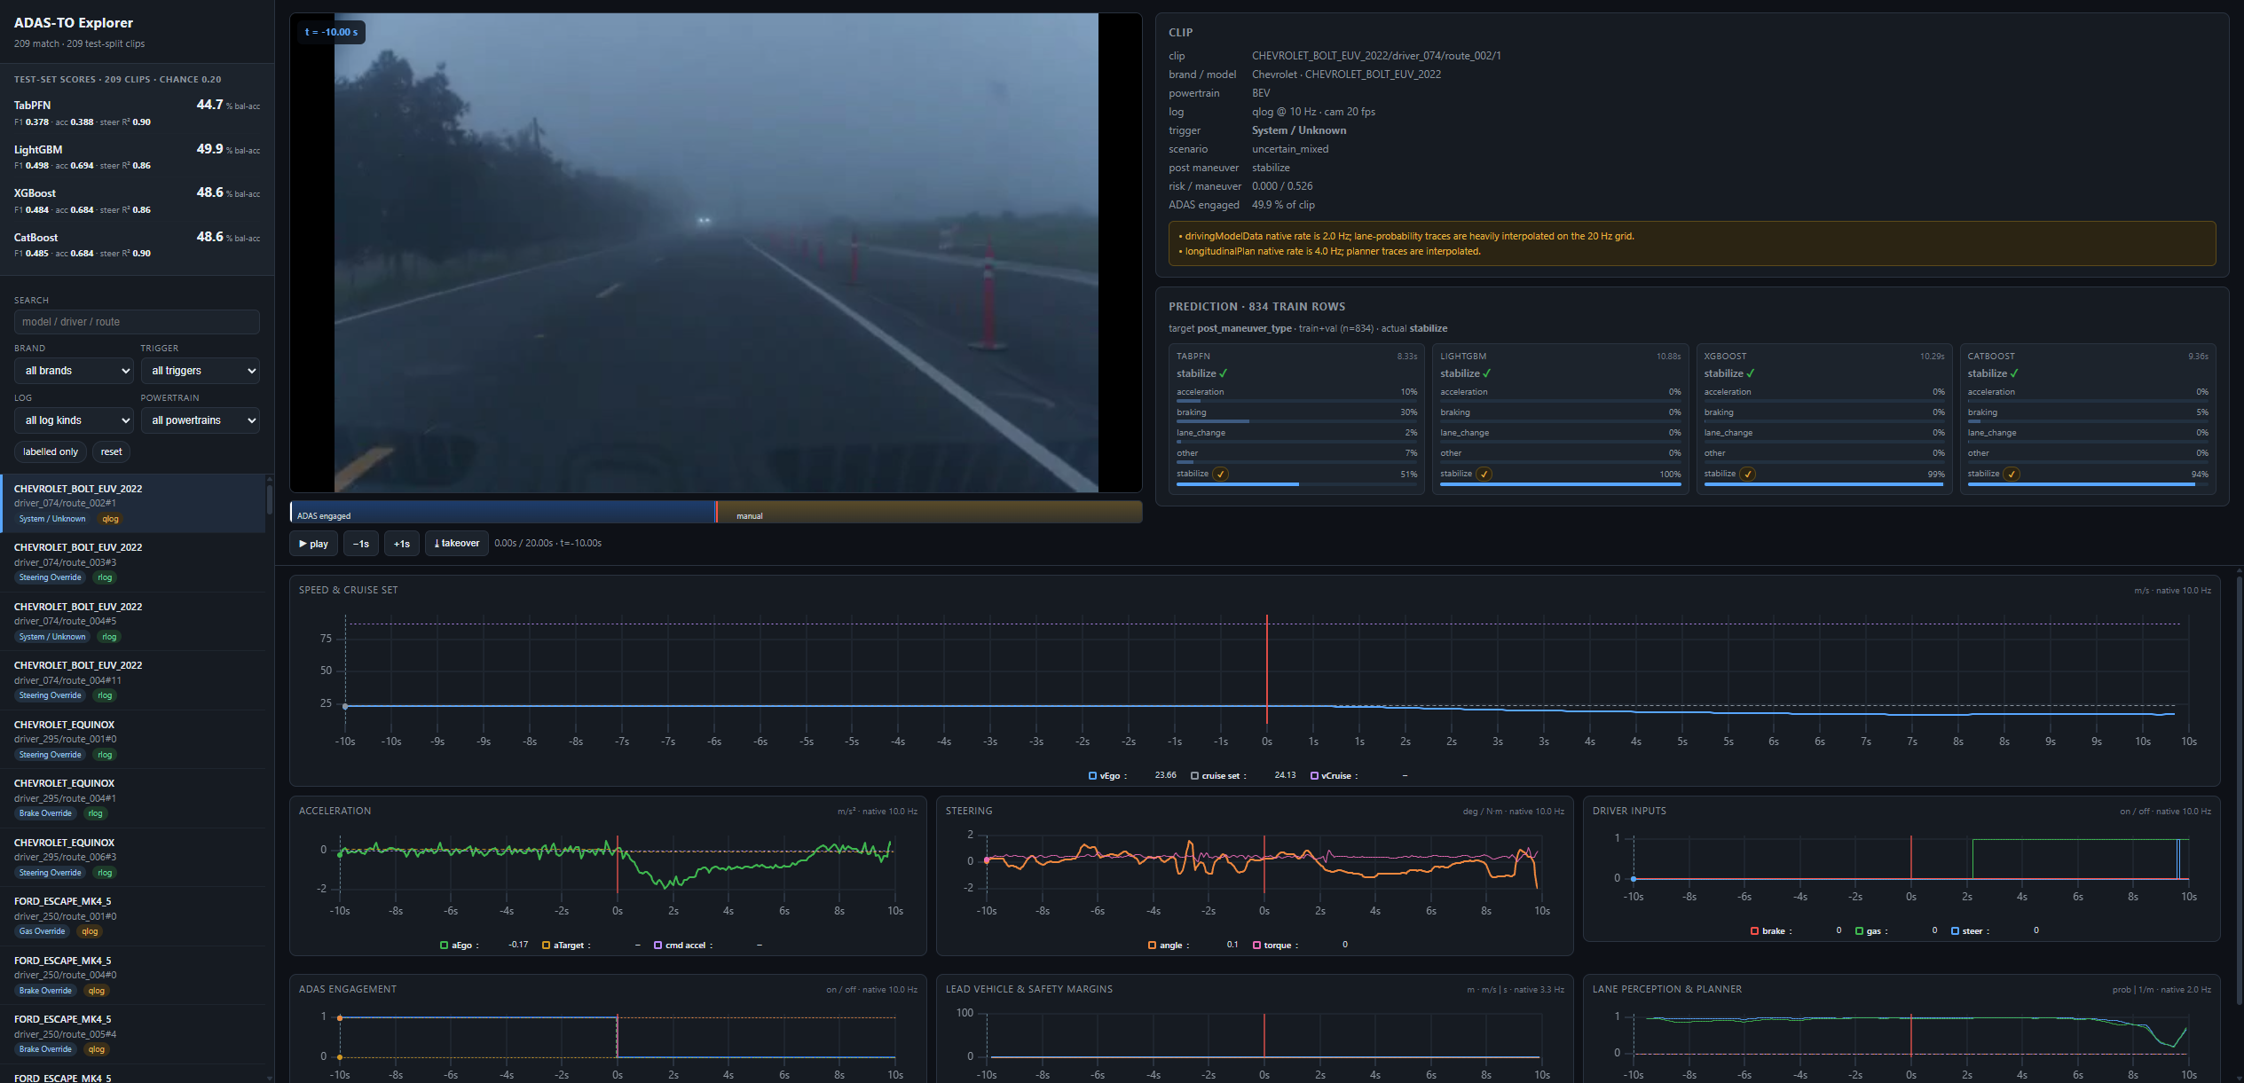
The explorer — four models, live, on held-out clips
• Shows test-split clips only.
• Each column = one model, filled asynchronously as its prediction lands.
• Per-model timing shown; TabPFN uses fit_with_cache.
• Top-left score cards = batch test-set metrics.

Slide 10
Takeaways
• Pre-takeover CAN signals genuinely predict post-takeover steering intensity (steer R² ≈ 0.51–0.66); the maneuver class is only weakly predictable.
• On the held-out test split: LightGBM leads the class task (bal-acc 0.499); CatBoost / TabPFN lead intensity regression (R² 0.90).
• Vision geometry and optical flow both add nothing net once the split is cross-platform — pooled gains reverse under brand-OOD.
• Guardrails matter: driver-disjoint splits, no trigger leakage, honest metrics.
• Reproduce with scripts/run_experiments.py and scripts/score_test.py; explore with app/server.py.

