Slide 1
BMW PRODUCT INTELLIGENCE
Which customer needs
shape the next vehicle?
Evidence to requirements. PMs in control.
Customer feedback
Product data
Market research
Spreadsheets and studies
Catalogs, options and sales
Rival products and trends
From scattered sources to a requirement the PM can defend.
Requirement Evidence Engine | BMW hackathon prototype
01
Notes:
TIMING: 0:00–0:20
SPEAKER SCRIPT
Imagine you're defining the successor to a vehicle. Customer complaints sit in spreadsheets, equipment details in PDFs, and competitor claims across the web. How do you turn that evidence into a requirement you can defend? That's the question behind BMW Product Intelligence.
DELIVERY CUE
Open with the question. Pause before introducing the project.
CLAIM BOUNDARY
Product problem and intended outcome; no claim of measured time savings.
SOURCE SNAPSHOT: 0fa94c3
SOURCES
docs/idea.md
docs/architecture/00-overview.md
docs/requirements/README.md

Slide 2
BMW PRODUCT INTELLIGENCE
A shared evidence base.
Every source stays traceable.
13,771
1,627
Customer-study cells
198
Equipment options
Customer comments
Loaded from the provided BMW files.
Original file and location preserved.
149
Catalog text passages
China has study and sales data, but no customer feedback in this dataset.
Requirement Evidence Engine | BMW hackathon prototype
02
Notes:
TIMING: 0:20–0:50
SPEAKER SCRIPT
The provided BMW files are already loaded into a shared evidence base: over thirteen thousand customer comments, plus customer studies, product catalogs, equipment options, and sales. Retrieval keeps the original file and location. Markets remain separate, and coverage gaps stay visible. For example, China has study and sales data, but no customer feedback in this dataset.
DELIVERY CUE
Let the audience read the large number. Do not read every statistic aloud.
CLAIM BOUNDARY
Documented loaded-data snapshot: 13,771 comments, 1,627 study cells, 198 equipment options, 149 catalog passages, 36 sales records. Study cells are not respondents. China has zero customer feedback in this dataset.
SOURCE SNAPSHOT: 0fa94c3
SOURCES
docs/architecture/03-ingestion.md
docs/architecture/11-knowledge-layer.md
docs/decisions/0007-option-availability-and-ontology-seed.md
docs/decisions/0008-knowledge-layer-normalization-and-retrieval.md
backend/app/knowledge/library.py

Slide 3
BMW PRODUCT INTELLIGENCE
AI proposes.
The PM decides.
"What should improve for the next G60 in the US?"
Ask
Plan
Review
Draft
Choose the vehicle,
market and question.
See the agents
and why they matter.
Inspect each
cited contribution.
Turn accepted
evidence
into a requirement.
Accept
Edit
Retry
Reject
Backend: runner + Critic + PM actions. Next: connect the live frontend.
Requirement Evidence Engine | BMW hackathon prototype
03
Notes:
TIMING: 0:50–1:25
SPEAKER SCRIPT
The PM starts with a question: what should improve for the next G sixty in the US? The planner chooses relevant agents and explains why. The backend runner now executes them behind Critic checks, and supports four PM actions: accept, edit, retry, or reject. Acceptance starts the next step using accepted evidence. The live frontend currently shows planning; connecting its review controls is the next integration.
DELIVERY CUE
Explain the backend workflow, then distinguish it from the current frontend. Say G sixty naturally.
CLAIM BOUNDARY
The runner and step-action endpoints are implemented and fixture-tested. Every agent passes through Critic checks with one automatic retry. The frontend does not call these execution endpoints yet. Edit changes the summary only. Full live execution was not validated for this presentation.
SOURCE SNAPSHOT: 0fa94c3
SOURCES
docs/architecture/02-orchestration-and-human-in-the-loop.md
docs/decisions/0005-chat-entry-and-orchestrator-planned-steps.md
docs/decisions/0012-planner-proposes-code-validates.md
docs/decisions/0013-frontend-uses-only-the-backend-api.md
backend/app/orchestration/catalog.py
docs/decisions/0014-all-roster-agents-implemented.md
docs/decisions/0015-step-runner-and-step-output-on-the-step.md

Slide 4
BMW PRODUCT INTELLIGENCE
Every priority has a reason.
Source row or page
Retrieved evidence
Proposed requirement
PM-EDITABLE SCORING
Priority and confidence
stay separate.
Customer relevance
Business signal
Strategic fit
Effort
High potential, thin evidence stays
visible.
PM decisions record what changed and why.
Requirement Evidence Engine | BMW hackathon prototype
04
Notes:
TIMING: 1:25–2:00
SPEAKER SCRIPT
The output is designed to be a requirement with supporting sources, a defensible target, and explicit assumptions. In the prototype, the PM can inspect and change the scoring components: customer relevance, business signal, strategic fit, and effort. Confidence stays separate from priority. A promising idea with thin evidence must look different from a well-supported one. Decisions carry reasons, so the review can be explained later.
DELIVERY CUE
Emphasize that confidence and priority answer different questions. Avoid presenting illustrative scores as validated recommendations.
CLAIM BOUNDARY
Cited retrieval, agent scoring and step audit events exist. The UI demonstrates editable scoring on fixtures. The runner retains outputs on steps, not in finding, requirement or score backlog tables. Business signal can use catalog-standard availability as an explicitly thin proxy; it is not observed customer option uptake.
SOURCE SNAPSHOT: 0fa94c3
SOURCES
docs/architecture/04-data-model.md
docs/architecture/06-prioritization.md
docs/architecture/07-audit-trail.md
docs/requirements/03-requirements-and-prioritization.md
docs/decisions/0011-local-demo-frontend-and-vercel.md
frontend/src/data.ts
docs/decisions/0014-all-roster-agents-implemented.md
docs/decisions/0015-step-runner-and-step-output-on-the-step.md

Slide 5
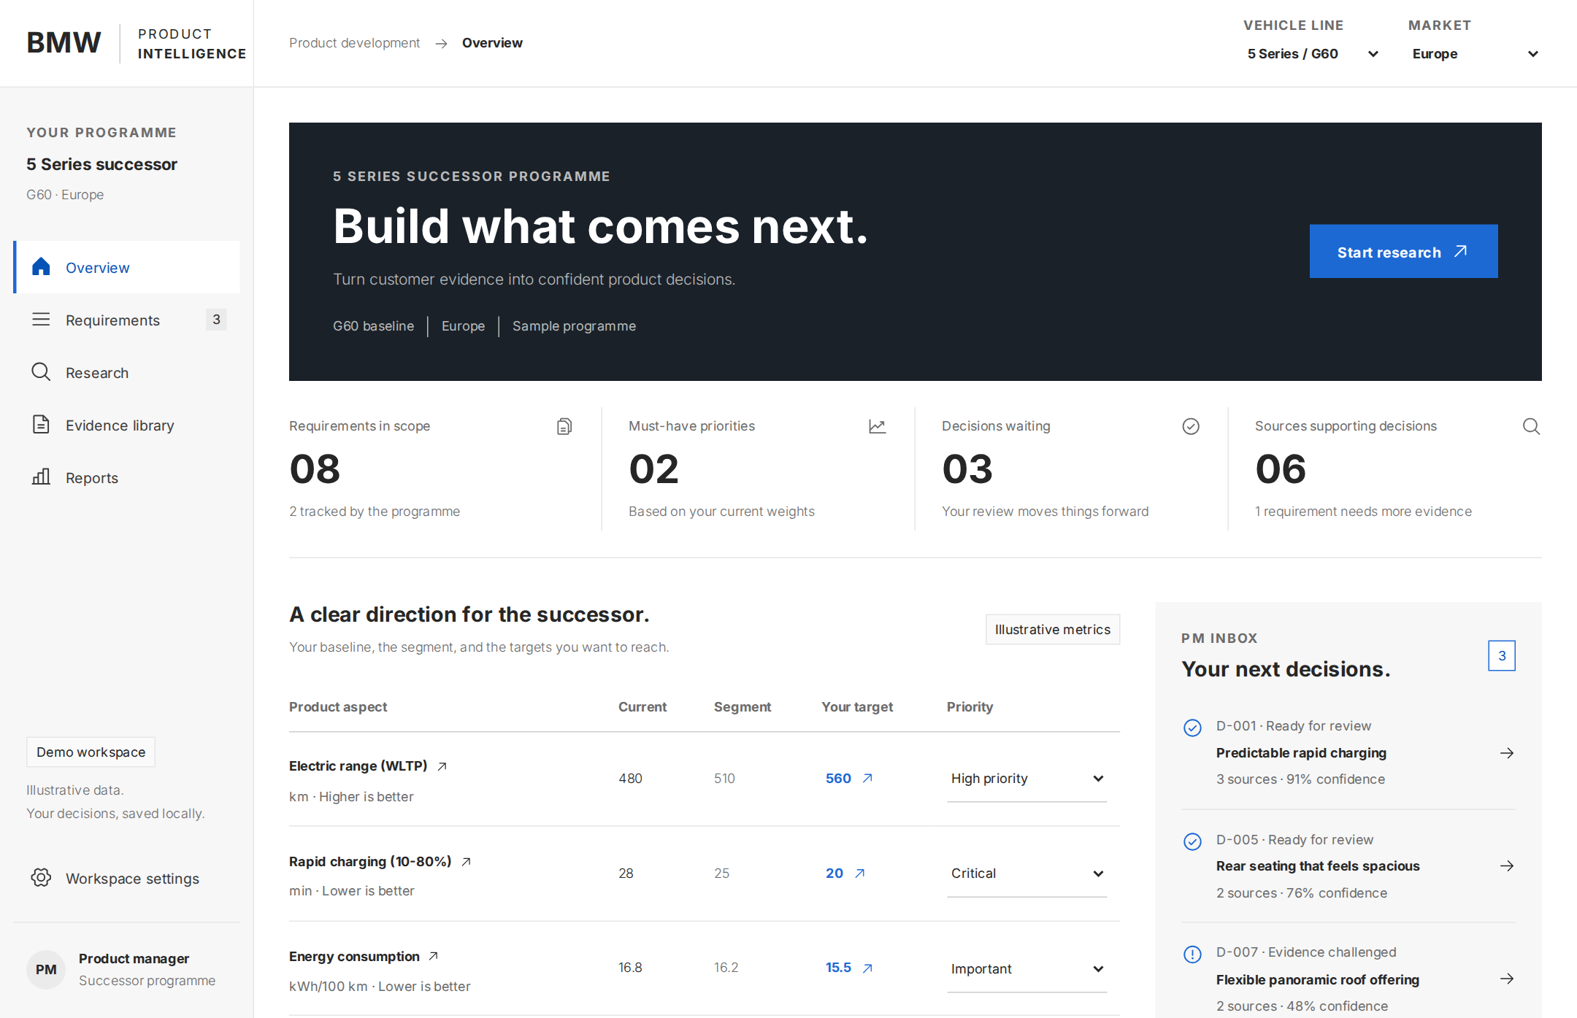
BMW PRODUCT INTELLIGENCE
A working foundation.
A clear next step.
IMPLEMENTED BACKEND
Cited search and planning
Agent runner + Critic
PM review endpoints
FRONTEND DEMO
Targets, requirement reviews
and reports on sample data.
NEXT: UI wiring + backlog writes
Actual deployed workspace. Clearly labeled illustrative data.
Requirement Evidence Engine | BMW hackathon prototype
05
Notes:
TIMING: 2:00–2:35
SPEAKER SCRIPT
Today, ingestion, cited retrieval and live planning work. The backend also has the agent modules, step runner, Critic checks, and PM review endpoints. These additions are fixture-tested; their full live path is not yet validated. The public workspace shows targets, reviews and reports on labeled sample data. Next, connect the live frontend and persist accepted outputs into the requirement backlog. The foundation is inspectable without treating demo decisions as verified BMW recommendations.
DELIVERY CUE
Point to the real workspace screenshot. Distinguish implemented backend code from verified live operation and the public sample-data demo.
CLAIM BOUNDARY
All roster modules and the backend runner are implemented per ADRs 0014 and 0015. The new agents were tested with fixtures, not validated end to end against the live services. The runner writes JSON outputs to steps and audit events; it does not write accepted requirements to backlog tables. Public Vercel remains a static fixture demo.
SOURCE SNAPSHOT: 0fa94c3
SOURCES
frontend/README.md
docs/decisions/0011-local-demo-frontend-and-vercel.md
docs/decisions/0013-frontend-uses-only-the-backend-api.md
docs/architecture/01-agents.md
docs/decisions/0009-web-search-through-the-llm.md
backend/app/agents/market_trend_agent.py
frontend/src/lib/live.ts
docs/decisions/0014-all-roster-agents-implemented.md
docs/decisions/0015-step-runner-and-step-output-on-the-step.md

Slide 6
BMW PRODUCT INTELLIGENCE
Pilot one vehicle line.
Make the decision traceable.
Wire the workspace, then measure:
01
02
03
Time to a cited draft
Evidence coverage
PM review effort
bmw-product-intelligence.vercel.app
Try the static demo. Live evidence and planning run with the local backend.
Requirement Evidence Engine | BMW hackathon prototype
06
Notes:
TIMING: 2:35–3:00
SPEAKER SCRIPT
Our next step is a pilot on one vehicle line and market. Connect the live workspace and backlog, then measure time to a cited draft, evidence coverage, and PM review effort. The goal is a faster path to requirements the PM can defend, with the evidence and decisions attached. Thank you.
DELIVERY CUE
Close on the pilot proposal. These are proposed evaluation measures, not results already achieved.
CLAIM BOUNDARY
Pilot and evaluation measures are this pitch's proposal, inferred from the documented PM goals. No customer adoption, ROI, accuracy or time-savings result is claimed. Recurring evidence refresh, weekly reports, broader inputs and long-term tracking are roadmap items.
SOURCE SNAPSHOT: 0fa94c3
SOURCES
docs/idea.md
docs/architecture/05-requirement-lifecycle.md
docs/architecture/08-scaling-and-config.md
docs/requirements/04-pm-overview.md
docs/requirements/06-lifecycle-and-configuration.md
docs/decisions/0014-all-roster-agents-implemented.md
docs/decisions/0015-step-runner-and-step-output-on-the-step.md

Slide 7
BMW PRODUCT INTELLIGENCE | Q&A
One evidence layer.
A backend the PM can inspect.
React
FastAPI
Knowledge layer
Supabase
Frontend workspace
/api only
Search, lookup, count, cite
Postgres + pgvector
Tables: exact rows and counts.
Narrative text: hybrid search.
Every retrieval hit keeps its citation.
OpenAI: embeddings, planning, agent drafts
Runner + Critic implemented. Next: frontend wiring, backlog writes and recovery.
Requirement Evidence Engine | Backup slide
07
Notes:
TIMING: Q&A only
SPEAKER SCRIPT
React calls FastAPI through /api. Shared knowledge tools combine hybrid search with exact structured lookups and row-based citations. Supabase Postgres and pgvector store evidence, plans, steps and audit events. The in-process background runner calls agent adapters behind Critic checks. Outputs live on the step and only accepted outputs reach later agents. Frontend execution wiring, backlog writes and recovery from server interruption are still pending.
DELIVERY CUE
Use only in Q&A. Explain exact data versus semantic retrieval, rather than listing technologies.
CLAIM BOUNDARY
Backend runner and Critic checks implemented in ADR 0015. No durable execution recovery exists; interrupted background work can remain stuck. LangGraph/checkpointed execution remains planned. Agents read evidence through the shared knowledge tools.
SOURCE SNAPSHOT: 0fa94c3
SOURCES
docs/architecture/03-ingestion.md
docs/architecture/09-tech-stack.md
docs/architecture/11-knowledge-layer.md
docs/architecture/12-repo-structure.md
docs/decisions/0001-two-tier-pdf-ingestion.md
docs/decisions/0010-frontend-backend-repo-structure.md
docs/decisions/0014-all-roster-agents-implemented.md
docs/decisions/0015-step-runner-and-step-output-on-the-step.md

Slide 8
BMW PRODUCT INTELLIGENCE | Q&A
Evidence is uneven.
We show the gaps.
United States
8,783
Europe
3,292
Rest of world
1,696
China
0
Customer-feedback comments. China still has customer studies and sales data.
Study cells are not respondents. Sales forecasts are not observed outcomes.
Requirement Evidence Engine | Backup slide
08
Notes:
TIMING: Q&A only
SPEAKER SCRIPT
The documented customer-feedback coverage is 8,783 US comments, 3,292 European comments, 1,696 from the rest of the world, and zero from China. China still has studies and sales. There are 2,666 comments without a mapped domain, and the customer-study cells have no respondent counts. The 2030 sales values are forecasts. Competitor benchmarking is designed to compare the same market, source type and measurement standard; the competitor module exists, while full live validation is pending.
DELIVERY CUE
Use only in Q&A. A zero is a data-coverage gap, not proof that customers have no unmet needs.
CLAIM BOUNDARY
Documented coverage snapshot, not unique customers or a representative population. The competitor module now exists per ADR 0014, but full live validation is pending. Preserve assumptions about market and vehicle-line mappings; confirm them with BMW. Likes and reach are not respondent counts.
SOURCE SNAPSHOT: 0fa94c3
SOURCES
docs/architecture/11-knowledge-layer.md
docs/architecture/10-competitor-benchmarking.md
docs/decisions/0008-knowledge-layer-normalization-and-retrieval.md
docs/requirements/01-inputs-and-ingestion.md
docs/requirements/02-analysis-and-structuring.md
docs/decisions/0014-all-roster-agents-implemented.md
docs/decisions/0015-step-runner-and-step-output-on-the-step.md

Slide 9
BMW PRODUCT INTELLIGENCE | Q&A
What works today.
What comes next.
CAPABILITY
STATUS
WHAT IT MEANS
Ingestion + cited retrieval
Live backend
Source files, locators, exact counts
Sources + coverage + planner
Live backend
Editable plans; code validates prerequisites
All roster agents + runner + Critic
Implemented
Fixture-tested; full live validation pending
Targets, reviews and reports
Fixture demo
Working workspace on sample data
Audit persistence
Partly wired
Audit events + step output; no backlog writes
Live review UI + backlog persistence
Next
Connect reviews; store accepted results
Recovery + recurring refresh
Roadmap
Resume interrupted work; refresh evidence
Scope: customer-facing requirements. Engineering, homologation and pricing business cases stay outside.
Requirement Evidence Engine | Backup slide
09
Notes:
TIMING: Q&A only
SPEAKER SCRIPT
Ingestion, cited retrieval and live planning work. All roster agents and a backend runner with Critic checks and PM actions are implemented and fixture-tested. The public frontend still shows sample-data reviews. Next are live frontend wiring and writing accepted results into the requirement backlog. Outputs currently stay on steps. Durable execution recovery and recurring refresh remain roadmap items. No measured time saving, recommendation accuracy or customer adoption is claimed.
DELIVERY CUE
Use only in Q&A. Implemented code is distinct from live-service validation. Explain step output versus backlog persistence.
CLAIM BOUNDARY
ADRs 0014 and 0015 supersede the old Market-only agent and no-runner status. The frontend does not call execution endpoints. Agent store_result methods were not live-validated. The runner deliberately avoids backlog writes. No restart recovery or production worker model is shipped.
SOURCE SNAPSHOT: 0fa94c3
SOURCES
docs/architecture/01-agents.md
docs/architecture/02-orchestration-and-human-in-the-loop.md
docs/architecture/12-repo-structure.md
docs/decisions/0003-critic-agent-and-agent-split.md
docs/decisions/0009-web-search-through-the-llm.md
docs/decisions/0012-planner-proposes-code-validates.md
docs/decisions/0013-frontend-uses-only-the-backend-api.md
docs/requirements/05-pm-control-and-traceability.md
docs/requirements/06-lifecycle-and-configuration.md
docs/decisions/0014-all-roster-agents-implemented.md
docs/decisions/0015-step-runner-and-step-output-on-the-step.md

