Slide 1


Territorial Information Retrieval from Heterogeneous Open Data through the Construction of a Data Warehouse for Water Management in Mexico City
5th International Conference on Ontologies and Knowledge Graphs
Eduardo Uriel Velázquez Arrieta · Omar Fernando Pulido Morales
Emilio García López · Clara Aide Hernández Martínez · Gabriel Hurtado Avilés
Escuela Superior de Cómputo (ESCOM) · Instituto Politécnico Nacional · Mexico City
Session: Data Warehousing and Geospatial Modeling
Thursday, September 24, 2026 · 14:20–14:40 · Virtual · SPRINGER
Notes:
Good afternoon, and thanks to the session chair. On behalf of my co-authors from ESCOM, Instituto Politécnico Nacional, I will present how we turned Mexico City's heterogeneous open water data into a data warehouse, how we republished it as a validated knowledge graph, and how we kept the whole system alive as a demonstration that needs no server. [~30 s]

Slide 2
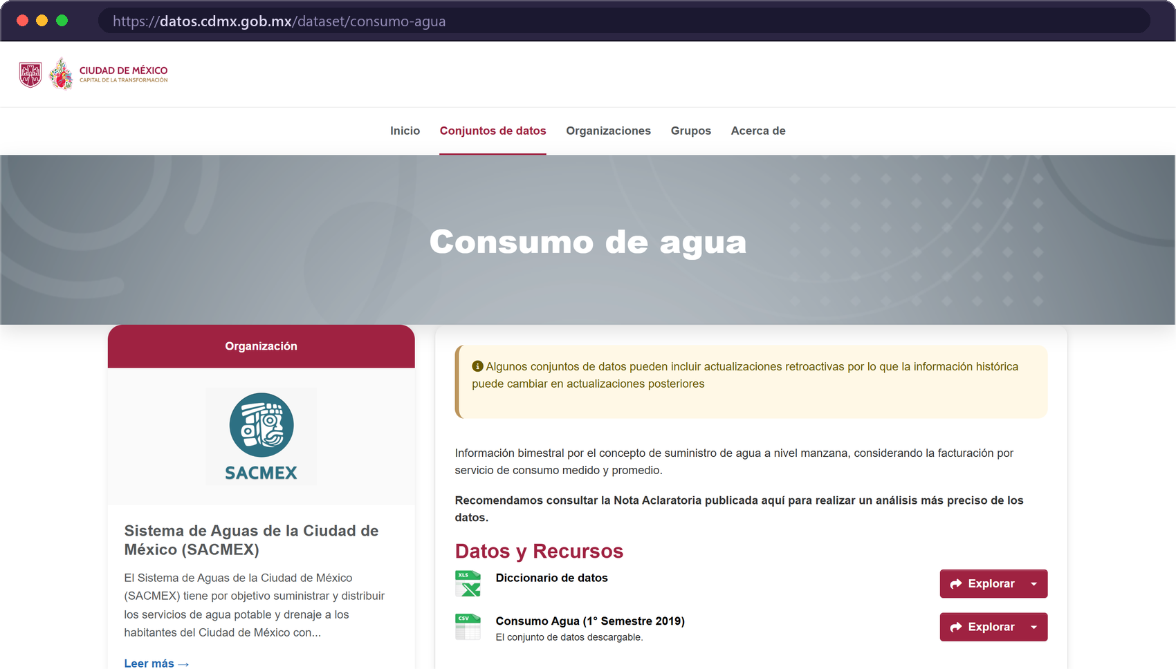



Open water data exist, but they cannot be queried
01 · MOTIVATION
A city under water stress
Aquifer overexploitation, network leaks and population growth.
71,102 block-level records
One CSV covering only the first semester of 2019, published once and never versioned.
No query tooling
Poorly accessible formats: no filters, no territorial retrieval, no map.
GOAL
Turn dispersed open data into queryable information for urban diagnosis, research and citizen monitoring.
Source: SACMEX · Mexico City Open Data Portal. The dataset holds a single resource: “Consumo Agua (1er Semestre 2019)”.
Velázquez Arrieta et al. · ICOKG 2026
02 / 18
Notes:
Mexico City faces a water crisis: the aquifer is overexploited, the network leaks and the population keeps growing. SACMEX does publish consumption data, but as you can see on the portal it is a single CSV, the first semester of 2019, published once and never versioned, and there is no tool to query it. So the data exist, but they are not usable for evidence-based decisions. Our goal was to turn those dispersed files into queryable information for diagnosis, research and citizen monitoring. [~1 min]

Slide 3



Three methodological contributions
02 · CONTRIBUTIONS
1
2
3
Reproducible ETL
→ dimensional data warehouse
Declarative R2RML
→ validated RDF knowledge graph
Continuous deployment
→ always-on static demo
Consolidates official SACMEX open data into a PostgreSQL star schema.
Republishes the star schema with RDF Data Cube, GeoSPARQL, SKOS and OWL-Time.
A dynamic PostgreSQL deployment plus a static version on GitHub Pages that needs no server.
70,886 facts · 99.70 % yield
IC-1 · IC-2 · IC-3 · IC-11: 0 violations
4 views · 0 servers · frozen release
Velázquez Arrieta et al. · ICOKG 2026
03 / 18
Notes:
The contribution is threefold. First, a reproducible ETL that consolidates the SACMEX files into a dimensional star schema: 70,886 facts, 99.7 % of the source. Second, a declarative R2RML mapping that republishes that star schema as an RDF knowledge graph; its Data Cube structure passes the vocabulary's integrity constraints with zero violations. Third, a deployment methodology: besides the dynamic PostgreSQL deployment there is a static version on GitHub Pages, so the demonstration never dies. [~1 min]

Slide 4
Where this work sits
03 · RELATED WORK
Water
domain
Open gov.
data
DW +
ETL
Knowledge
graph (RDF)
Reproducible
public demo
Soares et al. 2019
DW for water supply and consumption (operational data)
Abecker et al. 2014
WatERP: sensor + semantic data warehouse
Berro et al. 2015
Content-driven ETL for open data
Vetrò et al. 2016
Open-data quality measurement framework
Hill et al. 2023
Open-source dashboard for wastewater surveillance
This work
SACMEX open data → DW → KG → static demo
Synthesis of the paper's related-work section.
core focus
adjacent domain
not addressed
Gap: to the best of our review, no peer-reviewed, reproducible data warehouse had been built specifically over SACMEX / CDMX open data.
Velázquez Arrieta et al. · ICOKG 2026
04 / 18
Notes:
Water data warehouses exist, such as Soares et al. or the WatERP project, but they start from operational data, SCADA or proprietary sensors, not from open government data. The open-data literature, Berro and Vetrò, documents exactly the heterogeneity and quality problems we faced, but not in this domain. Hill et al. show a reproducible dashboard for wastewater. As far as we could find, nobody had built a peer-reviewed, reproducible warehouse over SACMEX data. [~45 s]

Slide 5
From 71,102 raw rows to 70,886 facts
04 · DATA & ETL
1
Extraction
2
Validation & cleaning
3
Staging & dimensions
4
Fact tables
Read the SACMEX consumption CSV and the Open-Meteo climate CSV.
Discard empty fields, inconsistent coordinates, incompatible formats.
COPY into staging; unique values populate the three dimensions.
Join staging × dimensions into fact_consumo_agua and fact_clima.
CSV
INNER JOIN
1_copy · 2_dim · 2_geo
3_fact.sql
CLEANING YIELD
SCOPE AND GRAIN
70,886 loaded · 99.70 %
216 discarded · 0.30 %
71,102 source records
3 bimesters · Jan–Jun 2019
22,930 block coordinates
1,553 neighbourhoods
Unmatched territorial label (literal “NA”)
216
Missing development index
0
16 boroughs (alcaldías)
181 daily climate records
Reading date absent from the time dimension
0
Velázquez Arrieta et al. · ICOKG 2026
05 / 18
Notes:
The pipeline has four phases: extraction of the two CSV files, validation and cleaning, loading into staging and populating the dimensions, and populating the fact tables. The exclusion criteria are enforced structurally by inner joins, so we could count exactly what was lost: 216 rows, 0.3 %, and a single criterion explains all of them, the literal NA in both territorial fields. That is a property of the SACMEX export rather than a merit of our process. Note the grain: one fact is one city block in one billing period, so every neighbourhood figure is a roll-up. [~1 min]

Slide 6




Layered architecture, two deployments
05 · ARCHITECTURE
SOURCES
ETL
DATA
QUERY
PRESENTATION
SACMEX consumption CSV
Open-Meteo climate CSV
Python + SQL
0_schema · 1_copy
2_dim · 2_geo · 3_fact
PostgreSQL 16
Star schema
Docker container
Parameterized SQL
R2RML → RDF
RDF Data Cube
HTML · CSS · JS
Leaflet · Plotly
Comunica SPARQL
Dynamic deployment
Complete architecture over PostgreSQL. Serves the parameterized queries and produced every result reported in the paper.
Static version · GitHub Pages
JSON, GeoJSON and Turtle exports of the warehouse. Querying, filtering, aggregation and visualisation run in the browser.
gabrielhuav.github.io/Data_Warehouse_static/
docker compose up -d --build
Velázquez Arrieta et al. · ICOKG 2026
06 / 18
Notes:
The system is layered: sources, an ETL in Python and SQL, a PostgreSQL star schema in a container, a query layer with parameterized SQL and, over it, the declarative RDF projection, and an HTML and JavaScript frontend with Leaflet and Plotly. It is published twice. The dynamic deployment produced the results of the paper. The static version exports the warehouse as JSON, GeoJSON and Turtle, so everything runs in the browser; this addresses the recurring problem of academic prototypes that stop working after evaluation. [~45 s]

Slide 7



Star schema with conformed dimensions
06 · DIMENSIONAL MODEL
dim_tiempo
181
fact_clima
181
WHY A STAR SCHEMA?
fecha · año · mes · día
bimestre
temp · humedad
lluvia
The workload is repeated aggregation of one measure over three dimensions with interactive filters.
fact_consumo_agua
70,886
Constant join depth; aggregation by a single grouped scan.
dim_ubicacion
1,553
dim_indice_des
4
consumo_total · consumo_prom
consumo_total_dom · _prom_dom
consumo_total_no_dom · …
consumo_total_mixto · …
id_tiempo · id_ubicacion
id_indice_des
alcaldía
colonia
latitud
longitud
ALTO
MEDIO
BAJO
POPULAR
A shared daily time dimension lets water and climate be queried together.
Grain: one city block (manzana) × one billing period. The location dimension is coarser than the grain, so every aggregate is a roll-up.
A graph would pay a traversal cost for joins that foreign keys already resolve.
Velázquez Arrieta et al. · ICOKG 2026
07 / 18
Notes:
The warehouse is a star schema with two fact tables: water consumption, which is the subject of the paper, and a daily climate series, joined through the shared time dimension. The conformed dimensions are time, location and the development index, which has four ordinal levels published by SACMEX. The star schema was a deliberate choice: the workload is repeated aggregation with interactive filters, which is exactly what dimensional modelling is for. [~45 s]

Slide 8

From the star schema to an RDF Data Cube
07 · KNOWLEDGE GRAPH
STAR SCHEMA · POSTGRESQL
R2RML
RDF KNOWLEDGE GRAPH
Fact row
qb:Observation
7
triples maps (R2RML)
Measures (m³)
qb:MeasureProperty
≈ 7.6 × 10⁵
Time & location dimensions
qb:DimensionProperty
triples, full materialisation
Neighbourhood + centroid
geo:Feature · geo:asWKT
71,067
observations (water + climate)
Derived adjacency ≤ 1.5 km
agua:nearbyWithin1500m
0 violations
Development index
skos:Concept (ordinal)
Data Cube IC-1, IC-2, IC-3, IC-11 on the published graph
Vocabularies: RDF Data Cube · GeoSPARQL 1.1 · SKOS · OWL-Time · PROV-O
Velázquez Arrieta et al. · ICOKG 2026
08 / 18
Notes:
Why a graph if we already have a warehouse? Because it adds interoperability, topological expressiveness and entity reconciliation; the star schema stays as the analytical store. The correspondence with the RDF Data Cube is almost mechanical: a fact row becomes a qb:Observation, measures become measure properties, dimensions become dimension properties, neighbourhoods become geo:Features with a WKT geometry, and the development index becomes an ordinal SKOS scheme. Seven R2RML triples maps derive the graph, so nobody maintains it by hand, and the published graph passes the Data Cube integrity constraints IC-1, 2, 3 and 11 with zero violations. [~1 min 15 s]

Slide 9
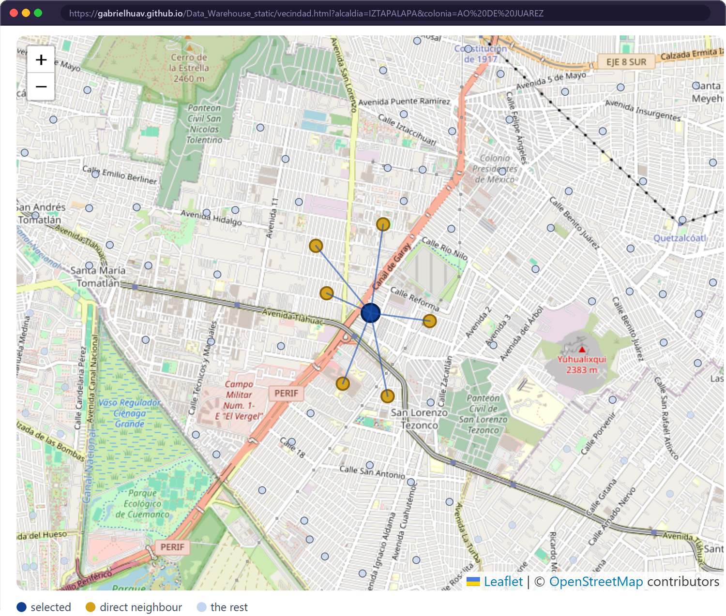
Territorial retrieval as graph traversal
08 · RETRIEVAL AS TRAVERSAL
Listing 1 · executed verbatim by vecindad.html
PREFIX agua: <https://w3id.org/cdmx/agua/>
PREFIX col: <https://w3id.org/cdmx/agua/colonia/>
PREFIX rdfs: <http://www.w3.org/2000/01/rdf-schema#>
SELECT ?vecina ?alcaldia (ROUND(SUM(?c)) AS ?consumo) WHERE {
col:465 agua:nearbyWithin1500m ?v .
?v rdfs:label ?vecina ; agua:borough ?alcaldiaIri .
?alcaldiaIri rdfs:label ?alcaldia .
?o agua:location ?v ; agua:totalConsumption ?c .
} GROUP BY ?vecina ?alcaldia ORDER BY DESC(?consumo)
140,499 triples
SPARQL 1.1 in the browser
no server
RESULT · AO DE JUÁREZ, IZTAPALAPA
TOTAL m³
MIRASOLES (U HAB)
196,176
LOMAS DE SAN LORENZO II
134,472
CERRO DE LA ESTRELLA II
101,785
CERRO DE LA ESTRELLA I
89,288
SAN NICOLAS TOLENTINO I
34,889
GUADALUPE (BARR)
17,338
Velázquez Arrieta et al. · ICOKG 2026
09 / 18
Notes:
This is what the graph adds in practice. This query, which the published interface executes verbatim, retrieves the neighbourhoods near a selected zone together with their own consumption: one traversal that the relational interface only resolves with an ad-hoc spatial self-join. It runs in the browser over a 140,499-triple subset with a vendored SPARQL 1.1 engine. One honest caveat: our geometry is the centroid of each neighbourhood, so the predicate is proximity within 1.5 km, not a GeoSPARQL topological relation like sfTouches. [~1 min]

Slide 10
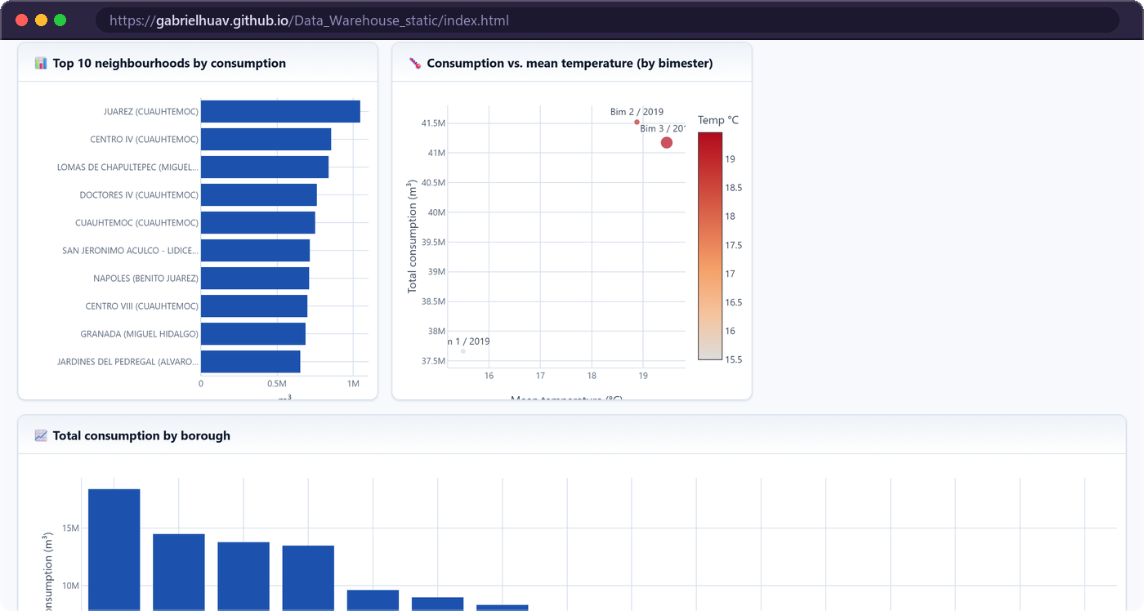
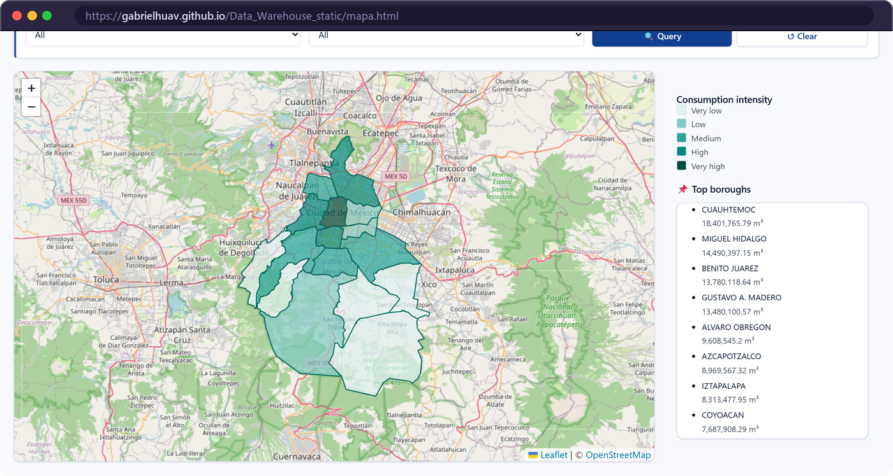

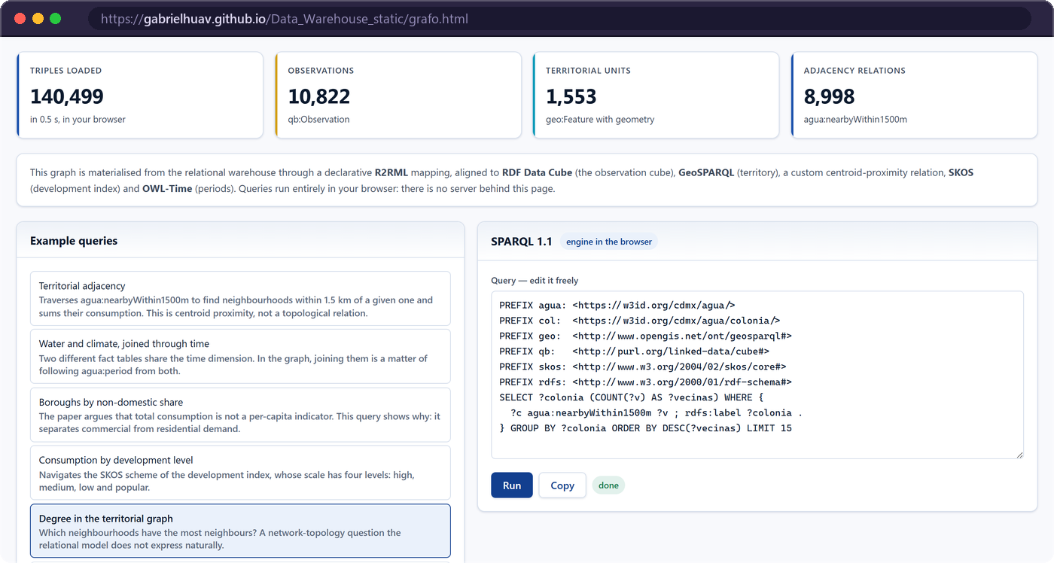
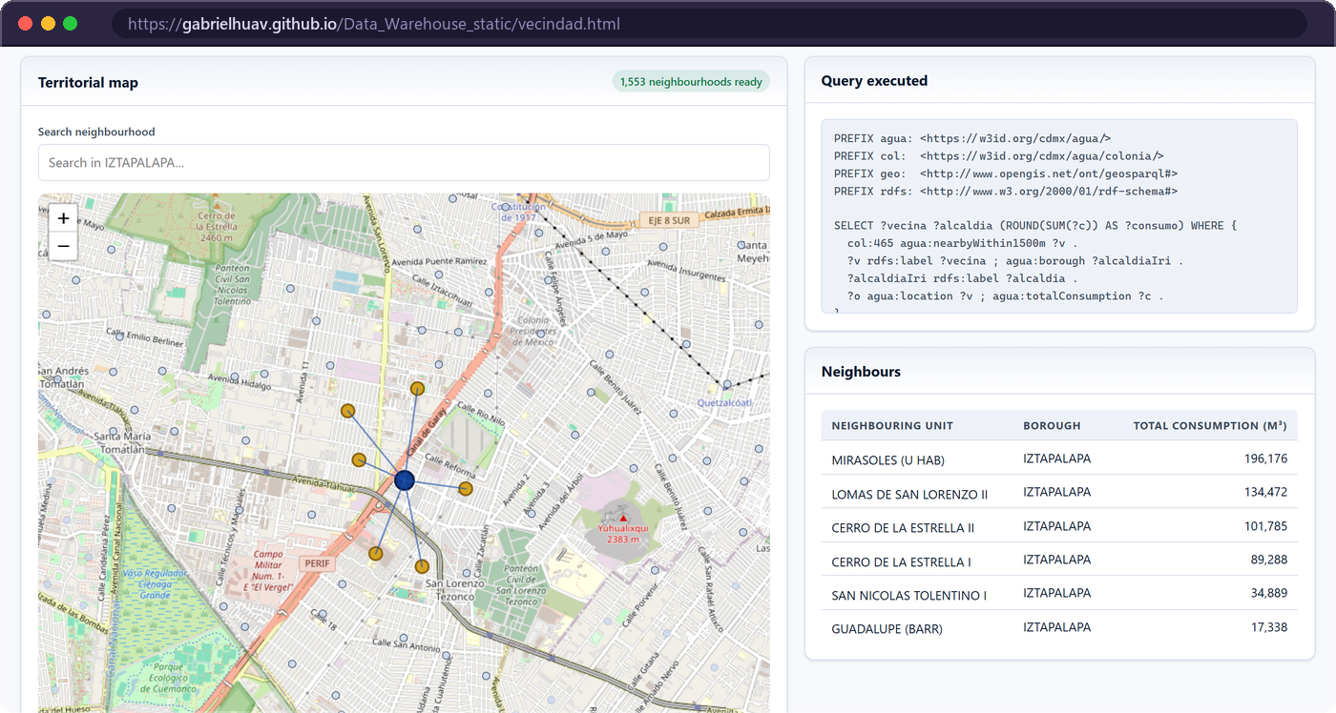
Four views, one warehouse, zero servers
09 · LIVE DEMO
TRY IT NOW
Dashboard filters, KPIs and Plotly charts
Choropleth map 16 boroughs · Leaflet + GeoJSON
gabrielhuav.github.io/Data_Warehouse_static
Runs from static files; the SPARQL engine is vendored in the release.
Spanish / English interface · light and dark modes.
Knowledge-graph explorer SPARQL 1.1 in the browser
Territorial adjacency retrieval as graph traversal
Velázquez Arrieta et al. · ICOKG 2026
10 / 18
Notes:
Everything I have shown lives in this demonstration, and you can open it right now with the QR code. It has four views over the same exported data: a dashboard with filters by year, bimester, borough, neighbourhood and development index; a choropleth map of the 16 boroughs; a SPARQL 1.1 explorer that loads the graph in your browser; and the territorial adjacency view. There is no backend at all. [~1 min — if time allows, switch to the browser for 20 seconds]

Slide 11
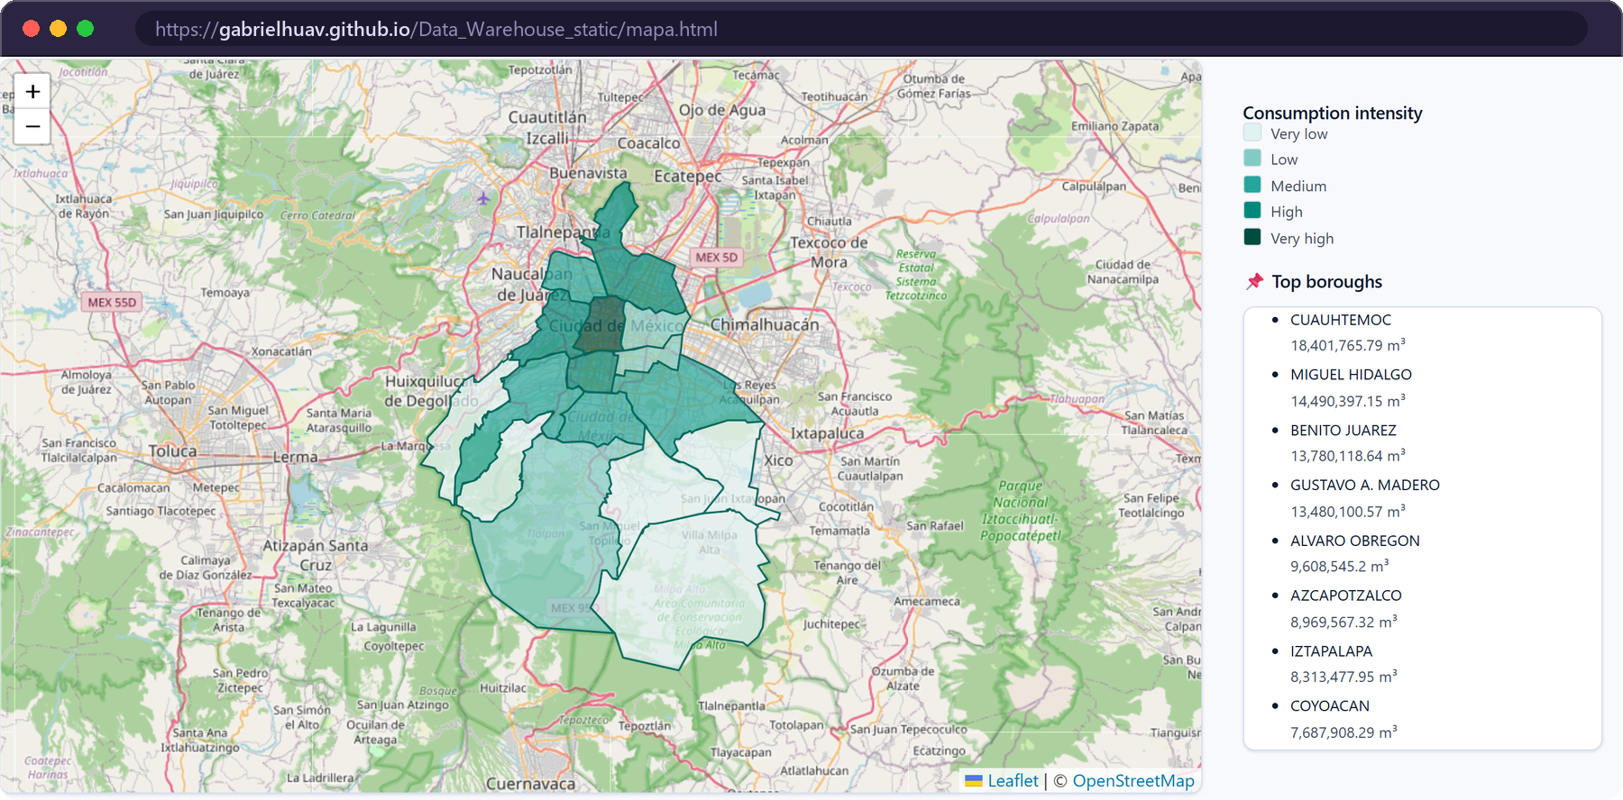
Consumption concentrates in the central boroughs
10 · FINDINGS
TOTAL CONSUMPTION BY BOROUGH · JAN–JUN 2019 · MILLION m³
Choropleth retrieval by borough (Fig. 1a) · © OpenStreetMap contributors
TOTAL BY BIMESTER · MILLION m³
37.7
B1 · Jan–Feb
41.5
B2 · Mar–Apr
41.2
B3 · May–Jun
Varies across bimesters; no causal link with dry or rainy periods is claimed.
Velázquez Arrieta et al. · ICOKG 2026
11 / 18
Notes:
What does the warehouse say? Consumption concentrates in the central boroughs: Cuauhtémoc leads with 18.4 million cubic metres in the semester, followed by Miguel Hidalgo, Benito Juárez and Gustavo A. Madero. Across bimesters, the second one is the highest, then the third and the first; with only three points we do not claim any causal relation with dry or rainy periods. [~45 s]

Slide 12

Totals are not a per-capita indicator
11 · DISCUSSION
BILLING COMPOSITION · FIVE LARGEST CONSUMERS (%)
32.5%
20.3%
Cuauhtémoc
non-domestic share
Gustavo A. Madero
non-domestic share
Twelve points apart, between boroughs whose totals differ by barely a third: the central boroughs concentrate commercial activity.
Implication
Do not allocate supply interventions by total consumption; the per-account average, also stored in the warehouse, is the appropriate measure.
Velázquez Arrieta et al. · ICOKG 2026
12 / 18
Notes:
A practical caution about reading those totals. The boroughs that consume most are not those that consume most per inhabitant. The source separates domestic from non-domestic billing, and the non-domestic share reaches 32.5 % in Cuauhtémoc against 20.3 % in Gustavo A. Madero: twelve points apart between boroughs whose totals differ by barely a third. So total consumption should not be used to allocate supply interventions; the per-account average, which the warehouse also stores, is the right measure. [~45 s]

Slide 13
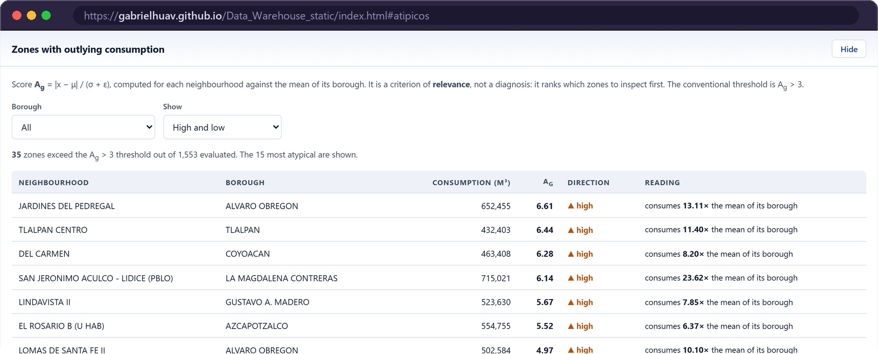



Ranking which zones to inspect first
12 · ATYPICAL CONSUMPTION
BOROUGH-RELATIVE ATYPICALITY SCORE
A_{g} = | x_{g} − μ | / (σ + ε)
x_{g} aggregate consumption of neighbourhood g
μ, σ mean and s.d. of the neighbourhoods of its own borough
Unsupervised; runs in the browser over the retrieved records.
Exploratory ranking, not a causal predictor.
The choropleth answers “how much is consumed here?” — the module answers “which units should I look at first?”
The ordering problem at the centre of information retrieval.
Not real-time leak detection: no leak reports or telemetry are integrated.
Velázquez Arrieta et al. · ICOKG 2026
13 / 18
Notes:
The open source carries no anomaly labels, so instead of training a model we compute a transparent statistic. Each neighbourhood is compared with the other neighbourhoods of its own borough, and the absolute z-score ranks the candidates for inspection. It is exploratory, not causal, and it is not leak detection, because no leak reports or telemetry are integrated. Its role is the ranking function of the retrieval framework: the map says how much, the module says where to look first. [~45 s]

Slide 14




An interpretable z-score, close to Isolation Forest
13 · EVALUATION
INJECTED-ANOMALY DETECTION · MEAN ± S.D. OVER 20 SEEDS
PROTOCOL
1,553 borough–neighbourhood pairs × 3 bimesters
47 injected anomalies per run (33 spikes, 14 drops)
20 seeds; the deployed function itself is scored
Equalised operating points → P = R = F1
0.966 vs 0.971 ROC-AUC
Within one s.d. of Isolation Forest, and inspectable by a municipal analyst. LOF (0.846) seeks local sparsity; the perturbations are global.
Velázquez Arrieta et al. · ICOKG 2026
14 / 18
Notes:
With no labels, we evaluated against injected ground truth: the synthetic set reproduces the structure of the warehouse, 1,553 neighbourhoods over three bimesters, with 47 injected anomalies per run, repeated over 20 seeds. Crucially, we score the deployed function itself, and all detectors emit the same number of alerts. Our z-score reaches a ROC-AUC of 0.966, within one standard deviation of Isolation Forest at 0.971, while LOF is clearly worse. Isolation Forest is still consistently better at the operating point, so it is the natural improvement. These are synthetic perturbations: they measure sensitivity, not performance against real leaks. [~1 min]

Slide 15

Fast enough for interactive retrieval
14 · PERFORMANCE
LIGHTHOUSE 13.4.1 · PERMANENT STATIC DEPLOYMENT
SQL LATENCY OVER 70,886 FACT ROWS · ms
89
76
100
100
100
Performance
desktop
Performance
mobile · 4G
Accessibility
Best
practices
SEO
0.2 s
first contentful paint
0.3 s
largest contentful paint
200 ms
total blocking time
Desktop metrics
Structural bound: the static version downloads the full 3.9 MB export and aggregates on the client — what a server computes once, each visitor computes.
PostgreSQL 16.14 in a container · 200 runs after 10 warm-ups · measured at the database, excluding serialisation and transport.
Velázquez Arrieta et al. · ICOKG 2026
15 / 18
Notes:
Two kinds of performance. On the frontend, Lighthouse scores the static deployment at 89 on desktop and 76 on throttled mobile, with 100 in accessibility, best practices and SEO. On the retrieval layer, four workloads over all 70,886 facts: three stay near 25 milliseconds, and the heaviest one, grouping by neighbourhood and bimester, returns in about a tenth of a second; p95 stays within 25 % of the mean. The honest bound is that the static version downloads the full 3.9 MB export and aggregates in each visitor's browser. [~40 s]

Slide 16




What can, and cannot, be concluded
15 · THREATS TO VALIDITY
A contribution of provenance and preservation, not of scale. We start from a public export with no schema, versioning or update cadence, and keep interface, graph and data as static artefacts anyone can re-execute.
Temporal extent
Three bimesters of a single year: a within-semester comparison; the climate correlation rests on three points.
Synthetic anomalies
Perturbations are injected and aligned with the detectors: an upper bound that says nothing about real leaks.
Centroids, not polygons
Adjacency is proximity within 1.5 km, not shared boundaries; official polygons would allow geo:sfTouches.
Descriptive association
Development index vs consumption is an observation; a socioeconomic mechanism would need an external source.
Velázquez Arrieta et al. · ICOKG 2026
16 / 18
Notes:
Four limitations bound our conclusions. The source only covers three bimesters of one year, so any seasonal reading is a within-semester comparison. The anomaly evaluation is synthetic, an upper bound that says nothing about real leaks. Neighbourhoods are centroids, so adjacency is proximity, not shared boundaries. And the association between development index and consumption is descriptive. Against the closest antecedents, our contribution is provenance and preservation rather than scale. [~45 s]

Slide 17




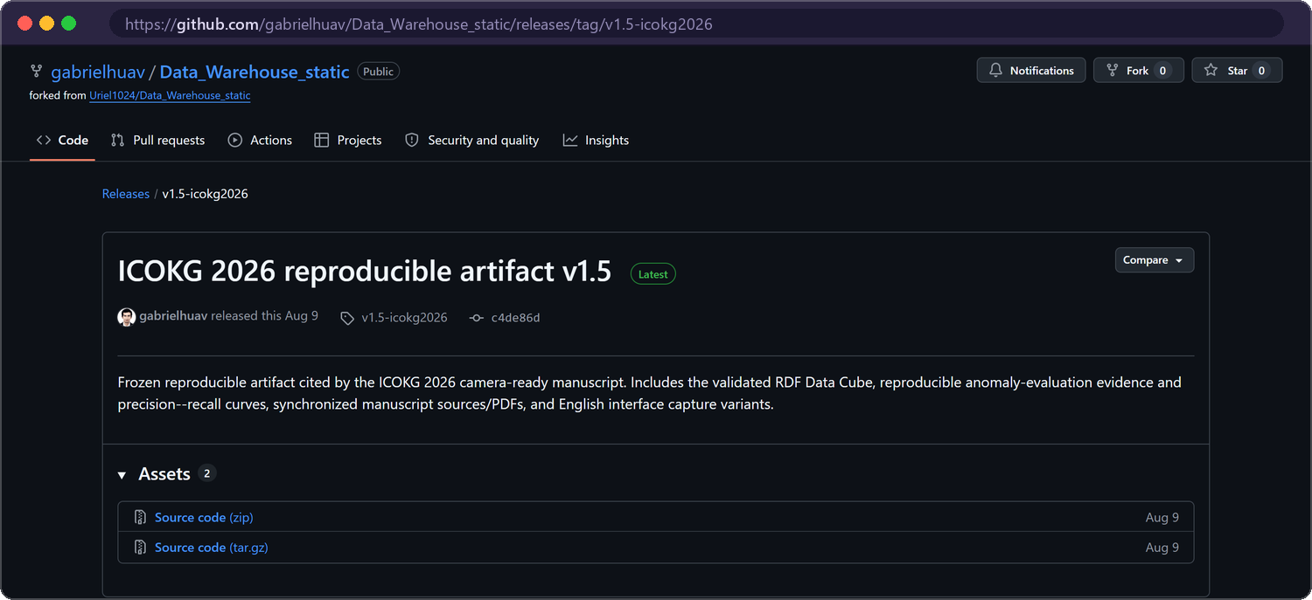


Conclusions and future work
16 · CONCLUSIONS
WHAT WE DELIVERED
FUTURE WORK
A consolidated warehouse
70,886 records and 1,553 locations across the 16 boroughs, in a PostgreSQL star schema.
Persistent triple store with a public SPARQL endpoint
A validated graph layer
Derived declaratively with R2RML and queryable with SPARQL in the browser.
Official neighbourhood polygons → exact geo:sfTouches
An always-accessible demo
Static deployment plus a frozen, citable release that anyone can re-execute.
Align identifiers with external authorities (w3id)
Frozen release
v1.5-icokg2026
Cite the release; the repository head may evolve.
Re-evaluate anomalies once labelled leak data exist
Transfer to mobility, air quality and seismic risk
Velázquez Arrieta et al. · ICOKG 2026
17 / 18
Notes:
To conclude: we consolidated 70,886 records and 1,553 locations into a star schema, derived a validated graph layer from it declaratively, and kept the system permanently accessible, with a frozen release for citation. Together they form a replicable method for bringing heterogeneous official open data to queryable and verifiable territorial information. Next steps: a persistent triple store with a public SPARQL endpoint, official polygons for exact topology, stable external identifiers, a re-evaluation with real leak data, and transferring the method to mobility, air quality and seismic risk. [~45 s]

Slide 18
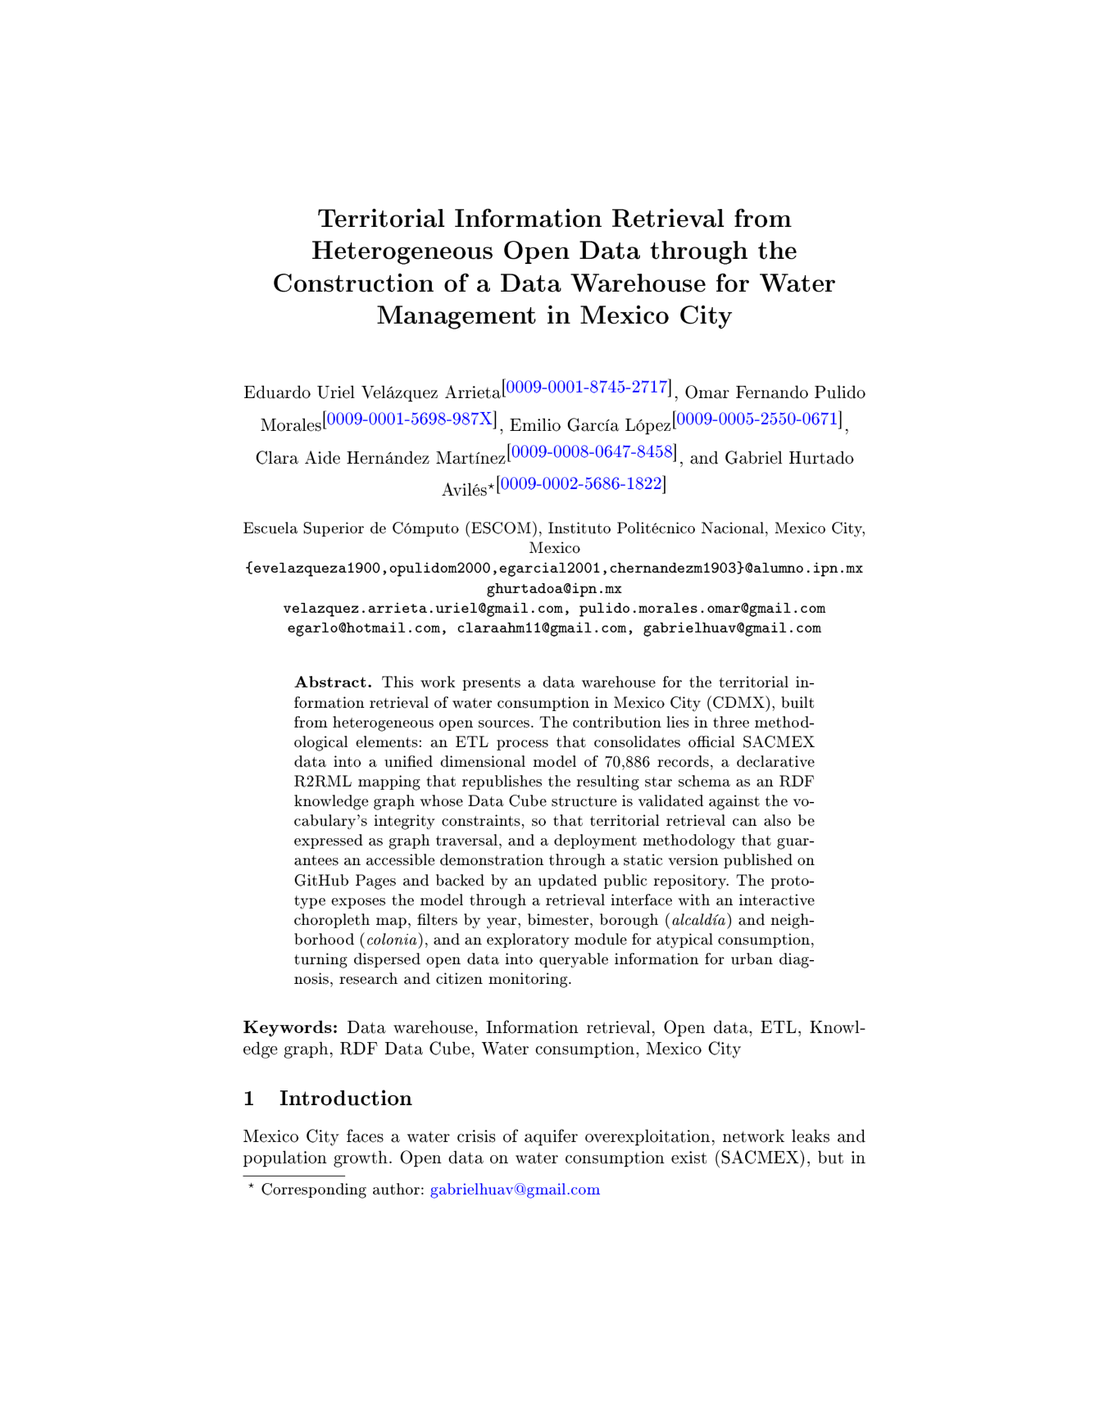

Thank you — questions?
Paper
Springer · ICOKG 2026
Live demo
github.io
Release v1.5
GitHub
Gabriel Hurtado Avilés · ghurtadoa@ipn.mx
ESCOM · Instituto Politécnico Nacional
Data: SACMEX, Mexico City Open Data Portal · Climate: Open-Meteo (CC BY 4.0) · Base map © OpenStreetMap contributors (ODbL)
Notes:
Thank you. The demo and the frozen release are one scan away, and every figure I showed can be recomputed from the two published source files. I am happy to take your questions.

