Slide 1

DriverPass
System Analysis
Gabriel Santos
Notes:
Good morning. This presentation summarizes the proposed DriverPass system and explains how the design supports online learning, driving lesson reservations, employee operations, and secure management. The goal is to make the experience convenient for customers while giving DriverPass reliable oversight.

Slide 2

System Requirements
FUNCTIONAL REQUIREMENTS
• Schedule, modify, and cancel two-hour lessons
• Track packages, practice tests, and progress
• Record lesson notes and activity reports
NONFUNCTIONAL REQUIREMENTS
• Secure, role-based access
• Cloud-hosted, mobile-friendly web access
Notes:
DriverPass customers need to select training packages, reserve two-hour driving lessons, and complete online practice tests when their package includes that feature. The office needs to manage reservations, drivers and vehicles, and track changes. The service should work through a web browser on phones and computers. Different staff members will only see the functions appropriate to their jobs.

Slide 3
Use Case Diagram
Notes:
This diagram shows who uses the system and what each person needs to accomplish. Customers register, choose packages, book lessons, and review training. The secretary helps customers over the phone or in person. Driving instructors record lesson notes. The owner reviews activity and controls available packages, while the IT officer maintains account access. DriverPass also receives notices when DMV training information changes.

Slide 4
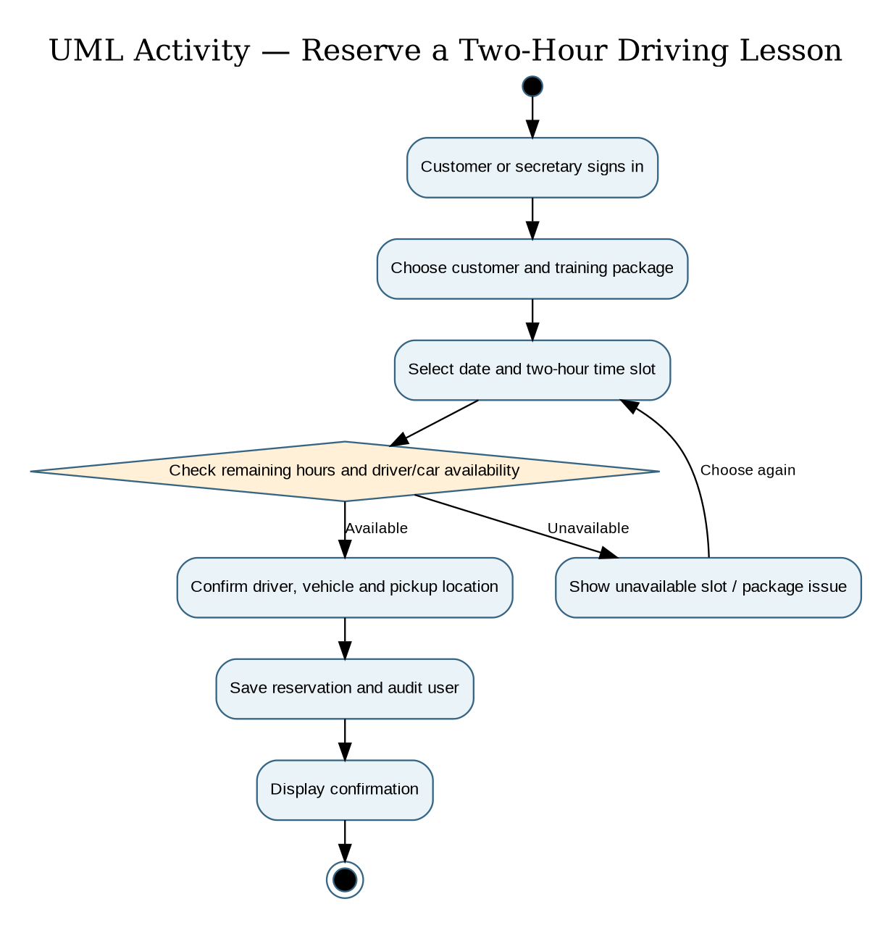
Activity
Diagram
Notes:
This example follows a customer booking a driving lesson. After signing in, the customer chooses a date and a two-hour slot. DriverPass checks whether the training package still has hours available and whether a driver and car are free. If not, the customer chooses another time. If everything is available, the system saves the appointment, records who made it, and confirms the booking. This helps prevent double bookings.

Slide 5
Security
• Secure sign-in and password recovery
• Access limited by employee role
• Encrypted connections and managed backups
• Booking-change history for accountability
• Secure payment service
Notes:
We protect customer information by requiring sign-in and giving each staff member access only to the information needed for their job. Information sent online is protected, backups are managed by the cloud provider, and DriverPass can see who changed or canceled a booking. Customers can recover forgotten passwords, and the IT officer can block accounts when needed. Payment information will be handled through a secure payment service.

Slide 6
System Limitations
• Internet required to update live records
• Offline reports are read-only copies
• New package modules need developer support
• Appointments depend on driver/car availability
• DMV updates depend on available source data
Notes:
The first version needs an internet connection to change live records, although reports can be downloaded for offline review. New types of training packages or major feature changes would require development work; the owner can still disable existing packages. The system also depends on driver and vehicle availability and on timely DMV information. These limits keep the initial release focused and manageable.

