Slide 1


from cyber-awareness
to cyber-operations

Slide 2

Physicist (UPL), Electrical Engineer (UM). Master in Cybersecurity (UOC), in Electrical Engineering (UPV), and in Business Administration (UC3M).
PhD in Engineering (UPV), current PhD Candidate in Information Technology (UOC).
Certified cybersecurity expert, software developer, and educator with 20+ years of professional experience.
Professor of Computer Crime for the school of Criminal Justice at Doral College.
AP Computer Science A, AP CSP, Cybersecurity, and Artificial Intelligence professor at Doral Academy Preparatory.
Apple Swift and Python instructor at Miami Dade College; develops in Swift, Python, C/C++, and Solidity.
Former energy-sector leader in Venezuela: directed national power generation at Corpoelec and led grid planning at the Ministry of Electric Energy (MPPEE).
Professor and former Director, School of Electrical Engineering at Metropolitan University.
Recipient of a 2025 Cyber Educator Award.
Husband, Father of two, Grampa (abuelito) of three!

Slide 3

The problem:
A student can recite the seven stages of the kill chain and still freeze when handed a screen full of Windows Event Logs. SOC-style activities close that gap between knowing about security and doing security.
A real entry-level real-life job-like experience IS A MUST!

Slide 4
Why a SOC-like experience?
It builds the analyst's actual core skill, which is triage judgment
It calibrates students to the texture of the real job. Real defensive work is mostly false positives, incomplete data, and alert fatigue.
It forces integration. Students tend to compartmentalize networking, OS internals, and attack methods as separate modules.
Workforce alignment is the blunt practical argument. The majority of entry-level cyber roles are Tier 1 analyst positions.

Slide 5
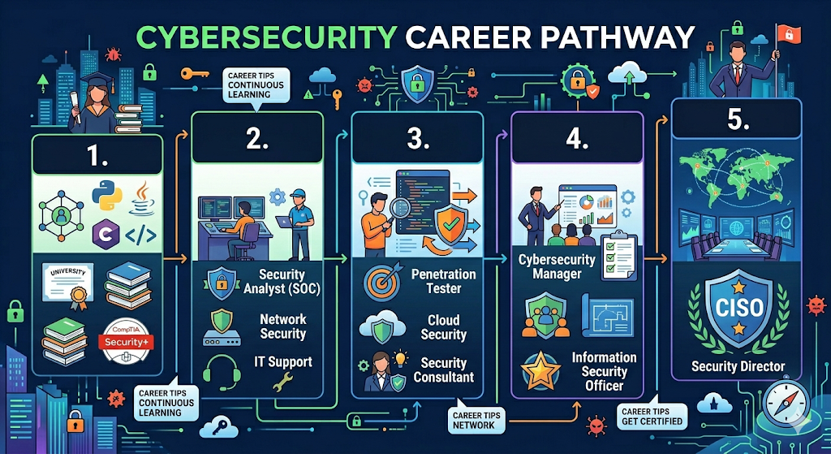

Slide 6
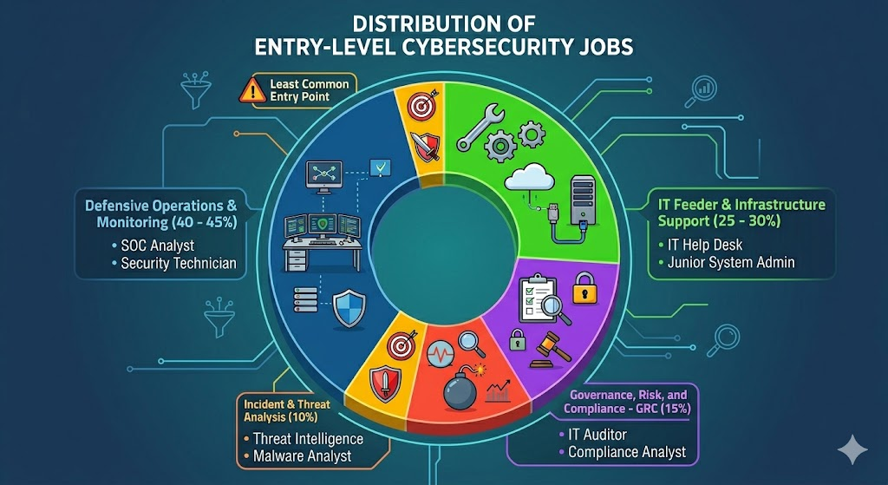

Slide 7
When?
The governing principle: SOC analysis is anomaly detection, and anomaly detection is impossible without a baseline of normal.

Slide 8
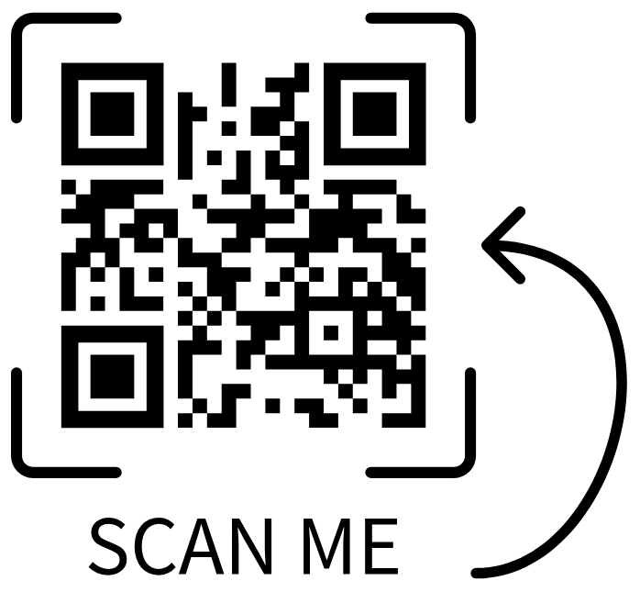
Example
The following example covers an alert triage operation that mirrors entry-level SOC workflow.

Slide 9
Build safe real-world SOC skills not just curriculum
The classroom’s Mini-SOC works when students monitor, analyze, document, and respond inside a protected environment that mirrors professional practice without exposing real school systems.

Slide 10


