Slide 1
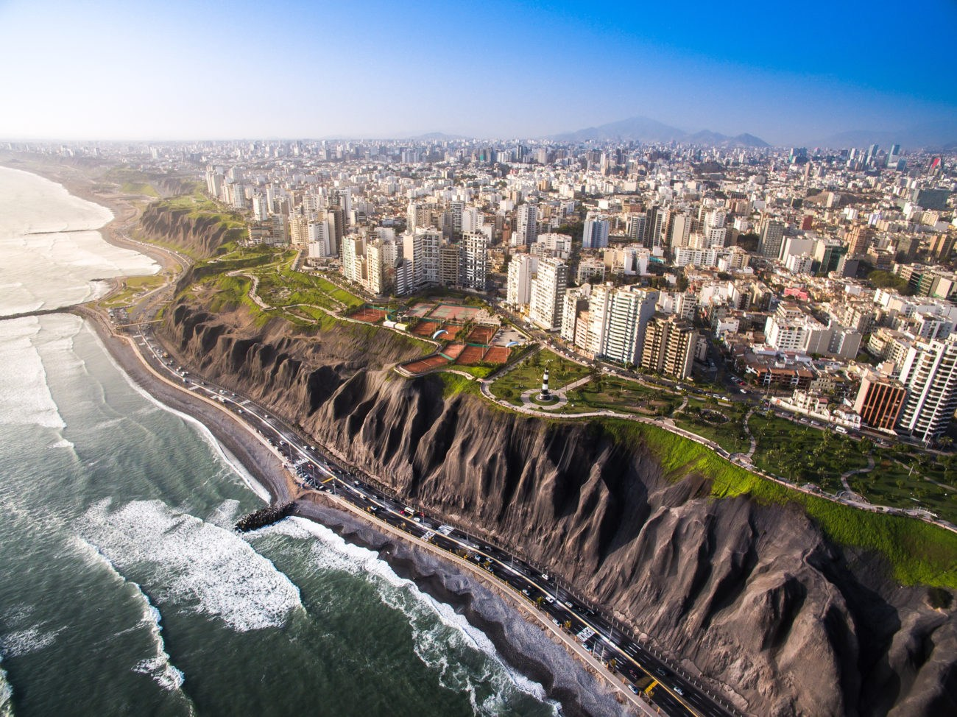
Hotels based on Tourist sites proximity

Slide 2
Introduction
Business Problem
Lima is the capital of Peru, a country known for its rich culture, its beautiful beaches, tourist spots, and delicious cuisine. The capital has many tourist places that many people, including its own citizens, do not know. That is why I decided to focus my project in Lima, Peru. The main objective is to focus on at least 3 tourist places, and find the best hotels based on reputation and proximity to the place.
Interest
With the global pandemic, the Tourism sector is suffering in many countries, so I think it is important give the tourists a safe experience.

Slide 3
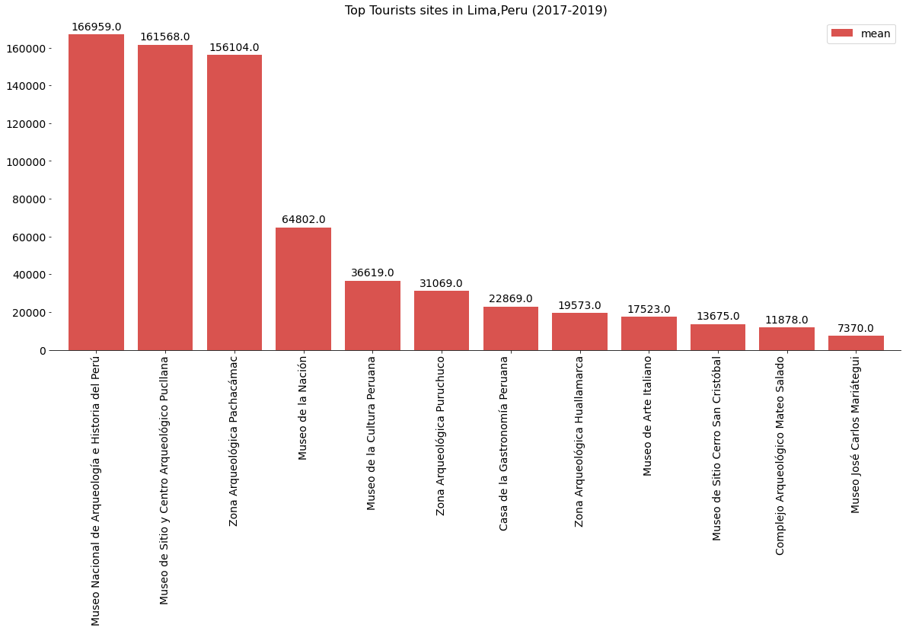
Exploratory Data Analysis
With the data extracted from the INEI, I decided to work with the top three most visited in Lima, Peru in the last three years.As we can see, in the gragh below these places are Museo Nacional de Arqueología e Historia del Perú , Museo de Sitio y Centro Arqueológico Pucllana and Zona Arqueologica Pachacamac.
Notes:
Considere la posibilidad de hablar acerca de:
Estados Unidos
Rusia
Europa
Canadá
Japón
Italia
Brasil

Slide 4
Methodology
I’ll be using foursquare to get info on hotels near this tourist sites. I’m interested in venues in 'hotel' category, they have to be at least 2000 meters from each site and should have good reviews

Slide 5
CONCLUSION
As we can observe in the notebook, the Zona Arqueologica Pachacamac doesn’t have many hotels near by, this could be a great business opportunity for some people. Meanwhile, the others two sites have plenty of hotels near by, for different budgets.

