Slide 1
Normalization
Database

Slide 2
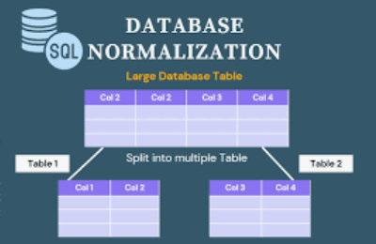
What does normalization mean?
Normalization is a process of reducing redundancy in your dataset by dividing the data into separated logical entities and related them to a common key.

Slide 3
In which case we use Normalization
Normalization is used when we have large amount of data with duplicate value
Normalizing the data will prevent the data for being duplicated
Help streamline the data
And will simplify the database and make it more concise (ensuring the data dependencies)

Slide 4
Process
To fully normalize a relational database, we have to determine dependency (relationships between different tables)
Create a table , define columns, keys and relationship in order to create an efficient database

Slide 5
Advantages of Normalization
The normalization:
Improves the data integrity
Reduces the disk space
Improves the performance of the query

Slide 6
Type of Normalization
1NF: the table must have a primary key
2NF: Eliminate redundant data
3NF: Eliminate columns that are not dependent on a primary key
4NF: Isolate independent multiple relationships (No table may contain 2 or more 1:M or M:M relationships that are not directly related)

Slide 7
Thanks for reading!
Don’t forget to comment and add more insights.

