Slide 1
Bluebikes: Who even uses them?
Gabrielle Dominique and Jose Velasquez

Slide 2
Table of contents
01
02
03
04
05
06
Introduction
Research Question
Data Used
Data Visualization
Model Training
Findings

Slide 3
Introduction
“Bluebikes is public transportation by bike! With more than 5,300 bikes and 550 stations, it's a fast, fun, and affordable way to get around Metro Boston.”
We’ve all seen one, some even used one, but who is keeping this business afloat? Specifically, we aimed at analyze the relationship between Colleges, Universities, and Bluebikes.

Slide 4
Research Question
Is there a relationship among college campus characteristic and Blue Bike usage, if so, what characteristics drive Blue Bike usage?
We used a Multiple Linear Regression analysis to examine the relationship.

Slide 5
Data
Dataset | Details | Variables | Role in model
Blue Bike Trip Data | Around 4 million individual trips in the year 2024 | Latitude, Longitude, Start Station ID, Data | We used this data to calculate the average monthly use (Y)
University Data | 50 college campuses in the Greater-Boston Area, including Boston, Cambridge, Somerville, and Medford | Student Population, University Type, Public/Private, Latitude, and Longitude | We were able to calculate the distance from Start Stations to the nearest campus using euclidean distance. Moreover, we used college characteristics in our model.
MBTA T-Stops | Every train station in the Greater Boston Area | Station ID, Station name, Latitude and Longitude | We mapped these points to the nearest university campus using euclidean distance, and then created a binary variable.

Slide 6
Spatial Linking
Because universities generate, high student foot traffic, predictable commute patterns, strong demand for micro mobility, in order to study how universities influence Bluebike ridership, we need to know:
Which Bluebike station is closest to each university?
How close are university campuses to the nearest T stop?
Method
Converted universities and Bluebike stations into spatial objects (sf package)
Used st_nearest_feature() to find:
the nearest Bluebike station to each university
the nearest MBTA T stop to each university
Calculated:
Distance_to_BlueBikeStation_miles
Distance_to_TStop_miles

Slide 7
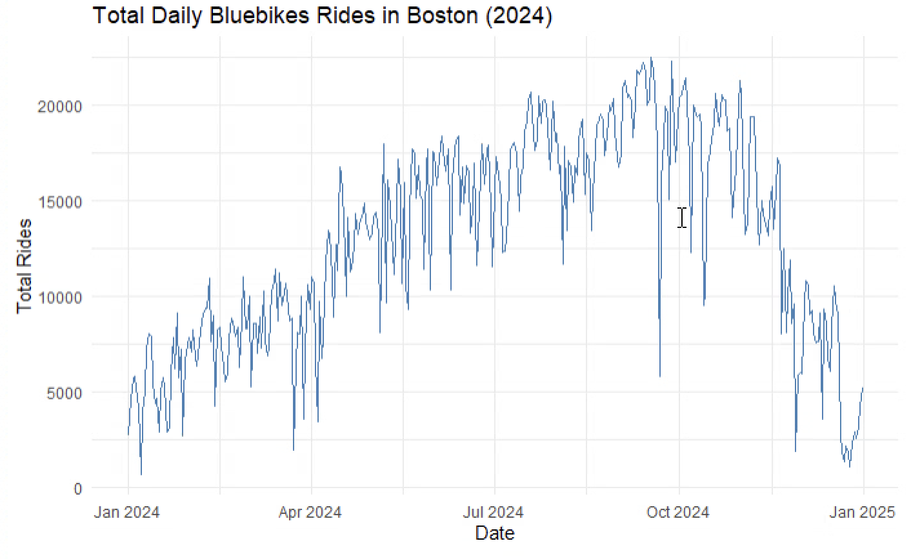
Bluebike Usage 2024

Slide 8
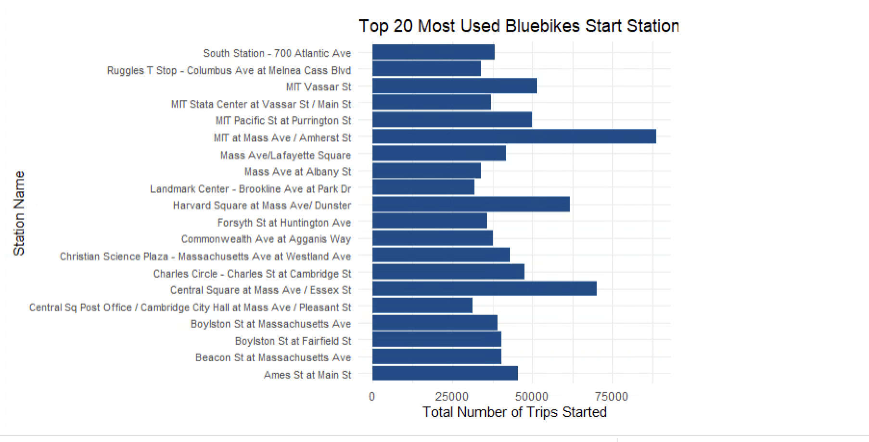
Most used stations 2024

Slide 9
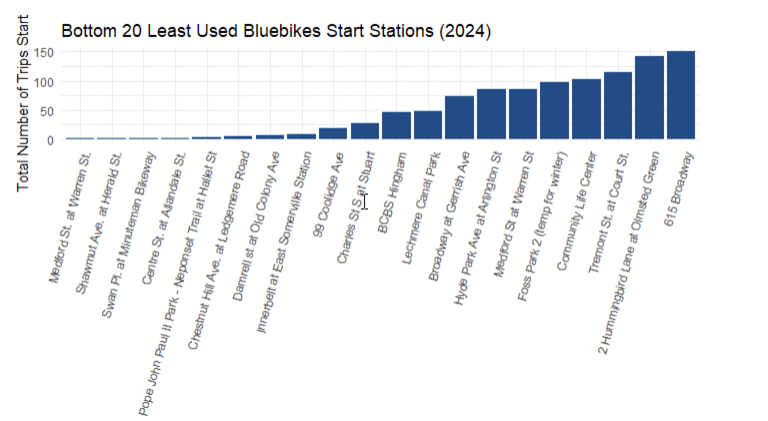
Least used stations 2024

Slide 10
Model 1: Academic and Non Academic Months
Regression:
Avg Monthly Rides_{i}​ = β₀​+β_{1​}(Student Population_{i}​)+β₂​(Distance to Bluebike Station_{i}​)+β_{3​}(Distance to T Stop_{i​})+β₄​(City Dummies_{i​})+β₅​(School Type Dummies_{i​})+β₆​(Category Dummies_{i​})+ϵ_{i}​
Where:
i indexes each university
Dummy variables represent CITY, TYPE, and CATEGORY(research, law school, liberal arts, etc)
Notes:
Monthly rides, for each uni , for each month we used groupby() to group all rides that occurred in that month toward that campus. Then for avg we took the mean of the total monthly rides per uni

Slide 11
Model 1 Results
Residual Standard Error ≈ 13,080 → The model’s predictions are off by about 13k rides on average.
Multiple R² = 0.3067 (~31%) → The model explains only ~31% of the variation in average monthly rides.
Adjusted R² = –0.6177 → The added predictors do not actually improve prediction. Useless predictors were strongly penalized.
F-statistic p-value = 0.9965 → The model is NOT statistically significant overall, the predictors do not meaningfully explain average monthly ridership.
Conclusion → The full model with many categorical variables (CITY, TYPE, CATEGORY) is overfitting → There is no statistical evidence that universities closer to Bluebike stations or T stops have higher Bluebike usage

Slide 12
Model 2: Solely Academic Months
Academic Months Regression Model
Uses the same variables as our full model (Student Population, Distance to Bluebike Station, Distance to T-Stop, CITY, TYPE, CATEGORY)
But only includes months where universities are in session: Jan, Feb, Mar, Apr, Sept, Oct, Nov, Dec
Purpose: To see whether university characteristics explain Bluebikes usage during the school year, excluding summer ridership.

Slide 13
Model 2 Results
Residual Standard Error ≈ 11,070 → The model’s predictions are off by about 11k rides on average.
Multiple R² = 0.3014 (~31%) → The model explains only ~31% of the variation in average monthly rides.
Adjusted R² ≈ –0.63 → The added predictors do not actually improve prediction. Useless predictors were strongly penalized.
F-statistic p-value = 0.9971 → The model is NOT statistically significant overall, the predictors do not meaningfully explain average monthly ridership.
Conclusion → The full model with many categorical variables (CITY, TYPE, CATEGORY) is overfitting → There is no statistical evidence that universities closer to Bluebike stations or T stops have higher Bluebike usage

Slide 14
Interpretation
Our analysis found that campus characteristics alone are insufficient predictors (p > 0.05). This argues that Bluebikes demand is not driven primarily by our predictions, but likely by dynamic factors like daily weather and time-series trends, which requires the more advanced models.

Slide 15
Thanks/ Questions/ Feedback

Slide 16
Data
Data Sources
Boston Colleges & Universities Dataset
University name, address, city, ZIP
Latitude & longitude
Enrollment size
Campus housing
School type (public/private)
Campus setting (city/suburb, small/midsize/large)
Bluebikes 2024 Ridership
~4 million trips
Station coordinates (latitude/longitude)
Boston T Stops
Latitude & longitude of subway stations

