Slide 1


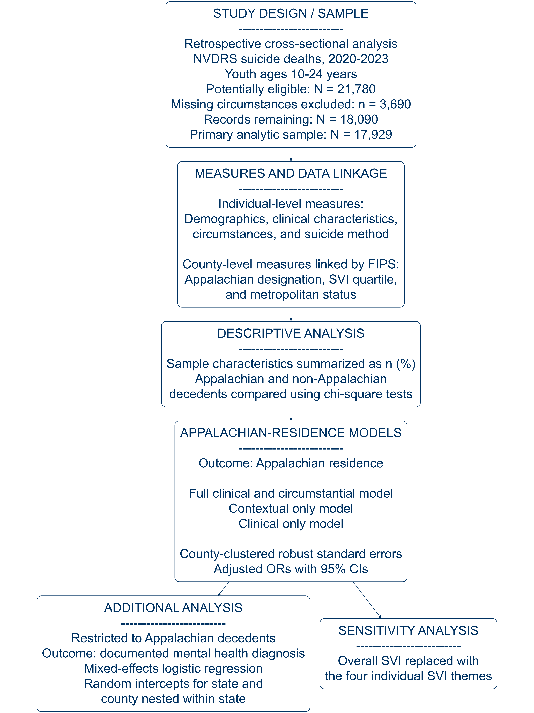
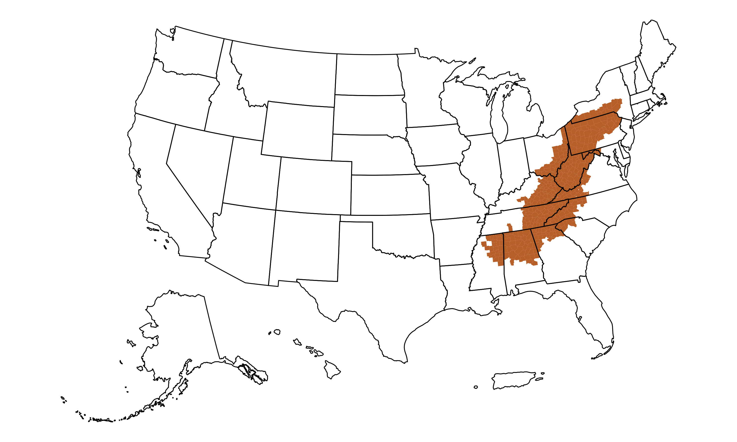
































  Characteristics of Appalachian Suicide Deaths in Young People: An NVDRS Analysis
Gabrielle B. McColly¹, Margaret V. Meyers², Reagan M. Hicks¹, Jonathan L. Doyle³, Laura J. Chavez, PhD^{1,4}, Yinuo Liu¹, Eric A. Youngstrom, PhD^{1,4}, Danielle L. Steelesmith, PhD^{1,4}
¹Nationwide Children's Hospital ; ²University of North Carolina at Chapel Hill ; ³UC Berkeley School of Public Health; ⁴The Ohio State University College of Medicine
The authors have no discloses to report.
BACKGROUND
RESULTS
Suicide is a leading cause of death among young people in the United States¹.
The Appalachian region experiences unique challenges that may contribute to suicide risk^{2, 3}.
Despite these disparities, no study has examined youth suicide deaths across all Appalachian counties.
The current study aimed to address this gap by:
  developing a comprehensive understanding of the individual and clinical characteristics associated with suicide deaths among young people in Appalachia.
  characterizing socioeconomic disparities and vulnerability among young suicide decedents in Appalachia.
Young suicide decedents in Appalachia were more likely to live in rural, socioeconomically vulnerable communities and less likely to have documented mental health concerns.
Table 1. Demographic Characteristics by Appalachian Residence
Characteristic | Non-Appalachia (N=16,384) | Appalachia (N=1,545) | p-value
Age, n (%) |  |  | .892
10-17 years | 4,014 (24.5) | 379 (24.5)
18-24 years | 12,370 (75.5) | 1,166 (75.5)
Sex, n (%) |  |  | .003
Female | 3,715 (22.7) | 299 (19.4)
Male | 12,669 (77.3) | 1,246 (80.6)
Race/Ethnicity, n (%) |  |  | <.001
Non-Hispanic White | 9,378 (57.2) | 1,208 (78.2)
Non-Hispanic Black | 2,244 (13.7) | 180 (11.7)
Hispanic | 2,988 (18.2) | 93 (6.0)
Other* | 1,774 (10.9) | 64 (4.1)
*Includes Non-Hispanic Asian, Non-Hispanic Two or More Races, and Other/Unknown.
Factors Associated with Appalachian Residence Among Young Suicide Decedents
(OR; 95% CI)
CONTEXTUAL
Nonmetro (2.21; 1.53, 3.12)
Low Mod. SVI (2.36; 1.15, 4.84)
Mod. High SVI (2.71; 1.41, 5.12)
METHODS
Geographic Representation of the Appalachian Region in the United States
(OR; 95% CI)
CLINICAL
Anxiety (0.70; 0.55,0.89)
Depressed Mood (0.73; 0.62, 0.85)
Suicidal Thoughts (0.69; 0.59, 0.80)
APPALACHIAN
RESIDENCE
METHOD
Firearm (2.01; 1.40, 2.87)
Hanging/Suffocation
(1.67; 1.23, 2.29)
(OR; 95% CI)
Higher Odds (OR > 1)
Lower Odds (OR < 1)
Figure 2. Path diagram illustrating factors associated with Appalachian residence among young suicide decedents. Contextual characteristics and suicide methods were associated with increased odds of residing in Appalachia, while clinical characteristics were associated with decreased odds. Odds ratios and 95% confidence intervals are included.
DISCUSSION
Appalachian and non-Appalachian young suicide decedents differed across demographic, clinical, and contextual factors.
Appalachian decedents were more likely to reside in nonmetro, socioeconomically vulnerable communities and less likely to have documented mental health concerns.
Findings highlight the need to better understand regional influences on suicide to inform community-based prevention efforts.
Figure 1. Map of the Appalachian Region. Counties designated as Appalachian are highlighted in orange. The 423 counties span 13 states, and include the entirety of West Virginia.
Scan the QR code for additional project information.
Notes:
Redo pictures (including wvu logo)
RStudio Code
---
title: "CHRT Individual Project"
output: html_document
date: "2026-07-02"
---
```{r setup, include=FALSE}
knitr::opts_chunk$set(echo = TRUE)
```
```{r}
#loading packages
#| warning: false
#| message: false
library(gamclass)
library(psych)
library(haven)
library(tidyverse)
library(nFactors)
library(dplyr)
library(readxl)
```
```{r}
#loading in dataset
CHRT <- read_xlsx("C:/Users/GBM003/OneDrive - Nationwide Children's Hospital/RISE_2026_datasets/CHRT_cleaned.xlsx")
```
```{r}
#eliminating all NA
CHRT <- na.omit(CHRT)
CHRT <- CHRT[
complete.cases(CHRT[, paste0("chrt", 1:14)]),
]
CHRT <- na.omit(CHRT)
```
```{r}
#making a sheet with only the CHRT items
chrt <- CHRT %>%
select(MRN, RECORDED_DATE,TEMPLATE_ID, chrt1:chrt14)
```
```{r}
#checking how many individual participants
length(unique(chrt$MRN))
```
```{r}
#deleting all responses from participants after their first response (if have multiple inputs)
chrt_items <- chrt %>%
arrange(MRN, RECORDED_DATE) %>%
distinct(MRN, .keep_all = TRUE)
```
```{r}
#verifying how many were deleted
nrow(chrt)
nrow(chrt_items)
nrow(chrt) - nrow(chrt_items)
```
```{r}
#including only the CHRT 14 items
chrt_items <- chrt_items %>%
select(-TEMPLATE_ID, -MRN, -RECORDED_DATE)
```
```{r}
#making sure all values are numeric
chrt_items <- data.frame(lapply(chrt_items, as.numeric))
```
```{r}
#shows the number of rows/columns of the chrt items
nrow(chrt_items)
ncol(chrt_items)
sapply(chrt_items, class)
colSums(is.na(chrt_items))
```
```{r}
#univariate normality (each variable looks normal by itself)
describe(chrt_items)
```
```{r}
#multivariate non-normal(not all together)
mardia(chrt_items, plot=TRUE)
```
```{r}
pairs.panels(chrt_items)
```
```{r}
#not many univariate outliers
boxplot(chrt_items, notch=FALSE, boxfill="royalblue", whiskcol="blue", pch=16, outcol="firebrick")
```
```{r}
#no major multivariate outliers
library(psych)
outlier(
chrt_items,
bad = 4,
plot = TRUE,
na.rm = TRUE
)
```
```{r}
#calculates Cronbach's alpha for internal reliability
psych::alpha(chrt_items)
#raw alpha= 0.91 (excellent)
```
```{r}
#calculates omega assuming 3 factor model for internal reliability
psych::omega(chrt_items, nfactors = 3)
#alpha=0.91
#omega=0.94
```
```{r}
#correlations
matrix <- cor(chrt_items)
print(matrix)
#Scan matrix and ensure coefficients are ≥ .30 (Hair et al., 2019; Tabachnick & Fidell, 2019).
library(qgraph)
qgraph(
matrix,
cut = .30,
details = TRUE,
posCol = "orangered3",
negCol = "green",
labels = names(chrt_items)
)
#Determine the number of high correlations
# number of r >.30
Above30 <- sum(abs(matrix) >= .30 & abs(matrix) < 1, na.rm = TRUE) / 2
nElements <- ncol(matrix) * (ncol(matrix) - 1) / 2
# Percent of off-diagonal elements > .30
print((Above30/nElements)*100)
# Determinant of the Correlation Matrix.
library ("base")
#If the determinant is > .00001
#then multicollinearity is probably not a problem (Field et al., 2012).
#Run code
det(matrix)
```
```{r}
#parallel analysis and scree plot to help determine number of factors
ev <- eigen(cor(chrt_items))
ap <- nFactors::parallel(
subject = nrow(chrt_items),
var = ncol(chrt_items),
rep = 100,
cent = .05
)
nS <- nScree(x = ev$values, aparallel = ap$eigen$qevpea)
plotnScree(nS)
#shows evidence for 3 factors
```
```{r}
#observed eigenvalues for chrt and parallel analysis eigenvalues
ev$values
ap$eigen$qevpea
```
```{r}
#before factor analysis
cortest.bartlett(chrt_items)
## statistically significant, p=0
cortest.bartlett(matrix,n=2948,diag=FALSE)
KMO(chrt_items)
## .90 is "marvelous"
```
```{r eigen scree nfactors}
## METHOD 1 to See How Many Factors: Eigenvalue (Kaiser criterion) (ChatGPT code)- psych & nFactors
library(nFactors)
## polychoric correlation matrix
chrt_polychor_cor <- psych::polychoric(chrt_items)$rho
write.csv(
chrt_polychor_cor,
"CHRT_polychoric_matrix.csv",
row.names = TRUE
)
ev <- eigen(chrt_polychor_cor)$values
ap <- nFactors::parallel(subject = nrow(chrt_items),
var = ncol(chrt_items),
rep = 100,
cent = .95)
ns <- nFactors::nScree(x = ev, aparallel = ap$eigen$qevpea)
ns$Components # shows suggested # factors by rules
nFactors::plotnScree(ns)
## Findings: 3 factors above ev = 1
```
```{r parallel analysis scree}
## METHOD 2 to See How Many Factors: parallel analysis- psych package only
psych::fa.parallel(
chrt_items,
fa = "fa",
fm = "minres",
cor = "poly"
)
##Suggests 4 factor
```
```{r}
#How many factors should I keep?
library(parameters)
chrt_14 <- n_factors(x = chrt_items,
type = "fa",
rotation = "promax", ## for VSS
algorithm = "minres",
package = c("nFactors", "psych"),
correlation_matrix = psych::polychoric(chrt_items)$rho)
chrt_14 ## print
as.data.frame(chrt_14)
#The choice of 3 dimensions is supported by 5 (26.32%) methods out of 19 (CNG, Optimal coordinates, Parallel analysis, Kaiser criterion, Velicer's MAP).
```
EFA
```{r Range 1-5 factors, eval=FALSE, include=FALSE}
## Same estimator as ESEM. This is to support continuity. Testing 1,2,3,4,5 factors (would not run with more than 5)
#Testing multiple EFA's at once
library(lavaan)
var.names <- paste0("chrt", 1:14)
set.seed(1234)
fit.efa <- efa(data = chrt_items, nfactors = 1:5, estimator = "WLSMV", ordered = var.names)
summary(fit.efa)
#chisq df cfi rmsea
# nfactors = 1 4291.903 77 0.693 0.208
# nfactors = 2 2140.866 64 0.788 0.189
# nfactors = 3 1068.542 52 0.914 0.133
# nfactors = 4 578.315 41 0.937 0.129
# nfactors = 5 206.822 31 0.982 0.079
```
```{r}
## EFA for a 3 factor using Lavaan
#same estimator as CFA. use over psych poly
var.names <- paste0("chrt", 1:14)
set.seed(1234)
fit_3 <- efa(data = chrt_items,
nfactors = 3,
estimator = "WLSMV",
ordered = var.names,
rotation = "promax")
summary(fit_3)
fitMeasures(fit_3, fit.measures = c("chisq.scaled", "df.scaled", "pvalue.scaled",
"rmsea.scaled", "cfi.scaled", "tli.scaled", "srmr",
"rmsea.robust", "cfi.robust", "tli.robust"))
fit_3$loadings
# Rotation affects factor loadings, not global model fit.
# Use unrotated solution for robust fit indices and rotated solution for interpretation.
## rotated promax
# chisq.scaled 1068.542
# df.scaled 52.000
# pvalue.scaled 0.000
# rmsea.scaled 0.129
# cfi.scaled 0.966
# tli.scaled 0.941
# srmr 0.040
# rmsea.robust NA
# cfi.robust NA
# tli.robust NA
```
```{r}
#making a heatmap for factor loadings
library(dplyr)
library(tidyr)
library(ggplot2)
library(forcats)
# Convert loadings matrix to dataframe
loadings_df <- as.data.frame(fit_3$loadings)
loadings_df$Item <- rownames(loadings_df)
loadings_df <- loadings_df %>%
select(Item, f1, f2, f3)
# Convert to long format and keep item order
load_long2 <- loadings_df %>%
pivot_longer(
cols = c(f1, f2, f3),
names_to = "Factor",
values_to = "Loading"
) %>%
mutate(
Loading = ifelse(abs(Loading) < .30, NA, Loading),
Item = factor(
Item,
levels = rev(paste0("chrt", 1:14))
),
Factor = recode(
Factor,
f1 = "Propensity",
f2 = "Impulsivity",
f3 = "Suicidal Thoughts"
),
# Force order left → right
Factor = factor(
Factor,
levels = c(
"Propensity",
"Impulsivity",
"Suicidal Thoughts"
)
)
)
# Heatmap
ggplot(
load_long2,
aes(
x = Factor,
y = Item,
fill = Loading
)
) +
geom_tile(
color = NA
) +
geom_text(
aes(
label = ifelse(
is.na(Loading),
"",
sub("^(-?)0\\.", "\\1.", sprintf("%.2f", Loading))
),
fontface = case_when(
is.na(Loading) ~ "plain",
abs(Loading) >= .70 ~ "bold",
TRUE ~ "plain"
)
),
size = 5.5
) +
scale_fill_gradientn(
colors = c(
"#F8F4E8",
"#F0D98B",
"#EAAA00"
),
na.value = "white"
) +
labs(
title = NULL,
x = NULL,
y = NULL
) +
theme_minimal(base_size = 16) +
theme(
panel.grid = element_blank(),
panel.background = element_rect(
fill = "white",
color = NA
),
plot.background = element_rect(
fill = "white",
color = NA
),
# Title
plot.title = element_text(
size = 20,
face = "bold",
hjust = 0.5,
margin = margin(b = 15)
),
plot.title.position = "plot",
# Factor labels
axis.text.x = element_text(
size = 16,
face = "bold",
margin = margin(t = 12)
),
# Item labels
axis.text.y = element_text(
size = 12,
face = "bold"
),
# Remove legend
legend.position = "none",
# Breathing room around plot
plot.margin = margin(
t = 15,
r = 15,
b = 15,
l = 15
),
ggsave(
"CHRT_factor_structure.png",
width = 9,
height = 6,
dpi = 600
)
)
ggsave(
"CHRT_factor_structure.png",
width = 12,
height = 7,
dpi = 600,
bg = "white"
)
```
IRT
```{r}
#IRT Factor 1
library(mirt)
F1_items <- chrt_items[, c(
"chrt1","chrt2","chrt3","chrt4",
"chrt5","chrt6","chrt7","chrt8","chrt9"
)]
grm_F1 <- mirt(
data = F1_items,
model = 1,
itemtype = "graded",
SE = TRUE
)
plot(grm_F1, type='trace', main='Factor 1',
theta_lim=c(-4,4), lwd=1,
par.settings=simpleTheme(lty=1:4,lwd=1))
plot(grm_F1, type='rxx',
theta_lim=c(-4,5),
main='Factor 1 Reliability')
fs_F1 <- fscores(
grm_F1,
full.scores = TRUE,
full.scores.SE = TRUE,
method = "EAP"
)
colnames(fs_F1)
F1_reliability <- empirical_rxx(fs_F1)
cat("Factor 1 Empirical Reliability:",
round(F1_reliability, 3), "\n")
F1_params <- coef(
grm_F1,
IRTpars = TRUE,
simplify = TRUE
)$items
F1_params
```
```{r}
#IRT Factor 2
F2_items <- chrt_items[, c(
"chrt10","chrt11"
)]
grm_F2 <- mirt(
data = F2_items,
model = 1,
itemtype = "graded",
SE = TRUE
)
plot(grm_F2, type='trace', main='Factor 2',
theta_lim=c(-4,4), lwd=1,
par.settings=simpleTheme(lty=1:4,lwd=1))
plot(grm_F2, type='rxx',
theta_lim=c(-4,5),
main='Factor 2 Reliability')
fs_F2 <- fscores(
grm_F2,
full.scores = TRUE,
full.scores.SE = TRUE,
method = "EAP"
)
colnames(fs_F2)
F2_reliability <- empirical_rxx(fs_F2)
cat("Factor 2 Empirical Reliability:",
round(F2_reliability, 3), "\n")
F2_params <- coef(
grm_F2,
IRTpars = TRUE,
simplify = TRUE
)$items
F2_params
```
```{r}
#IRT Factor 3
F3_items <- chrt_items[, c(
"chrt12","chrt13","chrt14"
)]
grm_F3 <- mirt(
data = F3_items,
model = 1,
itemtype = "graded",
SE = TRUE
)
plot(grm_F3, type='trace', main='Factor 3',
theta_lim=c(-4,4), lwd=1,
par.settings=simpleTheme(lty=1:4,lwd=1))
plot(grm_F3, type='rxx',
theta_lim=c(-4,5),
main='Factor 3 Reliability')
fs_F3 <- fscores(
grm_F3,
full.scores = TRUE,
full.scores.SE = TRUE,
method = "EAP"
)
colnames(fs_F3)
F3_reliability <- empirical_rxx(fs_F3)
cat("Factor 3 Empirical Reliability:",
round(F3_reliability, 3), "\n")
F3_params <- coef(
grm_F3,
IRTpars = TRUE,
simplify = TRUE
)$items
F3_params
```
```{r}
#General Fit
M2(grm_F1, type = "C2", calcNULL = FALSE)
M2(grm_F2, type = "C2", calcNULL = FALSE)
M2(grm_F3, type = "C2", calcNULL = FALSE)
```
```{r}
#Marginal Reliability
marginal_rxx(grm_F1)
marginal_rxx(grm_F2)
marginal_rxx(grm_F3)
```
```{r}
#Conditional Reliability (have better ones later on)
plot(grm_F1, type = "rxx")
plot(grm_F2, type = "rxx")
plot(grm_F3, type = "rxx")
```
```{r}
# Item fit statistics
F1_fit <- itemfit(grm_F1, na.rm = TRUE)
# View all item fit results
print(F1_fit)
# Identify misfitting items
F1_misfit <- subset(F1_fit, p.S_X2 < .05)
# Number of misfitting items
nrow(F1_misfit)
# Display misfitting items
F1_misfit
```
```{r}
# Item fit statistics
F2_fit <- itemfit(grm_F2, na.rm = TRUE)
# View all item fit results
print(F2_fit)
# Identify misfitting items
F2_misfit <- subset(F2_fit, p.S_X2 < .05)
# Number of misfitting items
nrow(F2_misfit)
# Display misfitting items
F2_misfit
```
```{r}
# Item fit statistics
F3_fit <- itemfit(grm_F3, na.rm = TRUE)
# View all item fit results
print(F3_fit)
# Identify misfitting items
F3_misfit <- subset(F3_fit, p.S_X2 < .05)
# Number of misfitting items
nrow(F3_misfit)
# Display misfitting items
F3_misfit
```
```{r}
#Information Curves
# Factor 1
plot(grm_F1, type = "infotrace")
plot(grm_F1, type = "info")
# Factor 2
plot(grm_F2, type = "infotrace")
plot(grm_F2, type = "info")
# Factor 3
plot(grm_F3, type = "infotrace")
plot(grm_F3, type = "info")
```
```{r}
#{r Fancy reliability plot}
# ── Reliability plot function ─────────────────────────────────────────────────
plot_reliability <- function(models, labels, colors = NULL,
theta_range = c(-4, 5),
threshold = 0.80,
title = NULL) {
if (!is.list(models)) models <- list(models)
if (length(models) != length(labels))
stop("models and labels must be the same length")
n_groups <- length(models)
default_colors <- c("#002855", "#D6604D", "#4DAC26", "#7B2D8B")
if (is.null(colors)) {
colors <- setNames(default_colors[seq_len(n_groups)], labels)
} else {
colors <- setNames(colors, labels)
}
theta_seq <- seq(theta_range[1], theta_range[2], by = 0.01)
rxx_list <- lapply(models, function(mod) {
info <- testinfo(mod, Theta = matrix(theta_seq))
info / (info + 1)
})
rxx_df <- data.frame(
theta = rep(theta_seq, n_groups),
rxx = unlist(rxx_list),
group = rep(labels, each = length(theta_seq))
)
rxx_df$group <- factor(rxx_df$group, levels = labels)
find_crossings <- function(theta, rxx, threshold) {
above <- rxx >= threshold
crossings <- which(diff(above) != 0)
if (length(crossings) == 0) return(numeric(0))
sapply(crossings, function(i) {
approx(x = rxx[i:(i+1)], y = theta[i:(i+1)], xout = threshold)$y
})
}
cross_list <- lapply(seq_len(n_groups), function(i) {
cx <- find_crossings(theta_seq, rxx_list[[i]], threshold)
if (length(cx) == 0) return(NULL)
data.frame(theta = cx, group = labels[i])
})
endpoints_df <- do.call(rbind, Filter(Negate(is.null), cross_list))
p <- ggplot(rxx_df, aes(x = theta, y = rxx, color = group)) +
geom_line(linewidth = 1.1) +
geom_hline(yintercept = threshold, linetype = "dashed",
color = "black", linewidth = 0.7) +
scale_color_manual(values = colors) +
scale_x_continuous(limits = theta_range,
breaks = seq(theta_range[1], theta_range[2] - 1,
by = 1)) +
scale_y_continuous(limits = c(0, 1.00), breaks = seq(0, 1, by = 0.25)) +
labs(
title = title,
x = expression(theta),
y = expression(r[xx]),
color = NULL
) +
theme_classic(base_size = 18) +
theme(
legend.position = if (n_groups > 1) c(0.15, 0.88) else "none",
legend.background = element_blank(),
plot.title = element_text(hjust = 0.5, face = "bold")
)
if (!is.null(endpoints_df) && nrow(endpoints_df) > 0) {
endpoints_df$group <- factor(endpoints_df$group, levels = labels)
p <- p +
geom_vline(data = endpoints_df,
aes(xintercept = theta, color = group),
linetype = 5,
show.legend = FALSE) +
ggrepel::geom_label_repel(
data = endpoints_df,
aes(x = theta, y = 0, label = sprintf("%.2f", theta), color = group),
label.size = NA,
nudge_y = 0.1,
box.padding = 0.5,
point.padding = 0.3,
segment.color = NA,
show.legend = FALSE
)
}
return(p)
}
# ── Single curve: Factor 1 ─────────────────────────────────────────────────
plot_reliability(
models = list(grm_F1),
labels = c("Factor 1"),
)
# ── Single curve: Factor 2 ─────────────────────────────────────────────────
plot_reliability(
models = list(grm_F2),
labels = c("Factor 2")
)
# ── Single curve: Factor 2 ─────────────────────────────────────────────────
plot_reliability(
models = list(grm_F3),
labels = c("Factor 3")
)
```
Convergent Validity
```{r}
#reading in other files
library(readxl)
phq <- read_xlsx("C:/Users/GBM003/OneDrive - Nationwide Children's Hospital/RISE_2026_datasets/PHQ_wide_nodup.xlsx")
psc <- read_excel("C:/Users/GBM003/OneDrive - Nationwide Children's Hospital/RISE_2026_datasets/PSC17.WideData2026.06.11.xlsx")
#Changing name of CHRT 'Total' column
CHRT <- CHRT %>%
rename(chrt_total = `Total`)
#Changing name of PSC 'Total' column
psc <- psc %>%
rename(psc_total = `Total`)
#deleting all responses from participants after their first response (if have multiple inputs)
chrtmerge <- CHRT %>%
arrange(MRN, RECORDED_DATE) %>%
distinct(MRN, .keep_all = TRUE)
phqmerge <- phq %>%
arrange(MRN, RECORDED_DATE) %>%
distinct(MRN, RECORDED_DATE, .keep_all = TRUE)
pscmerge <- psc %>%
arrange(MRN, RECORDED_DATE) %>%
distinct(MRN, RECORDED_DATE, .keep_all = TRUE)
#merging the datasets
chrt_phq <- merge(
chrtmerge,
phqmerge,
by = c("MRN", "RECORDED_DATE")
)
chrt_psc <- merge(
chrtmerge,
pscmerge,
by = c("MRN", "RECORDED_DATE")
)
```
```{r}
#deleting NA's
library(dplyr)
chrt_psc <- chrt_psc %>%
filter(!is.na(psc_total))
chrt_phq <- chrt_phq %>%
filter(!is.na(PHQ8_total))
```
```{r}
#Making sure everything is numeric
chrt_psc$chrt_total <- as.numeric(chrt_psc$chrt_total)
chrt_psc$psc_total <- as.numeric(chrt_psc$psc_total)
chrt_phq$chrt_total <- as.numeric(chrt_phq$chrt_total)
chrt_phq$PHQ8_total <- as.numeric(chrt_phq$PHQ8_total)
```
```{r}
#running the correlations
cor.test(chrt_psc$chrt_total, chrt_psc$psc_total)
#r=0.24
#95% CI [0.18, 0.30]
#p-value <.001
```
```{r}
#Correlations cont.
cor.test(chrt_phq$chrt_total, chrt_phq$PHQ8_total)
#r=.66
#95% CI [0.58, 0.73]
#p-value <.001
```
Demographic Information
```{r}
#deleting all responses from participants after their first response (if have multiple inputs)
chrtdemo <- chrt %>%
arrange(MRN, RECORDED_DATE) %>%
distinct(MRN, .keep_all = TRUE)
```
```{r}
#merging chrt with participant demographics; only keeping the chrt participants
#reading in demographics
library(readr)
demographics <- read.csv(
"C:/Users/GBM003/Onedrive - Nationwide Children's Hospital/RISE_2026_datasets/Copy of demographics.csv")
chrtdemo$MRN <- as.character(chrtdemo$MRN)
demographics$MRN <- as.character(demographics$MRN)
#merging data
library(dplyr)
finaldemo <- left_join(
chrtdemo,
demographics,
by = c(
"MRN" = "MRN")
)
#checking length and making demographic only of the chrt participant MRN
length(unique(finaldemo$MRN))
demo_only <- finaldemo %>%
select(MRN, AGE_AT_VISIT, GENDER, RACE) %>%
distinct(MRN, .keep_all = TRUE)
summary(demo_only)
```
```{r}
#running demographics
psych::describe(demo_only[, c("AGE_AT_VISIT")])
demo_only %>%
count(GENDER) %>%
mutate(Percent = round(100 * n/sum(n), 1))
demo_only %>%
count(RACE) %>%
mutate(Percent = round(100 * n/sum(n), 1))
```

