Slide 1
Big Mountain Project
Gabrielle Wald
Lead data scientist

Slide 2
Problem Identification
How can Big Mountain resort increase revenue per season by $3m-$5m capitalizing on its facilities (eg: increase ticket price) while decreasing costs by being more efficient with equipment usage?

Slide 3
Problem Identification
Process
Compare Big Mountain to other ski resorts in the United States similar in quality and size by evaluating the resorts key features such as length of vertical drop, number of lifts and number of runs with ticket prices

Slide 4
Recommendation & Key Findings
The model supports the increase of ticket prices from $81 up to $94.22.
This represents an increase of $4,627,000 in revenue
In order to increase ticket prices by another $1.99 to $96.21, Big Mountain can increase the vertical drop
For a total revenue of $33,673,500, representing an increase of $5,323,500 compared to current revenue

Slide 5
Modeling Results & Analysis
There is no meaningful relationship between state and ticket prices
The most relevant features justifying higher ticket prices are:
The number of fast four person chairs
Count of the number of runs on the resort
Total area covered by snow making machines in acres

Slide 6
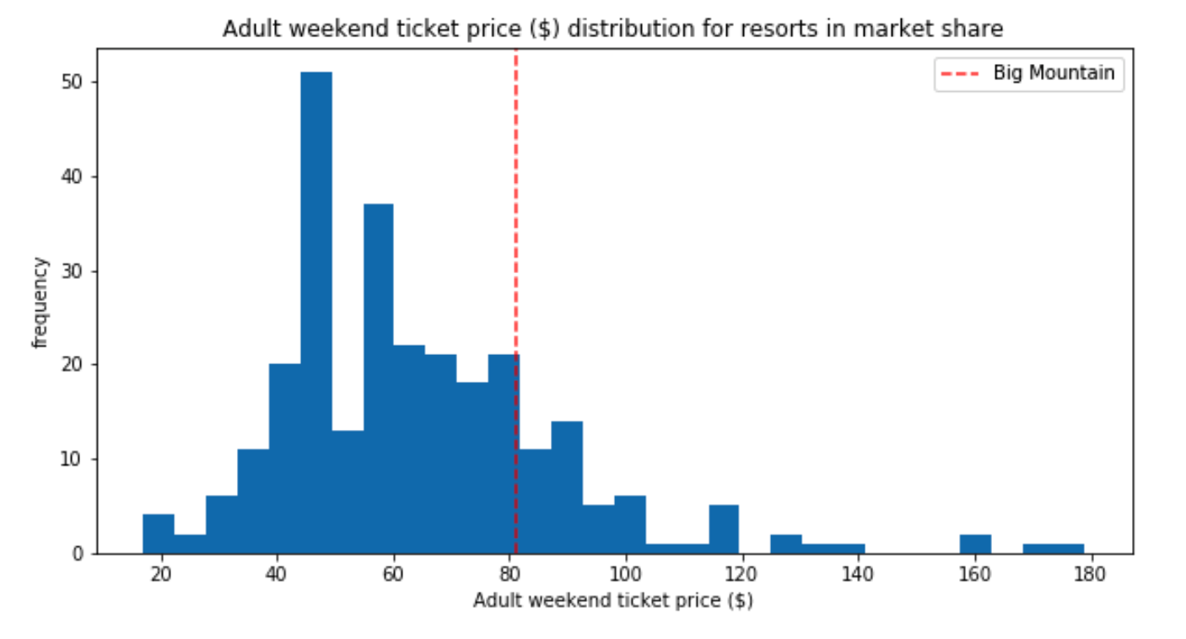
Modeling Results & Analysis

Slide 7
Modeling Results & Analysis
Compared to other ski resorts in the same segment offering similar quality and services:
Big Mountain Resort
Vertical drop: top resorts for vertical drop with its over 2600 feet
Snow making: one of the few with 600 acres covered by snow makers
Total number of chairs: amongst the highest number of total chairs
Fast Quads: Most resorts have no fast quads, BM has 3
Runs: compares well for the number of runs. There are some resorts with more, but not many
Longest run: has one of the longest runs of the 277 resorts
Skiable terrain: amongst the resorts with largest amount of skiiable terrain

Slide 8
Summary & Conclusion
There is room to increase ticket prices from the current $81 up to $94.22
The analyzed model didn’t justify cost reduction, since closing runs for instance would not justify the increase of ticket prices
Further analysis for cost reduction: Investigate other forms of revenue and costs the resorts has such as equipment rental and repairs

