Slide 1
ARQ Protocols
Prof. Anish Goel

Slide 2
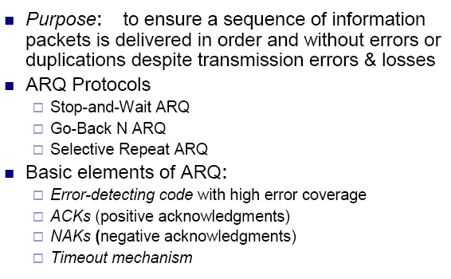
Automatic Repeat Request (ARQ)

Slide 3
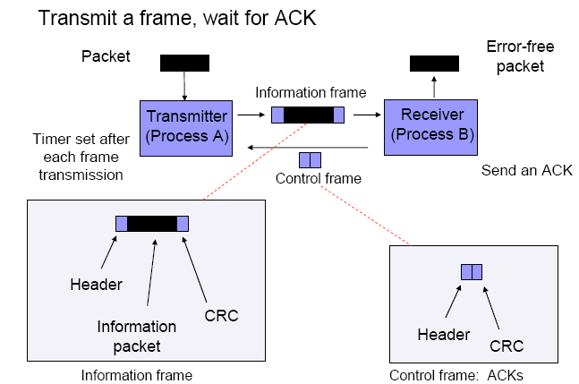
Stop-and-Wait ARQ

Slide 4
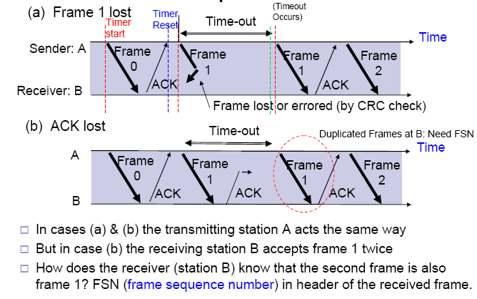
S&W ARQ - Sequence Numbers

Slide 5
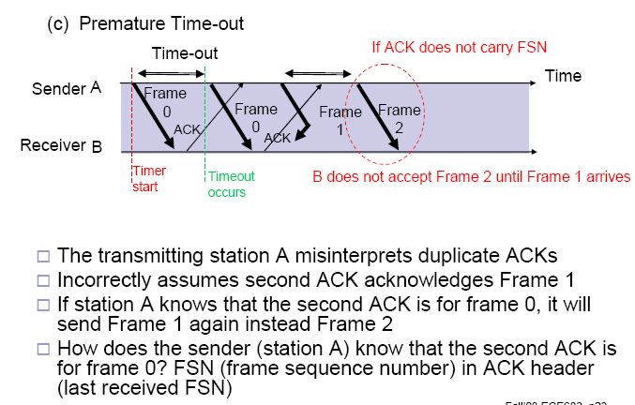
S&W ARQ - Sequence Numbers in ACK

Slide 6
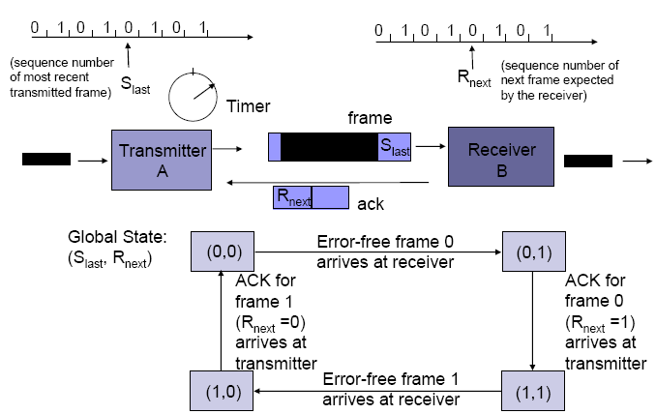
1-Bit Sequence Numbering suffices for Stop-and-Wait ARQ

Slide 7
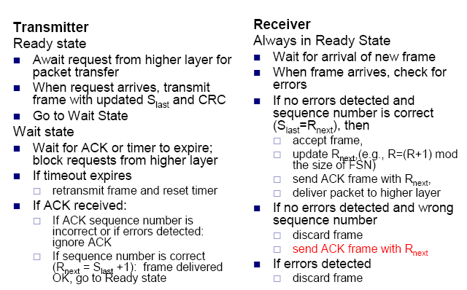
Stop-and-Wait ARQ

Slide 8
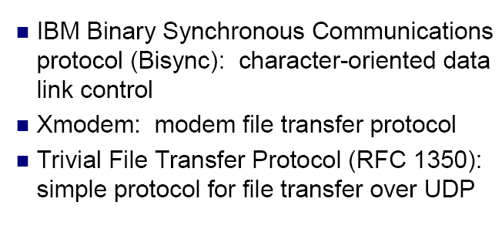
Applications of Stop-and-Wait ARQ

Slide 9
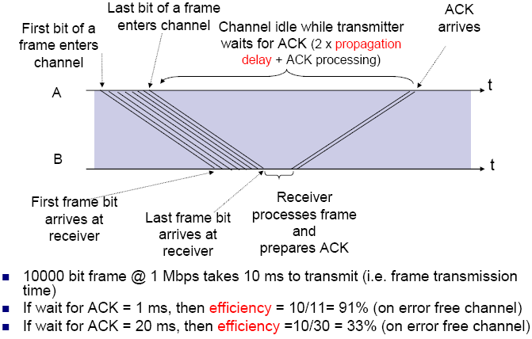
Stop-and-Wait Efficiency

Slide 10
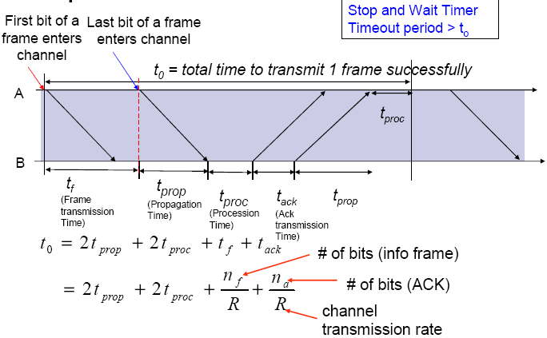
Stop-and-Wait Model

Slide 11
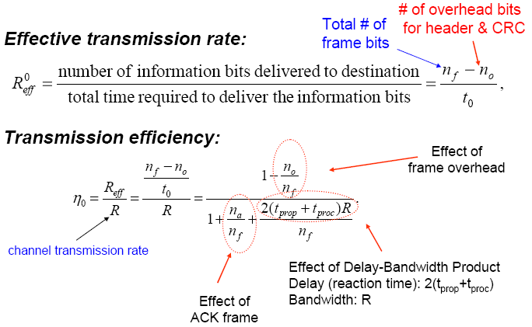
Stop & Wait Efficiency on Error-free channel

Slide 12
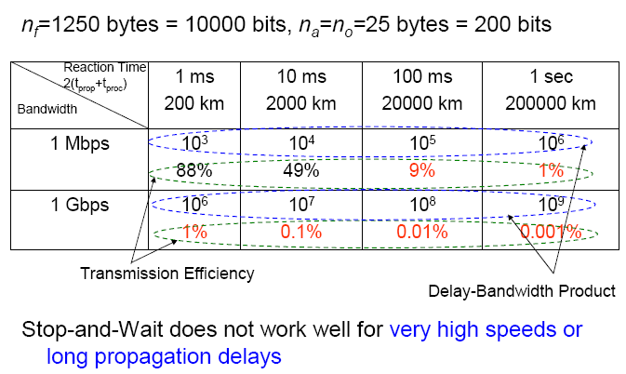
Example: Impact of Delay-Bandwidth Product on Transmission Efficiency

Slide 13
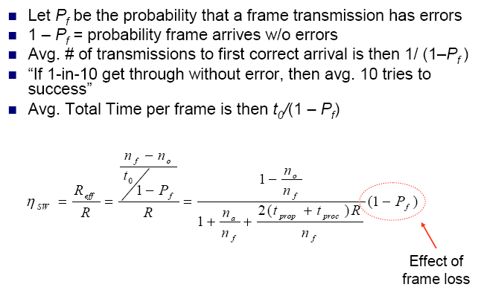
Stop and Wait Efficiency in Channel with Errors

Slide 14
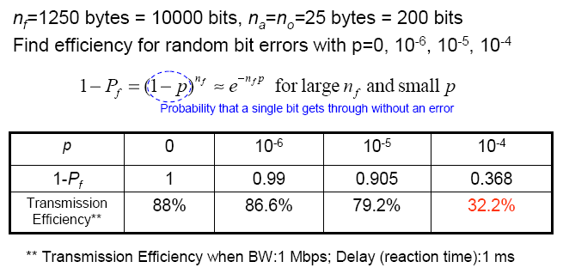
Example: Impact of Bit Error Rate on Transmission Efficiency

Slide 15
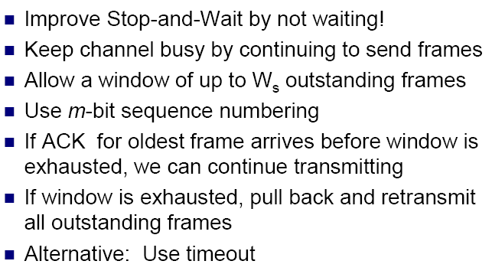
Go-Back-N (GBN)

Slide 16
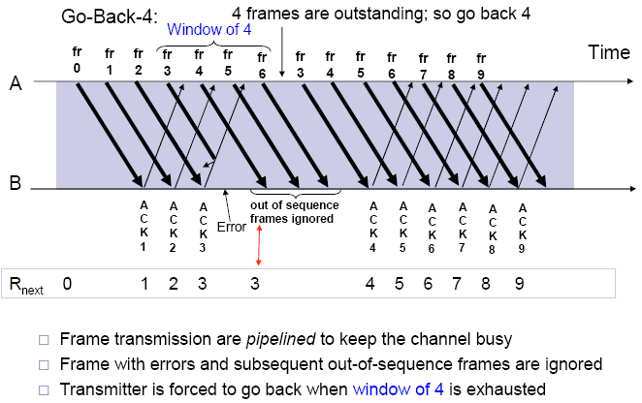
Go-Back-N ARQ

Slide 17
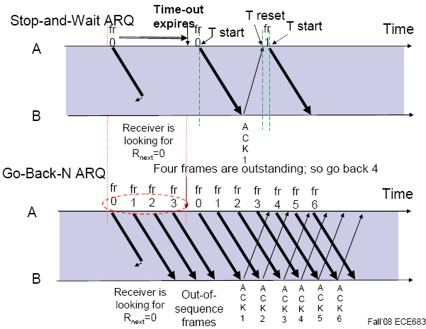
S&W timeout and GBN window size long enough to cover round trip time

Slide 18
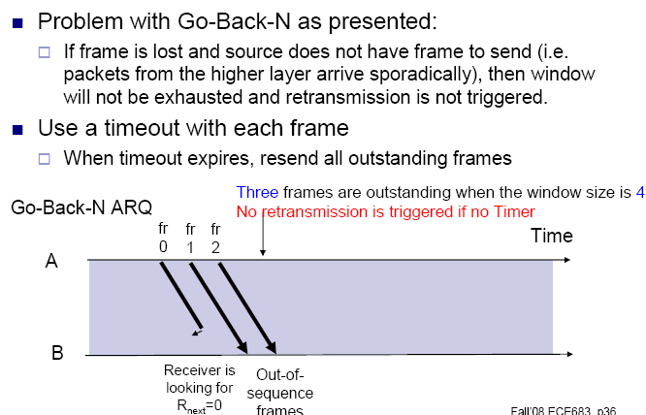
Go-Back-N with Timeout

Slide 19
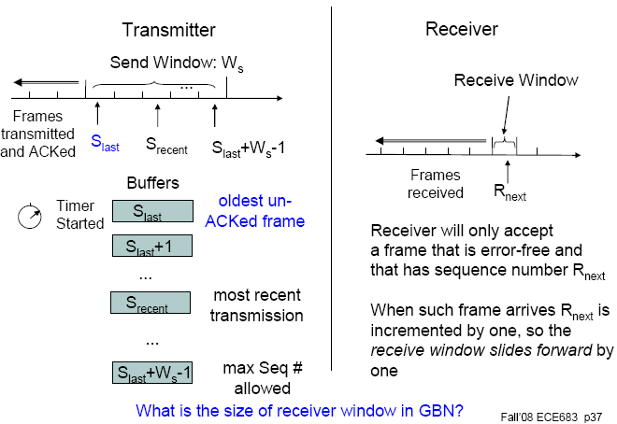
Go-Back-N Transmitter & Receiver

Slide 20
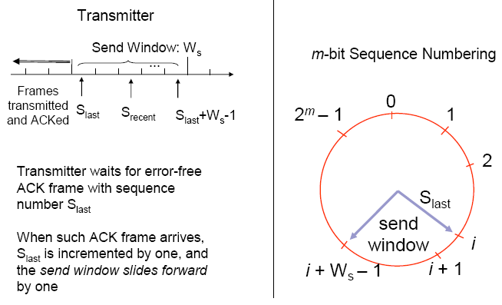
Sliding Window Operation

Slide 21
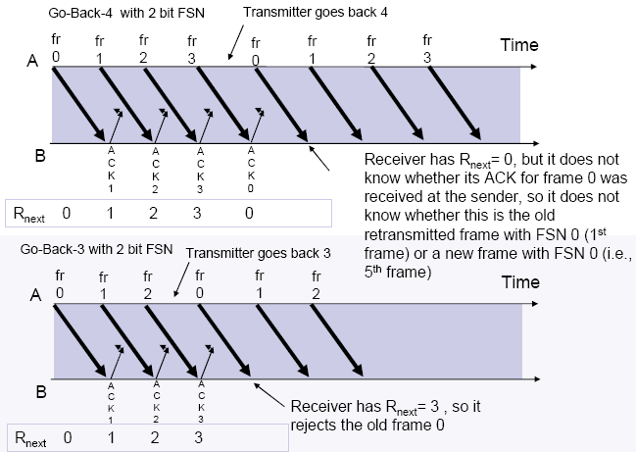
Maximum Allowable Window Size is Ws = 2m-1

Slide 22
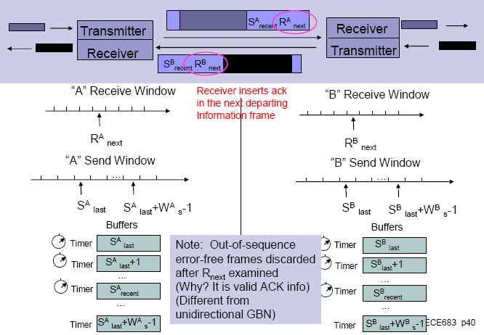
ACK Piggybacking in Bidirectional GBN

Slide 23
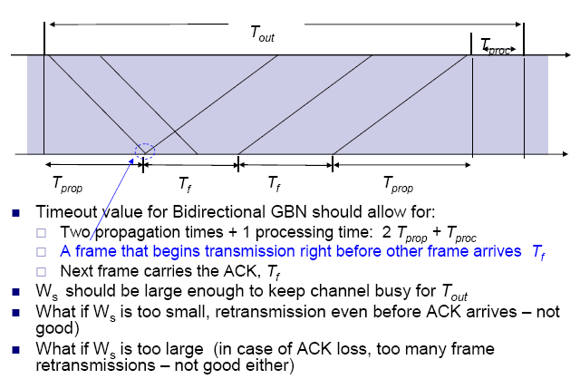
Required Timeout & Window Size for Bidirectional GBN

Slide 24
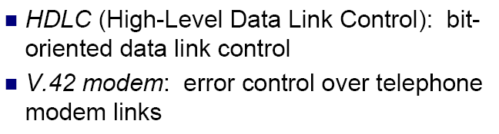
Applications of Go-Back-N ARQ

Slide 25
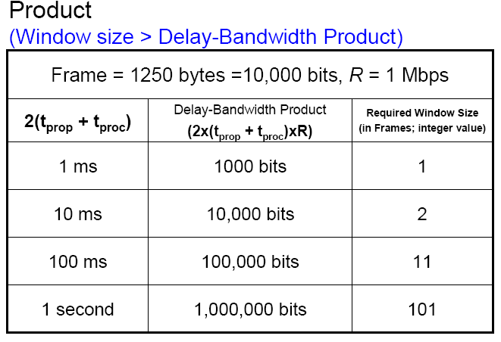
Required Window Size for Delay-Bandwidth

Slide 26
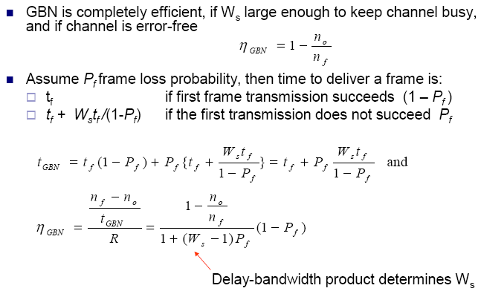
Efficiency of Go-Back-N

Slide 27
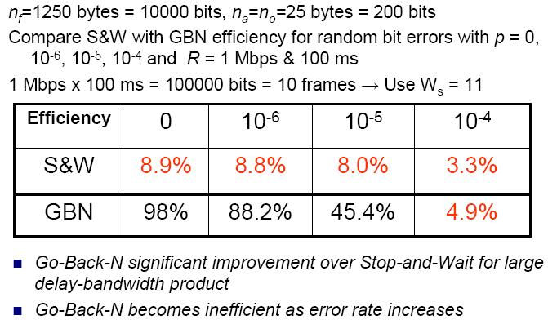
Example: Impact of Bit Error Rate on GBN

Slide 28
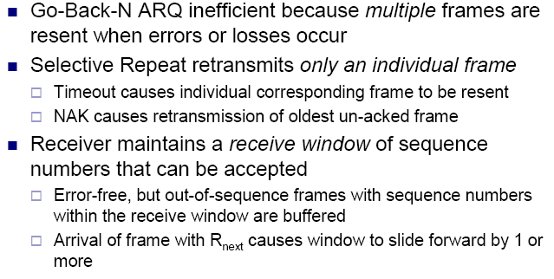
Selective Repeat ARQ

Slide 29
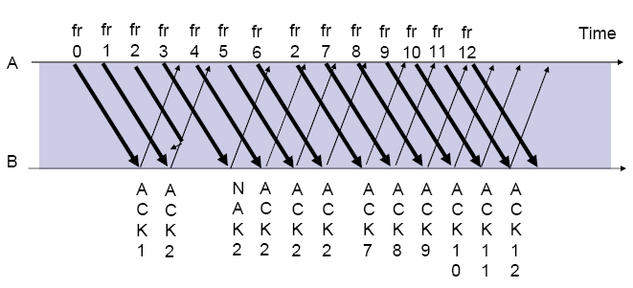
Selective Repeat ARQ

Slide 30
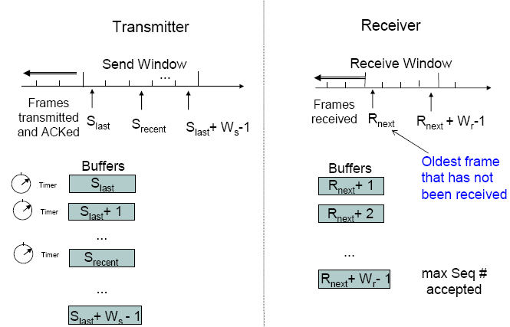
Selective Repeat ARQ

Slide 31
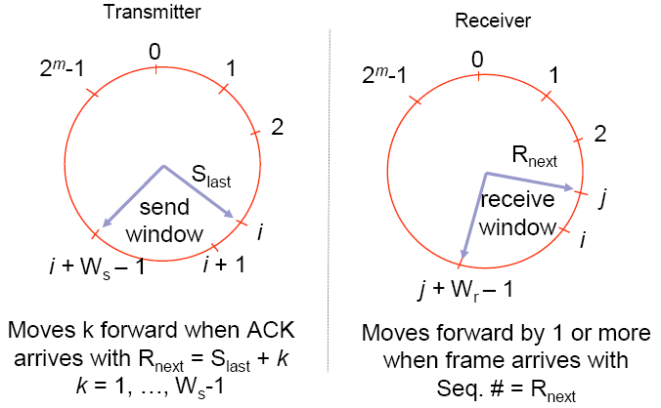
Send & Receive Windows

Slide 32
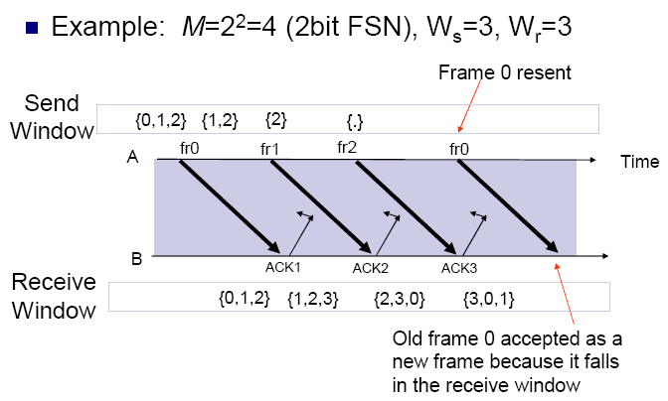
What size Ws and Wr allowed?

Slide 33
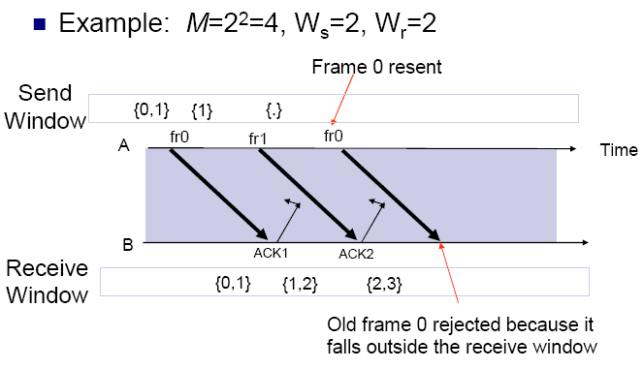
Ws + Wr = 2m is maximum allowed

Slide 34
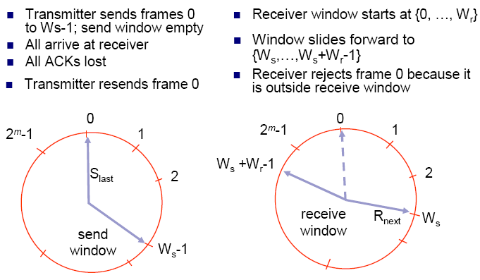
Why Ws + Wr = 2m works

Slide 35
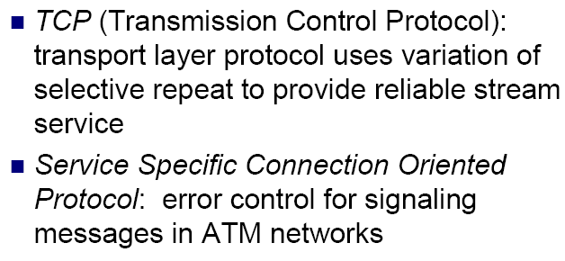
Applications of Selective Repeat ARQ

Slide 36
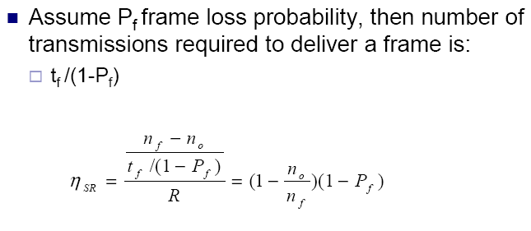
Efficiency of Selective Repeat

Slide 37
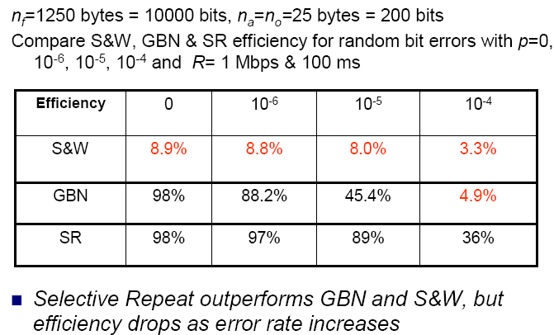
Example: Impact of Bit Error Rate on Selective Repeat

Slide 38
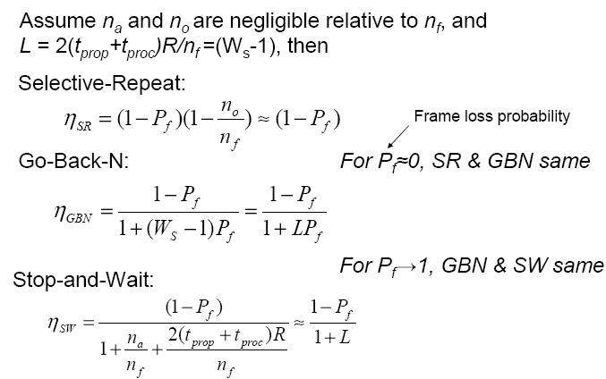
Comparison of ARQ Efficiencies

Slide 39
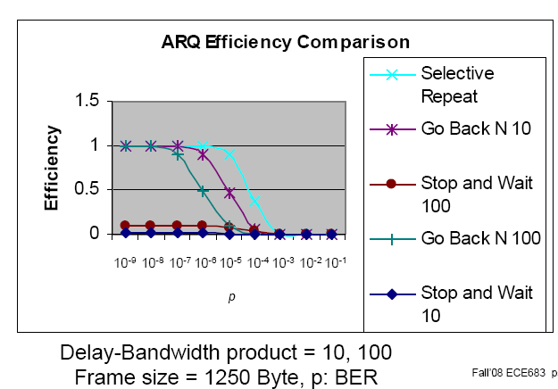
ARQ Efficiencies

