Slide 1
Visualizing covid-19 data Questions and Visual Answers Concerning the SARS-Cov-2 Epidemic in South Florida
Roy Williams, Mary Jo Trepka, Zoran Bursac, and Gabriel J. Odom
Stempel College of Public Health, Florida International University
Joint Statistical Meetings, 9 August 2021

Slide 2
MOTIVATION
In April 2020, local officials in South Florida requested assistance understanding the massive amount of data coming from clinics, hospitals, and COVID-19 testing sites.
Over the next year, these officials asked some key questions about the data.

Slide 3

3 Key Questions 3 Key Graphs
“When can we lift this lockdown?” (May 2020)
“How bad is this current surge compared to the First Wave?” (June 2020)
“Are we reporting the daily death tallies correctly?” (August-September 2020)

Slide 4
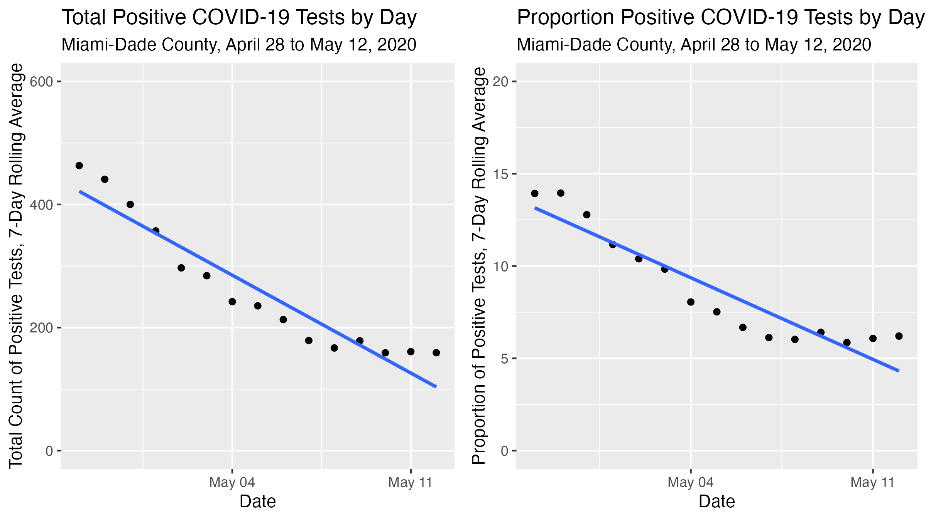
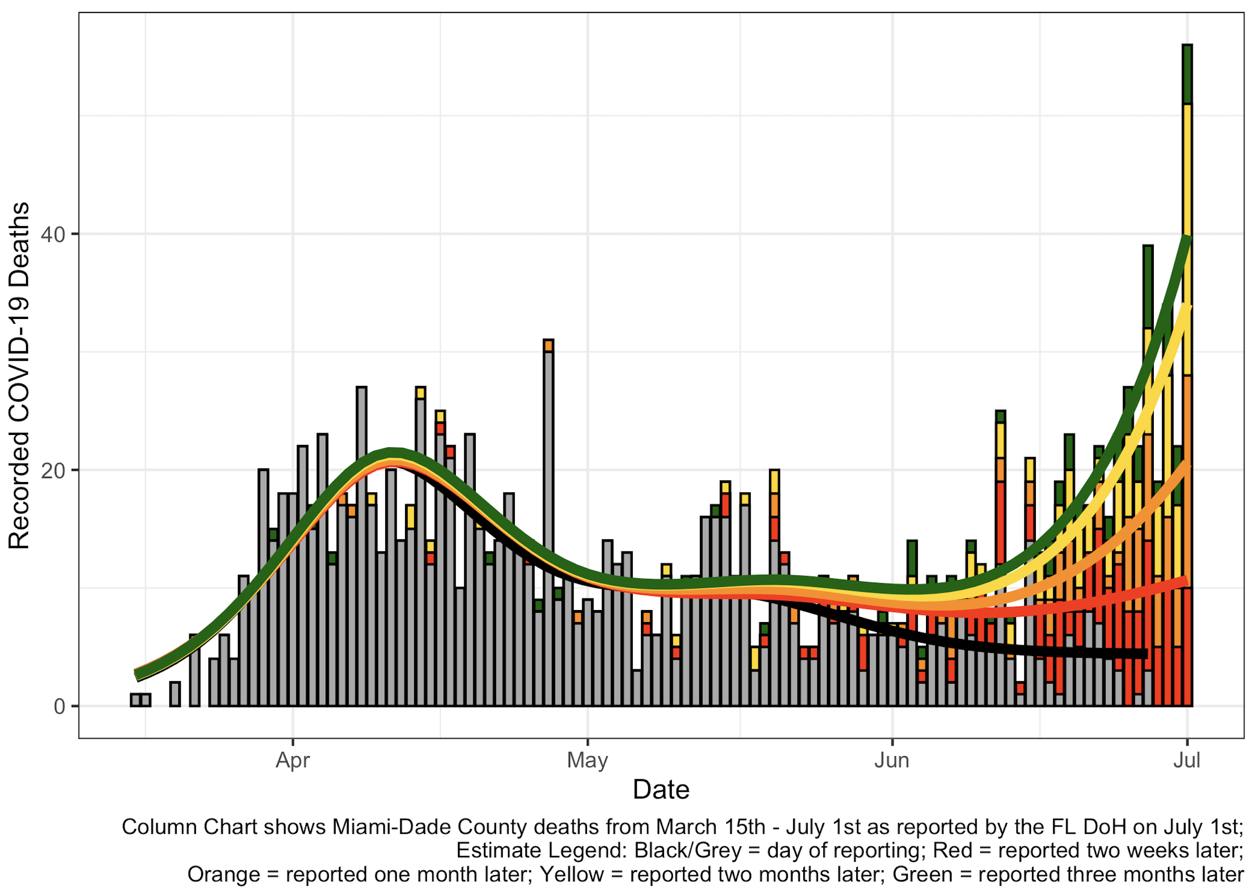
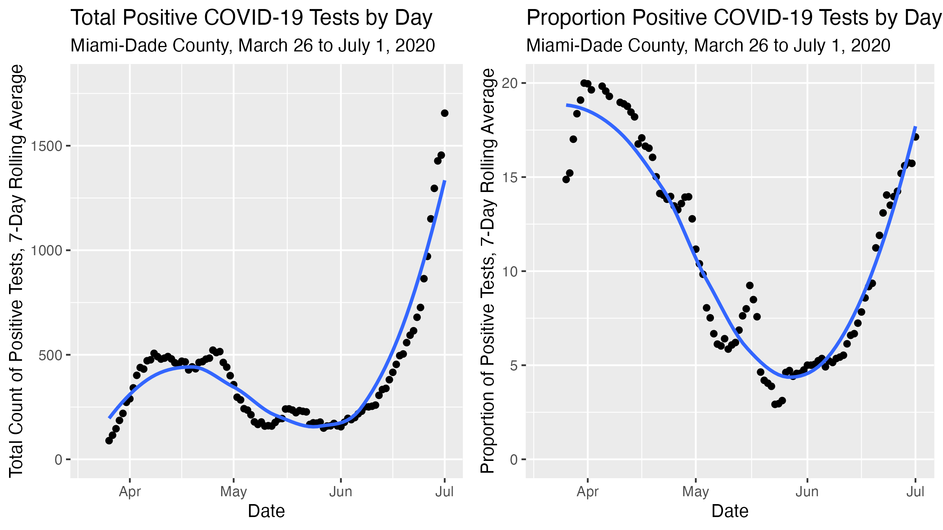

Slide 5
HOW TO HEAR MORE
Video title: “Visualizing COVID-19 Data in Miami-Dade County”
Link to our slides: https://rpubs.com/gabrielodom/JSM_2021_COVID_visuals
Contact us:
godom@fiu.edu
@RevDocGabriel

