Slide 1
Introduction to Python for Finance

Slide 2
Prologue Objectives, planning, Evals

Slide 3
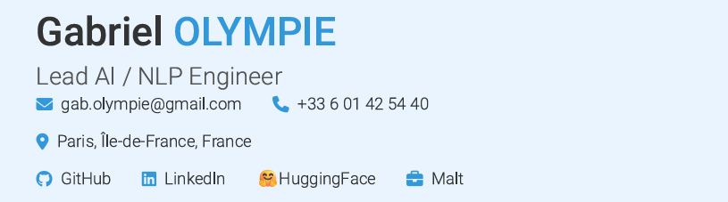

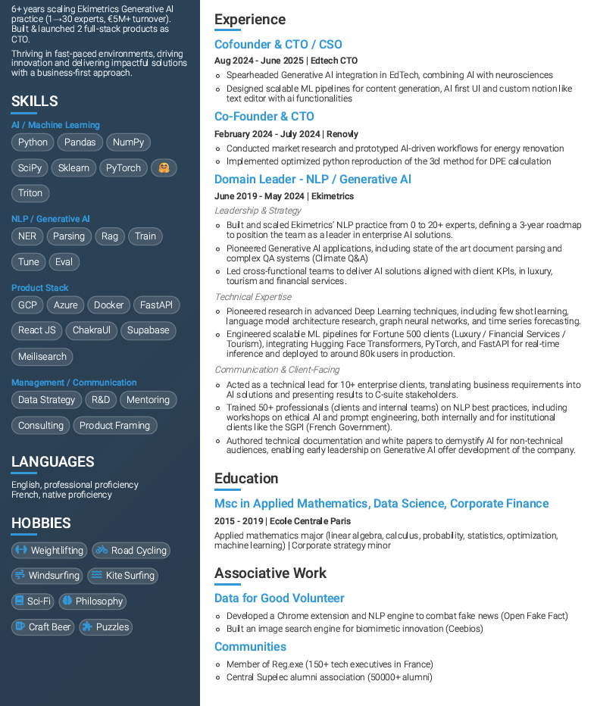



Presentation

Slide 4
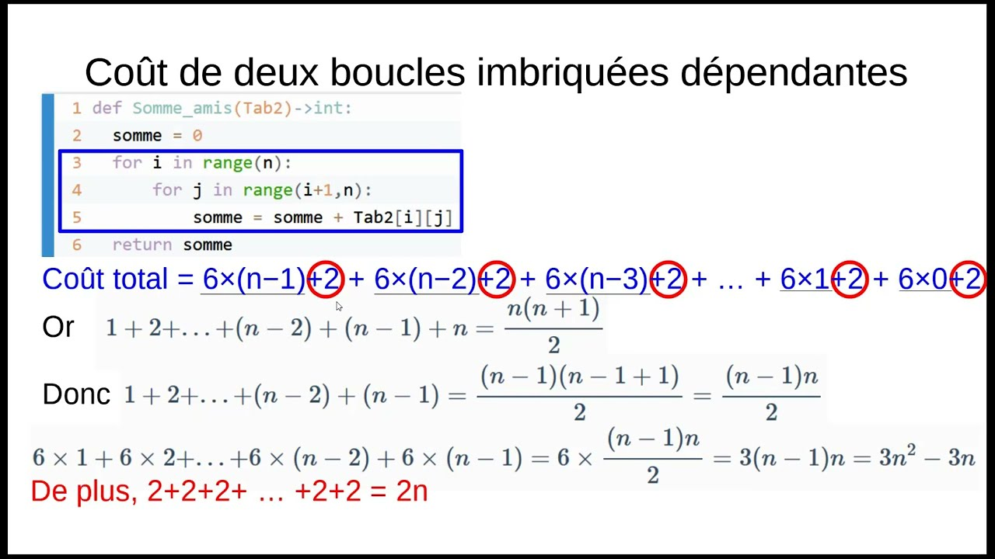
Teaching philosophy
Programing is an applied discipline, the best way to learn it is to practice, and solve real problems
Personal projects
Small automations
Coding Games
Kaggle competitions
Without those who came before, no program would be possible, sharing is at the core of programming

Slide 5
Pedagogic objectives
Understand the challenges of Python code in business
Understand the basics of Python programming
Be autonomous on simple issues of data analysis and visualization
Know how to manage a software development project cycle

Slide 6
Guiding Project: News Analytics
Create a simple full stack application, for news article analysis. This will include:
Learning to scrap a news website
Perform basic analytics on it
Display the results in a simple UI

Slide 7
Evaluation Project
Evaluation will be performed on a mini projects by team.
The topic of the mini project will be choosen at the end of first lesson. Eval will be done on:
- Capability to self organize the team for collaborative developping
Business value of the solution
Code and solution developped
Documentation of the solution
More details later

Slide 8
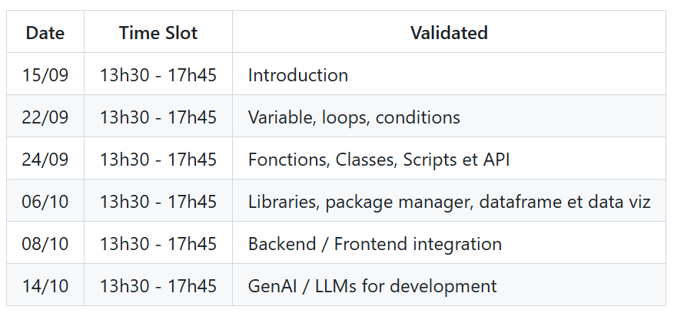
Planning

Slide 9
Course progression
Theory: Core notion to memorize
Applied theory: Micro use cases to illustrate the theory
TD: 20-30min phase to experiment on a given lesson
Ad Hoc: to let the curiosity flow

Slide 10
ACT I History, Industry, Usage

Slide 11
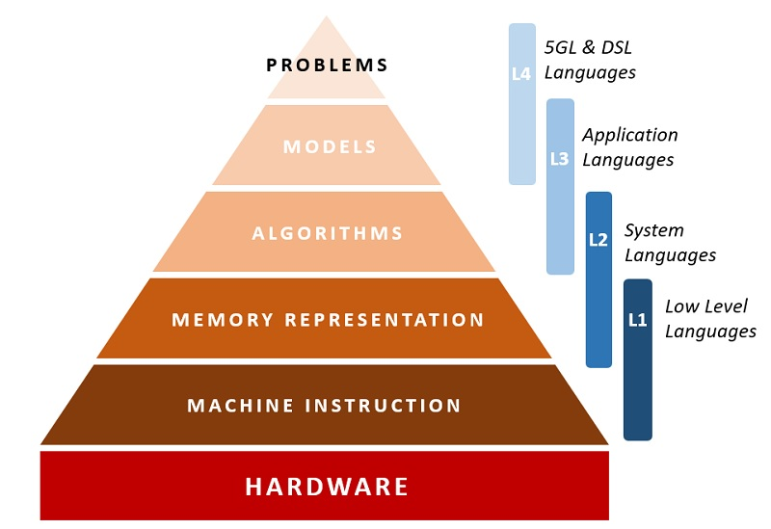
What is a programming language?
“A programming language is an artificial language for expressing computer programs”, Wikipedia

Slide 12
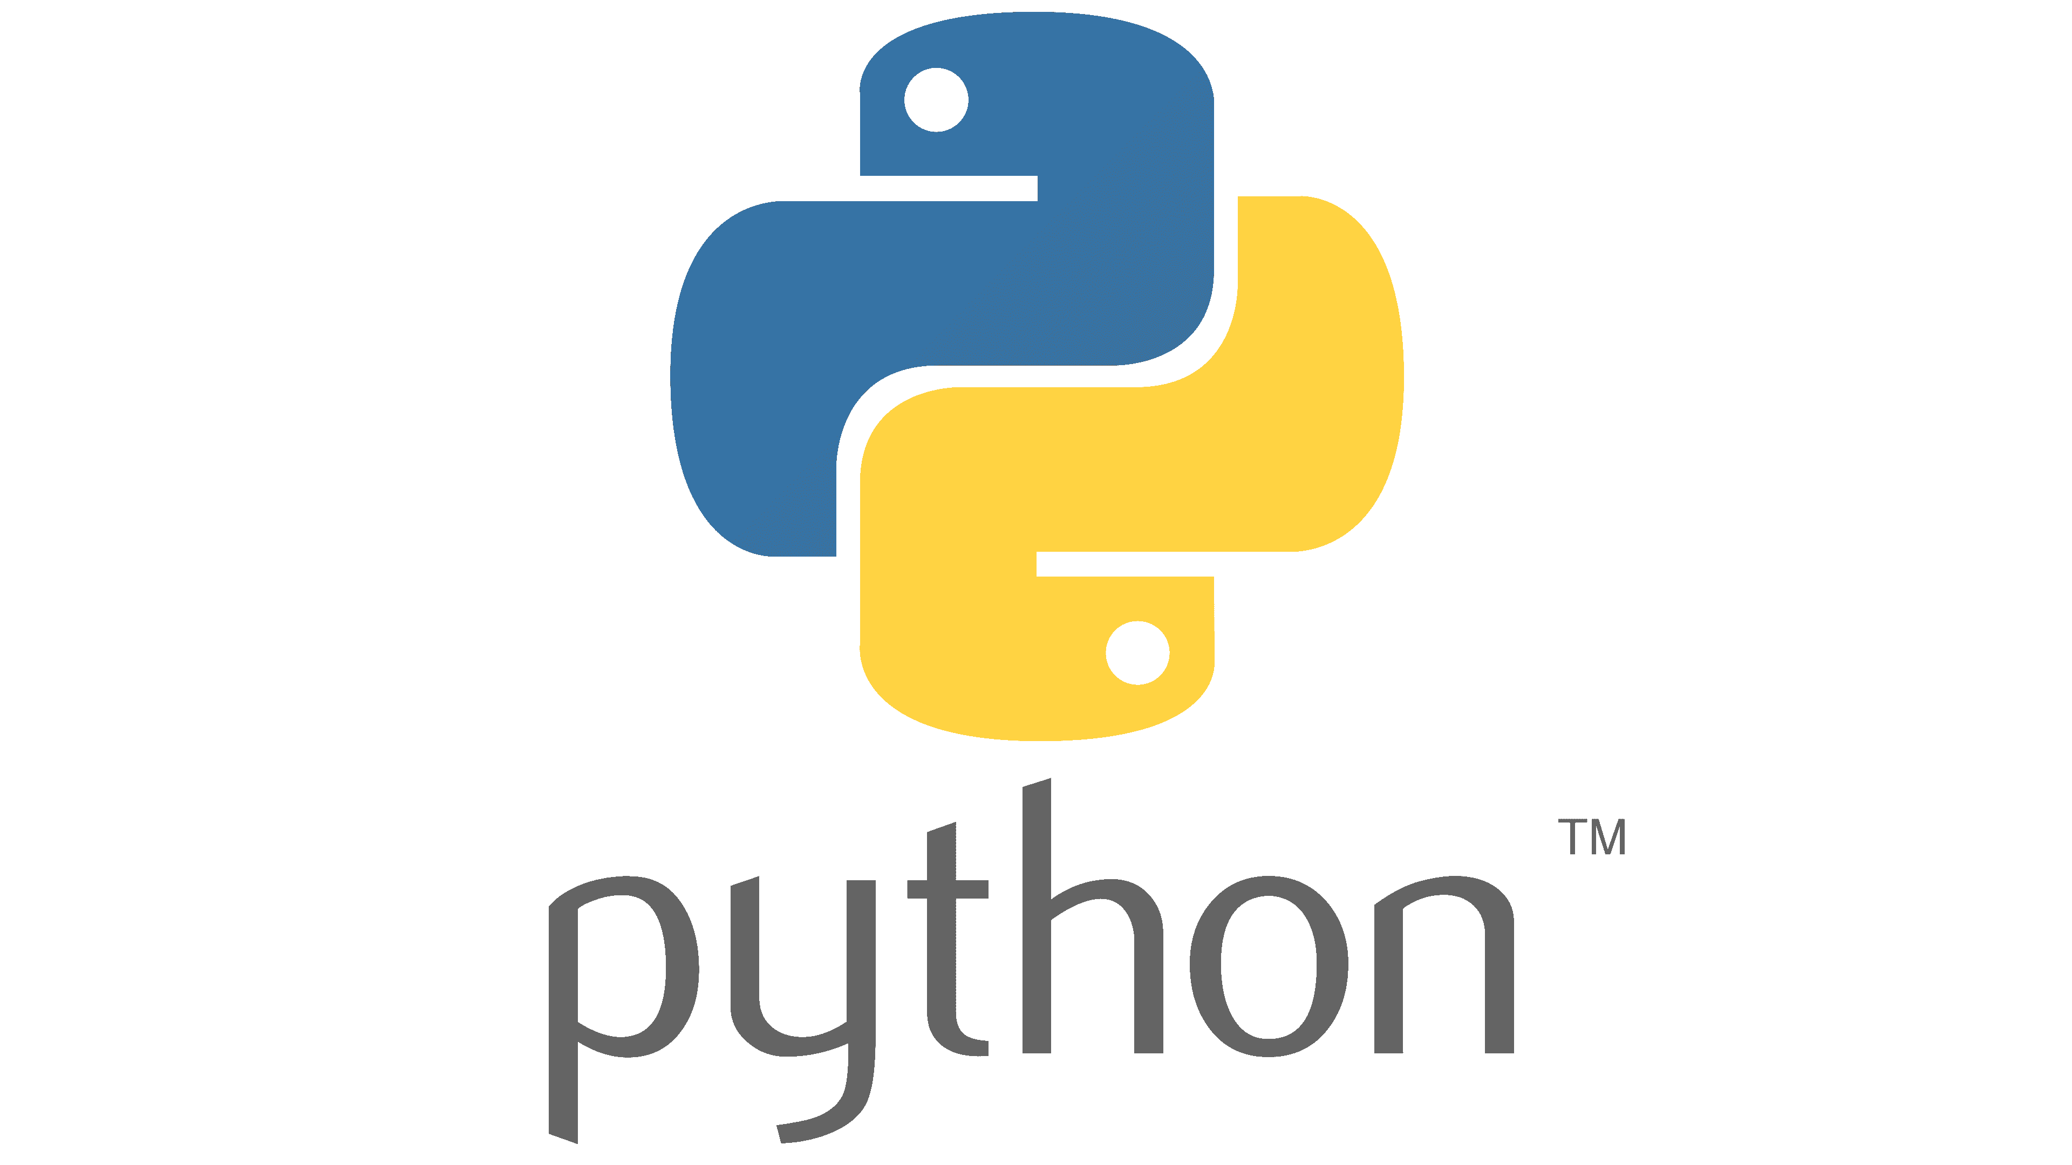
What is a python?
“Python (prononcé /pi.tɔ̃/) est un langage de programmation interprété, multiparadigme et multiplateformes. Il favorise la programmation impérative structurée, fonctionnelle et orientée objet.
Il est doté d'un typage dynamique fort, d'une gestion automatique de la mémoire par ramasse-miettes et d'un système de gestion d'exceptions ;
il est ainsi similaire à Perl, Ruby, Scheme, Smalltalk et Tcl.”, Wikipedia

Slide 13
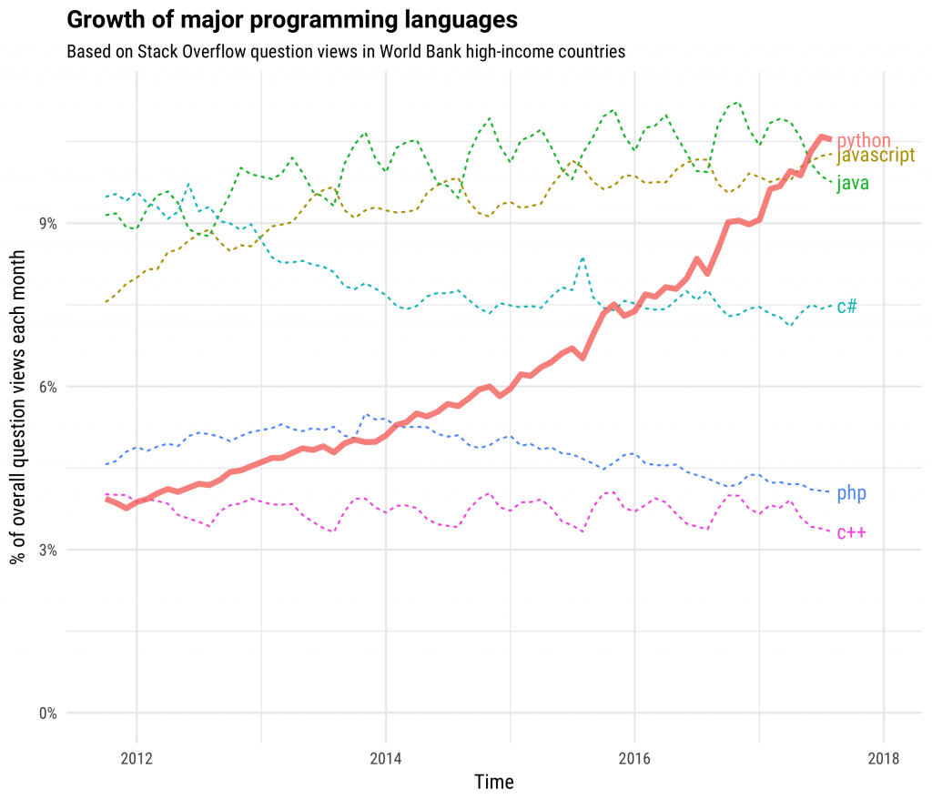
What makes it popular?
Python has been one of the fastest growing programming language of the last decade.
Its ease of use is one factor

Slide 14
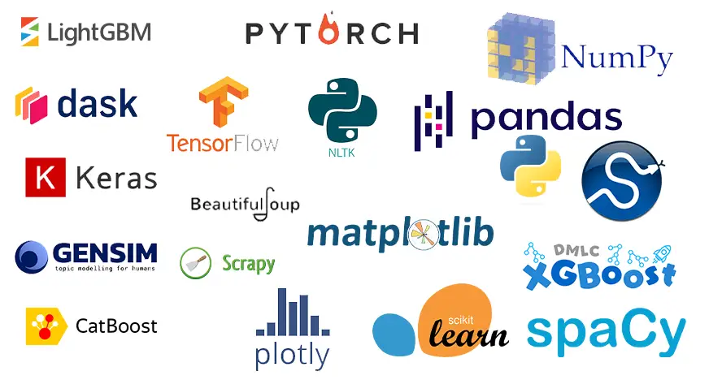
A wide community
Popularity is a virtuous cycle. Most modern software develop an interface for python, and hence reinforce its attractivity

Slide 15
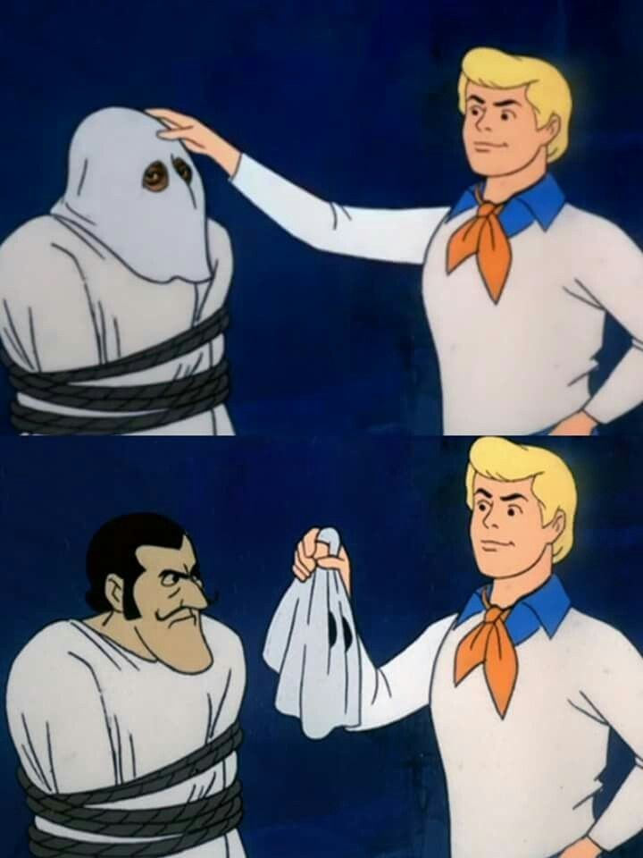


Large interoperability balance low performance
Simplicity has a cost, the python interpreter is rather slow (up to 100x slower than C)
Python balances this by being extremely interoperable. Most popular library are often reimplemented in C / Rust with python binding for performance

Slide 16
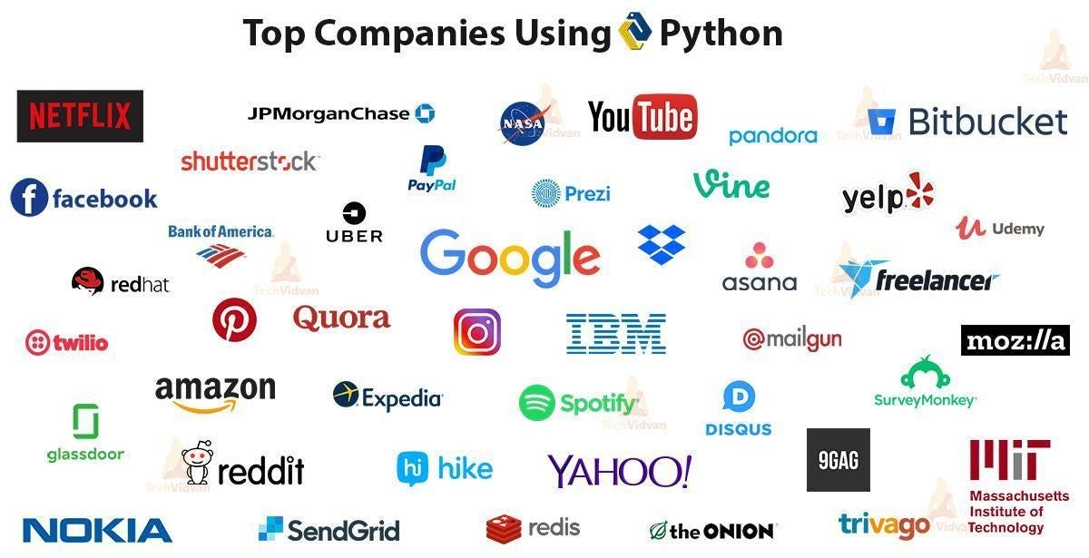
Even large tech company with different stack end up using python internally

Slide 17
Case where python is usefull
Individual usage
Internal tooling
Industrial software
Count documents with certain patterns
Find a specific information in a large folder
Categorize emails and send custom answer in some cases
Build your own media
GenAI automations
Quick interactive dashboards
Team level tools
Document parsing
RAGs
Self serve APIs
Backend application
Data / DevOps
Pipelines

Slide 18

Python as a Productivity booster
Developer have free access to most
new tools about 2y before anyone
Translation
Media categorisation
Serving llm prompts
Transcription
Image generation

Slide 19
ACT II « Hello world »

Slide 20
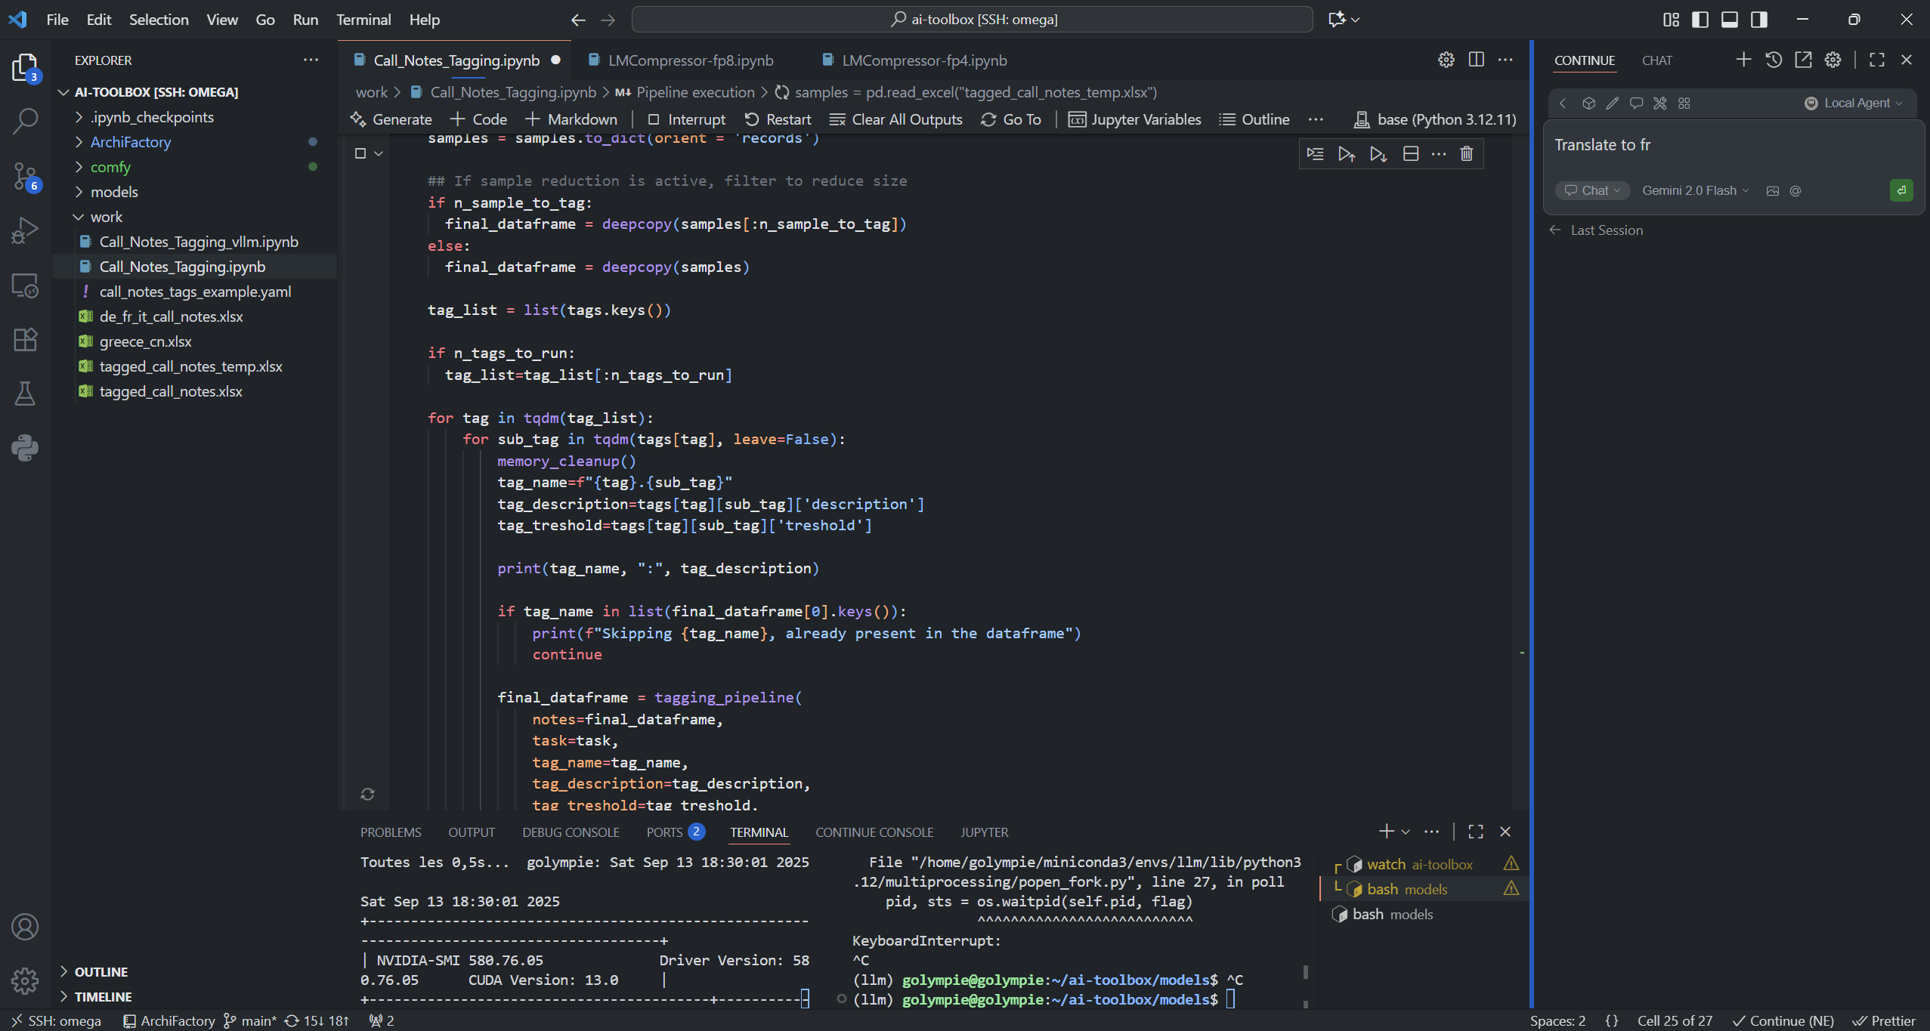
The IDE : The developer desktop

Slide 21
The IDE : The developer desktop
File
System
Opened
Files
Extensions
Embedded AI
Running commands

Slide 22


Visual Studio Code
Open Source
Large community
Fully configurable
Extension system

Slide 23
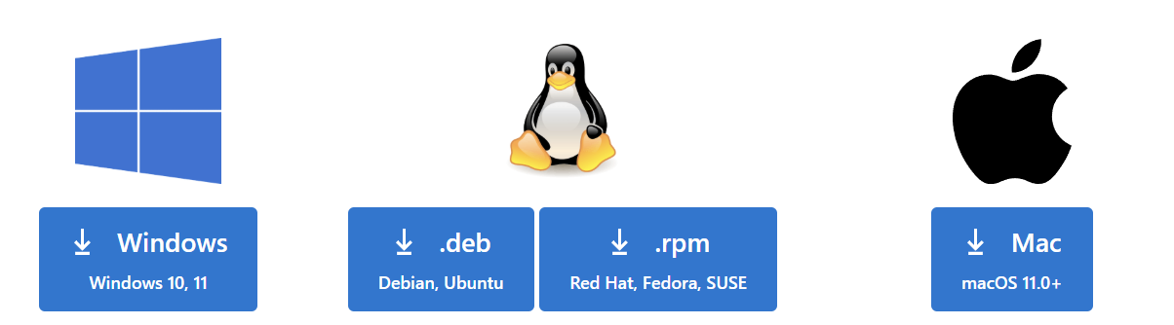
TD: Installation et présentation de vs code
1. Navigate to:
A few recommended extensions:
Jupyter
Markdown Preview
Tldraw
Pylance
Git Graph
Continue (details in last course)
https://code.visualstudio.com/download
2. Download version matching your OS:
3. Install, and follow steps
4. Use right click : open with code to open in a folder

Slide 24
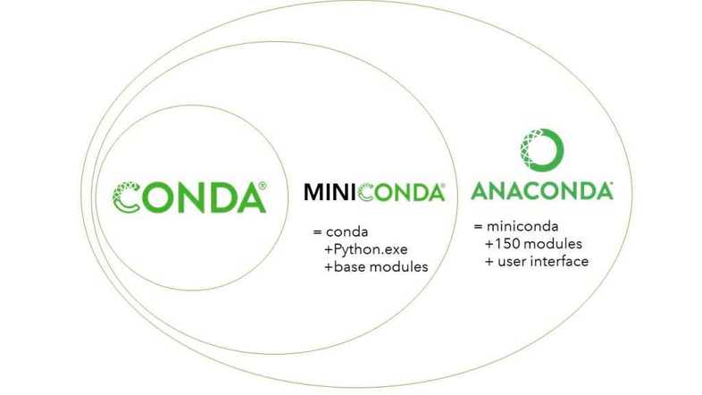
What is a development environment
Development language are evolving over time, a development environment is essentially a definition of what version of the language we are using and what third party library are installed
Several pre build environment exist (venv, anaconda, …) for this lesson we will be using a miniconda distribution

Slide 25
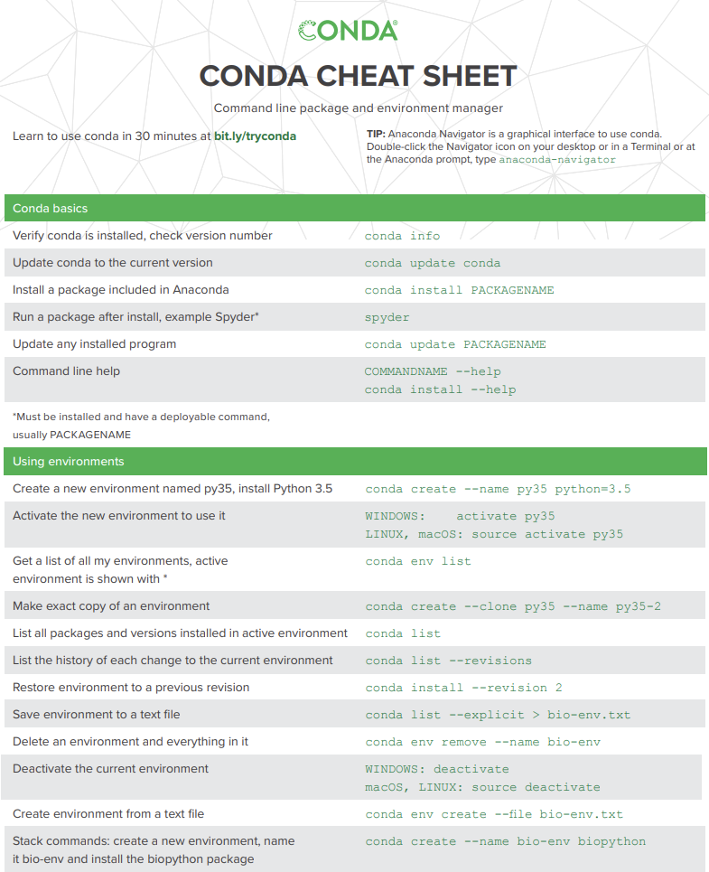



TD 1/6 : Installing miniconda
1. Download: version matching your OS:
https://repo.anaconda.com/miniconda/Miniconda3-py311_24.9.2-0-Windows-x86_64.exe
https://repo.anaconda.com/miniconda/Miniconda3-py311_24.9.2-0-Linux-x86_64.sh
https://repo.anaconda.com/miniconda/Miniconda3-py311_24.9.2-0-MacOSX-x86_64.pkg
2. Install

Slide 26
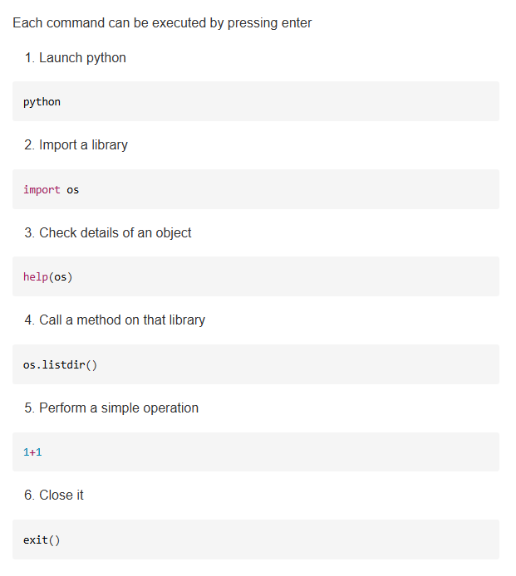
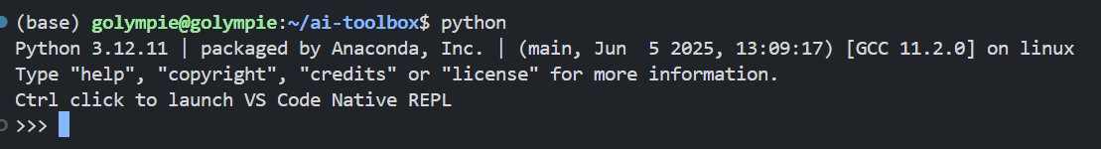
TD 2/6 : Starting python
In vscode, open a terminal
2. If the (base) is not displayed, type: conda activate base
3. Check if python was installed properly by typing: « python »
4. Play with the command on the cheat sheet to get started

Slide 27
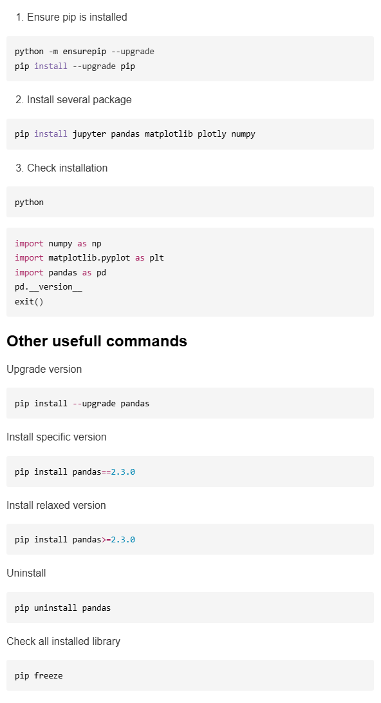
TD 3/6 : Using the package manager
Pip is the default package manager of python, it is used to install and uninstall libraries that can be used during development.
For now, let’s stick to a few very common libraries:
jupyter : get interactive notebooks for development
Pandas : the « excel » of python, to handle structured data and perform analytics on them
Matplotlib / plotly : Data viz in python
Numpy : vector manipulation
To be noted, these library are linked to your miniconda environment. If you create a new env or uninstall miniconda, you’ll have to restart all of this

Slide 28
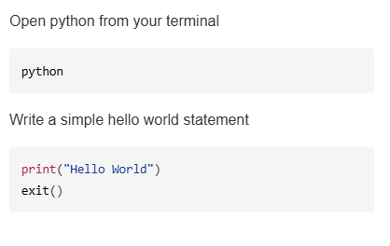
TD 4/6 : Hello World in the terminal
One of the common way to celebrate a successful setup is simply to print a hello world statement in your environment.
In python, this is done throught the « print » function, which just tells the interpréter to show the content of a given variable / object / function into the terminal written output.
To print your first hello world, let’s use the terminal as we previously did.

Slide 29
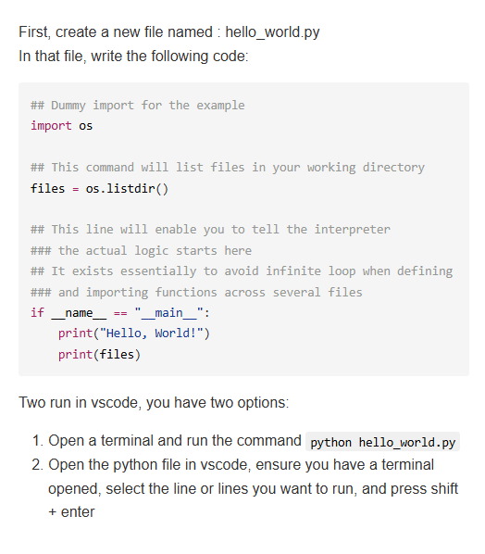
TD 5/6 : Hello World in a script
Using a terminal to write python is quick, but terminal often lack the features and utils you can find in a rich text editor.
To tackle that, we can rely on .py script, which are simple text files that can be run with python. We’ll dig deeper on how to use them later.
A script have two parts:
Imports / définition : you’ll often put that at the top of the script
Running logic : the logic that must be ran if you execute the script itself
The separation between both is by adding the line « if __name__=="__main__": » and intenting what is after

Slide 30
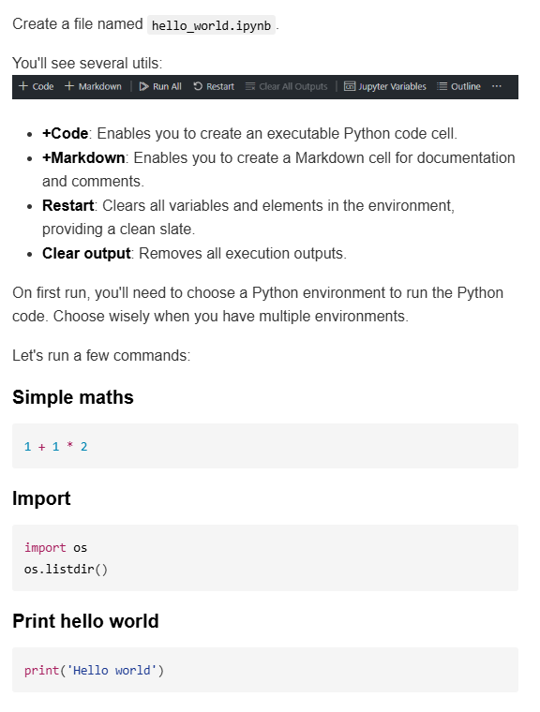
TD 6/6 : Hello World in a notebook
Python file are a simple and efficient ways to define your python program, and are at the core of production code.
But when you are prototyping, or starting to work on idea, having the script separated from the terminal can be tedious.
To tackle the issue, jupyter notebooks where invented, with an unified interactive python environment.
Jupyter are a mix of json and markdown files, that can be identified by ther .ipynb extension.
With the right extension, vscode enables you to directly run notebooks in your IDE.

Slide 31
ACT III Enterprise python : Collaborate, Document, Frame

Slide 32
Github : The collaborative development platform
When it comes to collaborative development, github is one the must know tools to enable development. For this reason, most of this course will be available on github,
GitHub starts as a simple util designed to help version and evolve textual content. It revolves around the principle of « diffs »
A diff is the minimal set of editions you must do to go from one text file to an other text file.
Hence if you remove one line from a text file, you can simply represent it as a diff of « remove line x »

Slide 33
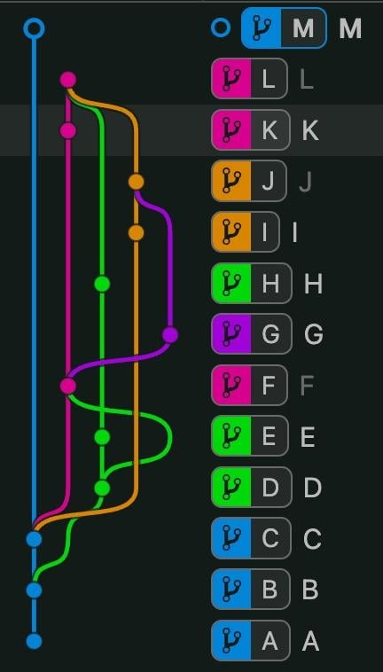
How to work with github
To collaborate, git offers several tools:
Branches : these are several version of the same codebase
Commits : they are tied to a given branch, and enable to check what have been added between two successive version and by who
Pull request : sometime you want to merge two branches. In that case you’re gonna need to submit a pull request.

Slide 34
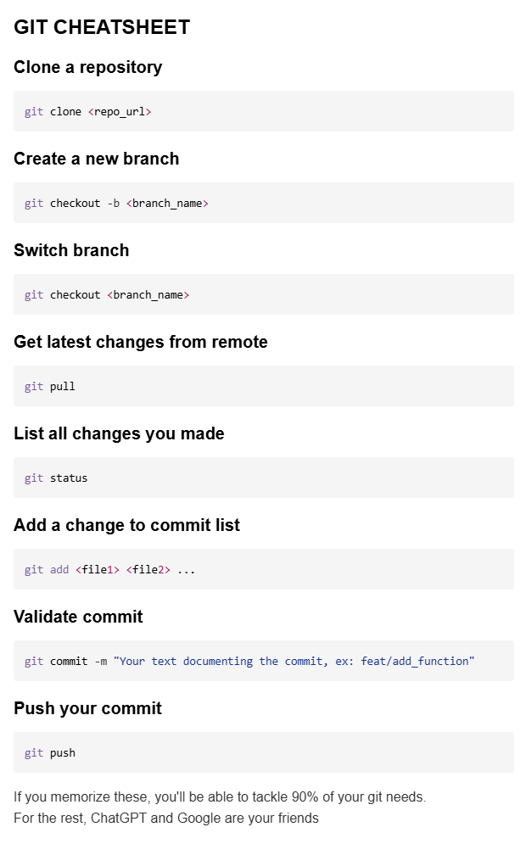
Best practices of Github
There is a very standard process to developp properly, which goes along the line:
Several versions of the application, often main, qa, dev
Dev is the development version, which is used to iterate
Qa is the testing version, used to test a stable candidate of the code
Main is the production version, used to deploy the official version of the app
When starting to work on a new feature i:
Start from dev
Create a new branche with an explicit name (ex: feat/feature_name)
Develop my feature with frequent and explicit commits
When my feature is ready, I make a pull request to dev branch
I review the request with the lead dev to ensure proper interfacing
I merge

Slide 35

TD 1/2: Install Git
1. Navigate to:
1. Navigate to:
https://git-scm.com/downloads
https://github.com/
2. Create an account
2. Download version matching your OS:
3. Navigate to:
https://github.com/gabrielolympie/PythonForFinance
4. Reopen a terminal in your IDE
3. Install, and follow steps
5. Clone the repository
4. Restart your computer
git clone https://github.com/gabrielolympie/PythonForFinance.git

Slide 36
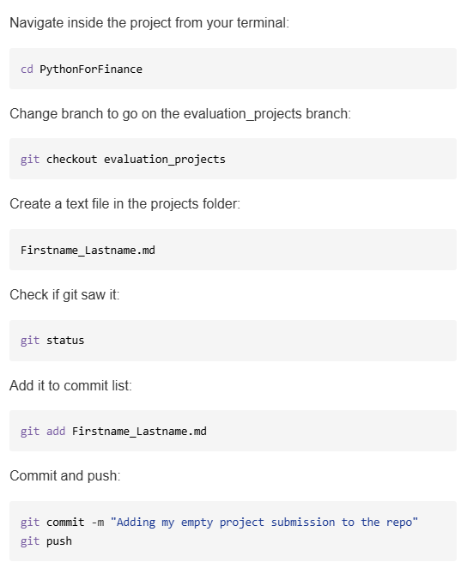
TD 2/2 : Push a first file in it
As said previously, the evaluation project will be choosen later durng the project.
To do that you are going to submit project propositions directly on git, everyone is required to submit at least one proposal.
For that, you’ll first gonna navigate inside the git project,
Then change branch to go on the project_submission branch
In the folder evaluation_projects, add an empty file named:
Firstname_Lastname.md
And then commit and push the file.
Homework for next week: Propose a project to be reviewed for the end of course projects

Slide 37
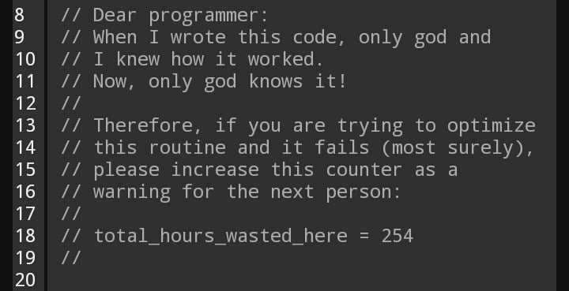
Documentation
Working on a python project is like architecturing an invisible building. If you don’t leave a correct documentation of how it works for other développers or even for future you, chances are the building will collapse very soon.
There are several documentation possibilities, but more often than not its easier to perform « as code » documentation as often as you can to leave a track of what have been done and why.
In python the special character # means that a given line is commented after that character, meaning that it won’t be executed at runtime.
Be helpful for your future you, leave comments 🙏

Slide 38
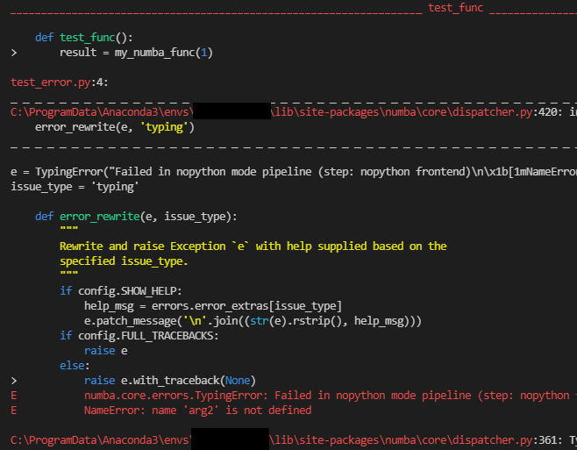
Debugging / Exception
Working on code is like fighting with an alien mind that speaks in a weird language, thats why its called coding.
The good thing is that when you have a problem, chances are that someone already stumbled over the error, or even that people who created the software intentionally triggered it to protect you.
One of the core skills of a developper is to dig into an error chain autonomously to find the root core of an error. For that, you can leverage tools as advanced as Google (that will lead you to stack overflow 3 times out of 4) or any modern AI, they will often find the exact verbatim in a long error trace.
Before asking something, always Google it.

Slide 39
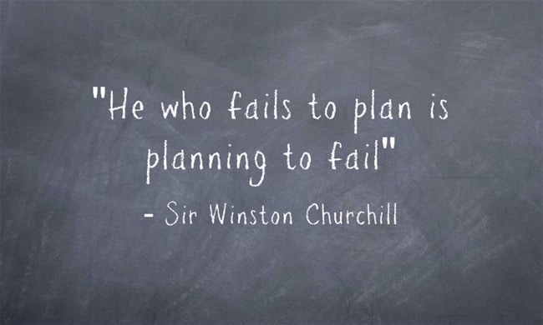
Framing a project
Code, as many thing is simple tool, that correctly used can help you get impacts several times what you could get with just your hands.
But it is a costly tool, evan with modern AI, getting any significant software to produce a meaning full output will take in the best case a few hours for individual scripts, up to months or years for full stack application.
Before even starting to implement anything you need to assess many stuff:
What you are expecting it to do
Who will be using it
What are the core features
What are the nice to have features
How you will architecture it
…

Slide 40
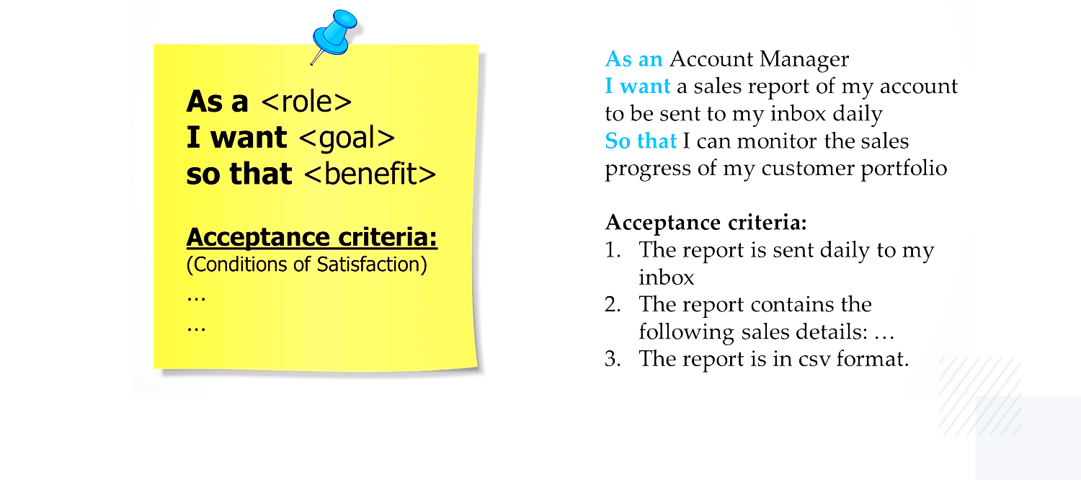
Building a user story
Most development comes from a user story, with clearly defined user, goal and acceptance criterion

Slide 41
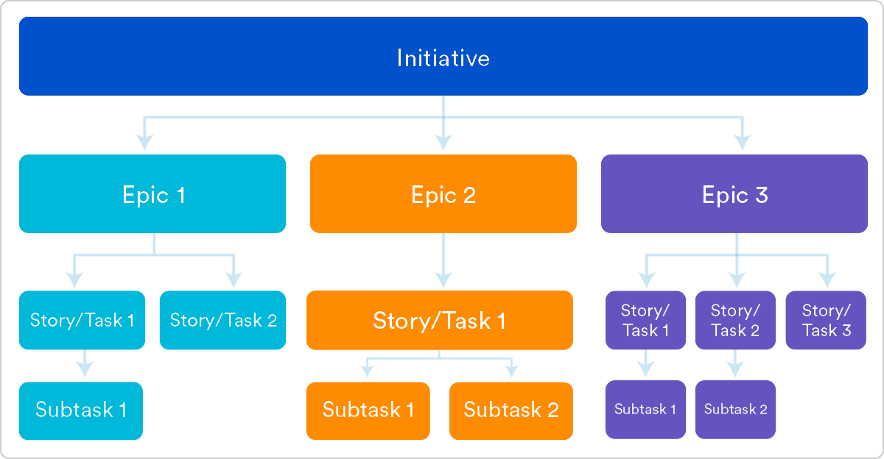
Defining EPIC and FEATURES
Once you know what you want, you then need to define very clearly what sub features will bring you to the result

Slide 42
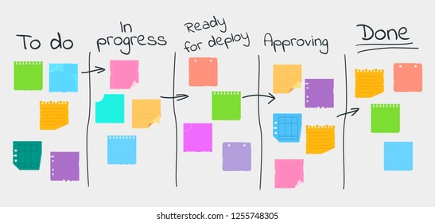
A Kanban can help keeping track of progression
Development can have unpredictable timelines, sometime its completely impossible to predict how much time a given feature will take. A kanban is a simple tool to help follow progress and dynamically adjust

Slide 43
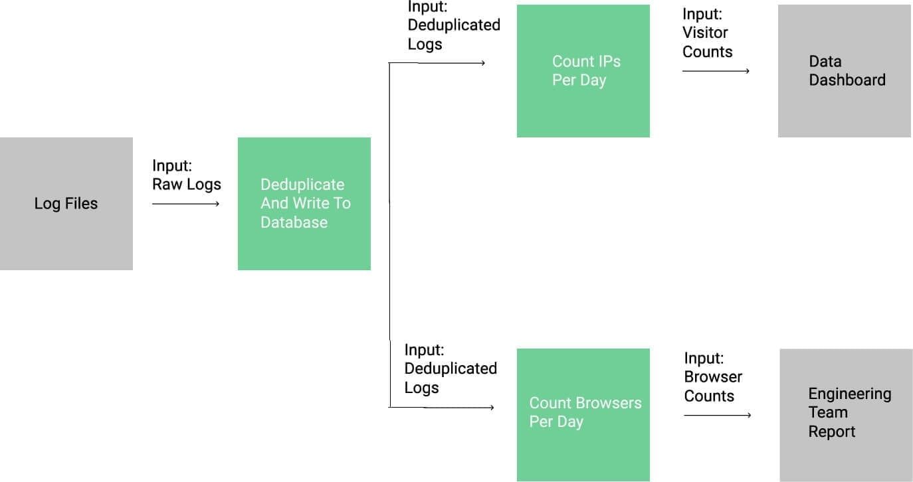
Decompose a task into a pipeline
On each task, you can then decompose it into micro sub tasks that will be usefull for solving it.
Being able to clearly breakdown a complex task into several micro tasks will enable tackling it more effectively

Slide 44




TD : Frame a small development framing for common single feature apps (groups of five)
Rich
Text Editor
Assitant
Chatbot
Search
Engine
Coding
Environment

Slide 45
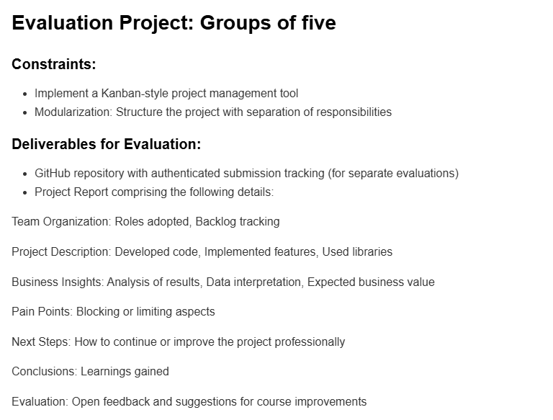
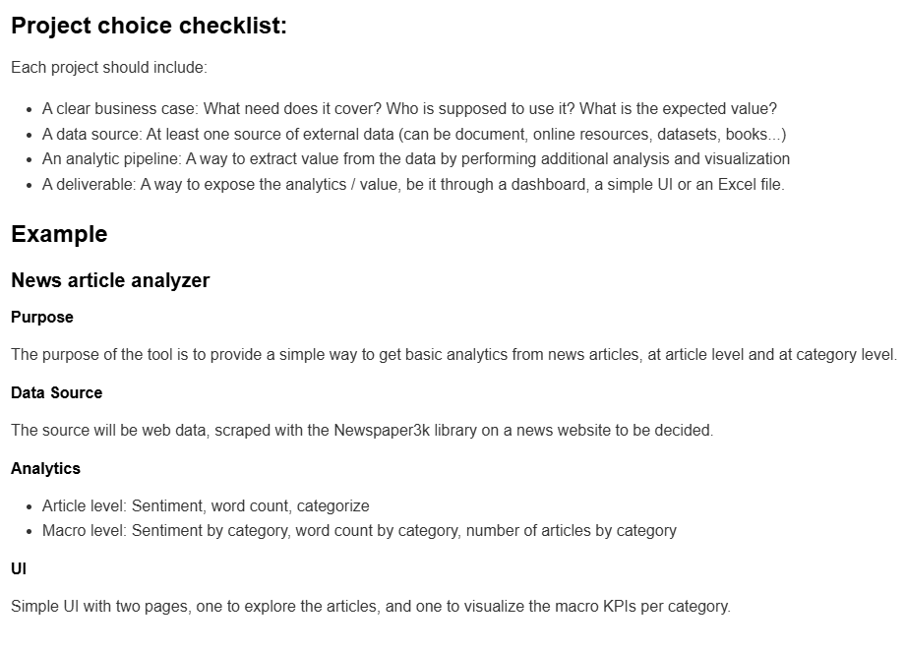
Homework: Deadline 19/09/2025 Propose your dream project for end of course

