Slide 1


Final Presentation
곽태욱 컴퓨터공학부 20171758
서신악 컴퓨터공학부 20170825
고가해 컴퓨터공하부 20161795
왕천용 컴퓨터공학부 20165172

Slide 2
목차
CONTENTS
01
02
03
04
Project
Structure
Program
Analyze
Demo
Design

Slide 3
01
Project
Structure
&
Design

Slide 4
01
Struct
Main
game
piece
lister
Chess Frame

Slide 5
01
Struct
Piece
Piece
Bishop
King
Knight
Pawn
Queen
Rook
Game
Player
Rule
Game
Main
Chess
Listener
Board Listener
Menu Listener
New Game Día log
Chess Frame
Board
Frame
Status bar
Enumeration
Board Type

Slide 6
02
Design

Slide 7
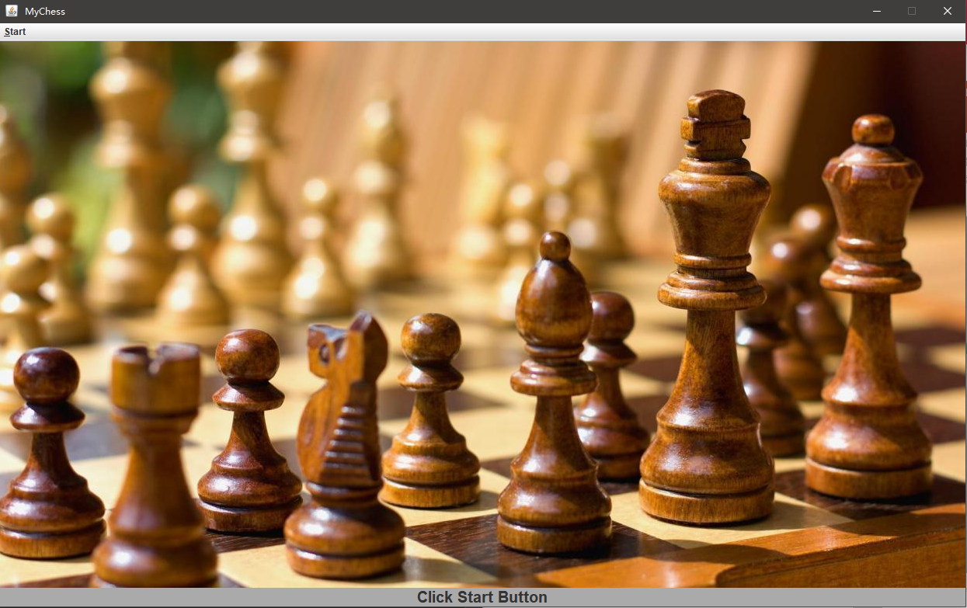
02
Design
Menu bar
Beautify Label
Status Bar

Slide 8
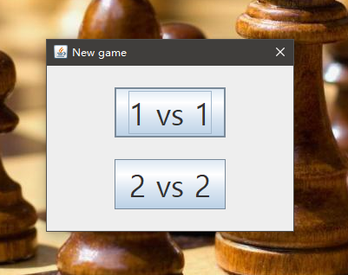
02
Design
Choice button

Slide 9
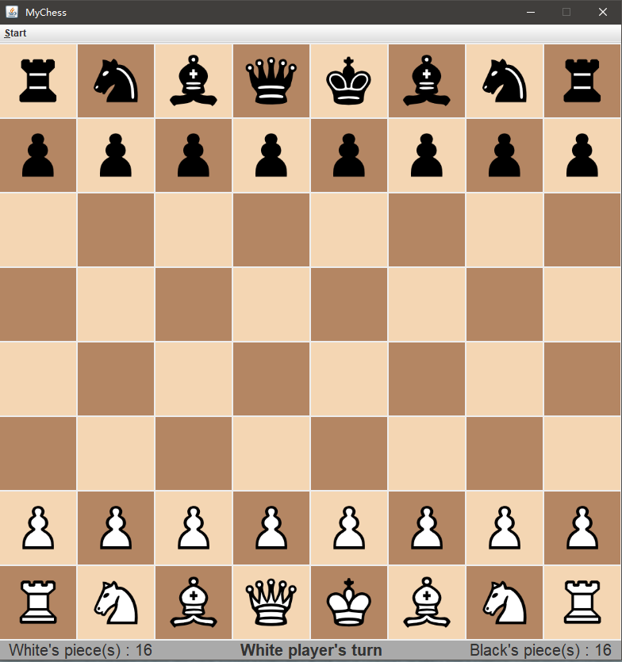
02
1VS1 Design
Black piece area
Board area
White piece area
Status Bar

Slide 10
02
Design
We use 14*14’s Board
And clear 3*3 frame at
Four corners

Slide 11
02
Design
We use 14*14’s Board
And clear 3*3 frame at
Four corners

Slide 12
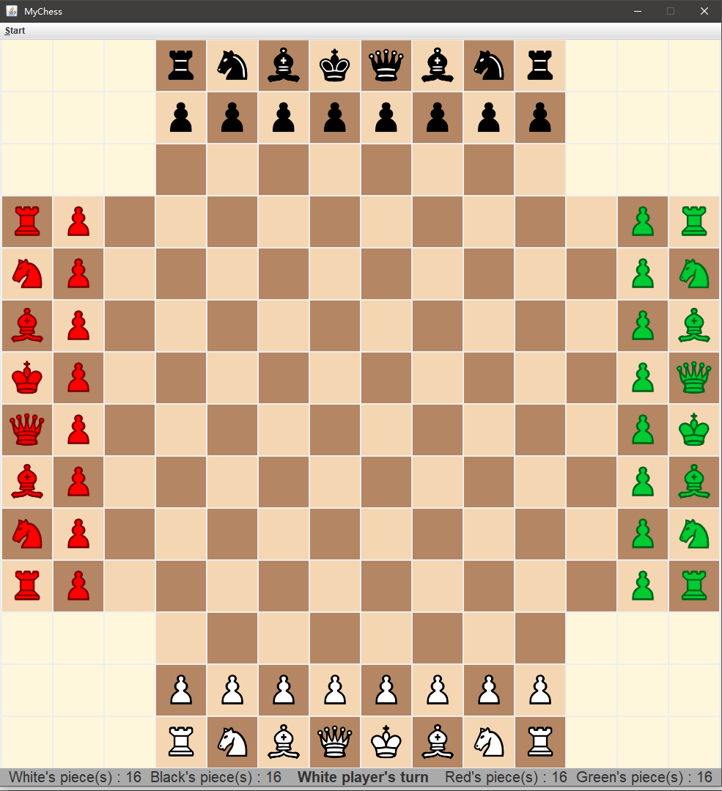
02
Design
Black piece area
Red piece area
Green piece area
Board area
White piece area
Status bar

Slide 13
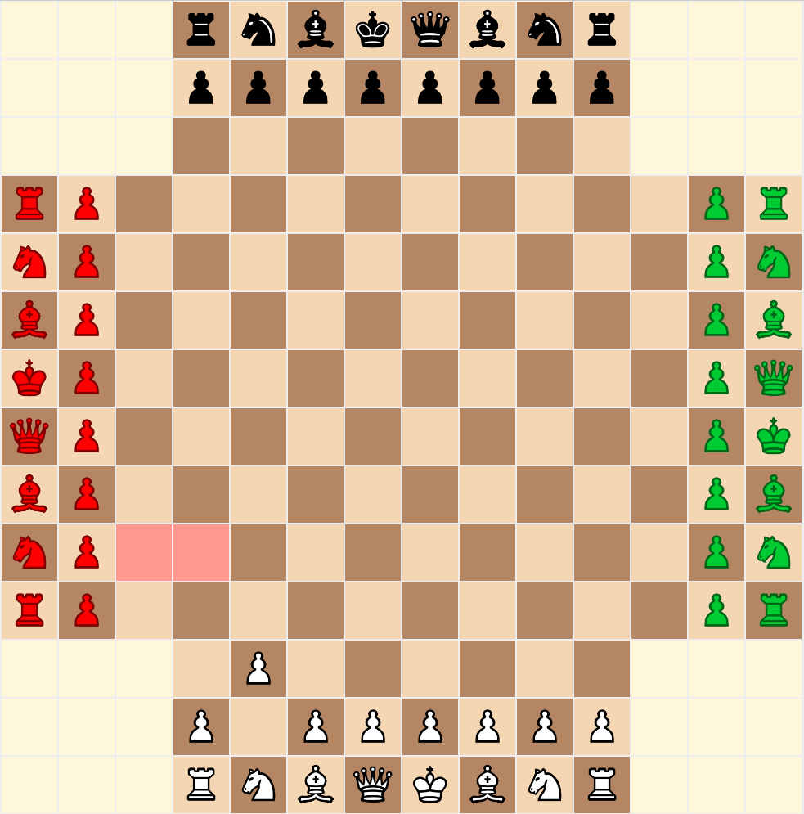
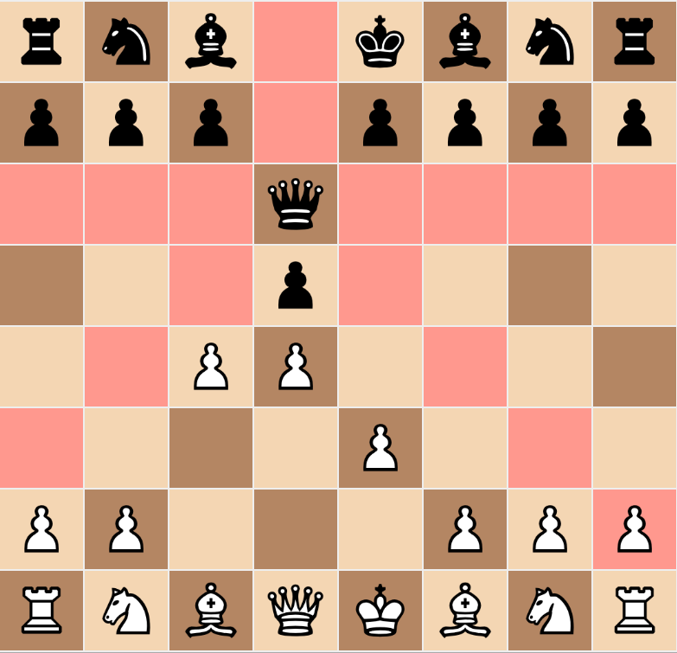
02
Design
We use carnation square that told to player what square
You go play if surrender you turn

Slide 14
03
Program
Analyze

Slide 15
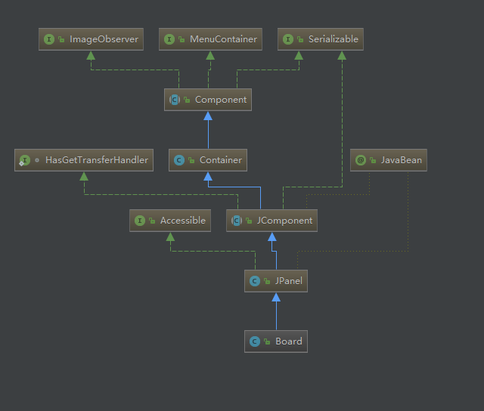
03
Program Analyze
Class : Board

Slide 16
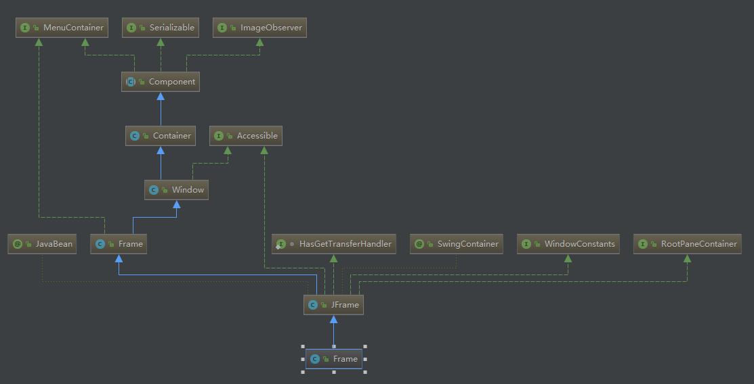
03
Program Analyze
Class : Frame

Slide 17
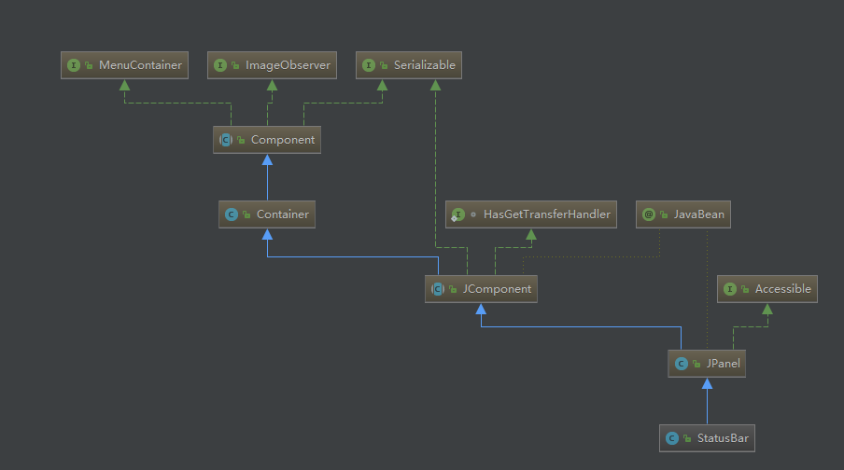
03
Program Analyze
Class : Frame

Slide 18
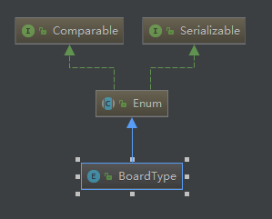
03
Program Analyze
Class : Board Type

Slide 19
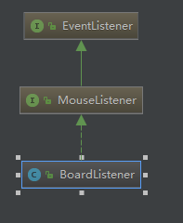
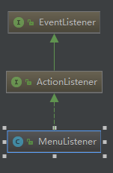
03
Program Analyze
Class : Board Listenter
Class : Mouse Listenter

Slide 20
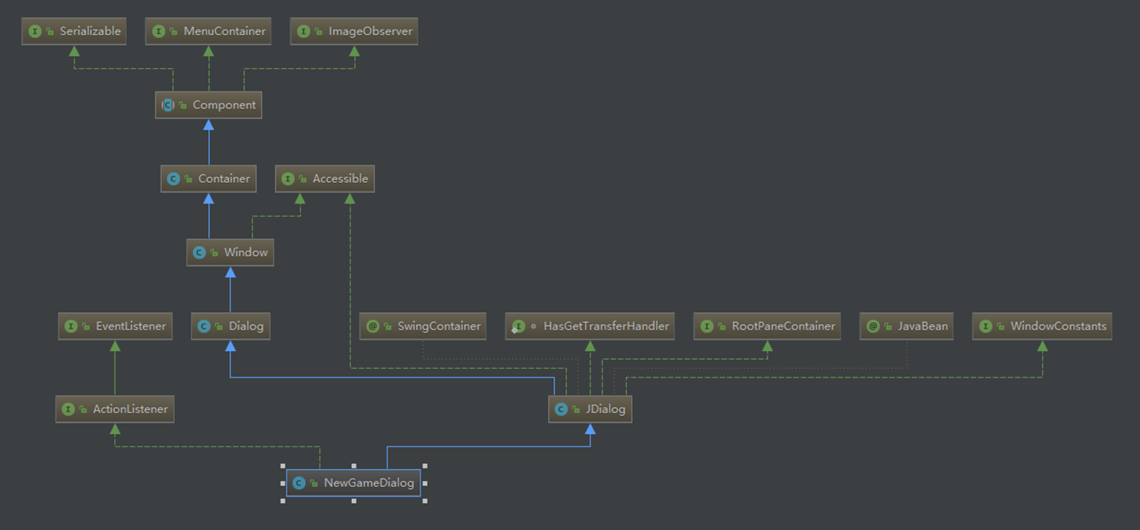
03
Program Analyze
Class : New Game DIALOG

Slide 21
03
Program Analyze
Class：Board
public class Board extends JPanel {
public static int WIDTH;
public static int HEIGHT;
//전체 체스판 정보
public ImagePanel[][] iPanel;
public BoardListener[][] boardInfo;
public boolean[][] attackZone;
//차례 정보
public String thisTurn; //현재 차례인 플레이어 색
public boolean click = true; //true : 체스말 클릭할 차례, false : 이동할 위치 클릭할 차례
public boolean end = false;
//첫번째 클릭된 체스판 정보
public BoardListener srcInfo;
}

Slide 22
1VS1 code
setPieceType(iPanel, i, j, ChessPieceSpriteType.BLACK_PAWN, bl, "Black", "pawn");
else if (i == 6)
setPieceType(iPanel, i, j, ChessPieceSpriteType.WHITE_PAWN, bl, "White", "pawn");
else if (i == 7) {
switch (j) {
case 0:
case 7:
setPieceType(iPanel, i, j, ChessPieceSpriteType.WHITE_LOOK, bl, "White", "rook");
break;
case 1:
case 6:
setPieceType(iPanel, i, j, ChessPieceSpriteType.WHITE_KNIGHT, bl, "White", "knight");
break;
case 2:
case 5:
setPieceType(iPanel, i, j, ChessPieceSpriteType.WHITE_BISHOP, bl, "White", "bishop");
break;
case 3:
setPieceType(iPanel, i, j, ChessPieceSpriteType.WHITE_QUEEN, bl, "White", "queen");
break;
case 4:
setPieceType(iPanel, i, j, ChessPieceSpriteType.WHITE_KING, bl, "White", "king");
break;
default:
System.out.println("Invalid Board. Width expected shorter than 9...");
}
}
else
setPieceType(iPanel, i, j, bl, "", "");
add(iPanel[i][j]);
}
}
setLayout(new GridLayout(HEIGHT, WIDTH, gap, gap));
public Board(Frame frame, BoardType t) {
int gap = 2;
//1vs1 보드 생성
if (t == ONEONE) {
WIDTH = 8;
HEIGHT = 8;
iPanel = new ImagePanel[HEIGHT][WIDTH];
boardInfo = new BoardListener[Board.HEIGHT][Board.WIDTH];
attackZone = new boolean[Board.HEIGHT][Board.WIDTH];
for (int i = 0; i < HEIGHT; i++) {
for (int j = 0; j < WIDTH; j++) {
BoardListener bl = new BoardListener(i, j, frame);
this.boardInfo[i][j] = bl;
iPanel[i][j] = new ImagePanel();
iPanel[i][j].setOpaque(true);
iPanel[i][j].setBackground((i + j) % 2 == 0 ? new Color(244, 214, 179) : new Color(180, 134, 99));
iPanel[i][j].addMouseListener(bl);
if (i == 0) {
switch (j) {
case 0:
case 7:
setPieceType(iPanel, i, j, ChessPieceSpriteType.BLACK_LOOK, bl, "Black", "rook");
break;
case 1:
case 6:
setPieceType(iPanel, i, j, ChessPieceSpriteType.BLACK_KNIGHT, bl, "Black", "knight");
break;
case 2:
case 5:
setPieceType(iPanel, i, j, ChessPieceSpriteType.BLACK_BISHOP, bl, "Black", "bishop");
break;
case 3:
setPieceType(iPanel, i, j, ChessPieceSpriteType.BLACK_QUEEN, bl, "Black", "queen");
break;
case 4:
setPieceType(iPanel, i, j, ChessPieceSpriteType.BLACK_KING, bl, "Black", "king");
break;
default:
System.out.println("Invalid Board. Width expected shorter than 9...");
}
} else if (i == 1)

Slide 23
2VS2 code
public Board(Frame frame) {
this(frame, ONEONE);
}
}
//2vs2 보드 생성
else {
WIDTH = 14;
HEIGHT = 14;
iPanel = new ImagePanel[HEIGHT][WIDTH];
boardInfo = new BoardListener[Board.HEIGHT][Board.WIDTH];
attackZone = new boolean[Board.HEIGHT][Board.WIDTH];
for (int i = 0; i < HEIGHT; i++) {
for (int j = 0; j < WIDTH; j++) {
BoardListener bl = new BoardListener(i, j, frame);
this.boardInfo[i][j] = bl;
iPanel[i][j] = new ImagePanel();
iPanel[i][j].setOpaque(true);
iPanel[i][j].addMouseListener(bl);
if (i == 0) {
switch (j) {
case 3:
case 10:
setPieceType(iPanel, i, j, ChessPieceSpriteType.BLACK_LOOK, bl, "Black", "rook");
break;
case 4:
case 9:
setPieceType(iPanel, i, j, ChessPieceSpriteType.BLACK_KNIGHT, bl, "Black", "knight");
break;
case 5:
case 8:
setPieceType(iPanel, i, j, ChessPieceSpriteType.BLACK_BISHOP, bl, "Black", "bishop");
break;
case 6:
setPieceType(iPanel, i, j, ChessPieceSpriteType.BLACK_KING, bl, "Black", "king");
break;
case 7:
setPieceType(iPanel, i, j, ChessPieceSpriteType.BLACK_QUEEN, bl, "Black", "queen");
break
else if (i == 1 && j > 2 && j < 11)
setPieceType(iPanel, i, j, ChessPieceSpriteType.BLACK_PAWN, bl, "Black", "pawn");
else if (j == 0 && i > 2 && i < HEIGHT - 3) {
switch (i) {
case 3:
case 10:
setPieceType(iPanel, i, j, ChessPieceSpriteType.RED_LOOK, bl, "Red", "rook");
break;
case 4:
case 9:
setPieceType(iPanel, i, j, ChessPieceSpriteType.RED_KNIGHT, bl, "Red", "knight");
break;
case 5:
case 8:
setPieceType(iPanel, i, j, ChessPieceSpriteType.RED_BISHOP, bl, "Red", "bishop");
break;
case 6:
setPieceType(iPanel, i, j, ChessPieceSpriteType.RED_KING, bl, "Red", "king");
break;
case 7:
setPieceType(iPanel, i, j, ChessPieceSpriteType.RED_QUEEN, bl, "Red", "queen");
break;
}
} else if (j == 1 && i > 2 && i < HEIGHT - 3) {
setPieceType(iPanel, i, j, ChessPieceSpriteType.RED_PAWN, bl, "Red", "pawn");
} else if (j == HEIGHT - 2 && i > 2 && i < HEIGHT - 3) {
setPieceType(iPanel, i, j, ChessPieceSpriteType.GREEN_PAWN, bl, "Green", "pawn");
} else if (j == HEIGHT - 1 && i > 2 && i < HEIGHT - 3) {
switch (i) {
case 3:
case 10:
setPieceType(iPanel, i, j, ChessPieceSpriteType.GREEN_LOOK, bl, "Green", "rook");
break;
case 4:
case 9:
setPieceType(iPanel, i, j, ChessPieceSpriteType.GREEN_KNIGHT, bl, "Green", "knight");
break;
case 5:
case 8:

Slide 24
setPieceType(iPanel, i, j, ChessPieceSpriteType.GREEN_BISHOP, bl, "Green", "bishop");
break;
case 6:
setPieceType(iPanel, i, j, ChessPieceSpriteType.GREEN_QUEEN, bl, "Green", "queen");
break;
case 7:
setPieceType(iPanel, i, j, ChessPieceSpriteType.GREEN_KING, bl, "Green", "king");
break;
}
} else if (i == HEIGHT - 2 && j > 2 && j < WIDTH - 3)
setPieceType(iPanel, i, j, ChessPieceSpriteType.WHITE_PAWN, bl, "White", "pawn");
else if (i == HEIGHT - 1) {
switch (j) {
case 3:
case 10:
setPieceType(iPanel, i, j, ChessPieceSpriteType.WHITE_LOOK, bl, "White", "rook");
break;
case 4:
case 9:
setPieceType(iPanel, i, j, ChessPieceSpriteType.WHITE_KNIGHT, bl, "White", "knight");
break;
case 5:
case 8:
setPieceType(iPanel, i, j, ChessPieceSpriteType.WHITE_BISHOP, bl, "White", "bishop");
break;
case 6:
setPieceType(iPanel, i, j, ChessPieceSpriteType.WHITE_QUEEN, bl, "White", "queen");
break;
case 7:
setPieceType(iPanel, i, j, ChessPieceSpriteType.WHITE_KING, bl, "White", "king");
break;
}
}
else
setPieceType(iPanel, i, j, bl, "", "");
if (i < 3 && j < 3 || i < 3 && j > WIDTH - 4 || i > HEIGHT - 4 && j < 3 || i > HEIGHT - 4 && j > WIDTH - 4) {
iPanel[i][j].setBackground(new Color(255, 247, 219));
setPieceType(iPanel, i, j, bl, null, null);
}
else
iPanel[i][j].setBackground((i + j) % 2 == 0 ? new Color(244, 214, 179) : new Color(180, 134, 99));
add(iPanel[i][j]);
}
}
setLayout(new GridLayout(HEIGHT, WIDTH, gap, gap));
}
}
private void setPieceType(ImagePanel[][] iPanel, int i, int j, ChessPieceSpriteType pieceType, BoardListener bl, String color, String type) {
iPanel[i][j].setImage(ChessPieceSprite.getInstace().getChessPiece(pieceType));
bl.pieceColor = color;
bl.pieceType = type;
}
private void setPieceType(ImagePanel[][] iPanel, int i, int j, BoardListener bl, String color, String type) {
iPanel[i][j].setImage(null);
bl.pieceColor = color;
bl.pieceType = type;
}

Slide 25
03
Program Analyze
Class：Frame
public class Frame extends JFrame {
public Board board;
public StatusBar statusBar;
public Game game;
public Frame() {
//프레임 생성
super(Chess.getTitle());
//메뉴바 생성
MenuListener menuListener = new MenuListener(this);
menuListener.createMenu();
//프레임 배경 설정
JLabel jLabel = new JLabel(new ImageIcon("image/MainDisplay.jpeg"));
statusBar = new StatusBar("Click Start Button");
setLayout(new BorderLayout());
add(statusBar, BorderLayout.SOUTH);
add(jLabel);
//프레임 속성 설정
setSize(1260, 790);
setLocationRelativeTo(null);
setResizable(false);
setDefaultCloseOperation(JFrame.EXIT_ON_CLOSE);
setVisible(true);
}
//N인용의 새로운 체스게임 생성 후 시작
public void newGame() {
NewGameDialog ngd = new NewGameDialog(this);
getContentPane().removeAll();
if (ngd.getBoardType() == ONEONE)
setSize(800, 840);
else
setSize(1000, 1080);
board = new Board(this, ngd.getBoardType());
add(board, BorderLayout.CENTER);
add(statusBar, BorderLayout.SOUTH);
revalidate();
repaint();
game = new Game(ngd.getBoardType(), this);
game.begin();
}
}

Slide 26
03
Program Analyze
Class：StatusBar
public class StatusBar extends JPanel {
private String status;
private JLabel[] jLabel = new JLabel[3];
StatusBar(String s) {
//패널 생성 및 초기화
super();
setBackground(new Color(0xAA, 0xAA, 0xAA));
setPreferredSize(null);
setMinimumSize(null);
setMaximumSize(null);
setLayout(new BorderLayout());
//라벨 추가
status = s;
jLabel[0] = new JLabel(status);
jLabel[0].setFont(new Font("Arial",Font.BOLD,20));
jLabel[0].setHorizontalAlignment(SwingConstants.CENTER);
add(jLabel[0], BorderLayout.CENTER);
jLabel[1] = new JLabel();
jLabel[1].setFont(new Font("Arial",Font.PLAIN,20));
add(jLabel[1], BorderLayout.WEST);
jLabel[2] = new JLabel();
jLabel[2].setFont(new Font("Arial",Font.PLAIN,20));
add(jLabel[2], BorderLayout.EAST);
}
public String getStatus() {
return status;
}
public void setStatus(String status, int i) {
jLabel[i].setText(status);
}
public void setStatus(Frame frame) {
if (Board.WIDTH == 8) {
frame.statusBar.setStatus(" White's piece(s) : " + frame.game.getPlayer()[0].getNumberOfPiece(), 1);
frame.statusBar.setStatus("Black's piece(s) : " + frame.game.getPlayer()[1].getNumberOfPiece() + " ", 2);
} else {
frame.statusBar.setStatus(" White's piece(s) : " + frame.game.getPlayer()[0].getNumberOfPiece() + '\n' + " Black's piece(s) : " + frame.game.getPlayer()[1].getNumberOfPiece(), 1);
frame.statusBar.setStatus("Red's piece(s) : " + frame.game.getPlayer()[2].getNumberOfPiece() + " \nGreen's piece(s) : " + frame.game.getPlayer()[3].getNumberOfPiece() + " ", 2);
}
}
}

Slide 27
03
Program Analyze
Class：Board Type
Class：Main
public enum BoardType { ONEONE, TWOTWO; }
public class Chess { public static void main(String[] args) { new Frame(); } public static String getTitle() { return " MyChess "; } }
Class：MoveException
public class MoveException extends RuntimeException { }

Slide 28
03
Program Analyze
public class Game {
private Player[] player = new Player[4];
private Frame frame;
public Game(Frame frame) {
this(ONEONE, frame);
}
public Game(BoardType bt, Frame frame) {
this.frame = frame;
player[0] = new Player("White");
player[1] = new Player("Black");
if (bt == TWOTWO) {
player[2] = new Player("Red");
player[3] = new Player("Greed");
}
}
public void begin() {
String thisTurn = player[0].getColor();
frame.board.thisTurn = thisTurn;
frame.statusBar.setStatus(thisTurn + " player's turn", 0);
frame.statusBar.setStatus(frame);
}
public void findMovablePosition(ImagePanel[][] iPanel, boolean flag) {
//체스말의 이동가능 위치 계산 후 색칠
if (flag) {
switch (frame.board.srcInfo.pieceType) {
case "bishop":
new Bishop().movePiece(frame);
break;
case "rook":
new Rook().movePiece(frame);
break;
case "knight":
new Knight().movePiece(frame);
break;
case "king":
new King().movePiece(frame);
break;
case "queen":
new Queen().movePiece(frame);
break;
case "pawn":
new Pawn().movePiece(frame);
break;
default:
System.out.println("등록되지 않은 체스말입니다.");
frame.statusBar.setStatus("등록되지 않은 체스말입니다.", 0);
}
}
Class：Game

Slide 29
//모든 체스판의 색을 원래대로
else {
//1vs1 체스판
for (int a = 0; a < Board.HEIGHT; a++) {
for (int b = 0; b < Board.WIDTH; b++) {
iPanel[a][b].setBackground((a + b) % 2 == 0 ? new Color(244, 214, 179) : new Color(180, 134, 99));
}
}
//2vs2 체스판
if (Board.HEIGHT == 14) {
for (int a = 0; a < Board.HEIGHT; a++) {
for (int b = 0; b < Board.WIDTH; b++) {
if (a < 3 && b < 3 || a < 3 && b > Board.WIDTH - 4 || a > Board.HEIGHT - 4 && b < 3 || a > Board.HEIGHT - 4 && b > Board.WIDTH - 4)
iPanel[a][b].setBackground(new Color(255, 247, 219));
}
}
}
}
}
public String nextTurn(Board b) {
String nextTurn = "";
if (Board.WIDTH == 8) {
switch (b.thisTurn) {
case "White":
nextTurn = "Black";
break;
case "Black":
nextTurn = "White";
break;
}
} else {
switch (b.thisTurn) {
case "White":
nextTurn = "Red";
break;
case "Red":
nextTurn = "Black";
break;
case "Black":
nextTurn = "Green";
break;
default:
nextTurn = "White";
break;
}
}
return nextTurn;
}
public boolean ifEnemy(String one, String two) {
if (Board.WIDTH == 8) {
switch (one) {
case "Black":
return two.equals("White");
case "White":
return two.equals("Black");
default:
return false;
}
} else {
switch (one) {
case "Black":
return two.equals("Red") || two.equals("Green");
case "White":
return two.equals("Red") || two.equals("Green");
case "Red":
return two.equals("Black") || two.equals("White");
case "Green":
return two.equals("Black") || two.equals("White");
default:
return false;
}
}
}
public boolean ifAlly(String one, String two) {
if (Board.WIDTH == 8) {
switch (one) {
case "Black":
return two.equals("Black");

Slide 30
case "White":
return two.equals("White");
default:
return false;
}
} else {
switch (one) {
case "Black":
return two.equals("Black") || two.equals("White");
case "White":
return two.equals("Black") || two.equals("White");
case "Red":
return two.equals("Red") || two.equals("Green");
case "Green":
return two.equals("Red") || two.equals("Green");
default:
return false;
}
}
}
//체스말이 목적지로 반드시 이동할 수 있어야 함
public void move(Board board, BoardListener desInfo) {
//목적지에 상대말이 있으면
if (!desInfo.pieceType.equals("")) {
switch (desInfo.pieceColor) {
case "White":
player[0].setNumberOfPiece(player[0].getNumberOfPiece() - 1);
break;
case "Black":
player[1].setNumberOfPiece(player[1].getNumberOfPiece() - 1);
break;
case "Red":
player[2].setNumberOfPiece(player[2].getNumberOfPiece() - 1);
break;
case "Green":
player[3].setNumberOfPiece(player[3].getNumberOfPiece() - 1);
break;
default:
System.out.println("등록되지 않은 사용자입니다...");
}
}
//목적지 정보 갱신
board.iPanel[desInfo.i][desInfo.j].setImage(board.iPanel[board.srcInfo.i][board.srcInfo.j].getImage());
desInfo.pieceColor = frame.board.srcInfo.pieceColor;
desInfo.pieceType = frame.board.srcInfo.pieceType;
//출발지 정보 삭제
board.iPanel[board.srcInfo.i][board.srcInfo.j].setImage(null);
board.srcInfo.pieceColor = "";
board.srcInfo.pieceType = "";
}
public void findAttackZone(Board board) {
//Attack zone 초기화
for (int i = 0; i < Board.HEIGHT; i++) {
for (int j = 0; j < Board.WIDTH; j++)
board.attackZone[i][j] = false;
}
//현재 차레의 Attack zone 찾기
for (int i = 0; i < Board.HEIGHT; i++) {
for (int j = 0; j < Board.WIDTH; j++) {
//보드 위에서 현재 차례의 체스말을 찾으면
if(board.boardInfo[i][j].pieceColor.equals(board.thisTurn)) {
//체스말의 이동규칙에 따라 Attack zone을 찾음
switch (board.boardInfo[i][j].pieceType) {
case "bishop":
new Bishop().movablePiece(frame, i, j);
break;
case "rook":
new Rook().movablePiece(frame, i, j);
break;
case "knight":
new Knight().movablePiece(frame, i, j);
break;
case "king":
new King().movablePiece(frame, i, j);
break;

Slide 31
case "queen":
new Queen().movablePiece(frame, i, j);
break;
case "pawn":
new Pawn().movablePiece(frame, i, j);
break;
default:
System.out.println("등록되지 않은 체스말입니다.");
frame.statusBar.setStatus("등록되지 않은 체스말입니다.", 0);
}
}
}
}
}
public Player[] getPlayer() {
return player;
}
public void setPlayer(Player[] player) {
this.player = player;
}
}

Slide 32
03
Program Analyze
public class Player {
private String color;
public boolean pieceDetail[] = new boolean[16];
private int numberOfPiece;
Player(String color) {
this.color = color;
numberOfPiece = pieceDetail.length;
for (int i = 0; i < pieceDetail.length; i++) {
pieceDetail[i] = true;
}
}
public int getNumberOfPiece() {
return numberOfPiece;
}
public void setNumberOfPiece(int numberOfPiece) {
this.numberOfPiece = numberOfPiece;
}
public String getColor() {
return color;
}
Class：Player

Slide 33
03
Program Analyze
public class Rule{
//킹이 위험한 곳에 있으면 체크
protected boolean ifCheck(Frame frame) {
//보드 위에서
for (int i = 0; i < Board.HEIGHT; i++) {
for (int j = 0; j < Board.WIDTH; j++) {
try {
//상대방 킹이
if (frame.board.boardInfo[i][j].pieceType.equals("king") && frame.game.ifEnemy(frame.board.thisTurn, frame.board.boardInfo[i][j].pieceColor)) {
//아군의 공격대상이면 체크
if (frame.board.attackZone[i][j])
return true;
}
} catch (NullPointerException ignore) {}
}
}
return false;
}
//킹이 위험한 곳에 있으면서 움직이지 못하면 체크메이트
protected boolean ifCheckmate(Frame frame) {
if(ifCheck(frame)) {
return kingCannotMove(frame);
}
return false;
}
//킹이 위험한 곳엔 없지만 움직이지 못하면 스테일메이트
protected boolean ifStalemate(Frame frame) {
if(!ifCheck(frame)) {
return kingCannotMove(frame);
}
return false;
}
protected boolean ifPromote(Frame frame) {
return true;
}
Class：Rule

Slide 34
private boolean kingCannotMove(Frame frame) {
//보드 위에서
for (int i = 0; i < Board.HEIGHT; i++) {
for (int j = 0; j < Board.WIDTH; j++) {
try {
//상대방 킹의
if (frame.board.boardInfo[i][j].pieceType.equals("king") && frame.game.ifEnemy(frame.board.thisTurn, frame.board.boardInfo[i][j].pieceColor)) {
for (int a = -1; a < 2; a++) {
for (int b = -1; b < 2; b++) {
//(상대방 킹자리는 제외)
if (a == 0 && b == 0)
continue;
try {
//모든 이동가능한 위치에(8칸)
if (frame.board.boardInfo[i + a][j + b].pieceColor != null) {
//아군의 공격지점이 하나라도 없으면 거짓
if (!frame.board.attackZone[i + a][j + b])
return false;
}
} catch (ArrayIndexOutOfBoundsException | MoveException ignore) {
}
}
}
}
} catch (NullPointerException ignore) {}
}
}
//상대방 킹의 이동가능한 위치가 모두 아군의 공격지점이면 참
return true;
}
}

Slide 35
03
Program Analyze
public class BoardListener extends Rule implements MouseListener {
public int i;
public int j;
public String pieceColor;
public String pieceType;
private Frame frame;
public BoardListener(int i, int j, Frame frame) {
this.i = i;
this.j = j;
this.frame = frame;
}
public void mouseClicked(MouseEvent e) {
}
public void mouseExited(MouseEvent e) {
}
public void mouseReleased(MouseEvent e) {
}
public void mouseEntered(MouseEvent e) {
}
public void mousePressed(MouseEvent e) {
if (!frame.board.end) {
//첫번째 클릭(체스말 클릭)
if (frame.board.click && frame.board.thisTurn.equals(this.pieceColor)) {
frame.board.srcInfo = this;
frame.game.findMovablePosition(frame.board.iPanel, true);
frame.board.click = false;
}
//두번째 클릭(이동할 위치 클릭)
else if (!frame.board.click && frame.board.iPanel[i][j].getBackground().equals(new Color(255, 152, 142))) {
frame.game.findMovablePosition(frame.board.iPanel, false);
frame.board.click = true;
frame.game.move(frame.board, this);
frame.game.findAttackZone(frame.board);
if (ifCheckmate(frame)) {
frame.statusBar.setStatus("Checkmate! " + frame.board.thisTurn + " player wins!", 0);
frame.board.end = true;
} else if (ifStalemate(frame)) {
frame.statusBar.setStatus("Stalemate. Game ended in draw...", 0);
frame.board.end = true;
} else if (ifCheck(frame)) {
frame.board.thisTurn = frame.game.nextTurn(frame.board);
frame.statusBar.setStatus("Check! " + frame.board.thisTurn + " player's turn", 0);
} else {
frame.board.thisTurn = frame.game.nextTurn(frame.board);
frame.statusBar.setStatus(frame.board.thisTurn + " player's turn", 0);
}
frame.statusBar.setStatus(frame);
frame.revalidate();
frame.repaint();
}
//두번째 클릭(이동할 위치말고 다른 곳 클릭)
else if (!frame.board.click) {
frame.game.findMovablePosition(frame.board.iPanel, false);
frame.board.click = true;
}
}
}
}
Class：Board Listener

Slide 36
03
Program Analyze
public class MenuListener implements ActionListener {
private Frame frame;
public MenuListener(Frame frame) {
this.frame = frame;
}
public void createMenu() {
JMenuBar menuBar = new JMenuBar();
JMenu startMenu = new JMenu("Start");
JMenuItem newGame = new JMenuItem("New game");
JMenuItem exit = new JMenuItem("Exit");
startMenu.setMnemonic('S');
newGame.setMnemonic('N');
exit.setMnemonic('E');
startMenu.add(newGame);
startMenu.add(exit);
newGame.addActionListener(this);
exit.addActionListener(this);
menuBar.add(startMenu);
frame.setJMenuBar(menuBar);
}
//메뉴바 이벤트
public void actionPerformed(ActionEvent e) {
if ("New game".equals(e.getActionCommand())) {
frame.newGame();
} else if ("Exit".equals(e.getActionCommand())) {
System.exit(0);
Class：MenuListener

Slide 37
public class NewGameDialog extends JDialog implements ActionListener {
private BoardType boardType = ONEONE;
public NewGameDialog(Frame owner) {
super(owner, "New game", true);
setLocationRelativeTo(owner);
setLayout(new FlowLayout(FlowLayout.CENTER, 30, 25));
setSize(300, 230);
setDefaultCloseOperation(JFrame.DISPOSE_ON_CLOSE);
JButton oneone = new JButton("1 vs 1");
JButton twotwo = new JButton("2 vs 2");
oneone.setSize(60,35);
twotwo.setSize(60,35);
oneone.setFont(new Font("맑은 고딕",Font.PLAIN,35));
twotwo.setFont(new Font("맑은 고딕",Font.PLAIN,35));
oneone.addActionListener(this);
twotwo.addActionListener(this);
add(oneone);
add(twotwo);
getRootPane().setDefaultButton(oneone);
setVisible(true);
}
public BoardType getBoardType() {
return boardType;
}
//New game Dialog 이벤트
public void actionPerformed(ActionEvent e) {
if(!"1 vs 1".equals(e.getActionCommand())) {
boardType = TWOTWO;
}
setVisible(false);
dispose();
03
Program Analyze
Class：MenuListener

Slide 38
04
Demo

Slide 39
感谢您的聆听
들어주셔서 감사합니다
Thank you for your listening

