Slide 1
SAT & ACT Analysys
Gabriel Prieto

Slide 2
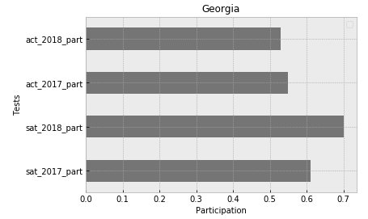
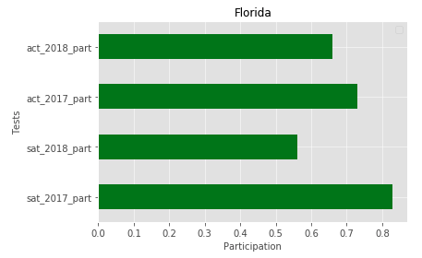
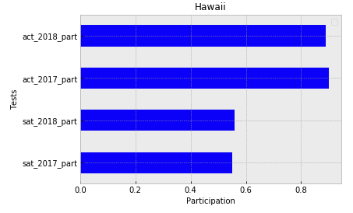
Strategy
Find a state that:
Does not have a ‘preferred’ exam
Not in a contract with the SAT or ACT
Largest impact campaign
Trend

Slide 3
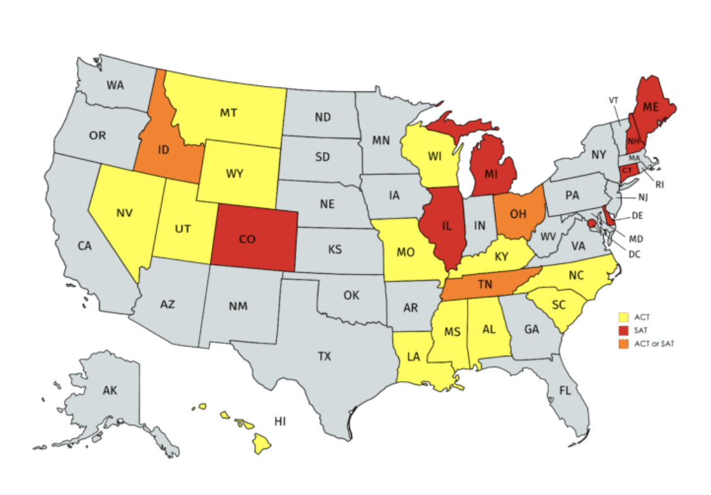
CHOICE: Florida
Population = 21.3 Million (3rd )
5th in total number of colleges
Participation downtrend:
SAT_17 = .83 → SAT_18 = .56 (-27p)
ACT_17 = .73 → ACT_18 = .66 (-7p)
Scores below National Average
Importance of the Test
Border with Georgia
No contracts
No preference for exam

Slide 4
References
https://simple.wikipedia.org/wiki/List_of_U.S._states_by_population
https://www.statista.com/statistics/306880/us-higher-education-institutions-by-state/
https://magoosh.com/hs/act/2017/states-that-require-the-act-or-sat/

