Slide 1
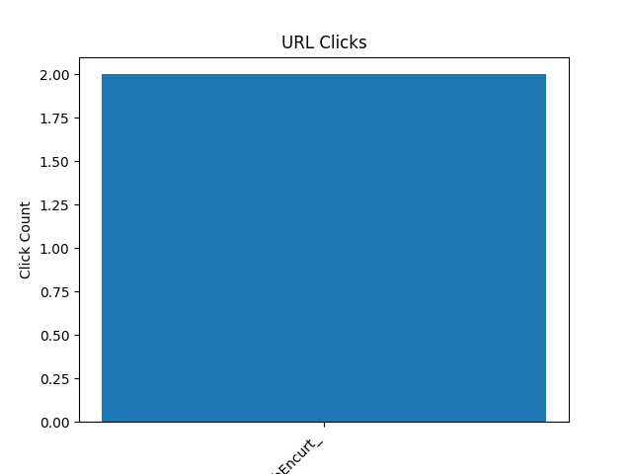
Short Code: WebEncurt_
Original URL: https://trello.com/u/gabrielaruanda/boards Clicks: 2 Created At: 2024-08-27 09:44:20 Last Click At: 2024-08-27 09:44:32 Last Click IP: 127.0.0.1

