Slide 1
Intraretinal cyst fluid detection using Deep Learning

Slide 2
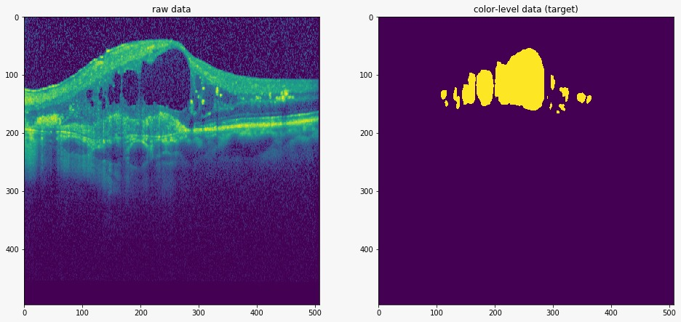
Detection
Our goal is

Slide 3
Background

Slide 4
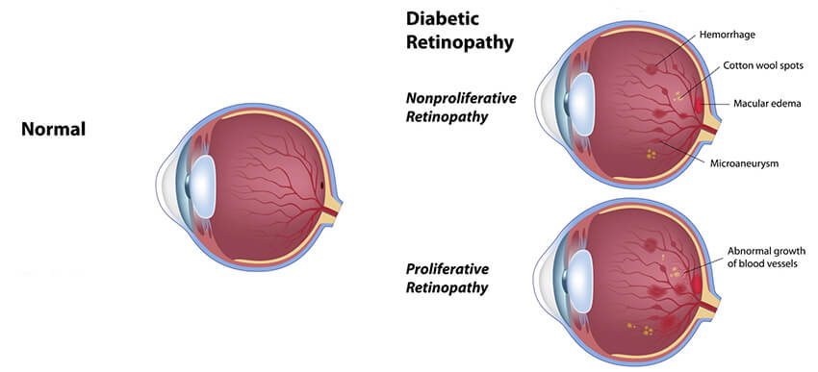
Retina Swelling
Retinal swelling due to the accumulation of fluid is associated with the most vision-threatening retinal diseases. Optical coherence tomography (OCT) is the current standard of care in assessing the presence and quantity of retinal fluid and image-guided treatment management
Image from : https://www.lantereyecare.com/comprehensive-eye-care-indianapolis/diabetes/

Slide 5
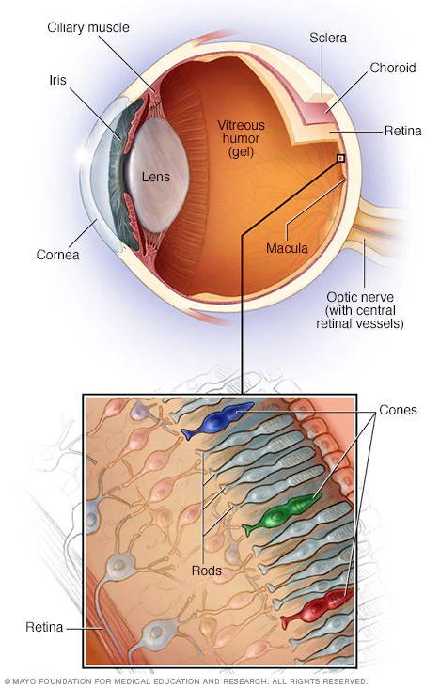
Retina diseases
d
Image from : https://www.mayoclinic.org/diseases-conditions/retinal-diseases/symptoms-causes/syc-20355825

Slide 6

Optical coherence tomography (OCT)

Slide 7
Retina Swelling
Retinal swelling due to the accumulation of fluid
is associated with the most vision-threatening retinal diseases.
Optical coherence tomography (OCT) is the current standard of
care in assessing the presence and quantity of retinal fluid and
image-guided treatment management
Image from : https://www.lantereyecare.com/comprehensive-eye-care-indianapolis/diabetes/

Slide 8
Glossary
Edema: is an abnormal accumulation of fluid in the interstitium, located beneath the skin and in the cavities of the body, which can cause severe pain. Clinically, hyperaldosteronism, edema manifests as swelling.
Definitions from : https://en.wikipedia.org/

