Slide 1


J-integral Evaluation - Python App Manual

Slide 2
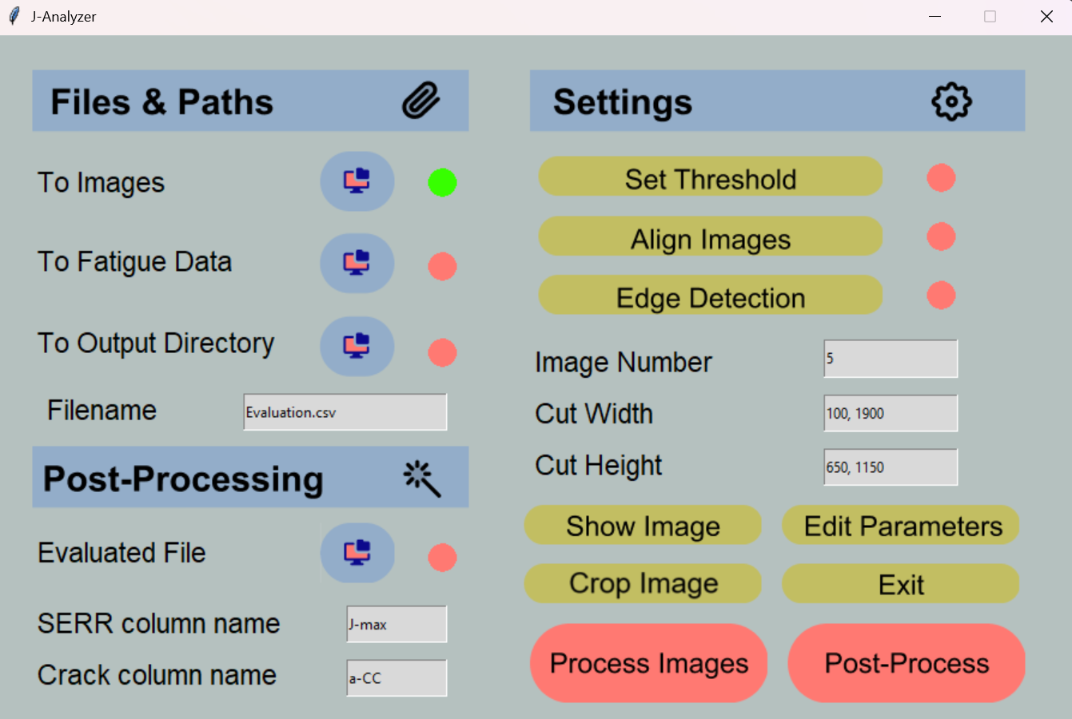
Overview
Indicators change from red to green when folder/file selected
Set paths to files and folders
Data preparation
Select image directory
Opens threshold app
Path to *.trends file of Instron
Opens image alignment app
Opens edge detection app
Select directory for file outputs
Image number shown by “show image” button
Choose file name for generated file
Cuts image in width direction [start, end]
Data post-processing
Cuts image in height direction [start, end]
Select file generated after „Process Images“
Allows for modification of compliance calibration parameters
Insert name of SERR column for data reduction
Exits App
Insert name of crack column for data reduction
Shows current edge fit
Starts image processing, calculates slope for all images. Generates evaluation file in output directory.
Starts data reduction of evaluated file & determines Hartman-Schijve parameters & fit. Generates results file in output directory.

Slide 3
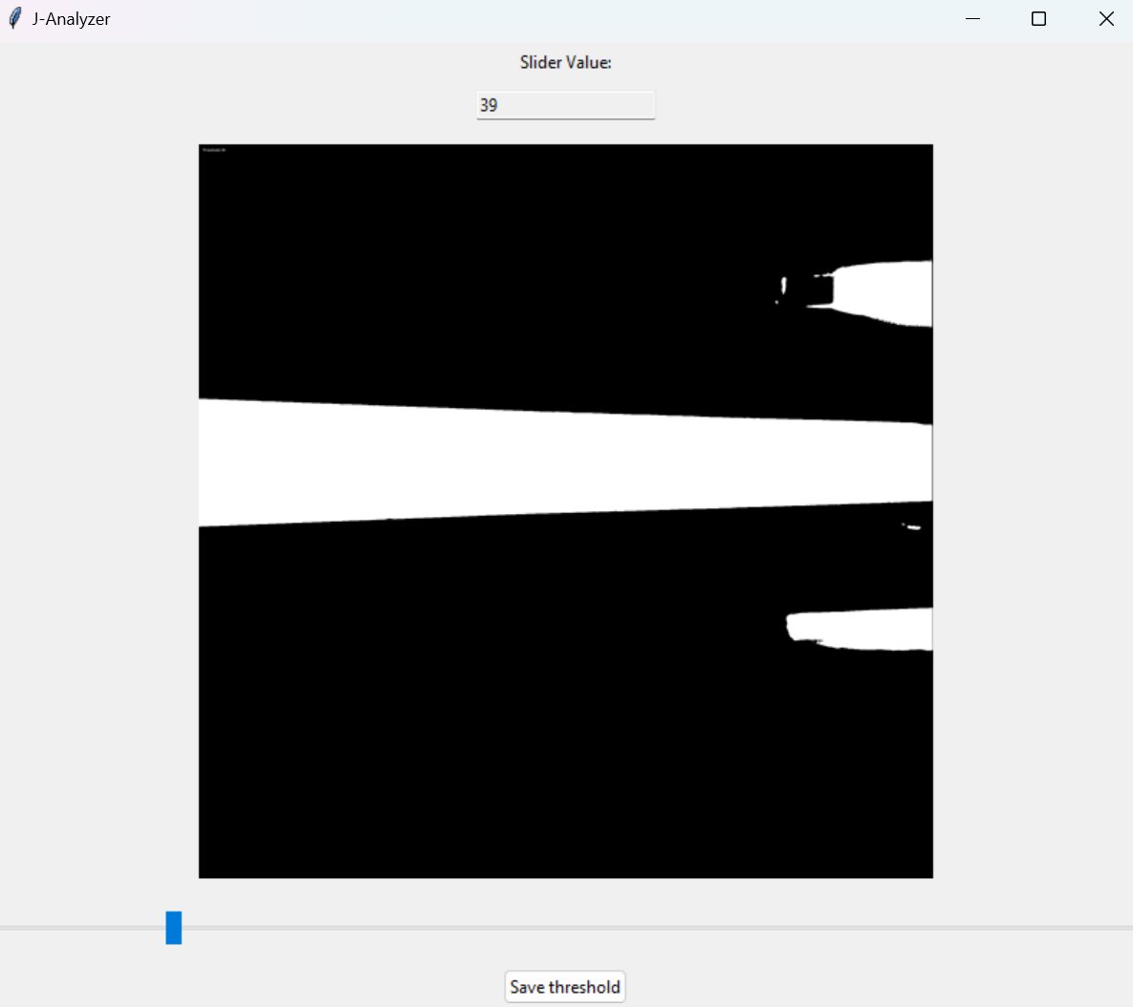
Set Threshold App
Image directory is selected → threshold can be set
Set threshold value so that edge is clearly visible. Avoid artefacts on edges.
Set threshold with slider, save parameter with button

Slide 4
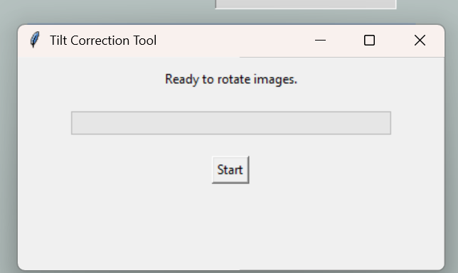
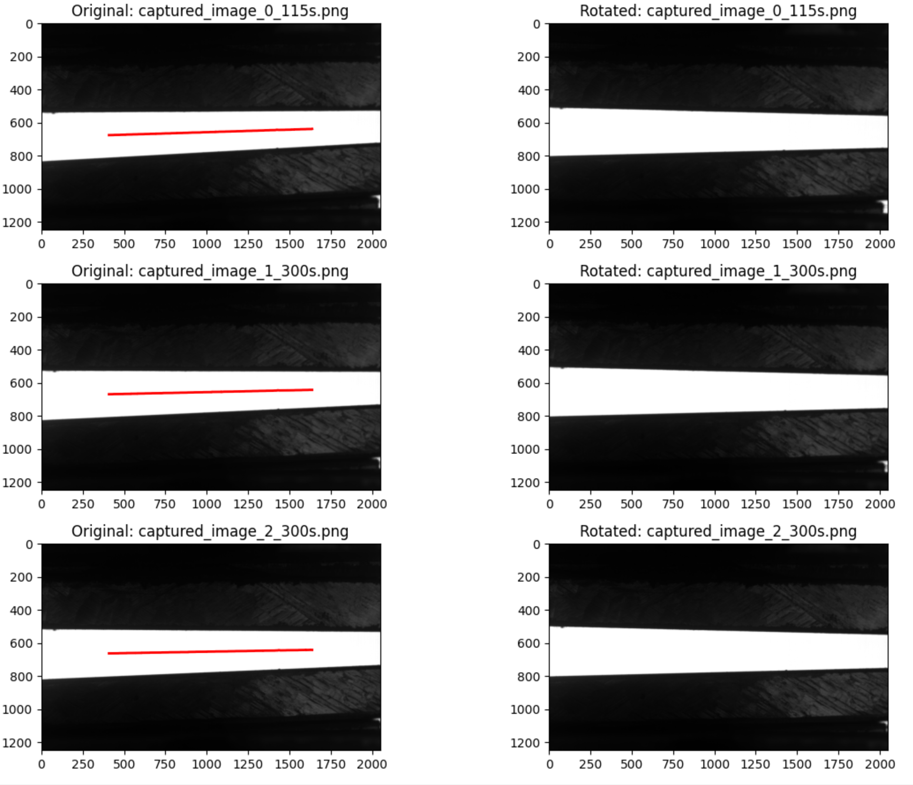
Align Images
Clicking the align images button will open the image alignment tool
Select the folder containing the images for alignment
Images need to be cropped first in order to run alignment algorithm
Cropping window opens automatically when clicking “align images”
Crop image (left top to bottom right), close window and click the start button
This tool aligns images symmetrical so that the upper and lower beam slope are equal
New Images are stored in a folder named “Tilt Correction” within the initial image path
Procedure:
Find white pixels in vertical direction, store coordinates in python list
Find the white pixel in the vertical center for each column
Fit the center pixels with linear regression
Note: 10% of the image width is excluded from evaluation at the image edges to avoid edge effects
Rotate image by the determined slope
Image alignment tool GUI
Fitted center pixels
Exemplary results of rotated images (pops up when script ends)

Slide 5
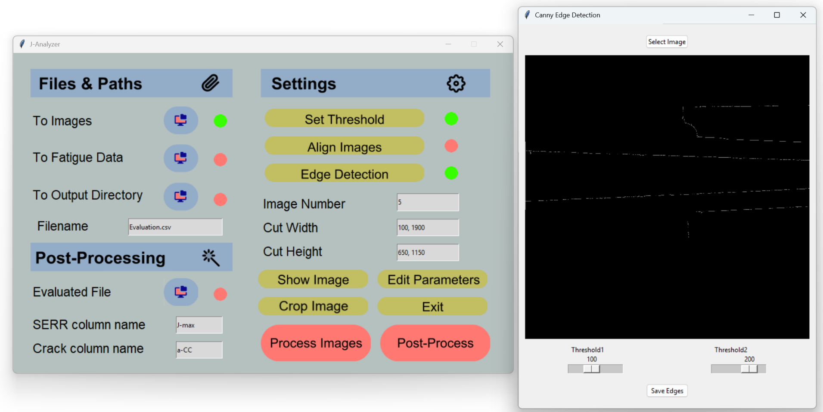
Edge Detection
Clicking the edge detection button will open the “Canny Edge Detection App”
This app detects edges based on the Canny algorithm, adjust sliders so beam edges are visible
Select image for edge detection preview
After detecting the beam edges make sure image is cut adequately, so no artefacts are fitted – Use the crop image button
Use “Show Image” to check if fitting process works properly
Adjust sliders so that edges are clearly visible
Save edge detection parameters

Slide 6
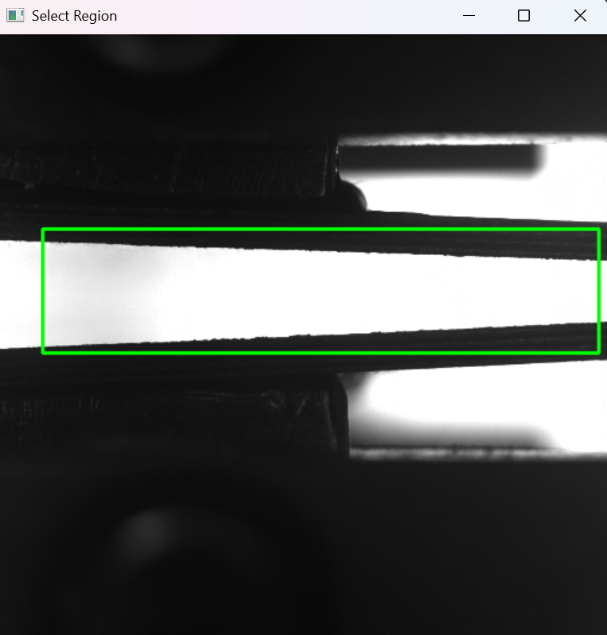
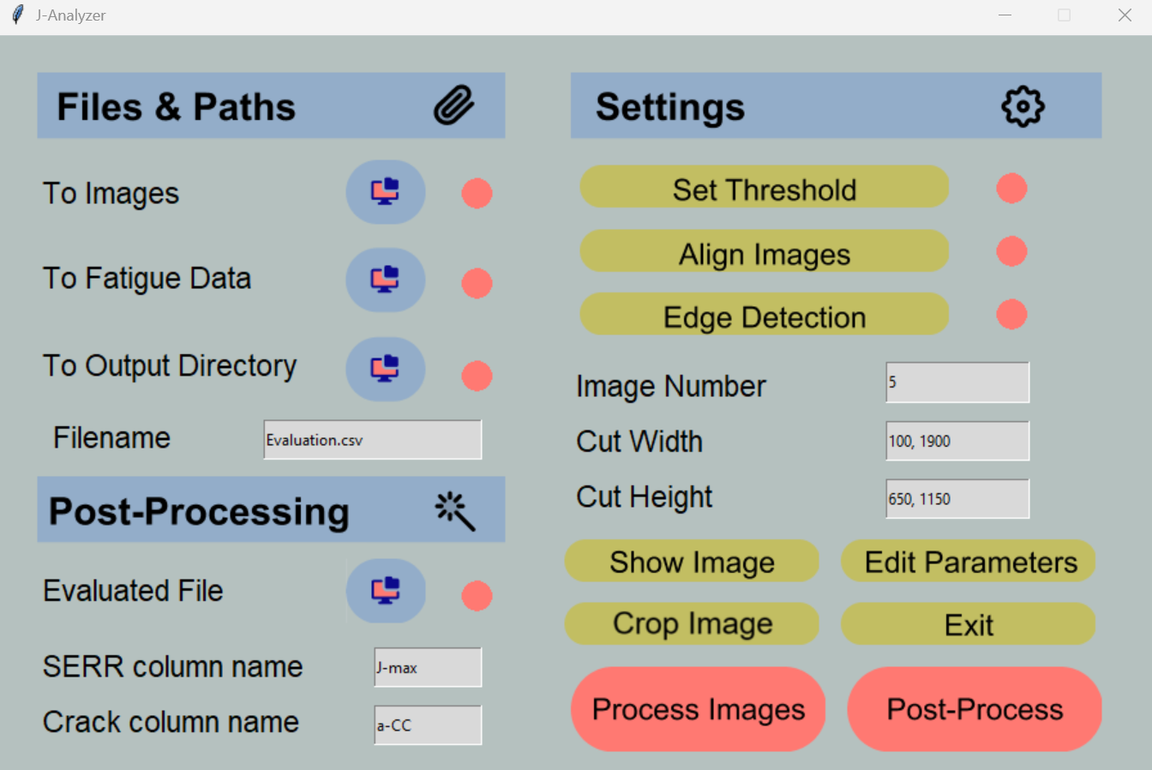
Cut Image Button
The cut image button helps finding the correct width and height parameters for cutting
Select path to images and click the “Crop Image” button
Draw a rectangle by clicking with the mouse in the image, start from the upper left go to lower right
Image cutting parameters will be deduced automatically depending on the drawn rectangle

Slide 7
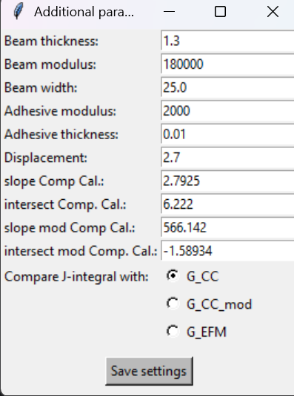
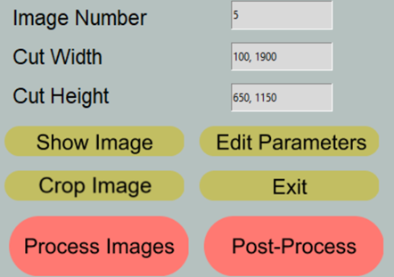
Edit Parameters Button
By clicking the “Edit Parameters” button, calculation parameters within the python script can be edited → e.g., compliance calibration parameters, set displacement and specimen dimensions
This is for comparing the J-integral results with LEFM methods based on compliance calibration or a elastic foundation model by Erdman (2000)
specimen and adhesive parameters for Erdman model “G_EFM”
Compliance calibration and modified compliance calibration parameters see Shivakumar (2005)
Compares the J-integral value with the choosen LEFM condition in the last column “perc_diff”: perc_diff = ((G / J) - 1) * 100

Slide 8
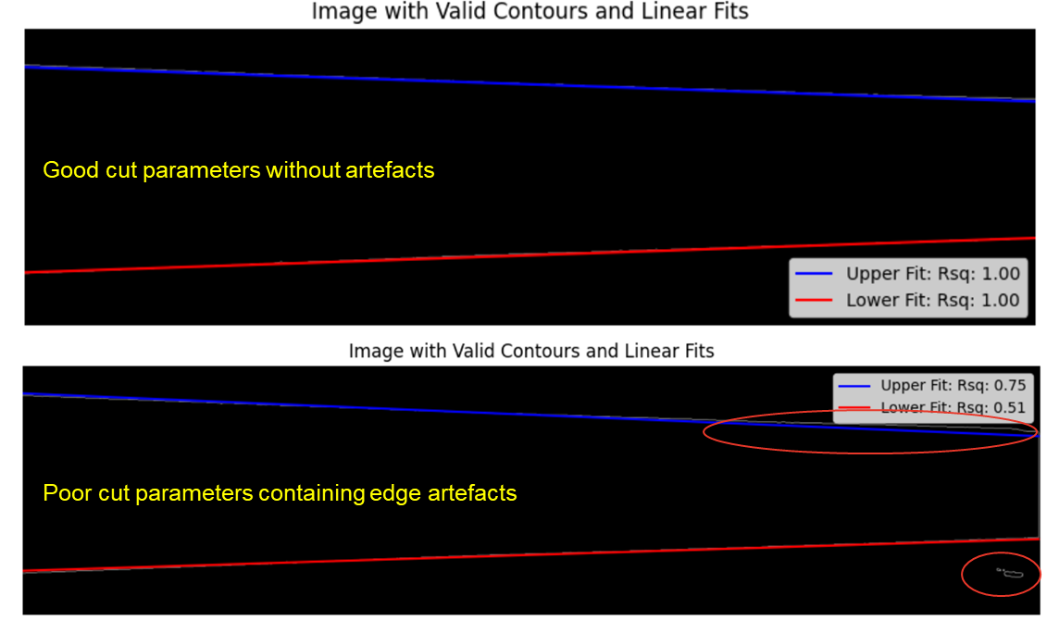
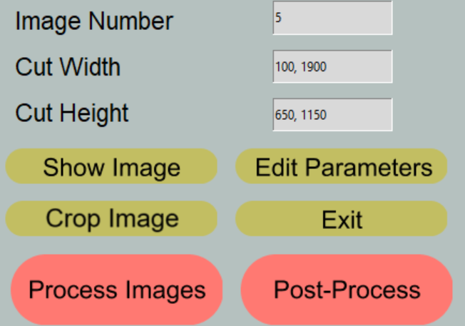
Show Image and Process Images
Before processing the images click the “Show Image” button to get a preview of the detected slope
To change the displayed image change the number in the “Image Number” entry field
When the parameters lead to satisfactory results click “Process-Images” to analyze all images within the selected directory
Check Rsq values of fit → should be close to 1
Width parameters should exclude image boundaries, edge detection sometimes results in artefacts in this region

Slide 9
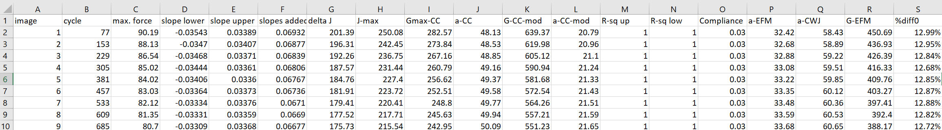
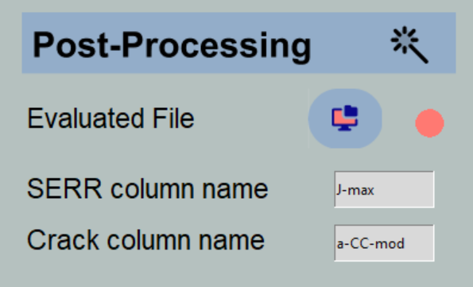
Post-Processing of Evaluated File 1
For post-processing enter the name of the column used for strain energy release rate values (J-integral, compliance calibration, modified compliance calibration, elastic foundation model) and the column with the desired crack length calculation method (used for da/dN vs. G graphs)
Excerpt of file created in the output directory after “process-images”

Slide 10
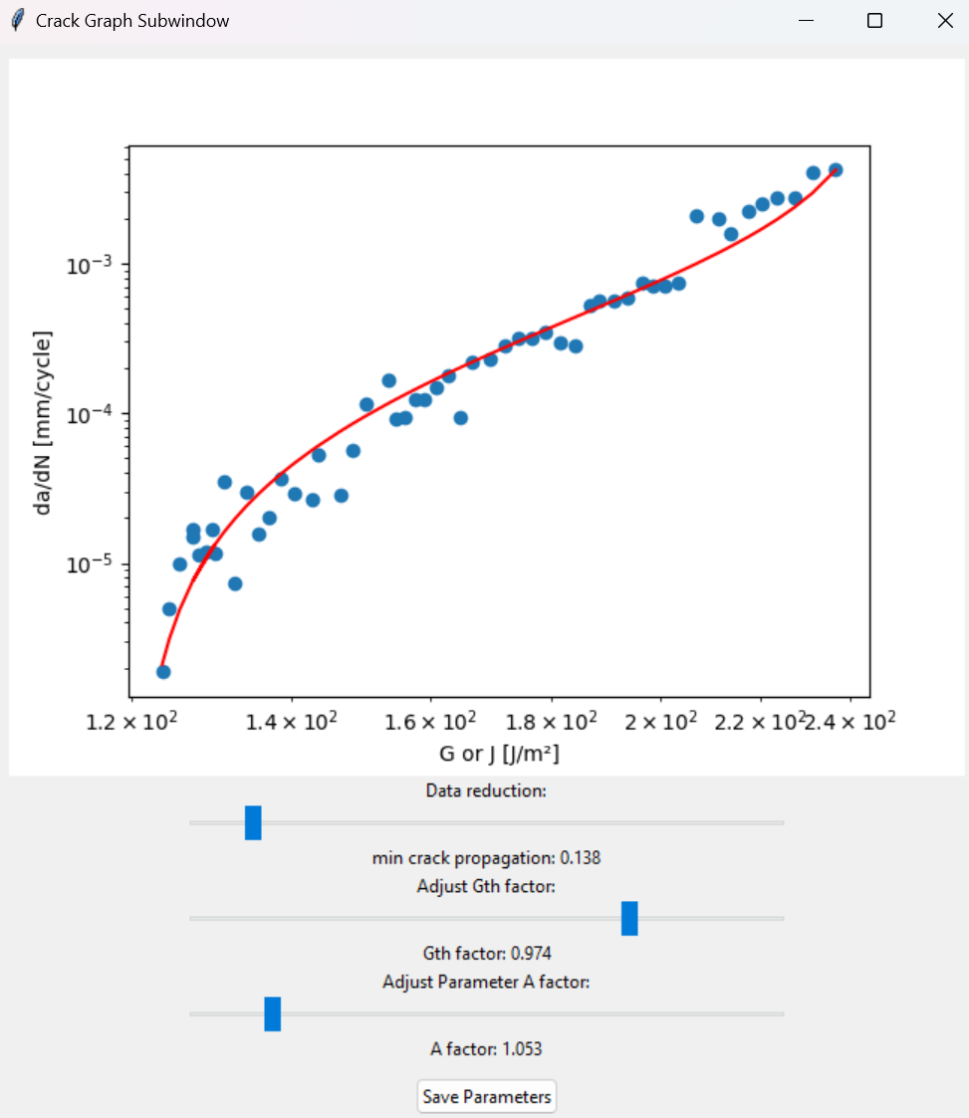

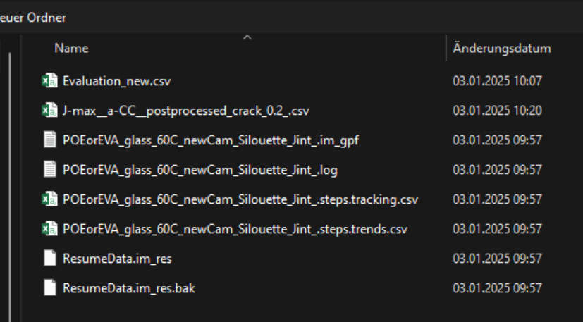
Post-Processing of Evaluated File 2
After entering the desired column names select the file created after “Process Images”
After selecting the file a pop-up window appears in which the Hartman-Schijve parameters A and G_{th} are set → Parameters D and n are calculated automatically
The top slider reduces the dataset according to a minimum crack propagation parameter
After setting the sliders click post-process to export data into a csv file
Double click
Set slider values to achieve desired data reduction and Hartman-Schijve fit!
Minimum crack propagation (data reduction parameter)
Sets G_{th} value of Hartman-Schijve fit (lowest measured G value * slider value)
Sets A value of Hartman-Schijve fit (highest measured G value * slider value)
Save parameters when finished

