Slide 1



Gemma 4 E2B
Canvas Study Agent
The model
A private AI tutor in your Chrome sidebar, running Gemma on your own GPU with WebGPU
WebGPU
The engine
Chrome side panel
The home
Hacktoberfest Hack Day Menifee × MSJC CSC Club · Open Source AI
Notes:
[0:00-0:20] Hi, we're presenting Canvas Study Agent. It's a Chrome sidebar that sits next to your MSJC Canvas lesson and answers questions about your course. The twist: the AI isn't in the cloud. Gemma, an open-weight model, runs on your own GPU through WebGPU. Two minutes on the demo, then I'll explain how those two pieces fit together.

Slide 2



Cloud tutors want your course data
Your material leaves your device
Our answer
Pasting lectures and chats into a hosted chatbot sends them to someone else's server.
A sidebar beside the lesson
Reads module-linked Canvas pages
Answers cite course sources
Gemma runs on your GPU; chats stay local
Accounts, API keys, usage limits
Hosted AI comes with sign-ups, quotas and bills.
Answers with no trail back
Generic replies don't point to your syllabus or lesson page.
Notes:
[0:20-1:00] Students already study inside Canvas. Most AI help means copying course material into a hosted chatbot: your content leaves your device, you need accounts or API keys, and the answers don't point back to your syllabus. Our answer: put the assistant in a sidebar, read the course pages locally, cite them, and run the model on the student's own machine.

Slide 3
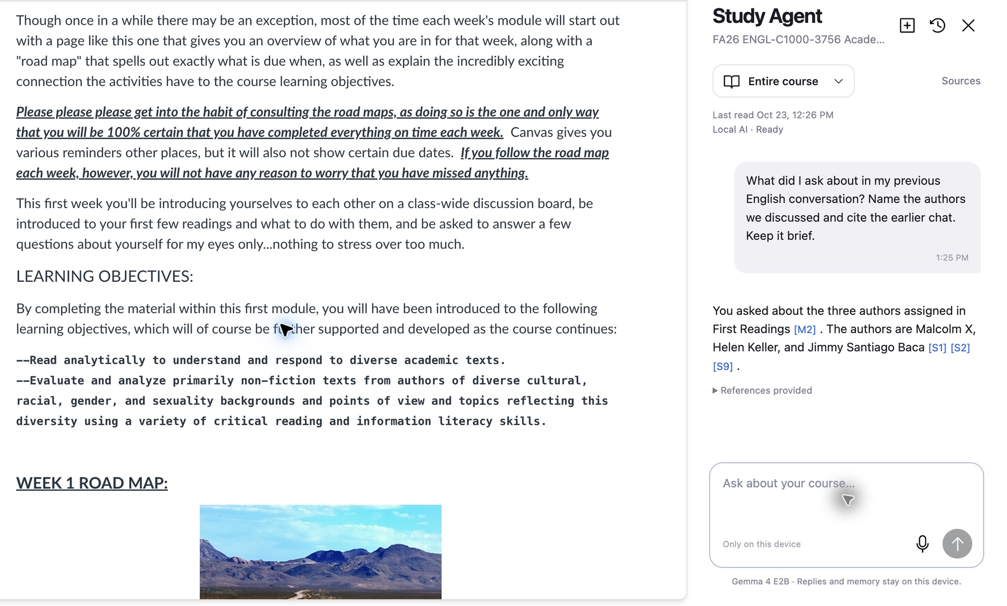
Live demo: ask your course
1
Open a Canvas page
The sidebar follows your course.
2
Check Sources
Every linked page, as Markdown.
3
Ask a question
Gemma streams a cited answer.
4
Start a new chat
It remembers the earlier one.
Real on-device run: Gemma 4 E2B cites course sources [S1] [S2] and earlier-chat memory [M2].
Notes:
[1:00-2:30] LIVE DEMO (screenshot is the backup). 1) Open a Canvas course page and click the extension: the sidebar opens beside the lesson and shows 'Local AI - Ready'. 2) Open Sources to show the modules it read as Markdown. 3) Ask a course question. Point out the streamed answer and the [S#] citations. 4) Open a new chat and ask 'what did I ask earlier?' to show [M#] memory. Mention: no API key, nothing is sent to a chat server.

Slide 4


How a question becomes an answer
1
2
3
4
Canvas page
Local grounding
Gemma on WebGPU
Cited answer
Read with your own login
Rank excerpts to fit 6,144 tokens
LiteRT-LM in a browser worker
Streamed with [S#] and [M#] refs
IndexedDB
OPFS
Course pages, chats and memory
Verified 2.01 GB Gemma weights
Notes:
[2:30-3:00] Quick tour. The extension reads the Canvas pages with the student's own login and turns them into Markdown. Local grounding ranks the most relevant excerpts and fits them into a 6,144-token budget. Gemma runs inside a browser worker through LiteRT-LM on WebGPU. The answer streams back with citations. Course data and chats live in IndexedDB; the model weights live in the browser's private file system.

Slide 5
Gemma thinks. WebGPU runs it.
Gemma 4 E2B
WebGPU
The model
The engine
Open weights (Apache 2.0): no API, no key
2.01 GB, downloaded once, SHA-256 verified
Answers from the course excerpts we hand it
Browser access to your GPU's compute
LiteRT-LM 0.18.0 runs Gemma in a worker
Needs shader-f16, checked before loading
Together: private by design, free to run, offline once cached
Notes:
[3:00-4:00] THE KEY SLIDE. Gemma 4 E2B is the brain: an open-weight model, Apache 2.0, a 2.01 GB file downloaded once and verified by checksum. It reads the course excerpts we give it and writes a grounded answer. WebGPU is the engine: a browser API that lets web code use the GPU for compute. LiteRT-LM compiles Gemma to run on it, so the matrix math happens on the student's GPU, not on a server. Without WebGPU a 2 GB model would be too slow to be usable in a browser; without Gemma being open and small, there would be nothing we could legally and practically ship. Together: private by design, free to run, and once the weights are cached it works offline.

Slide 6
Verified, and not yet verified
0
model-weight requests when loading from cache, offline
Not yet verified
Retrieval fix: unit-tested, native retest pending
Voice dictation: speech pack failed to install; typing works
12B QAT model: disabled until validated
Local is not the same as correct: check the sources
0.4 s
to first text from the cached model (warm-up reply)
2
real courses answered with citations
Observed on one 16 GiB development machine; not a compatibility guarantee.
Notes:
[4:00-4:35] We want to be upfront. What we measured on our dev machine: loading the cached model with the host offline made zero weight requests; the first text of a warm-up reply appeared in 0.4 seconds; and we got real cited answers in two courses. What isn't done: a retrieval bug that missed a syllabus requirement is fixed and unit-tested but the native retest is pending; voice dictation's language pack failed to install here, so typing is the supported path; and the 12B model is disabled until it's validated. And a local model can still be wrong, so the app shows its sources.

Slide 7

Open source. On-device. Yours.
Today
Next
App: MIT licensed
Model: Gemma 4, Apache 2.0
Runs on WebGPU in Chrome 141+
No chat API, no API key
Native retest of the retrieval fix
Read PDF and DOCX attachments
Validate larger Gemma models
github.com/gabrielromerod/hackathon-canvas-study-agent
Built with AI coding assistance (Codex, GPT-6.1 Sol). Runtime answers come from Gemma only.
Notes:
[4:35-5:00] Everything is open: the app is MIT, Gemma is Apache 2.0, and it runs on WebGPU in Chrome 141 or later with no chat API and no key. Next we want to finish the native retest of the retrieval fix, read PDF and DOCX attachments, and validate larger Gemma models. Repo is on screen. For transparency: we used AI coding assistants to build it, but every study answer at runtime comes from Gemma. Thank you. Questions?

