Slide 1



Gemma 4 E2B
Canvas Study Agent
The model
Local AI for everyone: a real LLM on your own GPU, installed like any Chrome extension
WebGPU
No install needed
Chrome extension
The only install
Hacktoberfest Hack Day Menifee × MSJC CSC Club · Open Source AI
Notes:
[0:00-0:25] Hi, we're Canvas Study Agent. Our pitch is about democratizing local AI. Running an LLM on your own machine usually means installing something like LM Studio or Ollama, picking a model, starting a server and wiring up your data. We took it one step further: with WebGPU, a Chrome extension is all you need. Install it, and a real open-weight model, Gemma, runs on your own GPU, reading your own data, with nothing leaving your device. Canvas courses are our proof of concept.

Slide 2
Local AI shouldn't need a setup guide
Typical local LLM setup
Canvas Study Agent
Install a runtime (LM Studio, Ollama)
Find, pick and download a model
Start a local server and tune settings
Connect your own data by hand
Add the Chrome extension
Click download once (2.01 GB)
Ask: your course data is already loaded
No server, no API key, no terminal
Today it loads unpacked in Chrome 141+; a store listing is the next step.
Notes:
[0:25-1:05] Local AI tools like LM Studio and Ollama are great, but they're built for people who are comfortable with a few extra steps: install a runtime, find and download a model, start a server, then somehow connect your own data. Most students, teachers and non-developers will never do that. Our version has three steps: add the extension, click download once, and ask. Your data is already there because the extension reads it for you. Honest note: today the extension is loaded unpacked in Chrome 141 or later; a store listing is the obvious next step.

Slide 3
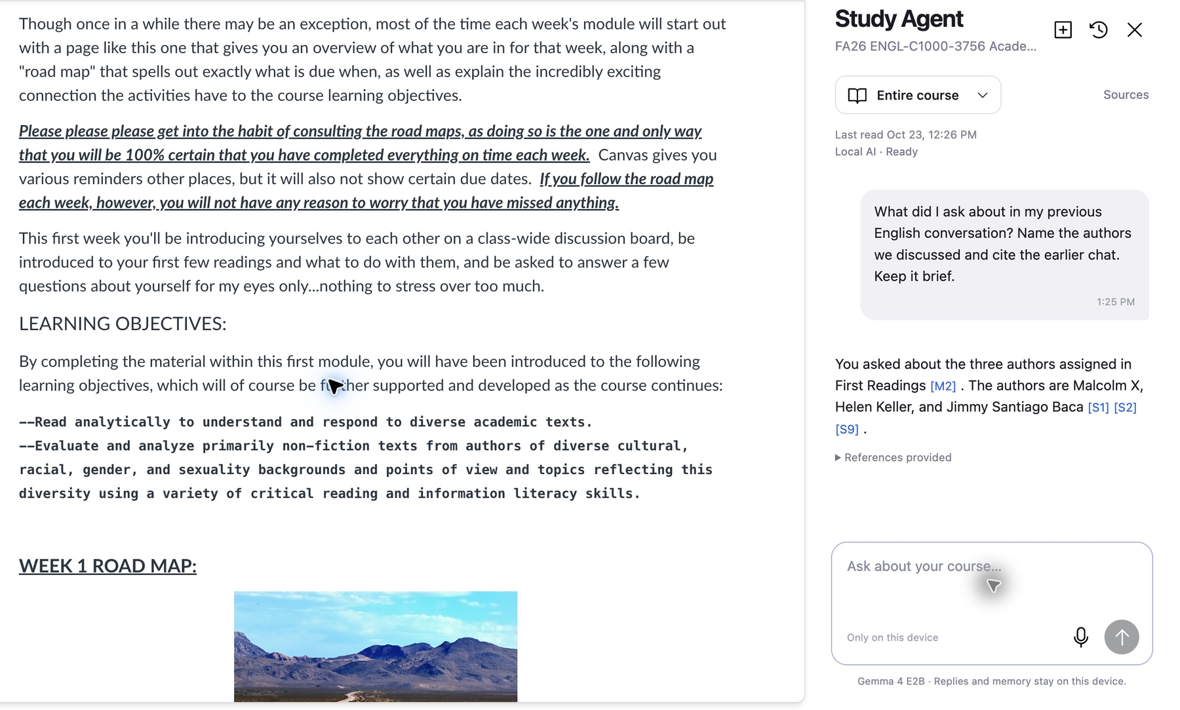
Live demo: ask your course
1
Open a Canvas page
The sidebar follows your course.
2
See your data
Every linked page, as Markdown.
3
Ask a question
Gemma streams a cited answer.
4
Start a new chat
It remembers the earlier one.
Real on-device run: Gemma 4 E2B cites course sources [S1] [S2] and earlier-chat memory [M2].
Notes:
[1:05-2:35] LIVE DEMO (screenshot is the backup). 1) Open a Canvas course page and click the extension: the sidebar opens beside the lesson and shows Local AI - Ready. Nothing else was installed. 2) Open Sources to show your data: the modules it read as Markdown. 3) Ask a course question. Point out the streamed answer and the [S#] citations. 4) Open a new chat and ask what you asked earlier to show [M#] memory. Mention: no API key, no server, nothing sent to a chat service.

Slide 4
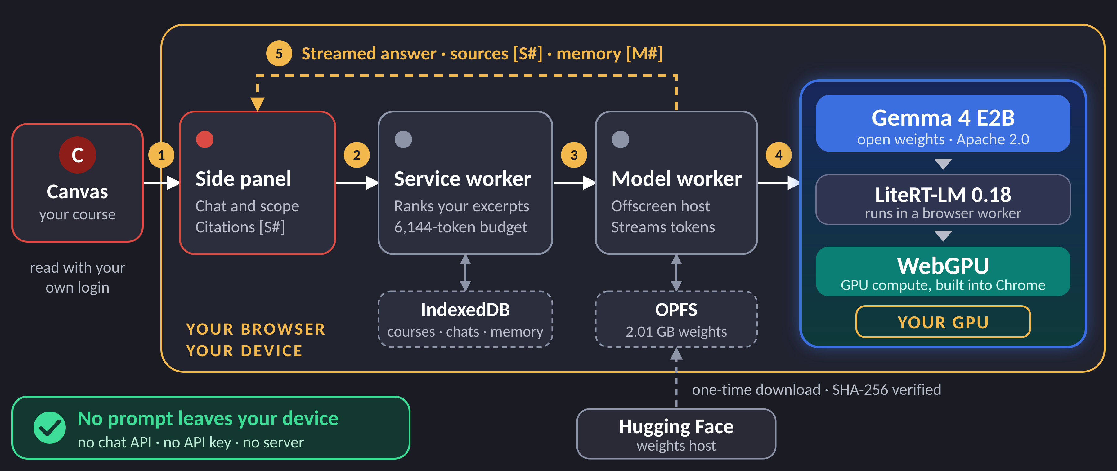
The whole stack lives in your browser
Notes:
[2:35-3:00] Follow the numbers. 1: the extension reads your Canvas pages with your own login. 2: you ask in the side panel. 3: the service worker picks the most relevant excerpts that fit a 6,144-token budget and hands the prompt to the model worker. 4: that worker runs Gemma 4 E2B through LiteRT-LM on WebGPU, so the math happens on your GPU. 5: the answer streams back with source and memory citations. Your data and chats stay in IndexedDB; the weights are cached in OPFS after a one-time, checksum-verified download from Hugging Face. Everything inside the yellow border is your device; no prompt leaves it.

Slide 5
Gemma thinks. WebGPU removes the setup.
Gemma 4 E2B
WebGPU
The model
Why there's nothing to install
Open weights (Apache 2.0): no API, no key
2.01 GB, downloaded once, SHA-256 verified
Answers from the course excerpts we hand it
Built into Chrome: GPU compute from a web page
LiteRT-LM 0.18.0 runs Gemma in a worker
No separate runtime or local server; needs shader-f16
Together: local AI with no terminal, no server, no API key
Notes:
[3:00-4:00] THE KEY SLIDE. Gemma 4 E2B is the brain: an open-weight model under Apache 2.0, a 2.01 GB file downloaded once and verified by checksum. It reads the excerpts of your data and writes a grounded answer. WebGPU is why there is nothing to install: it is built into Chrome and lets a web page use your GPU for compute. LiteRT-LM runs Gemma on it, so the math happens on your GPU, not on a server, and not in a separate app like LM Studio or Ollama. That is the democratizing part: if you can install a Chrome extension, you can run a real LLM locally on your own data. Once the weights are cached it even works offline.

Slide 6
Verified, and not yet verified
0
model-weight requests when loading from cache, offline
Not yet verified
Retrieval fix: unit-tested, native retest pending
Voice dictation: speech pack failed to install; typing works
12B QAT model: disabled until validated
Local is not the same as correct: check the sources
0.4 s
to first text from the cached model (warm-up reply)
2
real courses answered with citations
Observed on one 16 GiB development machine; not a compatibility guarantee.
Notes:
[4:00-4:35] We want to be upfront. What we measured on our dev machine: loading the cached model with the host offline made zero weight requests; the first text of a warm-up reply appeared in 0.4 seconds; and we got real cited answers in two courses. What isn't done: a retrieval bug that missed a syllabus requirement is fixed and unit-tested but the native retest is pending; voice dictation's language pack failed to install here, so typing is the supported path; and the 12B model is disabled until it's validated. And a local model can still be wrong, so the app shows its sources.

Slide 7

Local AI for everyone.
Today
Next
App: MIT licensed
Model: Gemma 4, Apache 2.0
Runs on WebGPU in Chrome 141+
No chat API, no API key
Native retest of the retrieval fix
Read PDF and DOCX attachments
Bring the recipe to any web app
github.com/gabrielromerod/hackathon-canvas-study-agent
Built with AI coding assistance (Codex, GPT-6.1 Sol). Runtime answers come from Gemma only.
Notes:
[4:35-5:00] Everything is open: the app is MIT, Gemma is Apache 2.0, and it runs on WebGPU in Chrome 141 or later with no chat API and no key. Next: finish the native retest of the retrieval fix, read PDF and DOCX attachments, and bring the same recipe, an extension plus WebGPU plus an open model, to any web app where people have their own data. Repo is on screen. For transparency: we used AI coding assistants to build it, but every study answer at runtime comes from Gemma. Thank you. Questions?

