Slide 1
Current state of Staxnet for data transmission
Youngrak Ryu
27 Feb 2021

Slide 2
Main features
Address mapping server
KV-pairs based data transmission
P2P data transmission
TCP
UDP
QUIC

Slide 3
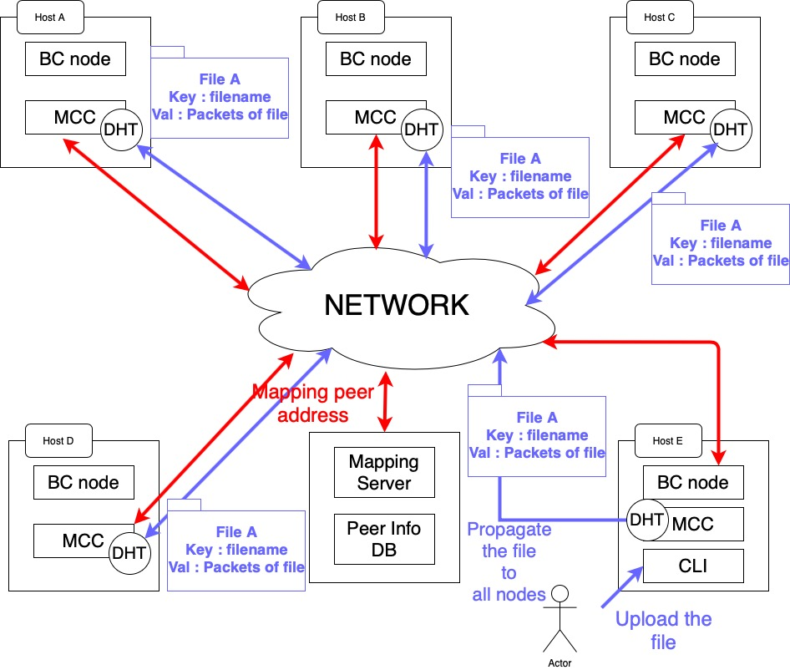
#1 Scnario architectur

Slide 4
#1 Scnario’s problem
Lack of reliability
Data integrity
Needs fault tolerance
Data transmission speed
Network resources

Slide 5
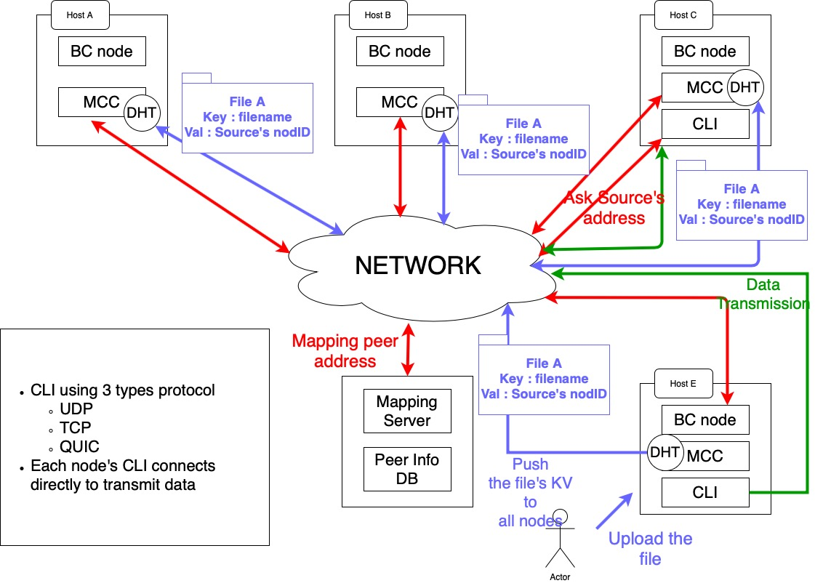
#2 Scnario architectur

Slide 6
#2 Scnario’s features
P2P Data transmission
Encrypted packet communication
QUIC protocol implementation
Using LSQUIC LIB
Stream transmission
Data transmission speed

Slide 7
#2 Scnario’s problem
BoringSSL doesn’t support Arm architecture
Failed to build on Raspberry pi 3
Complex procedures
Current system provides only 1:1 communication
Mapping server ( pros and contras )

Slide 8
Demo
#1 scenario’s short demo
#2 scenario’s demo
Using each protocols

Slide 9
Further improvements
Using resolvable uri such as DID without the mapping server
Full connevtion over QUIC
Efficient garbage collection
Maybe need DB?

Slide 10
Thank you for watching the demo

