Slide 1
“Phylogenetic regression”

Slide 2
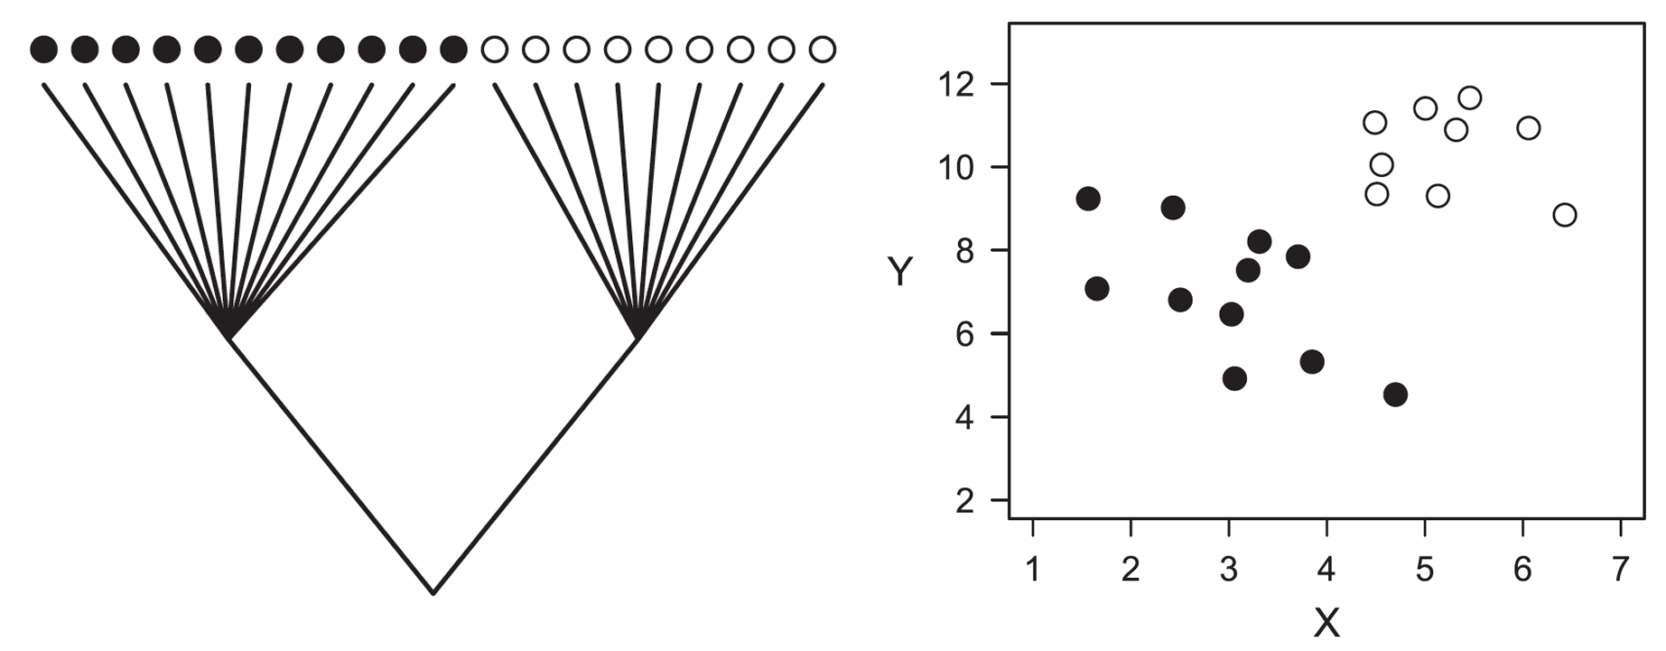
How to make regression phylogenetic?
Generic term for a class of methods
Phylogenetic independent contrasts (PIC)
Phylogenetic generalized least squares (PGLS)
Phylogenetic mixed models (PMM)
Phylogenetic generalized linear models (PGLM)
Phylogenetic generalized linear mixed-effects models (PGLMM) …
Felsenstein (1985), Cheverud et al. (1985), Grafen (1989), Lynch (1991)
Transformation of the mean vs. the error structure
Multilevel models (mixed-effects models)
Phylogeny also a “random effect”

Slide 3
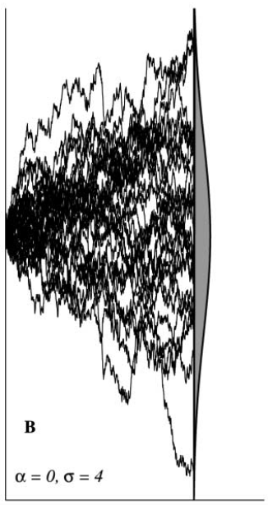
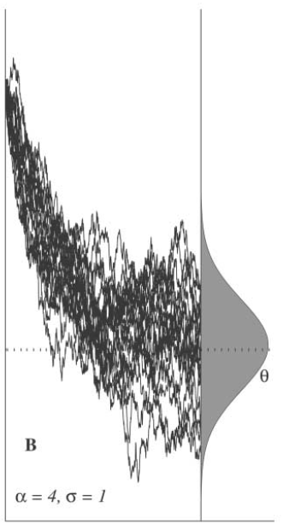
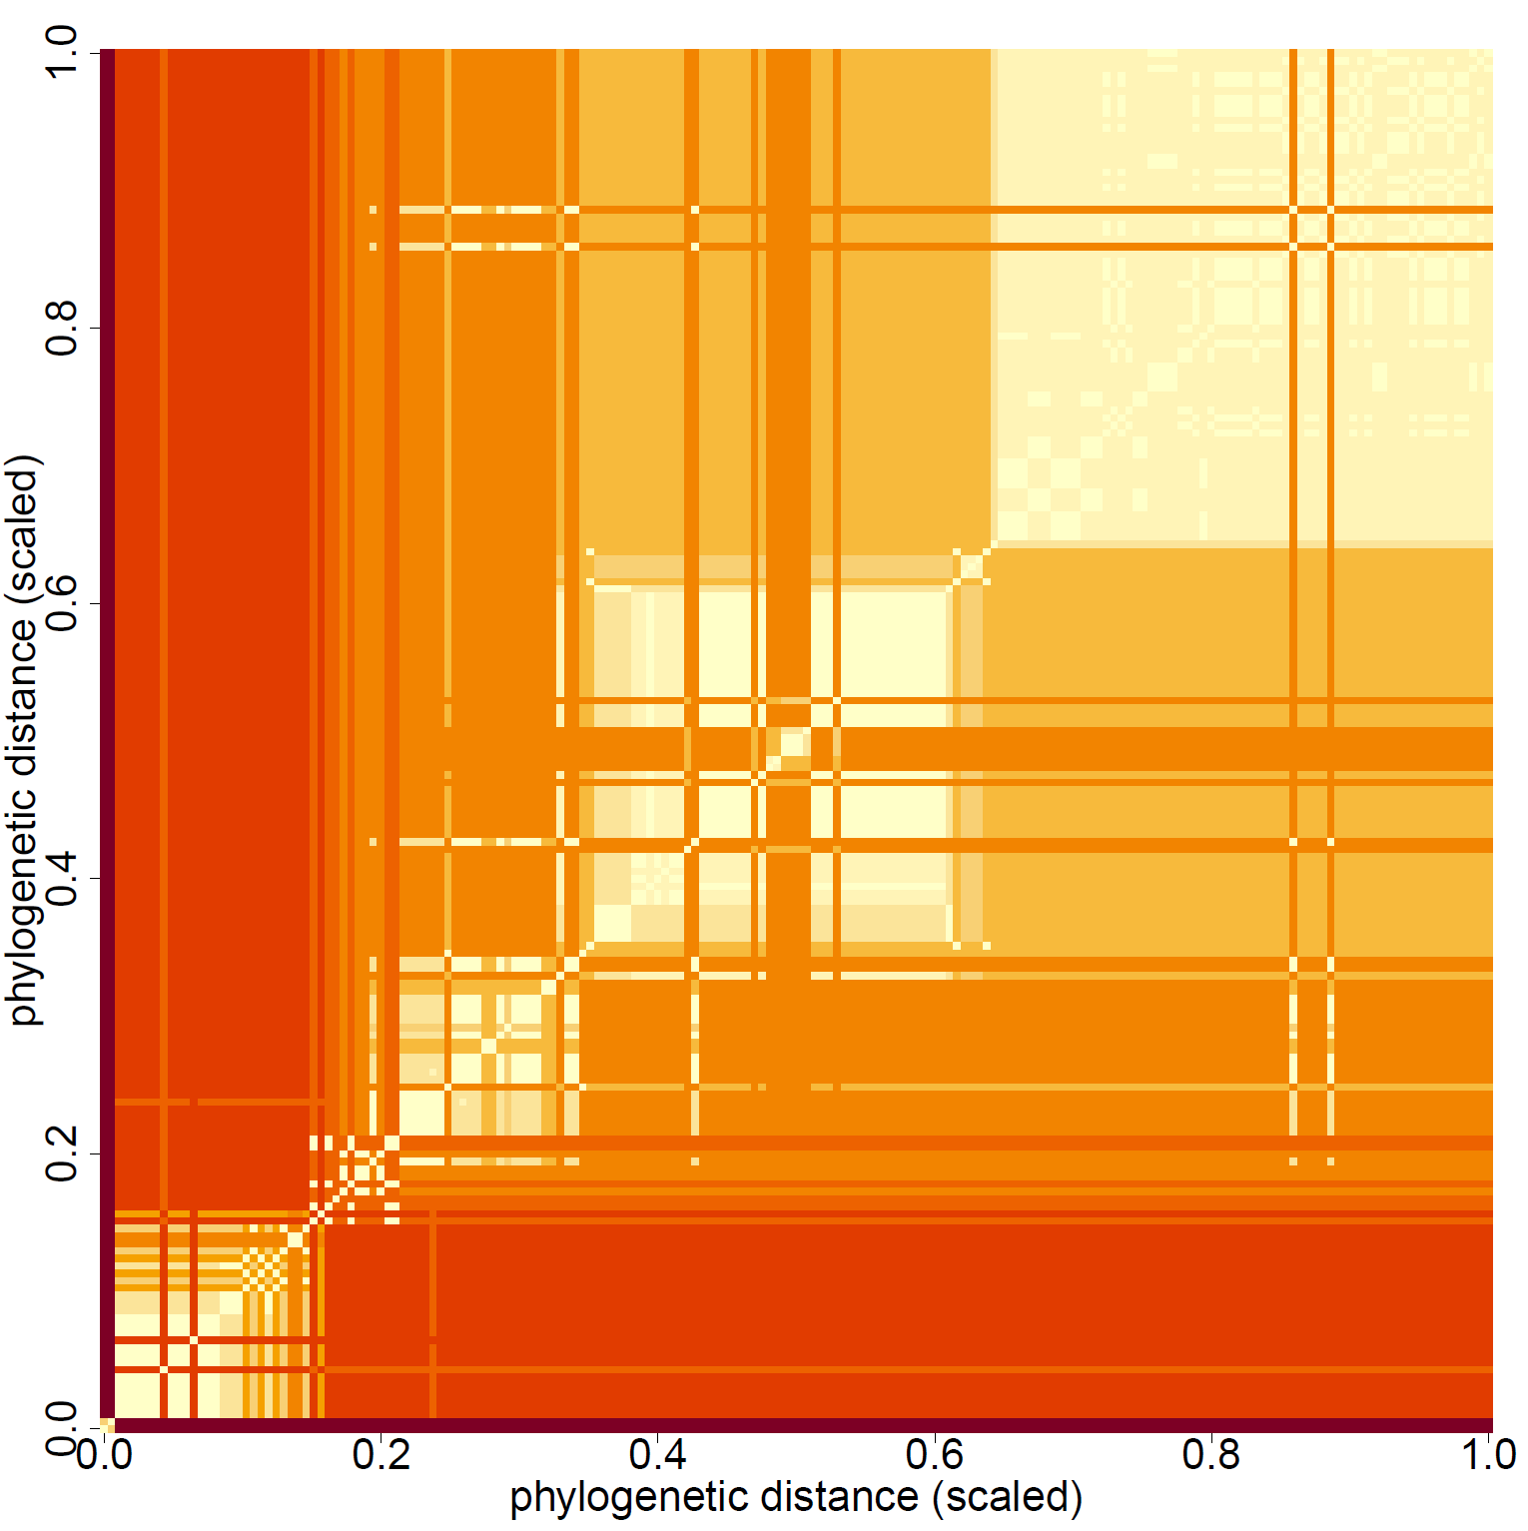
Gaussian process regression
Multivariate normal distribution
Phylogenetic distance (between pairs of points)
Change in covariance as function of distance
Evolutionary model (BM, OU)
Each data point its own intercept (or “phylogenetic residual”)
Expected values adjusted for relatedness (covariance is finite)
Direct – non-independence from shared history (Galton’s problem)
Indirect – proxy for unobserved similarities (=confounds)

Slide 4
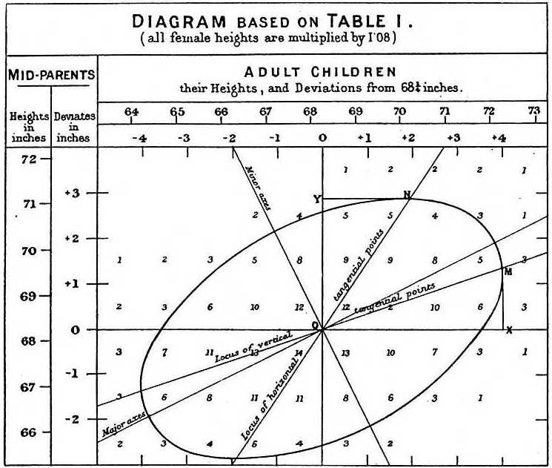
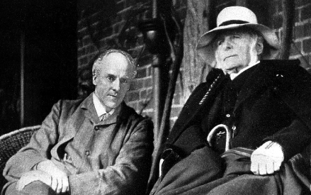

Phylogenies and causal inference … and regression
Correlation is not causation
From Galton (and Pearson) to Pearl
Causal inference = de-confounding
Experimental vs. observational (e.g., cross-sectional) studies
Think (hard) before you regress (and regret)
Generative (non-null) model of the data
Heuristic, not a mechanistic description of the system

Slide 5
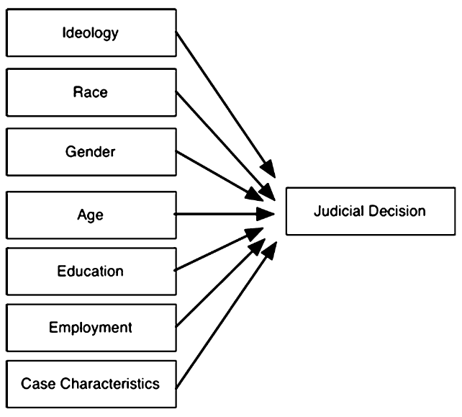
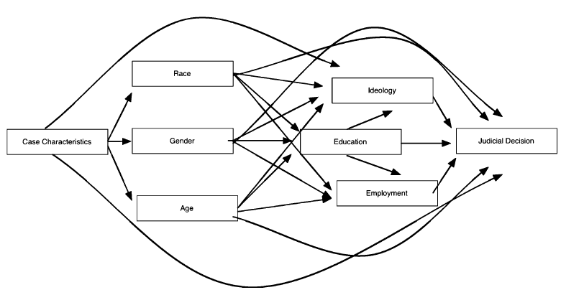
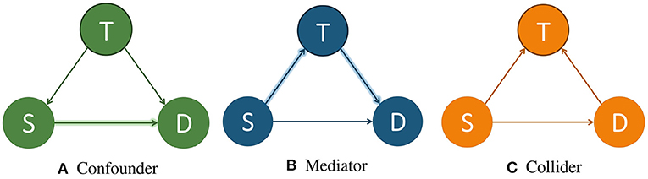
Phylogenies and causal inference … and regression
How to deal with confounding?
“We controlled for …” (Table 2 fallacy)
Adding controls can harm analyses as well
Serious implications for inference
How to decide what variables to include in the model?
Three elemental confounds – fork, pipe, collider
How can phylogeny help?
Phylogeny partially reconstructs unobserved confounds
VanderWeele & Staudt (2011)

Slide 6
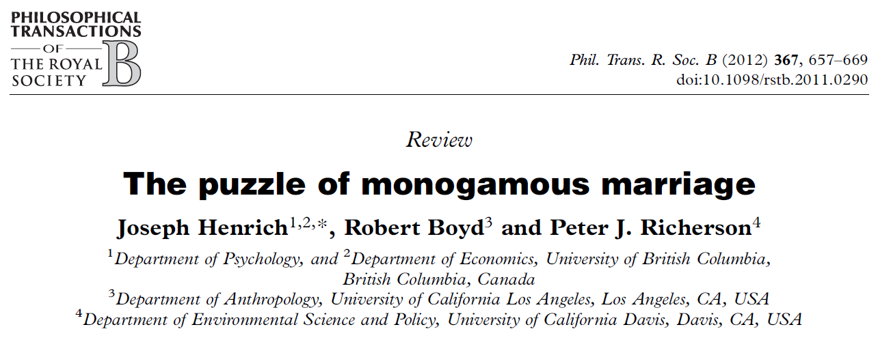
Why monogamy?
Inter-group competition
Monogamous societies compete better
Through reduction of intra-sexual competition
Higher economic output
marriage
patterns
marriage
patterns
competitive success
male competition
trade
trade

Slide 7
Materials
github.com/gabrielsaffa/ISHE_workshop_2023

Slide 8
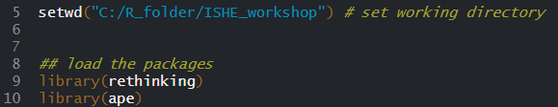
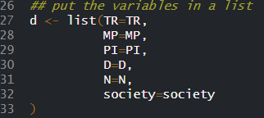
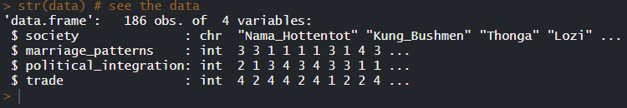


Slide 9
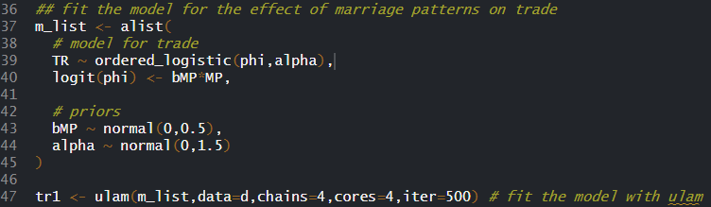
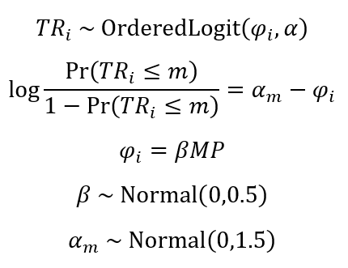
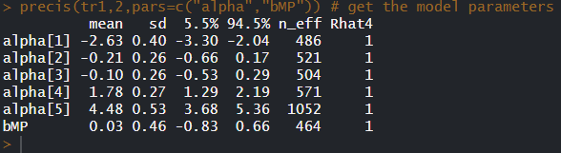
No relationship between marriage and trade

Slide 10
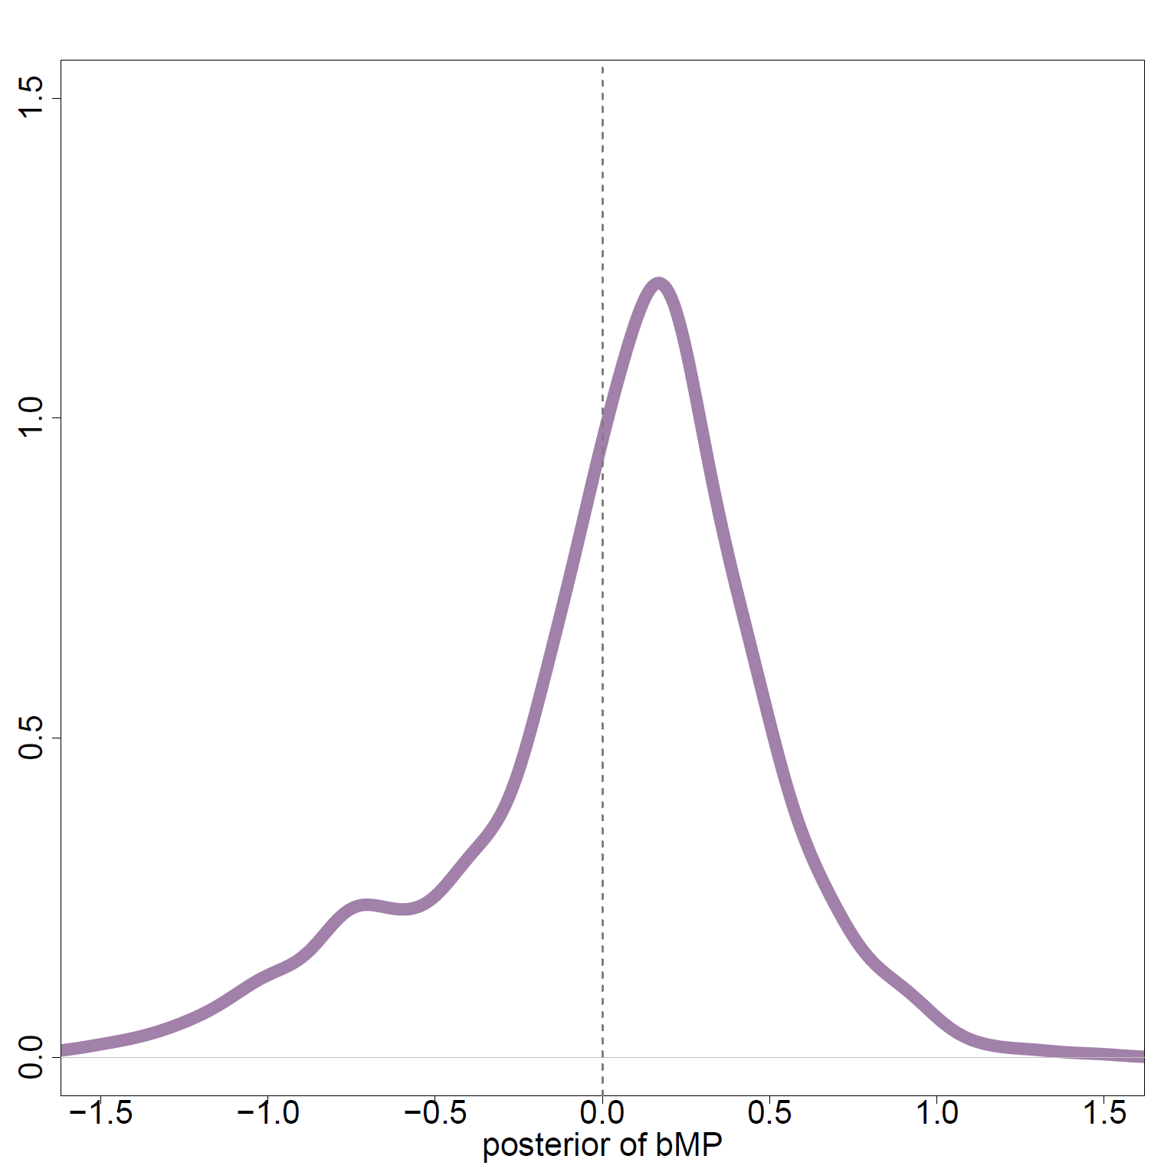
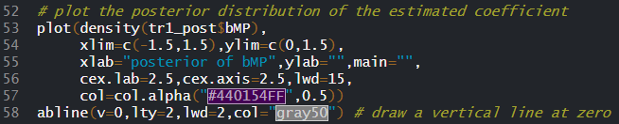

Slide 11
Monogamy favored only in complex societies
Effect of marriage varies across levels of social complexity
political integration
marriage
patterns
political integration
trade
marriage
patterns
trade

Slide 12
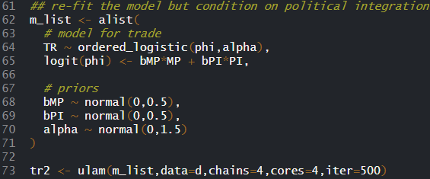
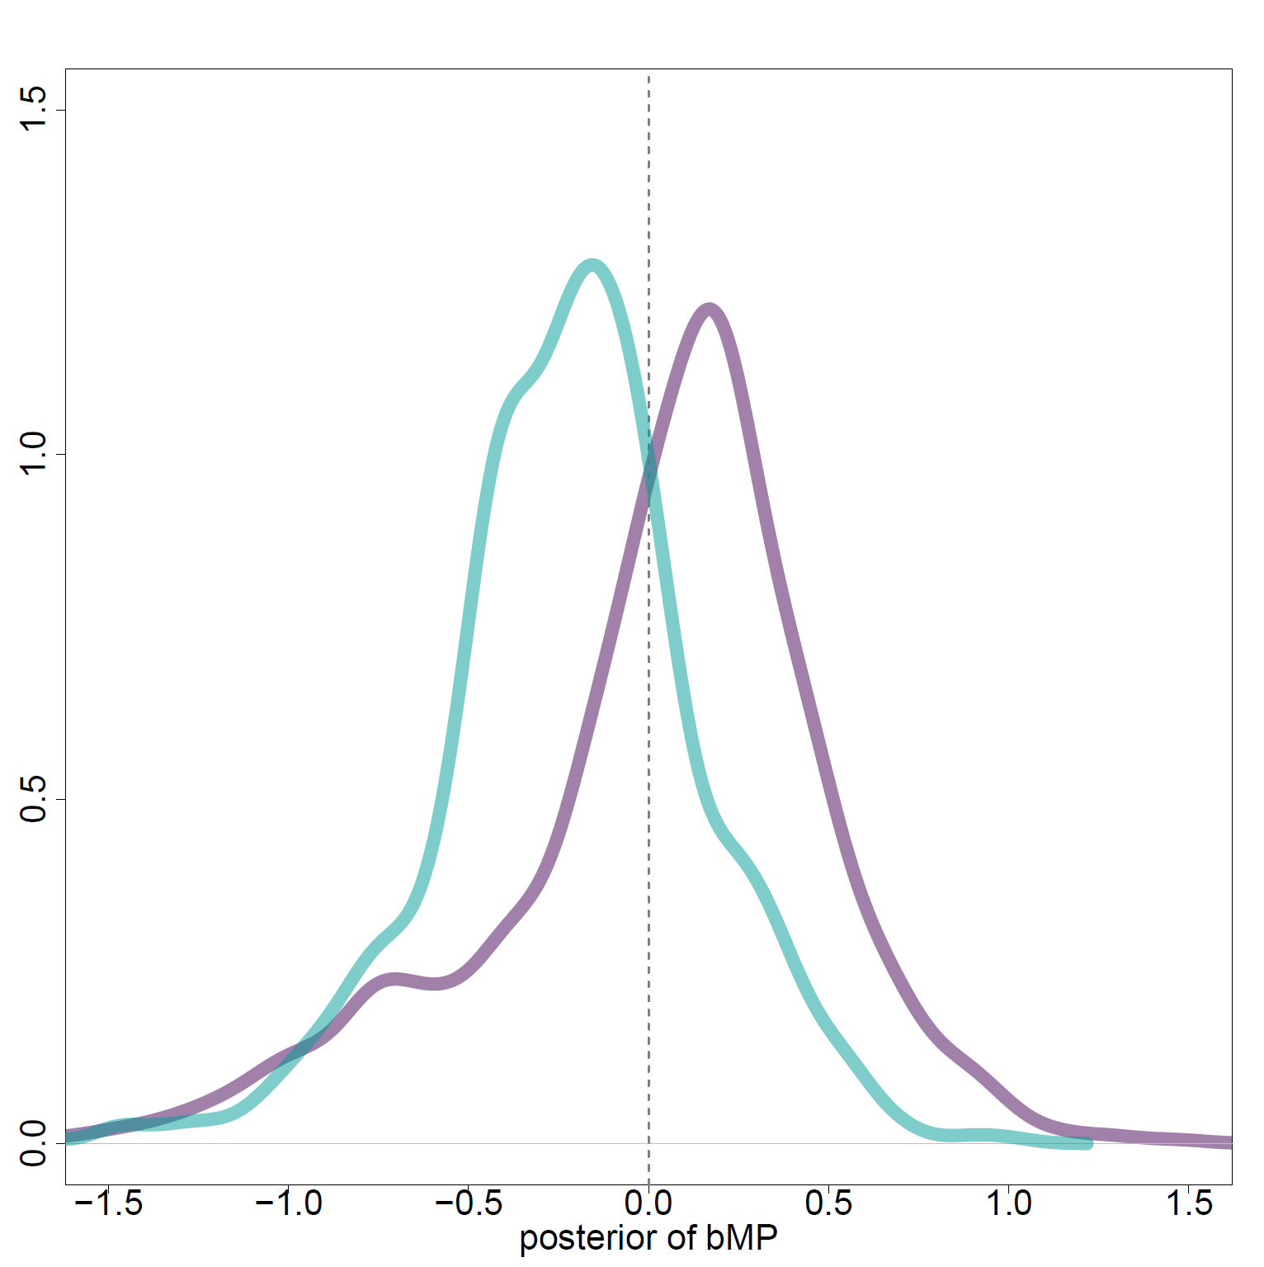
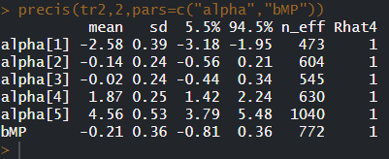

Slide 13
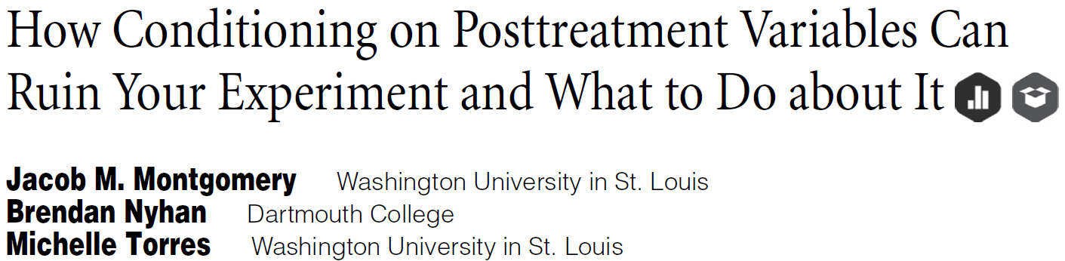
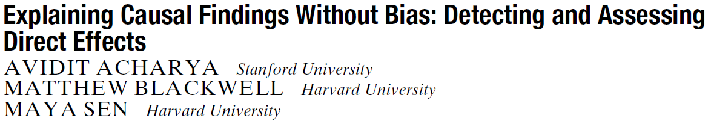
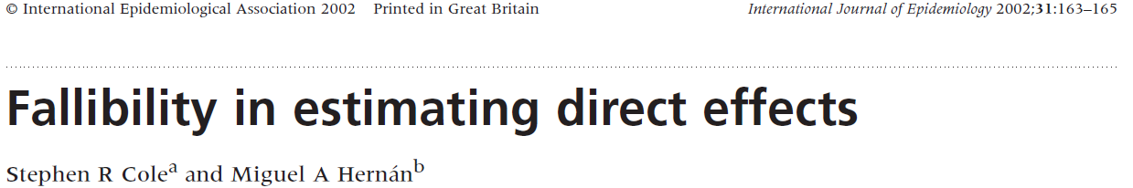
Conditioning on mediator induces (negative) effect on trade
Bias due to unmeasured confound U
Political integration is a collider (MP → PI ← U → TR)
Use phylogeny as proxy for U
political integration
U
phylogeny
marriage
patterns
trade

Slide 14
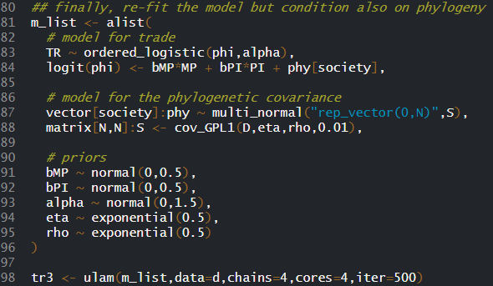
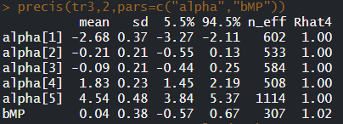

$$\left(\begin{aligned}&{phy}_{1} \\ &{phy}_{2} \\ &… \\ &{phy}_{n}\end{aligned}\right)\sim MVNormal\left(\left(\begin{aligned}&0 \\ &0 \\ &… \\ &0\end{aligned}\right),S\right)$$
$$S_{i,j}=η^{2}\exp\left(−ρ^{2}D_{i,j}\right)$$
$$η^{2} \sim Exponential(0.5)$$
$$ρ^{2} \sim Exponential\left(0.5\right)$$
Conditioning on phylogeny recovers the original estimate

Slide 15
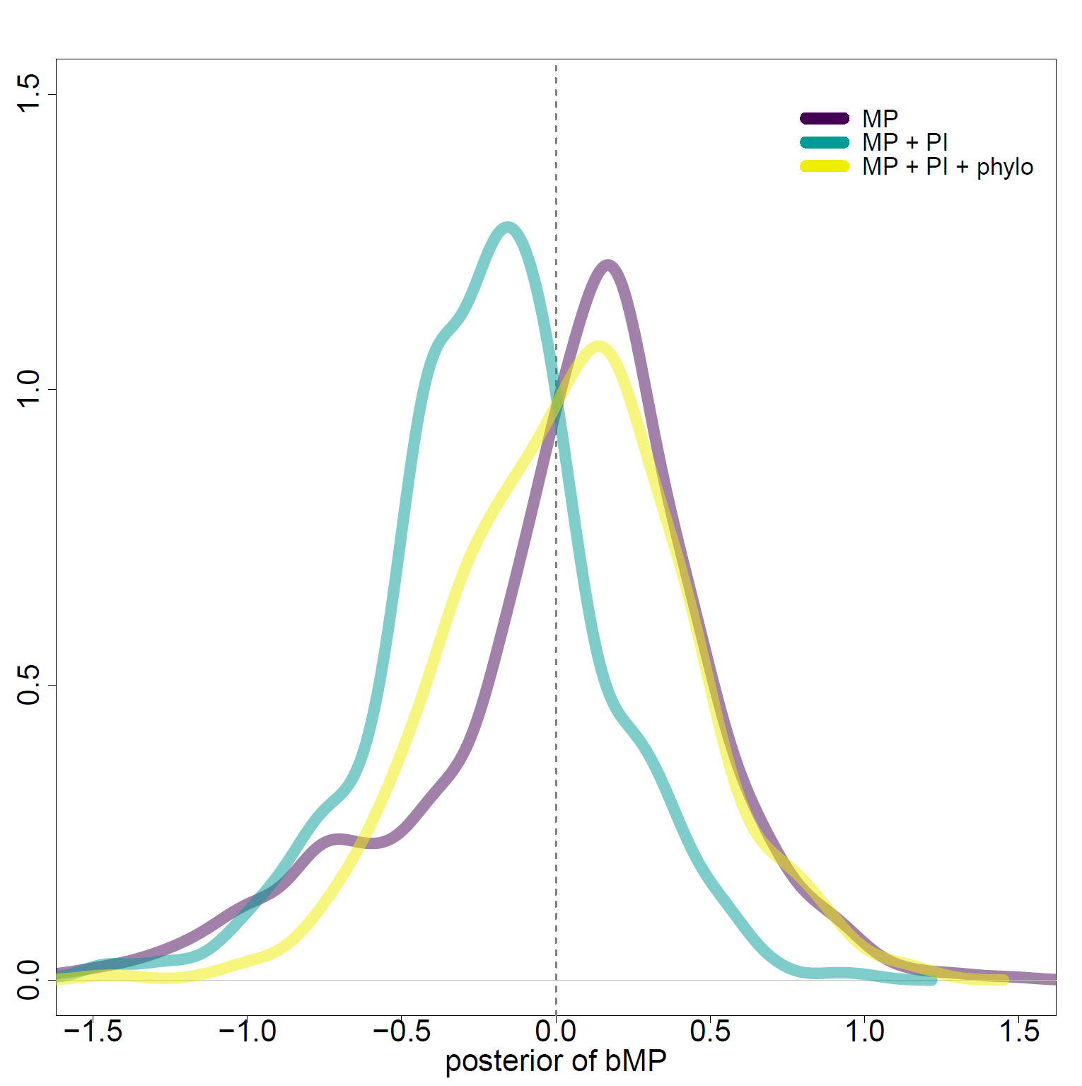


Slide 16
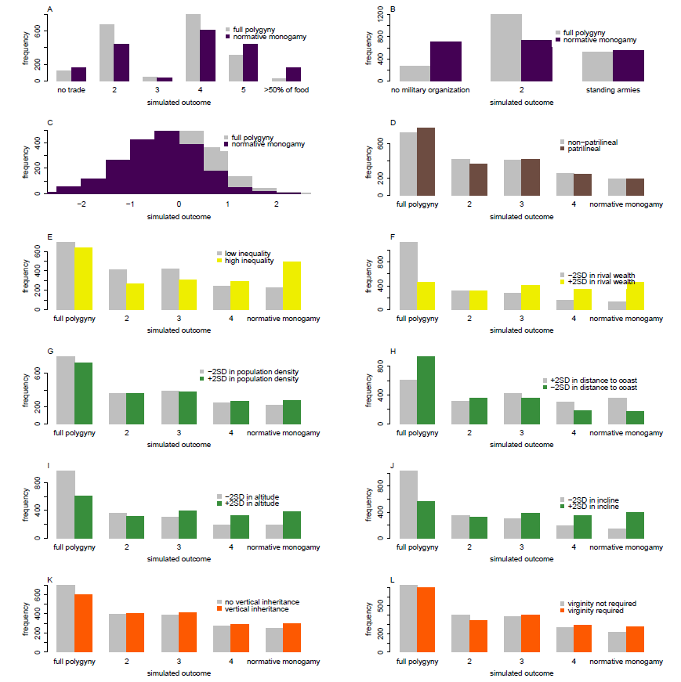
Why monogamy?
Simulated distributions of marriage patterns with low and high levels of proxies for
Inter-group competition; heir number limitation; rival wealth;
land shortage;
monogamous inheritance
No support for inter-group competition and high support for rival wealth and land shortage

Slide 17
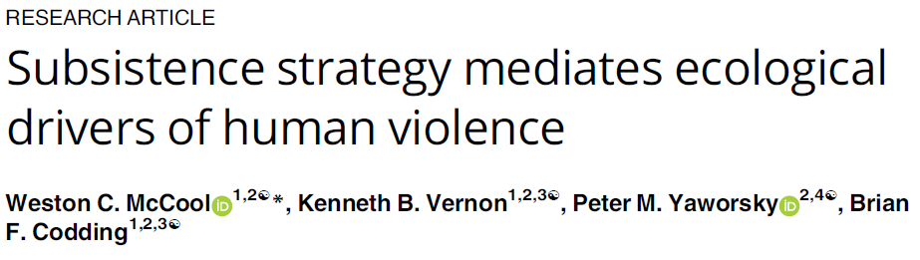
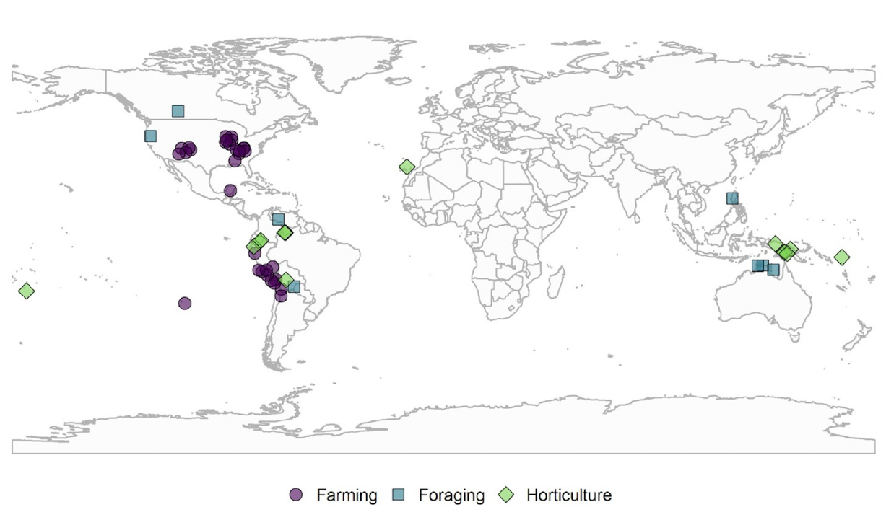
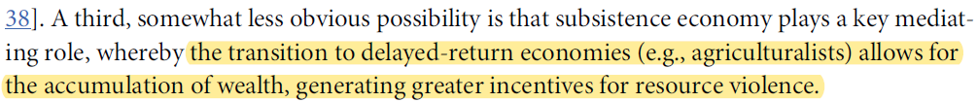
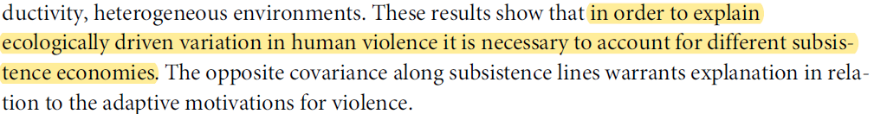
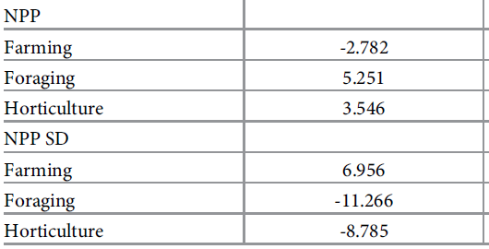
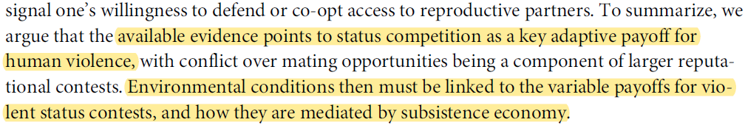
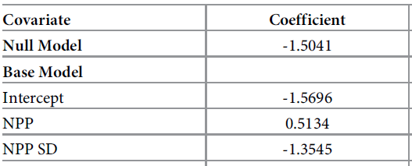
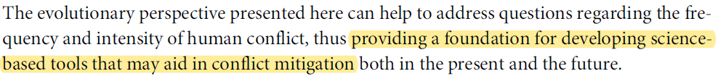
Builds on wrong conception of mediation
No consideration of confounding
Subsistence reverses expected relationships
Results likely confounded
Discussion broad adaptive storytelling

Slide 18
Take-home message
Phylogeny can partially reconstruct unobserved confounds
Overreliance on phylogeny as treatment of confounding
Still need generative model of the data (make assumptions)
Phylogeny a strong assumption itself
Phylogenies have their own inferential problems
Phylogenies help to ask right questions
…

