Slide 1


Towards N-API on JerryScript
Gabriel Schulhof <gabriel.schulhof@intel.com>
@gabrielschulhof

Slide 2
Intro
Emphasis on low memory consumption
Able to run with less than 64 KiB of RAM
Takes up less than 200 KiB of storage
Challenges
  Every byte counts
  One does not simply malloc()
Goal: Implement N-API, so N-API modules can use a single code base on both Node.js and JerryScript

Slide 3


Slide 4
Step 0
Where to put napi_env?
  In Node.js it’s currently per-module, but we’re working on per-context
  JerryScript already has a context stored thread-locally and not passed around so as to reduce stack usage
Where to put loaded module instances for require() caching?
Solution: A mechanism for attaching data to the context

Slide 5
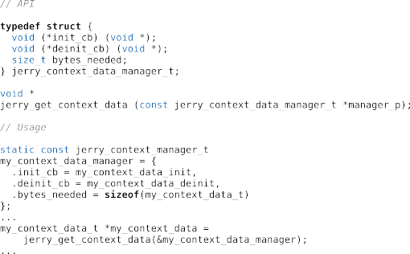

Slide 6
Step 1
Ummm … modules?
Two levels:
  Resolvers
    Module definitions
Resolvers know how to load modules
  Text modules
  Binary modules
Default module definition provided – via linker section

Slide 7
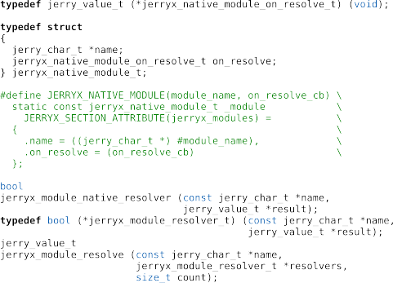

Slide 8
Remaining
Engine
  Symbols → JerryScript is so far only up to ES 5.1
  ArrayBuffer and TypedArray
N-API implementation
  Externals
  Scope → JerryScript values are released explicitly
  Multiple string encodings
  Async work via job queue
  Buffer

Slide 9
Thank you!
Gabriel Schulhof <gabriel.schulhof@intel.com>
@gabrielschulhof

