Slide 1
DARTS WORKSHOP
Basic geothermal model

Slide 2
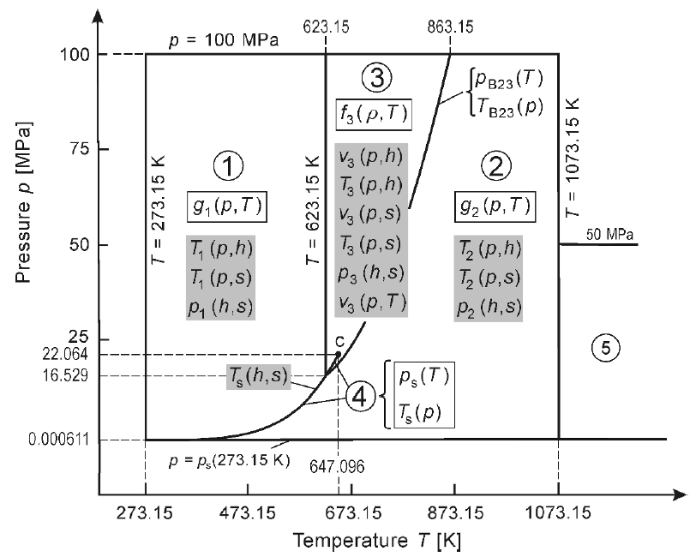
IAPWS-97 Formulation International Association for the Properties of Water and Steam
Regions:
① liquid
② vapor
③ (super)critical
④ two-phase
⑤ high-temp vapor
Regions ①②⑤ are covered by specific Gibbs free energy;
Region ③ is covered by specific Helmholtz free energy;
Region ④ is described by saturation-pressure equation.

Slide 3
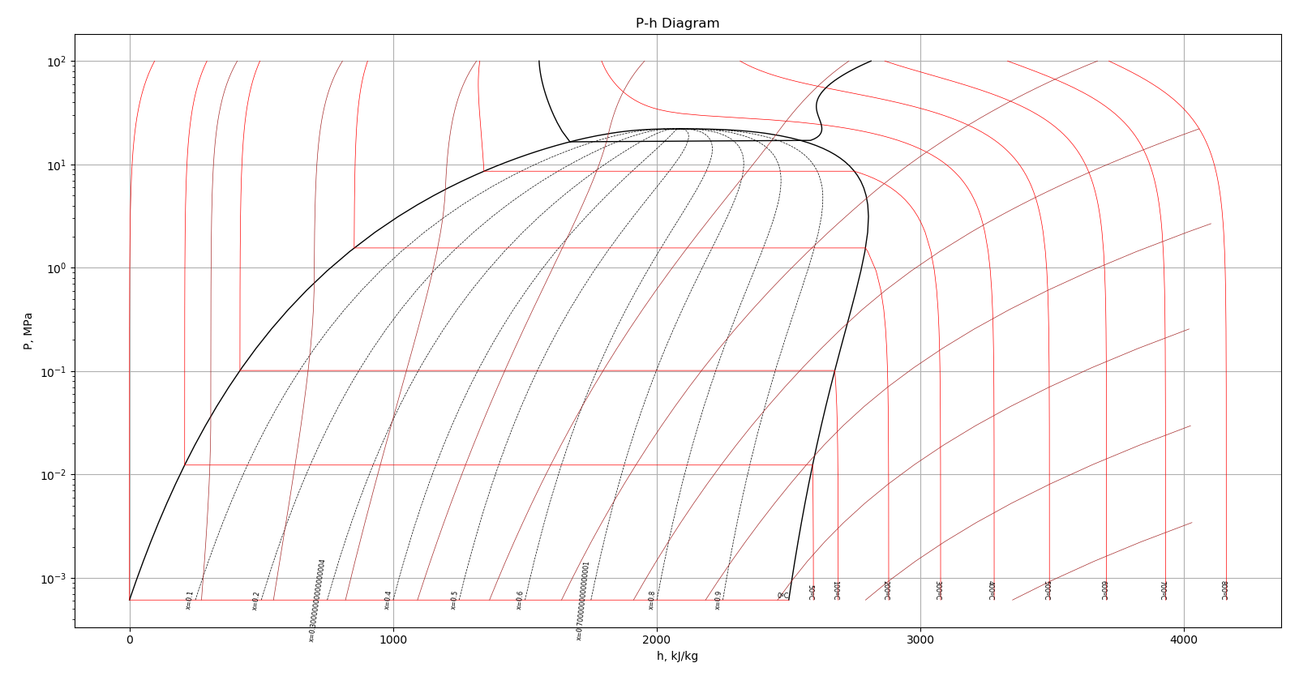
Water and Steam Table

Slide 4
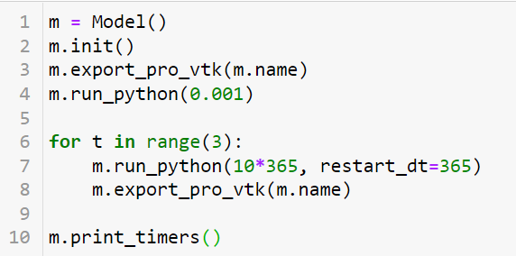
Run simulation model
Define and initialize the model
Export initial maps
Run first (transient) timestep
Run simulation with output every 10 years
Print simulation statistics

Slide 5
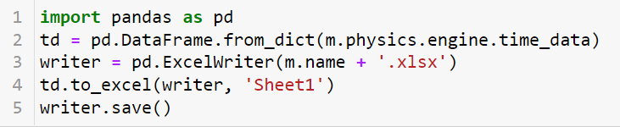
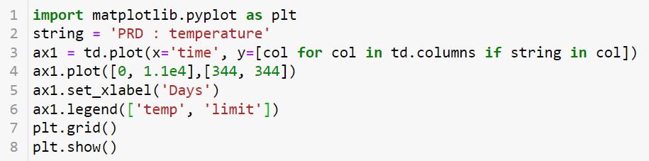
Write well data to the file and plot

