Slide 1

Modern Database Management
10^{h} Edition, International Edition
Jeffrey A. Hoffer, V. Ramesh,
Heikki Topi
Slides amended by C Maria Keet
© 2011 Pearson Education

Slide 2

Define terms
List five properties of relations
State two properties of candidate keys
Define first, second, and third normal form
Describe problems from merging relations
Transform E-R and EER diagrams to relations
Create tables with entity and relational integrity constraints
Use normalization to convert anomalous tables to well-structured relations

Slide 3

A relation is a named, two-dimensional table of data.
A table consists of rows (records) and columns (attribute or field).
Requirements for a table to qualify as a relation:
  It must have a unique name.
  Every attribute value must be atomic (not multivalued, not composite).
  Every row must be unique (can’t have two rows with exactly the same values for all their fields).
  Attributes (columns) in tables must have unique names.
  The order of the columns must be irrelevant.
  The order of the rows must be irrelevant.
NOTE: all relations are in 1st Normal form

Slide 4

Relations (tables) correspond with entity types and with many-to-many relationship types.
Rows correspond with entity instances and with many-to-many relationship instances.
Columns correspond with attributes.
NOTE: The word relation (in relational database) is NOT the same as the word relationship (in E-R model).

Slide 5
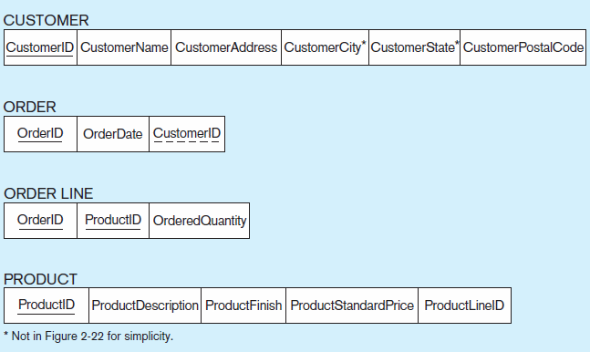
Figure 4-3 Schema for four relations (Pine Valley Furniture Company)

Slide 6


Keys are special fields that serve two main purposes:
  Primary keys are unique identifiers of the relation in question. Examples include employee numbers, social security numbers, etc. This is how we can guarantee that all rows are unique.
  Foreign keys are identifiers that enable a dependent relation (on the many side of a relationship) to refer to its parent relation (on the one side of the relationship).
Keys can be simple (a single field) or composite (more than one field).
Keys usually are used as indexes to speed up the response to user queries (more on this in Chapter 5).

Slide 7
Figure 4-3 Schema for four relations (Pine Valley Furniture Company)
Primary Key
Foreign Key (implements 1:N relationship between customer and order)
Combined, these are a composite primary key (uniquely identifies the order line)…individually they are foreign keys (implement M:N relationship between order and product)

Slide 8

Customer(CustomerID, CustomerName, CustomerAddress, CustomerCity, CustomerState, CustomerPostalCode)
Order(OrderID, OrderDate, CustomerID)
OrderLine(OrderID, ProductID, OrderedQuantity)
Product(ProductID, ProductDescription, ProductFinish, ProductStandardPrice, ProductLineID)

Slide 9

Domain Constraints
  Allowable values for an attribute. See Table 4-1 (next slide)
Entity Integrity
  No primary key attribute may be null. All primary key fields must have data, or: are NOT NULL
Action Assertions
  Business rules.

Slide 10
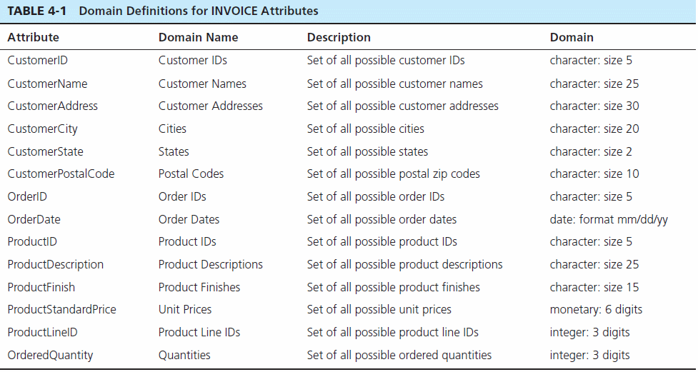
Domain definitions enforce domain integrity constraints

Slide 11
Referential Integrity–rule states that any foreign key value (on the relation of the many side) MUST match a primary key value in the relation of the one side. (Or the foreign key can be null)
  For example: Delete Rules
    Restrict–don’t allow delete of “parent” side if related rows exist in “dependent” side
    Cascade–automatically delete “dependent” side rows that correspond with the “parent” side row to be deleted
    Set-to-Null–set the foreign key in the dependent side to null if deleting from the parent side → not allowed for weak entities

Slide 12
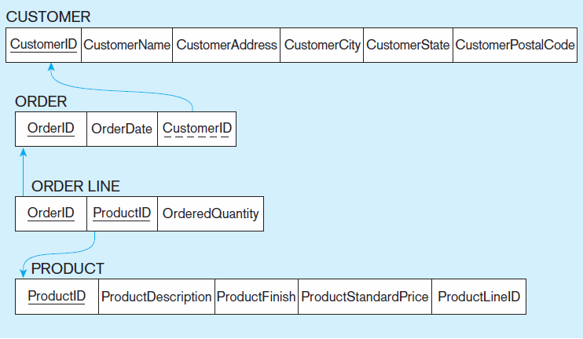
Figure 4-5
Referential integrity constraints (Pine Valley Furniture)
Referential integrity constraints are drawn via arrows from dependent to parent table

Slide 13
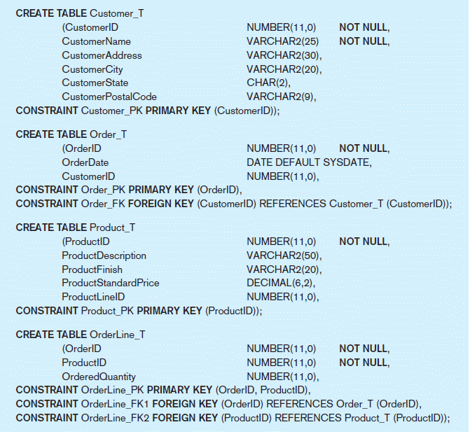
Figure 4-6 SQL table definitions
Referential integrity constraints are implemented with foreign key to primary key references

Slide 14

Mapping Regular Entity types to Relations
  Simple attributes: E-R attributes map directly onto the relation
  Composite attributes: Use only their simple, component attributes
  Multivalued Attribute: Becomes a separate relation with a foreign key taken from the superior entity

Slide 15

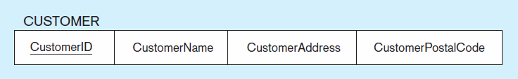
Figure 4-8 Mapping a regular entity
(a) CUSTOMER entity type with simple attributes
(b) CUSTOMER relation

Slide 16
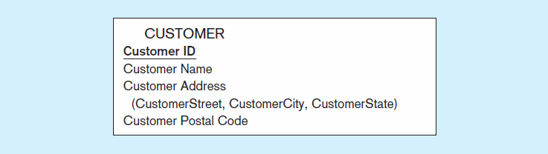

Figure 4-9 Mapping a composite attribute
(a) CUSTOMER entity type with composite attribute
(b) CUSTOMER relation with address detail

Slide 17

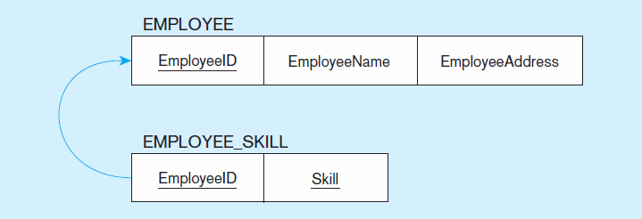
Figure 4-10 Mapping an entity with a multivalued attribute
(a)
Multivalued attribute becomes a separate relation with foreign key
(b)
One–to–many relationship between original entity and new relation

Slide 18

Mapping Weak Entity types
  Becomes a separate relation with a foreign key taken from its strong entity
  Primary key composed of:
    Partial identifier of weak entity
    Primary key of identifying relation (strong entity)

Slide 19
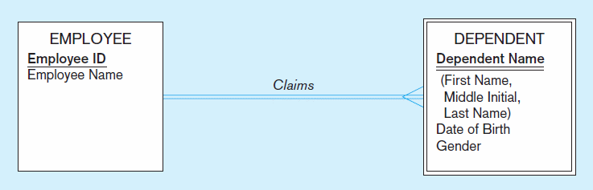
Figure 4-11 Example of mapping a weak entity
a) Weak entity DEPENDENT

Slide 20
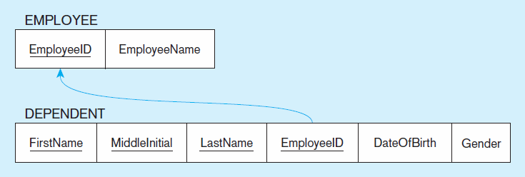
Figure 4-11 Example of mapping a weak entity (cont.)
b) Relations resulting from weak entity
NOTE: the domain constraint for the foreign key should NOT allow null value if DEPENDENT is a weak entity
Foreign key
Composite primary key

Slide 21
Mapping Binary Relationships
  One-to-Many: Primary key on the one side becomes a foreign key on the many side
  Many-to-Many: Create a new relation with the primary keys of the two entities as its primary key
  One-to-One: Primary key on the mandatory side becomes a foreign key on the optional side

Slide 22
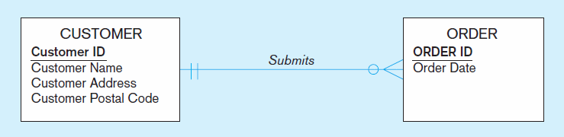
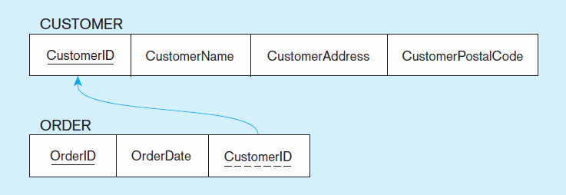
Figure 4-12 Example of mapping a 1:M relationship
a) Relationship between customers and orders
Note the mandatory one
b) Mapping the relationship
Note: no null value in the foreign key…this is because of the mandatory minimum cardinality
Foreign key

Slide 23
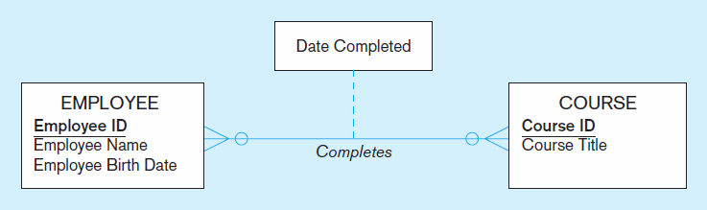
Figure 4-13 Example of mapping an M:N relationship
a) Completes relationship (M:N)
The Completes relationship will need to become a separate relation,
which we call Certificate

Slide 24
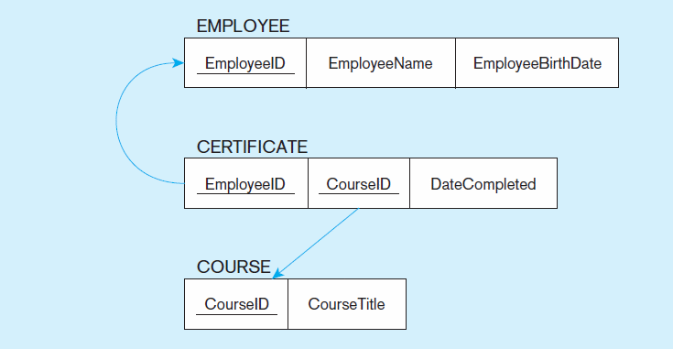
Figure 4-13 Example of mapping an M:N relationship (cont.)
b) Three resulting relations
Composite primary key
Foreign key
New intersection relation
Foreign key

Slide 25
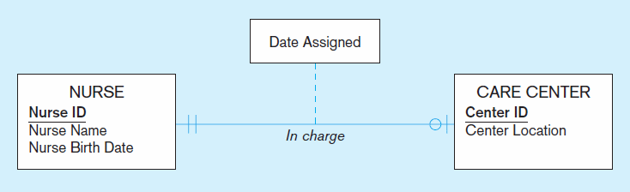
Figure 4-14 Example of mapping a binary 1:1 relationship
a) In charge relationship (1:1)
Often in 1:1 relationships, one direction is optional

Slide 26
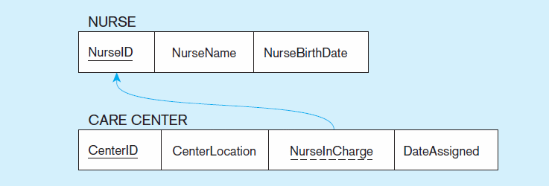
Figure 4-14 Example of mapping a binary 1:1 relationship (cont.)
b) Resulting relations
Foreign key goes in the relation on the optional side,
matching the primary key on the mandatory side
(this approach will prevent the need to store null values in the FK attribute)

Slide 27

Mapping Associative Entities
  Identifier Not Assigned
    Default primary key for the association relation is composed of the primary keys of the two entities (as in M:N relationship)
  Identifier Assigned
    It is natural and familiar to end-users
    Default identifier may not be unique

Slide 28
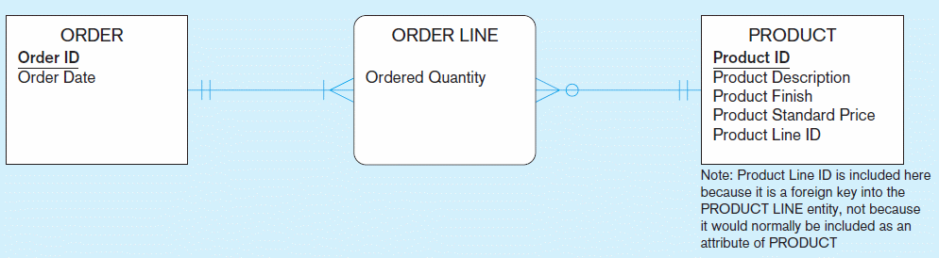
Figure 4-15 Example of mapping an associative entity
a) An associative entity

Slide 29
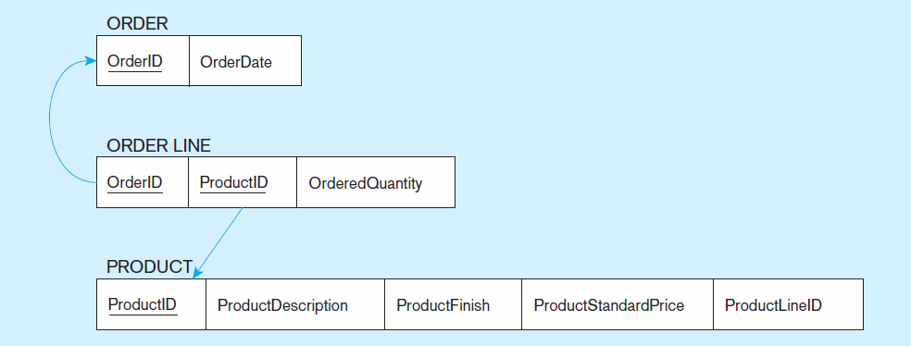
Figure 4-15 Example of mapping an associative entity (cont.)
b) Three resulting relations
Composite primary key formed from the two foreign keys

Slide 30
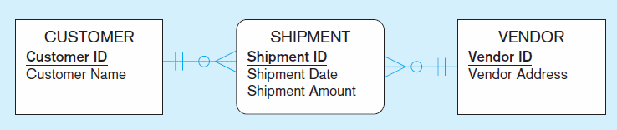
Figure 4-16 Example of mapping an associative entity
with an identifier
a) SHIPMENT associative entity

Slide 31
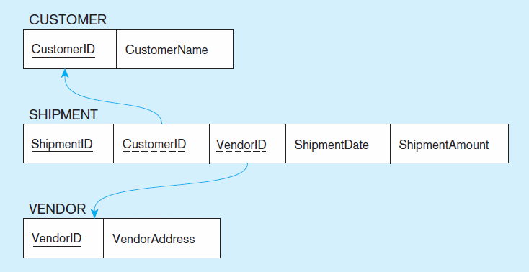
Figure 4-16 Example of mapping an associative entity with
an identifier (cont.)
b) Three resulting relations
Primary key differs from foreign keys

Slide 32
Mapping Unary Relationships
  One-to-Many: Recursive foreign key in the same relation
  Many-to-Many, with two relations:
    One for the entity type
    One for an associative relation in which the primary key has two attributes, both taken from the primary key of the entity

Slide 33
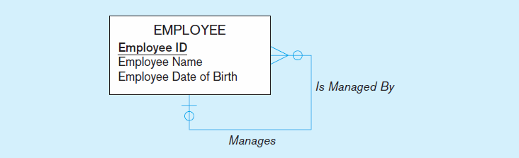
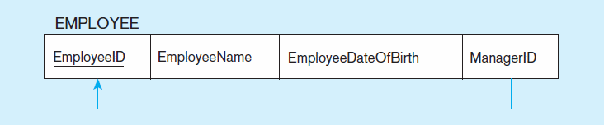
Figure 4-17 Mapping a unary 1:N relationship
(a) EMPLOYEE entity with unary relationship
(b) EMPLOYEE relation with recursive foreign key

Slide 34
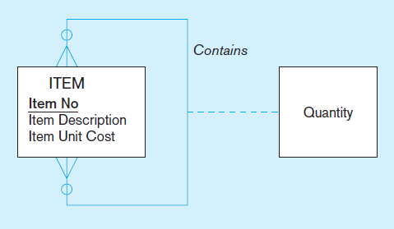
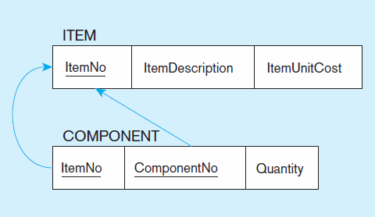
Figure 4-18 Mapping a unary M:N relationship
(a) Bill-of-materials relationships (M:N)
(b) ITEM and COMPONENT relations

Slide 35
Mapping Ternary (and n-ary) Relationships
  One relation for each entity and one for the associative entity
  Associative entity has foreign keys to each entity in the relationship

Slide 36
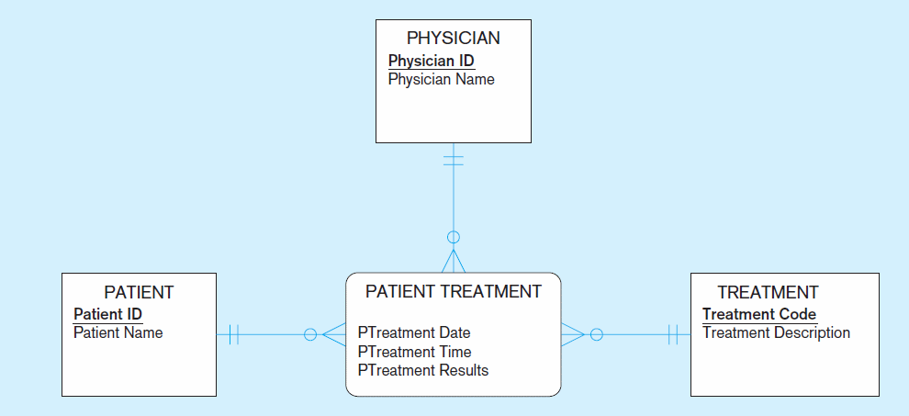
Figure 4-19 Mapping a ternary relationship
a) PATIENT TREATMENT Ternary relationship with associative entity

Slide 37
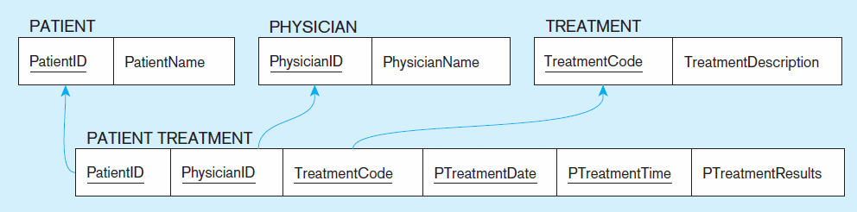
Figure 4-19 Mapping a ternary relationship (cont.)
b) Mapping the ternary relationship PATIENT TREATMENT
Remember that the primary key MUST be unique
This is why treatment date and time are included in the composite primary key
But this makes a very cumbersome key…
It would be better to create a surrogate key like Treatment#

Slide 38

Mapping Supertype/Subtype Relationships
  One relation for supertype and for each subtype
  Supertype attributes (including identifier and subtype discriminator) go into supertype relation
  Subtype attributes go into each subtype; primary key of supertype relation also becomes primary key of subtype relation
  1:1 relationship established between supertype and each subtype, with supertype as primary table

Slide 39
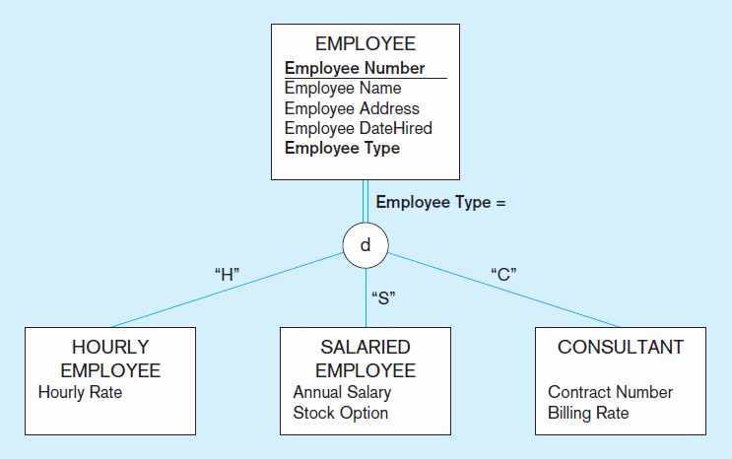
Figure 4-20 Supertype/subtype relationships

Slide 40
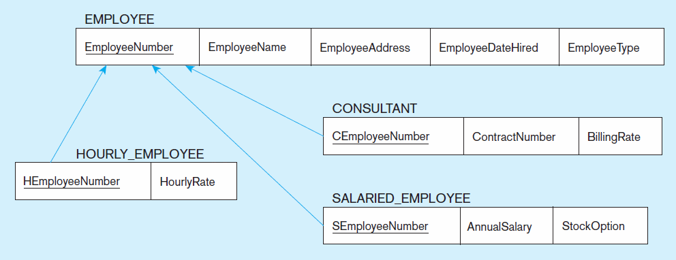
Figure 4-21
Mapping supertype/subtype relationships to relations
These are implemented as one-to-one relationships

Slide 41

Primarily a tool to validate and improve a logical design so that it satisfies certain constraints that avoid unnecessary duplication of data
The process of decomposing relations with anomalies to produce smaller, well-structured relations

Slide 42

A relation that contains minimal data redundancy and allows users to insert, delete, and update rows without causing data inconsistencies
Goal is to avoid anomalies
  Insertion Anomaly–adding new rows forces user to create duplicate data
  Deletion Anomaly–deleting rows may cause a loss of data that would be needed for other future rows
  Modification Anomaly–changing data in a row forces changes to other rows because of duplication
General rule of thumb: A table should not pertain to more than one entity type

Slide 43

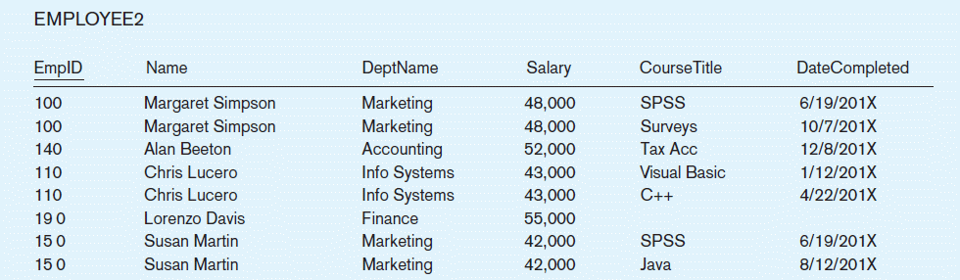
Question–Is this a relation?
Answer–Yes: Unique rows and no multivalued attributes
Question–What’s the primary key?
Answer–Composite: EmpID, CourseTitle

Slide 44

Insertion–can’t enter a new employee without having the employee take a class
Deletion–if we remove employee 140, we lose information about the existence of a Tax Acc class
Modification–giving a salary increase to employee 100 forces us to update multiple records
Why do these anomalies exist?
  Because there are two themes (entity types) in this one relation. This results in data duplication and an unnecessary dependency between the entities

Slide 45

Functional Dependency: The value of one attribute (the determinant) determines the value of another attribute
Candidate Key:
  A unique identifier. One of the candidate keys will become the primary key
    E.g. perhaps there is both credit card number and SS# in a table…in this case both are candidate keys
  Each non-key field is functionally dependent on every candidate key

Slide 46
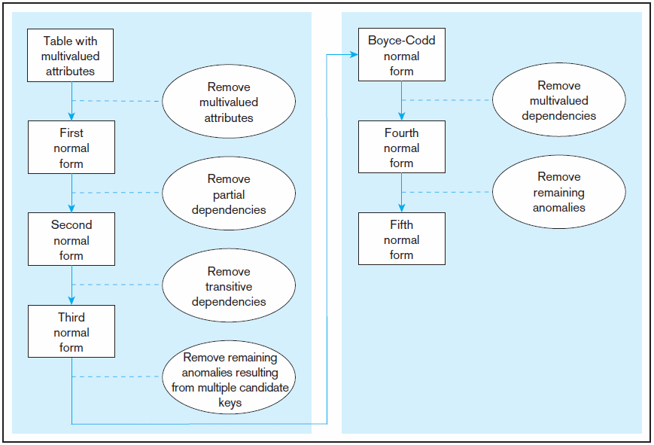
Figure 4.22 Steps in normalization
3rd normal form is generally considered sufficient, considering query performance

Slide 47

No multivalued attributes
Every attribute value is atomic
Fig. 4-25 is not in 1st Normal Form (multivalued attributes) ➔ it is not a relation
Fig. 4-26 is in 1st Normal form
All relations are in 1st Normal Form

Slide 48
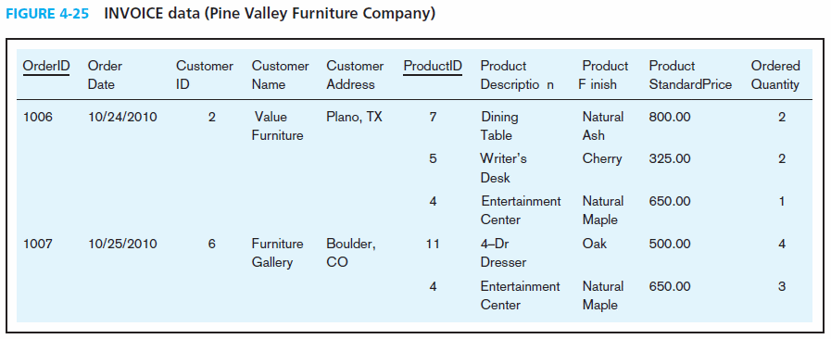
Table with multivalued attributes, not in 1st normal form
Note: this is NOT a relation

Slide 49
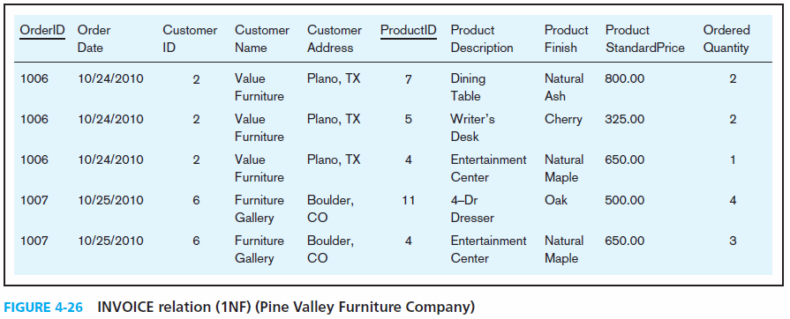
Table with no multivalued attributes and unique rows, in 1st normal form
Note: this is a relation, but not a well-structured one

Slide 50
Insertion–if new product is ordered for order 1007 of existing customer, customer data must be re-entered, causing duplication
Deletion–if we delete the Dining Table from Order 1006, we lose information concerning this item's finish and price
Update–changing the price of product ID 4 requires update in multiple records
Why do these anomalies exist?
  Because there are multiple themes (entity types) in one relation. This results in duplication and an unnecessary dependency between the entities

Slide 51

1NF PLUS every non-key attribute is fully functionally dependent on the ENTIRE primary key
  Every non-key attribute must be defined by the entire key, not by only part of the key
  No partial functional dependencies

Slide 52
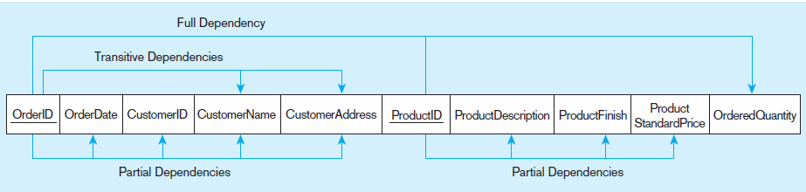
Figure 4-27 Functional dependency diagram for INVOICE
OrderID ➔ OrderDate, CustomerID, CustomerName, CustomerAddress
CustomerID ➔ CustomerName, CustomerAddress
ProductID ➔ ProductDescription, ProductFinish, ProductStandardPrice
OrderID, ProductID ➔ OrderQuantity
Therefore, NOT in 2nd Normal Form

Slide 53
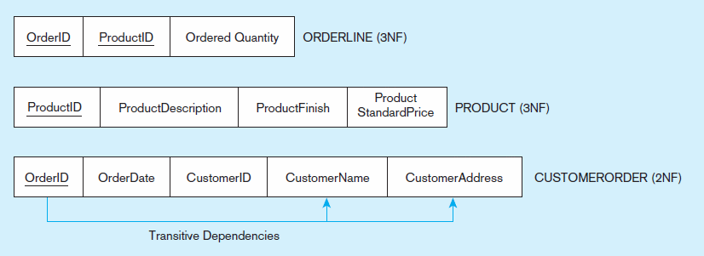
Figure 4-28 Removing partial dependencies
Getting it into Second Normal Form
Partial dependencies are removed, but there are still transitive dependencies

Slide 54

2NF PLUS no transitive dependencies (functional dependencies on non-primary-key attributes)
Note: This is called transitive, because the primary key is a determinant for another attribute, which in turn is a determinant for a third
Solution: Non-key determinant with transitive dependencies go into a new table; non-key determinant becomes primary key in the new table and stays as foreign key in the old table

Slide 55
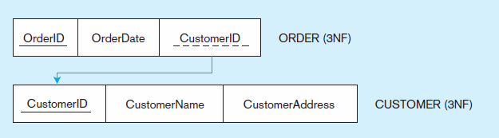
Figure 4-29 Removing partial dependencies
Getting it into Third Normal Form
Transitive dependencies are removed

Slide 56

A relation is in BCNF if and only if every determinant in the relation is a candidate key
4NF: in BCNF and contains no multivalued dependencies
5NF: deals with so-called “lossless joins” (occurs very rarely and difficult to detect)
DKNF (domain key normal form)

Slide 57

View Integration–Combining entities from multiple ER models into common relations
Issues to watch out for when merging entities from different ER models:
  Synonyms–two or more attributes with different names but same meaning
  Homonyms–attributes with same name but different meanings
  Transitive dependencies–even if relations are in 3NF prior to merging, they may not be after merging
  Supertype/subtype relationships–may be hidden prior to merging

Slide 58

Primary keys that are unique in the whole database, not just within a single relation
Corresponds with the concept of an object ID in object-oriented systems

Slide 59
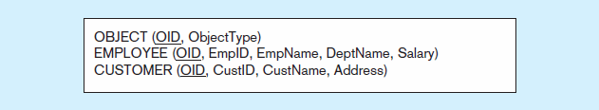
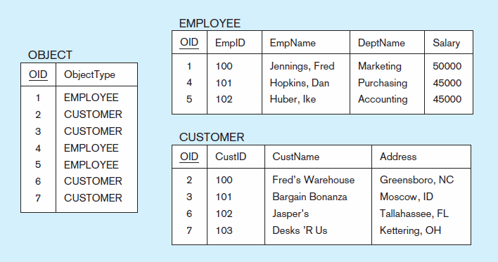
Figure 4-31 Enterprise keys
a) Relations with enterprise key
b) Sample data with enterprise key

Slide 60

All rights reserved. No part of this publication may be reproduced, stored in a retrieval system, or transmitted, in any form or by any means, electronic, mechanical, photocopying, recording, or otherwise, without the prior written permission of the publisher. Printed in the United States of America.
Copyright © 2011 Pearson Education, Inc. Publishing as Prentice Hall

