Slide 1



edChain
Student - Input
Notes:
Loan and Course selection page:
Inputs:
Dropdown: courses on edChain
Name
Loan Amount
Upload docs
Nice to Have:
Dynamic upload doc bar

Slide 2
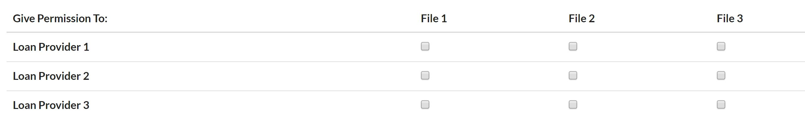
edChain
Student - Input
Notes:
Loan and Course selection page:
Inputs:
Dropdown: courses on edChain
Name
Loan Amount
Upload docs
Nice to Have:
Dynamic upload doc bar

Slide 3
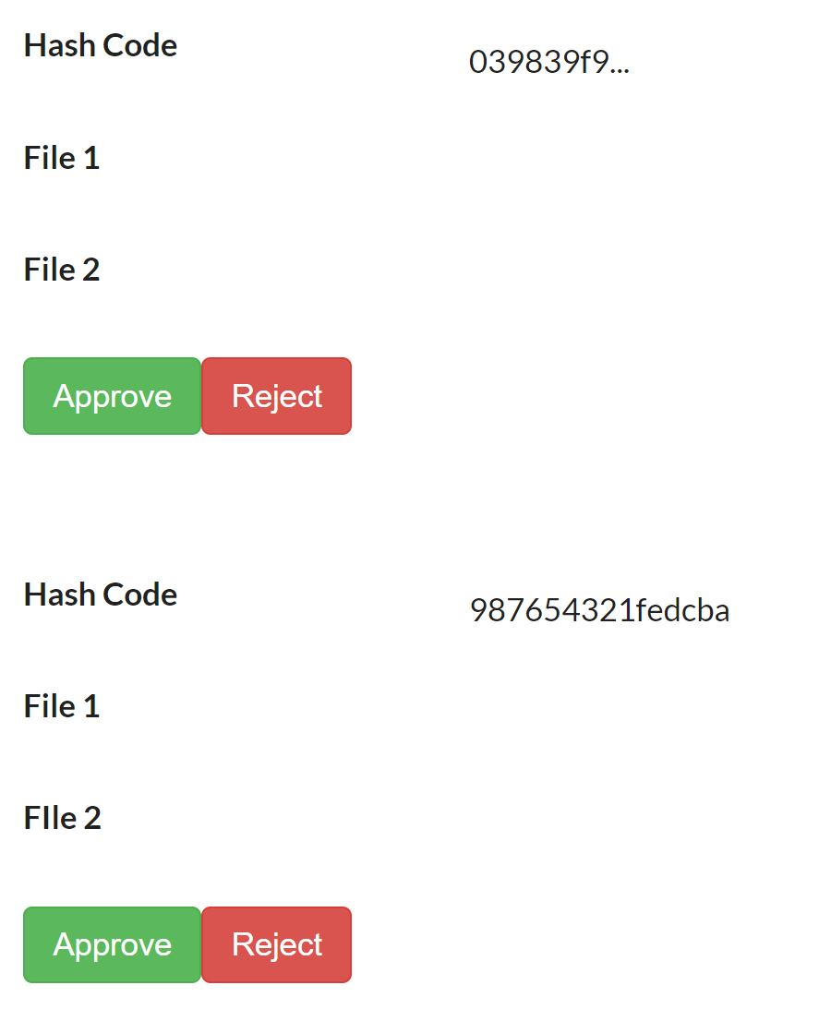
edChain
Loan Provider - View
Notes:
Loan and Course selection page:
Inputs:
Dropdown: courses on edChain
Name
Loan Amount
Upload docs
Nice to Have:
Dynamic upload doc bar

Slide 4


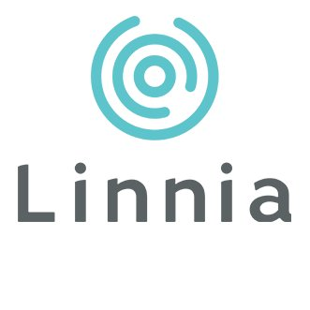
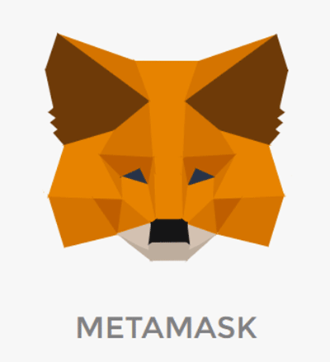
Storage
Infura is an API and developer tool which we will use to boostrap to the Etherum Network
4) Data is then encrypted with the student’s private key
3) Linnia will retrieve the requested data according to the owner’s rules
1) Student’s upload their sensitive financial documents on edChain and permission third party loan providers to gain access to the data
2) The third provider uses this granted permission to access the data
5) Data is then encrypted with the loan provider’s public key
Application Users:
- Students
- Third Party Loan Providers
MetaMask will be used as the Identity provider when logging on to the dApp
6) Third party is able to view the data with their private key
Notes:
Workflow

